Slide 1

Hardware-Assisted Software Support for Heterogeneous Computing
Jiyuan Wang
University of California, Los Angeles
03/04/2025
Notes:
Hello everyone, thank you for joining today. My name is Jiyuan Wang, and I am excited to share my research journey and future plans. The topic of my defense is 'Hardware-assisted Software support for Heterogeneous Computing Applications.' This work has been the focus of my Ph.D. research at UCLA

Slide 2

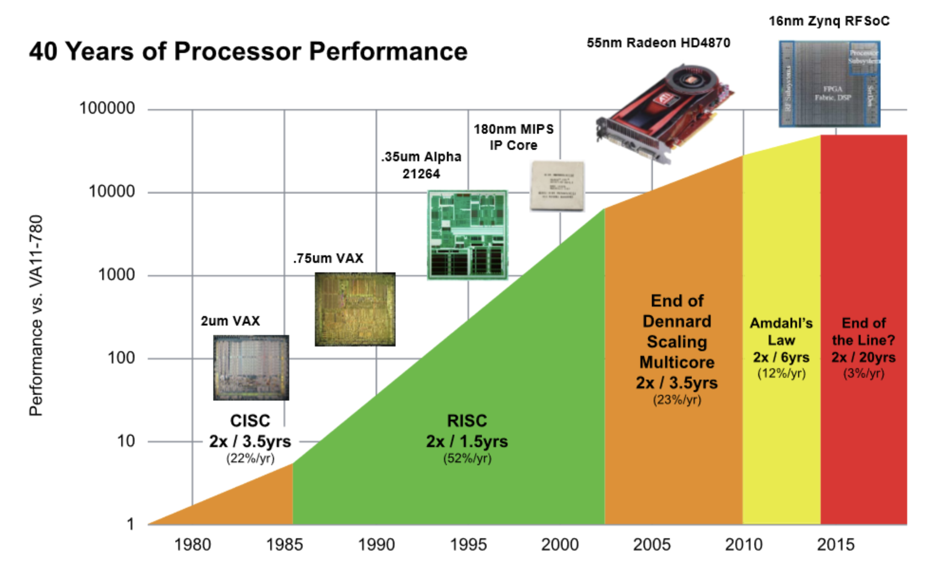

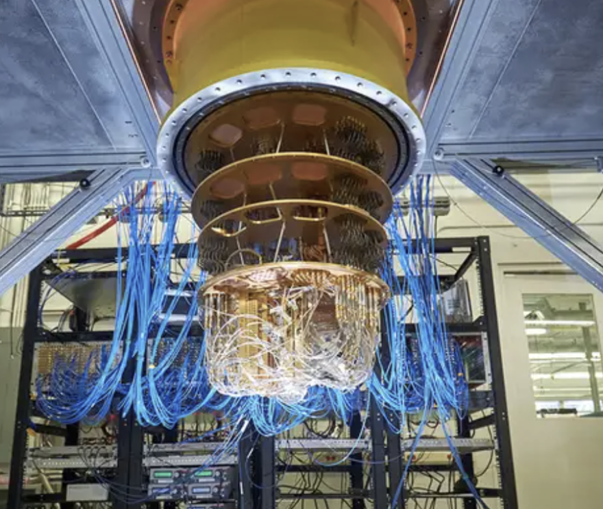


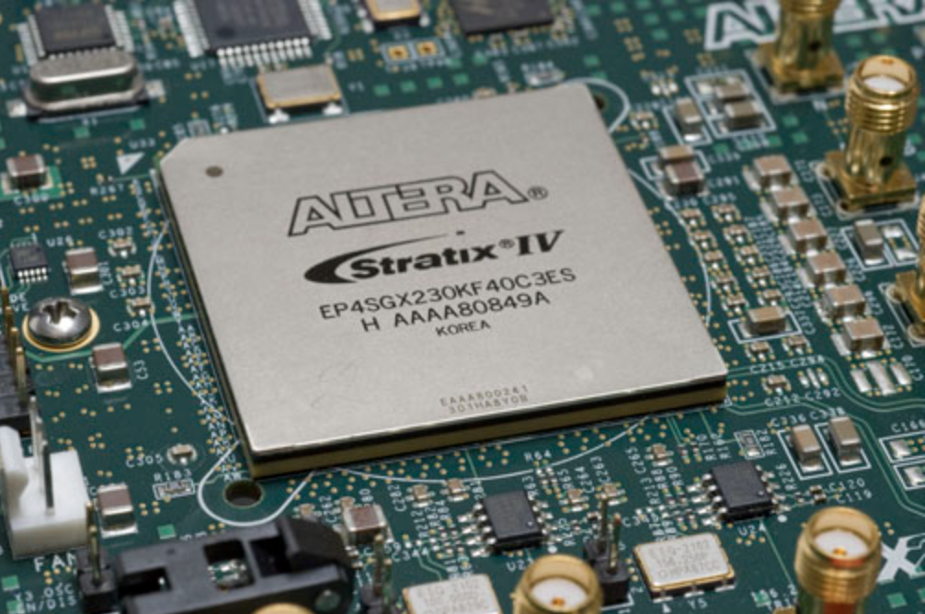

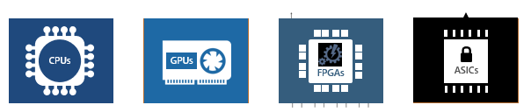

Heterogeneous computing is becoming popular.
Notes:
Moore’s original prediction in 1965 called for a doubling in transistor density yearly; Although Moore’s Law held for many decades (it began to slow sometime around 2000 and by 2018 showed a roughly 15-fold gap between Moore’s prediction and current capability.
While Moore law is dying, but we still need to face the huge increase of computing task
So, we are entering the exciting era of a diverse spectrum of hardware accelerators on public cloud.
For example, IBM quantum cloud and Intel provide FPGA dev cloud.
Expensive hardware such as supercomputers, and quantum computers are also being offered as a public cloud service.
This is attractive for developers and end-users – Pay as you go. – no need to buy an expensive hardware.

Slide 3
What does a heterogeneous application look like?
Host code: on CPU
Calls Kernel code
Kernel code:
- Heavy task
- Running on accelerator
- Hard to write
Gets results from kernel
…
Kernel code:
- Heavy task
- Running on accelerator
- Hard to write
Kernel code runs on HW accelerators
Host code runs on CPU, which then invokes hardware (HW) accelerators
Notes:
What does heterogeneous application look like? Usually it has two parts of code: Host code, which runs on CPU, handle the logic flow, and invoke hardware accelerators with kernel code. Kernel code handle the heavy computation task and are running on hardware

Slide 4
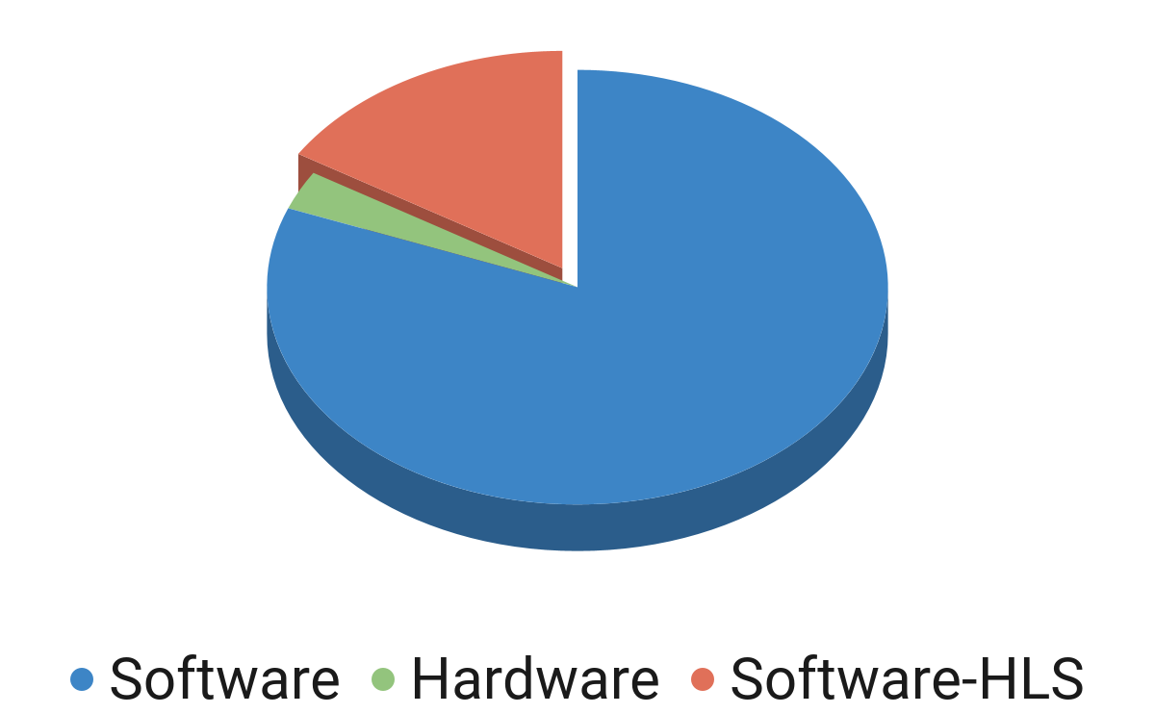
Computing power is locked in a few hands.
Less than 20% of software developers are able to make use of FPGAs [1].
1. Xilinx: https://www.xilinx.com/products/design-tools/developer-forum.html
Notes:
However, the computing power is locked in a few hands. Take FPGAs as an example, based on the xilinx study, the truth is, less than 5% of software developers in the US are able to easily make use of FPGA heterogeneity in their software systems. Why? Why people do not want to use these powerful accelerator?
Have some title “FPGA got errors, whole system down”, have more motivation
Some challenges: why this is challenge, why original testing does not work (take xxx hours)

Slide 5

What is developer workflow with heterogeneous program?
Performance Profiling
Int KNN()
…
//Calculate Distance
for (i=0 to number{
dist[i] = l2norm(data[i],dim)
}
Get results from kernel
…
Kernel function identification in C
Manual rewriting for FPGA compatibility
~10 mins co-simulation [1]
7x speedup on FPGA
Manual testing with input samples in simulation
2.5 hours RTL synthesis [1]
Execution on FPGA
1. Q. Zhang, J. Wang, and M. Kim, “Heterofuzz: Fuzz testing to detect platform dependent divergence for heterogeneous applications", FSE2021
Notes:
To figure out why, let’s take look at the developer workflow with heterogeneous programs
Consider this KNN example, in order to achieve 7X speed up on FPGA
hardware design engineer profiles an KNN application code. Once she identifies a time-consuming hot code path shown in blue, she separates this kernel code from a host application code.
Then she writes this computation kernel directly in HDL like Verilog and VHDL.
before committing to proceed with RTL synthesis, developers use C and RTL co-simulation tool to perform testing. After developers are confident with her design
She produces gate-level bit streams through RTL synthesis process by going through steps such as gate-Level synthesis, routing, timing validation, etc.
The entire workflow may take several hours or even days.. It is because each HLS compilation and co-simulation are in the order of 10 minutes or long. Also developers must repeat this process of manual rewriting “multiple times” (easily several days for a graduate student or HW engineer) in order to achieve this performance boost.

Slide 6

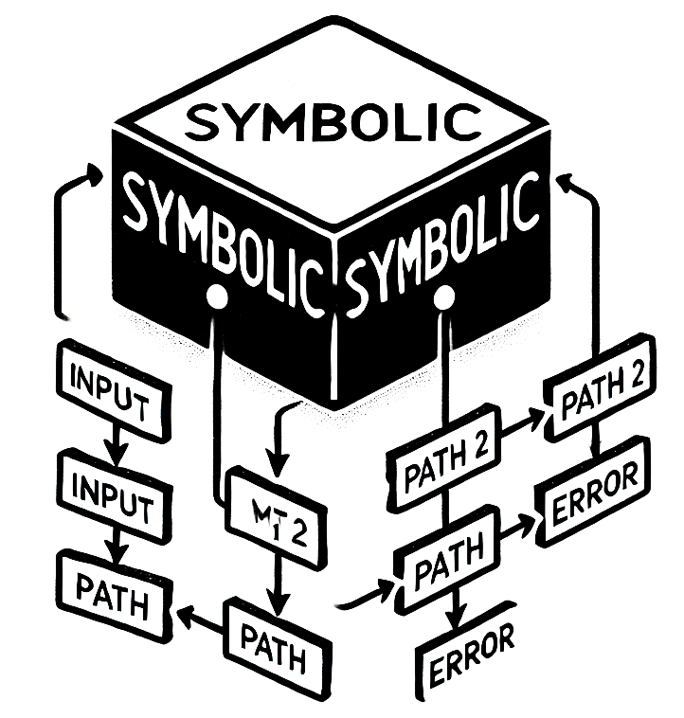
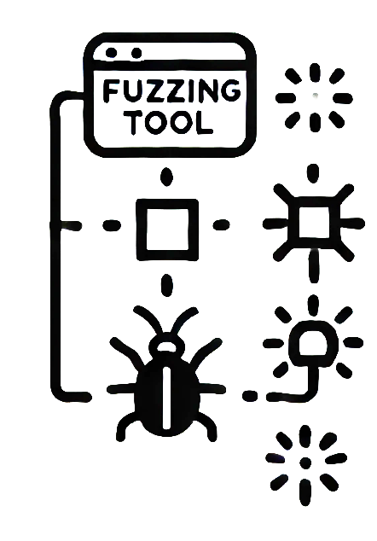
Traditional SE tools do not work for heterogeneous computing.
While ensuring the correctness is important, heterogeneous application is hard to
test and debug.
Manual rewriting for FPGA compatibility
~10 mins co-simulation
Manual testing with input samples in simulation
2.5 hours RTL synthesis
Execution on FPGA
Traditional SE tools do not work in heterogeneous computing,
because the characteristics of HW accelerators are not considered.
Notes:
Give a better example, why the traditional fuzz / symbolic / debug does not work
The previous workflow is complex, which make heterogeneous application hard to program, hard to debug, and hard to test. As shown in the previous example, write FPGA program on a single KNN could take days. Writing and compiling a heterogeneous application running with FPGA takes ~2.5 hours. If you find a new bug when execute on FPGA, you need to re-program and re-synthesis, which is another 2.5 hours. Traditional Testing tools, including symbolic or fuzz testing, do not work for heterogeneous applications. Take fuzz testing as an example, it's not efficient due to the lack of effective guidance. Symoblic execution need additional *concrete* finitization. Why the traditional SE tools cannot handle heterogeneous applications? Because the characteristics of HW accelerators are not considered.
Symbolic execution relies on constraint solvers (e.g., Z3, CVC4) to reason about program paths.These solvers are designed for software logic and do not account for hardware constraints like timing, pipeline stalls, or circuit delays.

Slide 7




Traditional fuzzing does not consider the HW characteristics.
Pick
Mutate
Input
Input
Input
Input'
Input
Execute
Add Input'
Feedback
Yes
New Branch Coverage?
Program
Bandwidth
Branch coverage works
for CPU applications.
FIFO Usage
Hardware Noise
….
Notes:
Take fuzz testing as an example, it's not efficient due to the lack of effective guidance

Slide 8

Key Insight for My PhD Research
By accounting for hardware execution behaviors and characteristics, we can build efficient and effective tools by redesigning the traditional SE approaches.
We want to combine the knowledge from hardware domain and software domain, to lower the barrier for software developers using hardware accelerators.
Notes:
So here comes my key insight for my phd research. By accounting for hardware execution behavior and characteristics, we can build efficient and effective SE techniques. The overall goal of my research is, We want to combine the knowledge from hardware domain and software domain, to lower the barrier for software developer using hardware accelerator.

Slide 9
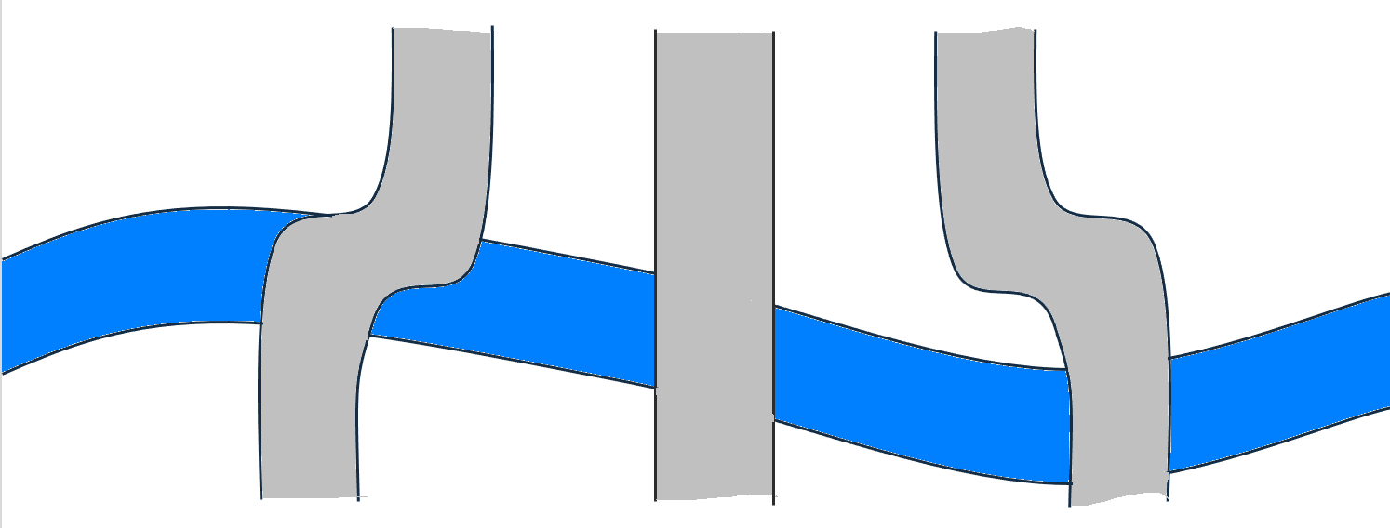



Research Overview: Software Support for Heterogeneous Computing
Heterogeneous
Computing Stacks
Application
Compiler & System
Redesign Repair for Heterogeneous Application (ASPLOS’23*)
Redesign Testing for Heterogeneous Application (FSE’22*, FSE’23, ASE’20*)
Redesign Debugging for Heterogeneous Compiler (FSE’25)
Hardware
Characteristic
Redesign Testing for Heterogeneous Compiler & System (ASE’21, ICSE’25*)
Traditional SE Approaches
Repair
Testing
Debugging
* are my second authored papers.
Notes:
Here is my research overview. Starting from the traditional SE approaches, I redesign repair, testing, and debugging by understanding and leveraging. the hardware characteristics.I published 7 papers on the top-tier conference, by building efficient and effective testing, repair and debugging tools for both heterogeneous applications, compiler, and systems.

Slide 10



Agenda
QDiff (ASE’21)
HFuzz (FSE’23)
DuoReduce (FSE’25)
Understand Hardware
Use
Hardware
Beyond Testing
Notes:
Transition from previous slides, pick the publications from the previous slides
So for today’s agenda , I’ll introduce two of my works, to illustrate how to redesign the traditional software approach with hardware accelerators
Qdiff, redesigning differential testing for quantum compilers, by understating the quantum hardware
Hfuzz, redesigning fuzz testing for FPGA applications, by leveraging the powerful parallesm in FPGA
I’ll briefly introduce my third work, DuoReduce, which is a debugging tool for multi-layer heterogeneous compilers by redesigning traditional delta-debugging
In the end, I’ll talk about the future work, how to further lower the barrier between software developers and hardware accelerators by developing compiler and systems.

Slide 11
Quantum
FPGA
MLIR
QDiff: Differential Testing for Quantum Software Stack
Jiyuan Wang, Qian Zhang, Harry Xu, Miryung Kim
Understand the Noise of Quantum Hardware
ASE’21
Selected as 2021 SIGSOFT research highlights
Notes:
Now let me start with QDiff, and I will use it as one example to demonstrate how understanding the hardware characteristics can help to improve the traditional differential testing and enable it for quantum software stacks. This work was selected as 2021 SIGSOFT research highlights
Relate to personal information!

Slide 12



Why testing quantum software stacks?
Quantum
FPGA
MLIR
Fast Evolving
Qiskit [1]: 15 version updates in last year
Short of Hands
Cirq [2]: 40 contributors (>10 commits)
Serious
Compiler bugs can affect many programs
1. Javadi-Abhari, Ali, et al. "Quantum computing with Qiskit." arXiv preprint arXiv:2405.08810 (2024).
2. Hancock, Andrew, et al. "Cirq: A Python Framework for Creating, Editing, and Invoking Quantum Circuits."
Notes:
One main reason that I start with quantum testing, it’s because my undergraduate major is Physics. And my advisor does not understand quantum so I can do whatever I want. Not exactly
So why testing quantum software stacks, why testing quantum compilers? Quantum compilers is a fast evolving domains, take qiskit, a quantum compiler developed by IBM as an example, it has 15 version updates in last year, more than monthly updates. Despite the quick updates, the quantum compiler groups are short of hands. Take Cirq, a quantum compiler developed by google as an example, it only has 40 contributors with more than 10 commits, including the summer interns, contribution from academic. That is to say, they don’t have enough time to test their compiler. However, bugs in quantum compiler can be as serious as traditional compiler bugs. The compiler bugs can affect a large number of programs using the compiler.

Slide 13
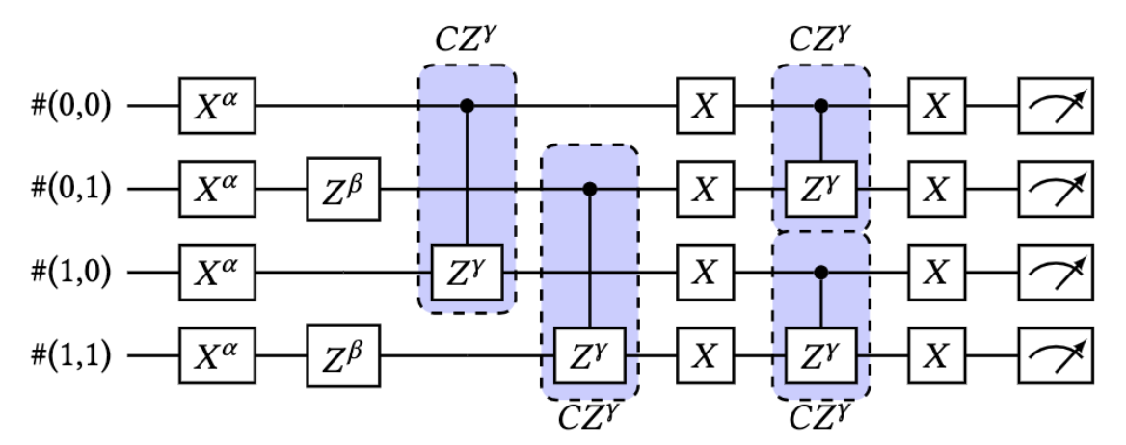


Bugs are difficult to notice.
Quantum
FPGA
MLIR
Bugs in Cirq, a quantum computing framework developed at google [1]:
Quantum circuits produce wrong results.
Cirq users: "quantum randomness?"
Cirq developers: "There is a bug!"
Quantum randomness hides the bugs
1. Stackoverflow: https://quantumcomputing.stackexchange.com/questions/8694/is-there-a-mistake-in-the-vqe-ansatz-in-cirqs-tutorial
Notes:
Because of the quantum randomness, bugs are difficult to notice. Cirq is one of the most famous quantum computing framework developed at google. Take one bug in quantum software stacks Cirq that we find on stackOverflow as an example. Cirq users write a VQE circuit and thought her quantum programs works perfectly, however, a Cirq developer noticed that "The strange thing is the example output shows the output probabilities varying with gamma (the CZ parameter)", where gamma should not have any effect on the measurement results. The author of the post actually believed the wrong output is due to quantum randomness until the Cirq developer labeled it as a compiler bug.

Slide 14
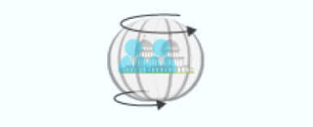
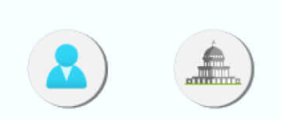

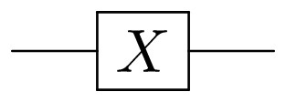
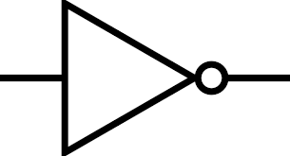
Background: Qubit and Quantum Gate
Quantum
FPGA
MLIR
The state of a qubit is a linear combination of 0 and 1
0 1
Qubit
Classical bit
QC changes the states of qubits by quantum gates
Quantum gate
Classical gate
Notes:
Let's get started with some basic concepts of quantum computing. A qubit or quantum bit is a basic unit of quantum information—the quantum version of the classic binary bit. Unlike classical bit which has two separate value 0 and 1, the state of qubit is the linear combination of 0 and 1, which can represented as \phi = \alpha 0 + \beta 1. And to change the state of qubit, we use the quantum gate, like we use classical gate to change the value of classical bit. For example, the X gate, behave just like classical not gate, will flip the qubit. For example, change \alpha 0 + \beta 1 to \beta 0 + \alpha 1. Quantum gate can be represented as a unitary matrix. Two quantum gate sequences are equivalent as long as they yield same matrix representation

Slide 15
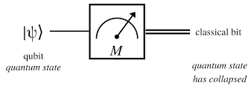
Background: Quantum Circuit
Quantum
FPGA
MLIR
Measurement: the read operation on a qubit yields a classical result
Quantum
Circuit
Qubit
Quantum gate
Measurement
Quantum circuit is the combination of qubits, quantum gates, and measurements
Notes:
Quantum circuit is the combination of qubit, quantum gate, and measurement. The measurement is used to read information from the qubit, and the result is usually probabilistic. For example, the qubit \alpha 0 + \beta 1 change to \beta 0 + \alpha 1 after X gate, and then in the measurement, we will have \beta square probability to get 0 and \alpha square probability to get 1.

Slide 16
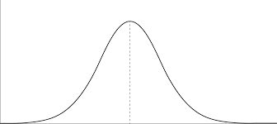
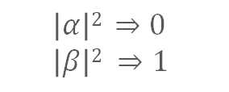
Observation 1: Probabilistic Measurement Results
Quantum
FPGA
MLIR
$$\left|α\right|2 ⇒0 \\ \left|β\right|2 ⇒1$$
Quantum circuit's measurement result is probabilistic.
People need to run the circuit multiple times and results are usually presented as distributions.
Notes:
Since Quantum circuit's measurement result is probabilistic. User usually run and measure the circuit for multiple times and summary the results. The results are usually presented as distributions. Second, the quantum computer is noisy today, and it will last for at least 10 years. To be more specific about noisy, a qubit can only retain a correct state for only a limited amount of time because of decay, the time is called T1/T2 time. Besides, the error rate of 2-qubit quantum gate is pretty high, and usually dominate the error rate of the quantum circuit. It implies, the circuit with too many 2-qubit quantum gate, or the circuit with a large circuit depth, will produce an unreliable result because of the noise.

Slide 17
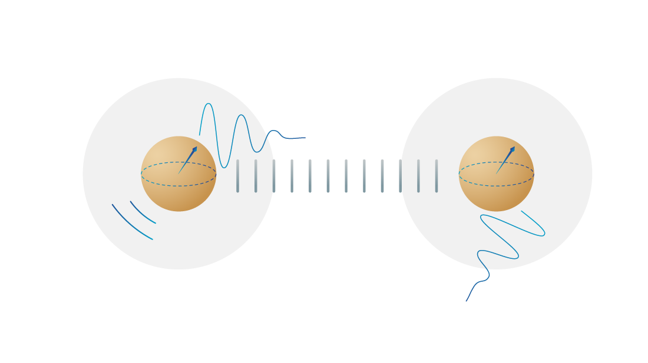
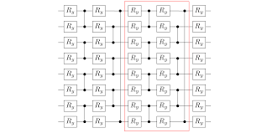
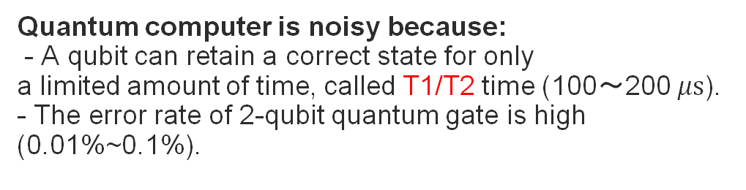
Observation 2: Quantum Noise
Quantum
FPGA
MLIR
Quantum computer is noisy because:
- A qubit can retain a correct state for only a limited amount of time, called T1/T2 time (100～200 $μs$).
- The error rate of 2-qubit quantum gate is high (0.01%~0.1%).
The circuit with long execution time (large circuit depth) or many 2-qubit quantum gate will produce an unreliable result.
Notes:
Too dense, too many figure, too many text
Quantum results (Distribution) vs. traditional programs
Split to two slides
Using logo to represent noise / 2-qubit gate (2-qubit gates / execution time, bring testing challeneges, lots of noises)
Since Quantum circuit's measurement result is probabilistic. User usually run and measure the circuit for multiple times and summary the results. The results are usually presented as distributions. Second, the quantum computer is noisy today, and it will last for at least 10 years. To be more specific about noisy, a qubit can only retain a correct state for only a limited amount of time because of decay, the time is called T1/T2 time. Besides, the error rate of 2-qubit quantum gate is pretty high, and usually dominate the error rate of the quantum circuit. It implies, the circuit with too many 2-qubit quantum gate, or the circuit with a large circuit depth, will produce an unreliable result because of the noise.

Slide 18

Key Question
Quantum
FPGA
MLIR
How to isolate and find quantum software stack bugs from quantum randomness and hardware noise?
Notes:
So, we want to answer the following question: how to isolate and find software bugs from quantum randomness and hardware nosie?

Slide 19

Differential Testing: CSmith [1]
Quantum
FPGA
MLIR
Transformation
Equivalent Circuit
C/C++ program
Equivalent Circuit
Equivalent Program
A new
program generated by mutation
Execution
No
Divergent Result?
Comparison
Equivalent Circuit
Equivalent Circuit
Result
Yes
Crash
1. Yang, Xuejun, et al. "Finding and understanding bugs in C compilers." PLDI 2011.
Notes:
We try to answerer this question by redesign differential testing, a famous testing approach in traditional compiler testing. Traditional differential testing approach, like CSmith, Starting from a C program, it will generate multiple equivalent C program, then execute these equivalent programs. While all of them should yield the same results, it will report bugs if a crash happen, or divergent result is found. Then they will keep the iteration by generate a new program with mutation. How to redesign this approach to make it suitable for quantum framework testing?

Slide 20
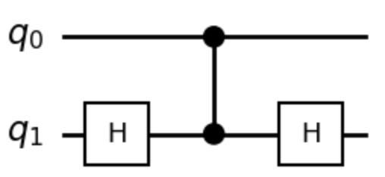
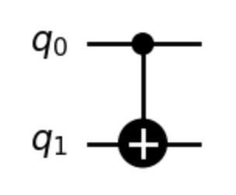
Approach 1: Quantum Gate Transformation
Quantum
FPGA
MLIR
Transformation
Equivalent Circuit
Quantum Circuit
Equivalent Circuit
Equivalent Circuit
A new
program generated by mutation
Execution
No
Divergent Result?
Comparison
Equivalent Circuit
Equivalent Circuit
Result
Yes
Yes
Crash
Notes:
Figure in conference slides is better
The first step is generate bunch of equivalent quantum circuit based on the seed quantum circuit. As we mentioned in our background knowledge, two quantum gate sequences are equivalent if they yield the same math matrix representation. Based on this insight, QDiff transforms quantum gates with their equivalent math representation.
Get key words

Slide 21
Isolate SW bugs from HW noise by filtering noisy circuit.
Quantum
FPGA
MLIR
Transformation
Equivalent Circuit
Quantum Circuit
Equivalent Circuit
Equivalent Circuit
A new
program generated by mutation
Execution
No
Divergent Result?
Comparison
Equivalent Circuit
Equivalent Circuit
Result
Yes
Crash
Notes:
After we generate bunches of equivalent programs, we need to execute them. However, not all circuit should be executed on quantum computers due to the noise in quantum computer. Some noisy circuits' results is unreliable because of the known hardware noise. We need to avoid unnecessary quantum hardware invocation by filtering noisy circuit.

Slide 22



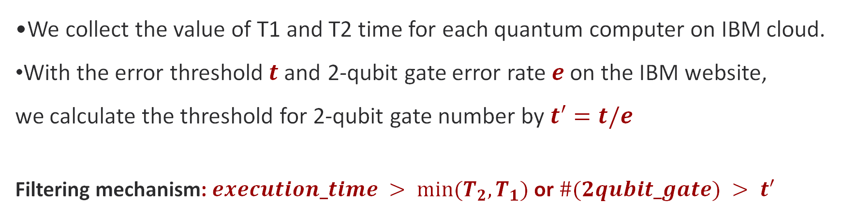
Approach 2: Filtering Mechanism
Quantum
FPGA
MLIR
We collect the value of T1 and T2 time for each quantum computer on IBM cloud.
With the error threshold$t$and 2-qubit gate error rate $e$ on the IBM website, we calculate the threshold for 2-qubit gate number by$t′=t/e$
Filtering mechanism: $execution_time > {{min⁡(T}_{2}, T}_{1})$ or $\#(2qubit_gate) > t′$
Quantum circuits
Analyzing the number of 2-qubit gates, a circuit depth and execution time
Executing on
quantum hardware
Notes:
Here comes our filtering mechanism. Our insight is, if the quantum circuit execution time is more than T1 time, or the 2-qubit gate number is more than a threshold number t', then QDiff will label this circuit as the noisy circuit. IBM website has average gate execution time and T1 time for each quantum devices, so we collect these values from the website. For 2-qubit gate threshold, we collect the 2-qubit gate error rate from the IBM website, and with the user-given threshold t, we calculate the threshold for 2-qubit gate number by t'=t/e

Slide 23
Repeat the measurement to avoid quantum randomness.
Quantum
FPGA
MLIR
Transformation
Equivalent Circuit
Quantum Circuit
Equivalent Circuit
Equivalent Circuit
A new
program generated by mutation
Execution
No
Divergent Result?
Comparison
Equivalent Circuit
Equivalent Circuit
Result
Yes
Crash
Notes:
After we filter out all the noisy circuit and execute all the good circuit on quantum computers, we need to compare the result to check if there is any divergence. If there is a divergent result, then maybe we found a potential bugs in software stacks. Since the results of quantum circuit is probalistic, we should repeat the measurement to get a distribution, and then we need to figure out how to check the equivalence of two distributions.

Slide 24
Approach 3: KS-Based Distribution Comparison
Quantum
FPGA
MLIR
KS test [1]: the equality test of probability distributions in statistics.
KS Statistics: the max distance D between two cumulative probability.
QDiff reports divergent if D is larger than a user-defined threshold t.
Measurement Distribution | ‘00’ | ‘01’ | ‘10’ | ‘11’ | Total
M1 | 250 | 250 | 250 | 250 | 1000
M2 | 247 | 247 | 253 | 253 | 1000
Cumulative Probability | ‘00’ | ‘01’ | ‘10’ | ‘11’
S1 | 0.250 | 0.500 | 0.750 | 1.00
S2 | 0.247 | 0.494 | 0.747 | 1.00
D=0.06
1. Berger, Vance W., and YanYan Zhou. "Kolmogorov–smirnov test: Overview." Wiley statsref: Statistics reference online (2014).
2. S.-O. Chan, I. Diakonikolas, P. Valiant, and G. Valiant, “Optimal algorithms for testing closeness of discrete distributions,” in Proceedings of the twenty-fifth annual ACM-SIAM symposium on Discrete algorithms.SIAM, 2014, pp. 1193–1203.
Notes:
We adapt KS based comparison. The ks comparison works as follow: We first define cumulative probability, that is, add all probabilities that are smaller or equal to x. And the K-S statistic D is the max distance between two cumulative probabilities. We report divergent if D is larger than a user-defined threshold.
Take the following two distributions as examples. N1 and N2 are measurement distribution results for two 2-qubit circuits. Users run and measure each circuits with the total trail number N = 1000, and get following results in the first chart. We first calculate cumulative probability in right corner chart S1 and S2. With S1 and S2, we calculate K-S statistic D as the max distance between them. It is clear D=0.06 in this example.
QDiff will Report divergent if D is larger than a user given threshold. The total trial number N can be determined by the threshold t and the confidence level p given by the users.
In our evaluation, we empirically set p=⅔(two third), as it is a commonly used constant in statistics research. And we set t=0.1 to avoid false positive.

Slide 25
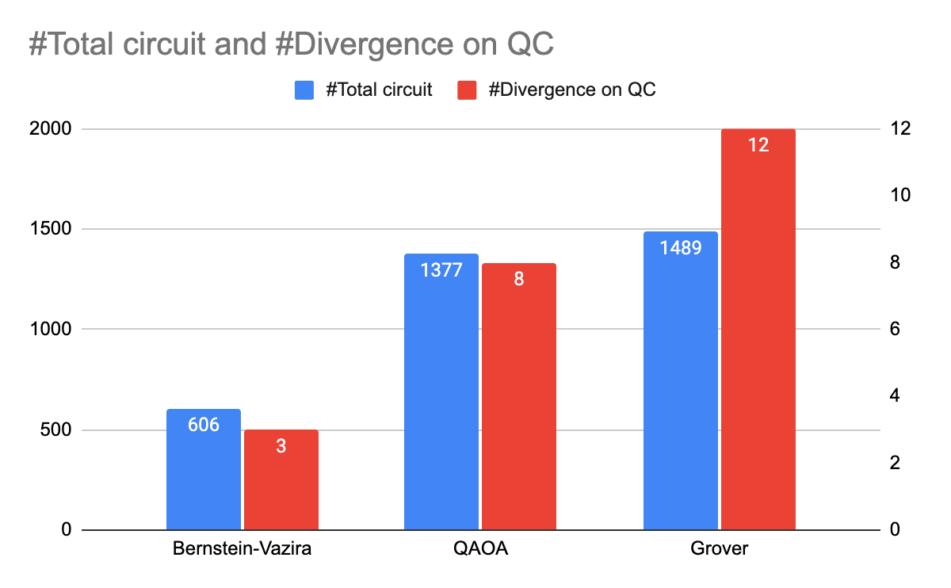
Evaluation: Test Generation, Speed Up, and Divergence
Quantum
FPGA
MLIR
We evaluated QDiff on three quantum software stacks: Cirq, Qiskit, and Pyquil.
We ran the circuits on five IBM quantum computers with 6 well-known quantum algorithms (QAOA, Grover, etc.) as the initial test cases.
QDiff found 4 crashes in the quantum simulators and
29 divergences on QC.
Notes:
Only highlight results in red
With our approaches, can we find bugs
We evaluated QDiff on three quantum software stacks: Cirq, Qiskit, and Pyquil. We ran the circuits on five IBM quantum computers with 6 well-known quantum algorithm (QAOA, Grover, etc.) as the initial test cases.

Slide 26
What we found: divergent result in quantum computers.
Quantum
FPGA
MLIR
The divergence cases in hardware might be due to the sub-optimal quantum circuit compilation.
We speculated 2 possible root causes for 25 of them:
  qubit dephasing: 9 cases.
  2-qubit gate mapping: 16 cases.
Notes:
Let's take a deep look at what QDiff found on quantum computers. We find that the divergence cases in hardware might due to the sub-optimal quantum circuit compilation, and speculated 2 possible root causes for 25 of them: qubit dephasing and 2-qubit gate mapping.

Slide 27
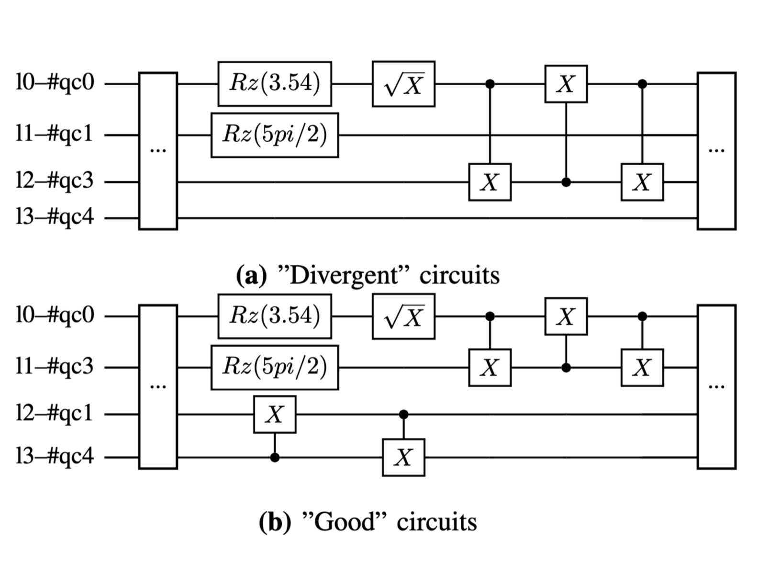
Qubit Dephasing
Quantum
FPGA
MLIR
Qubit dephasing:
no operation on #qc4 in (a) for too long time [1].
1. https://quantumai.google/cirq/google/best_practices#keep_qubits_busy, 2021
Notes:
Dephasing simply means qubit lost its correct state. Suggested by google cirq, Qubits that remain idle (same as idol,爱豆,偶像) for long periods tend to dephase. For example, although circuit A and circuit B are semantically equivalent, since there is no operation on #qc4 for too long time, qubit 4 lost its correct state and thus circuit A produce divergent results. Seems IBM Compiler did not consider the qubit dephasing, thus produce the bad circuit as (a).

Slide 28
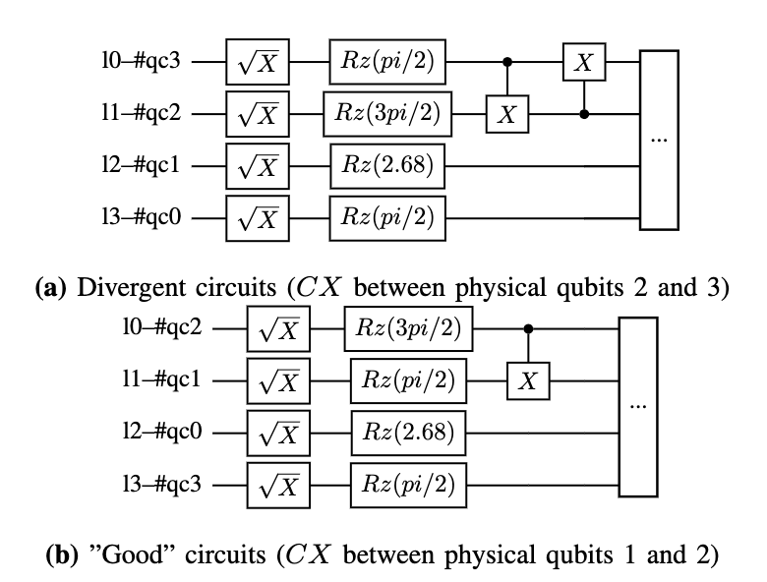
Sub-Optimal 2-qubit Gate Mapping
Quantum
FPGA
MLIR
qc2
qc3
qc1
qc0
- The connection between #qc2 and #qc3 is far worse than it between #qc2 and #qc1 [1].
- Circuit (a) leads to divergent results.
1. https://quantum-computing.ibm.com/services/resources?tab=yours&system=santiago
Notes:
Another example is sub-optimal 2-qubit gate mapping. On hardware santiago, the connection between #qc2 and #qc3 is far worse than it between #qc2 and #qc1 [1]. Although two circuits has few 2-qubit gates, circuit (a) leads to divergent results due to the bad connection between qc2 and qc3.

Slide 29
Conclusion
Quantum
FPGA
MLIR
By accounting for characteristics of quantum hardware, QDiff redesigned the differential testing for quantum software stacks
Selected as SIGSOFT research highlights
Inspired the follow up works like MorphQ (compiler testing designed for Qiskit)
Notes:
We are the first one to do differential testing
pioneer work in extending software testing to hardware-assited testing

Slide 30
Understanding hardware is the first step.
Quantum
FPGA
MLIR
QDiff (ASE’21)
Understand Hardware
HFuzz (FSE’23)
Use Hardware for Acceleration
Notes:
Understanding hardware is the first step. Hardware accelerators provide speed up for xxxx, software tools for systems stacks are wasting computation resource in the process of testing system stack. Motivate me: how can we make use of these hardware resource in system stack testing. Next I’ll show case my work, how to leverage hw resources to redesign the traditional fuzz testing
Q: we move our focus from quantum computer to FPGA because quantum computer is not mature enough for using it for testing

Slide 31
Quantum
FPGA
MLIR
HFuzz: Leveraging Hardware Probes and Acceleration for Testing Heterogeneous Applications
Jiyuan Wang, Qian Zhang, Hongbo Rong, Harry Xu, Miryung Kim
Understand Hardware
Use Hardware for Acceleration
FSE’23
Notes:
Previous work: leverage quantum hardware info to test quantum framework
Now: leverage FPGA info to test FPGA applications. Underlying idea and insight is extensible, how to extend by xxxxx, push mutation to kernels / accelerators, not specific to FPGAs, can be implemented to quantum computer (not mature) After we understand the hardware, the next step is to leverage the hardware. Now I’m gonna introduce my second work Hfuzz, which redesign the traditional fuzz testing by leverage the powerful FPGA.

Slide 32
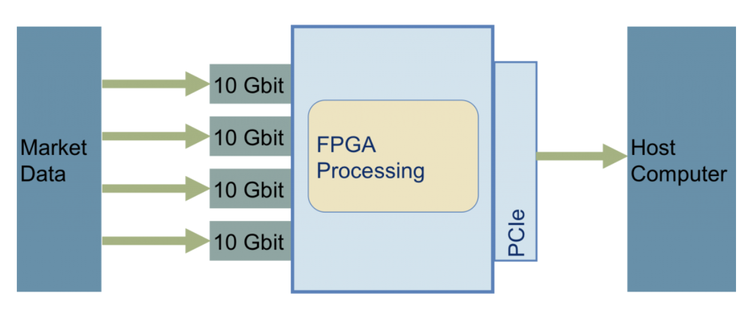



FPGA applications are widely used in financial markets.
Quantum
FPGA
MLIR
Wallstreet uses FPGAs in
High Frequency Trading (HFT)
Bugs in applications == money loss on market!

Slide 33
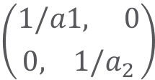
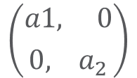
Motivating example: bug cannot be found in CPU emulation.
Quantum
FPGA
MLIR
Kernel 1 sends data a[i] through Channels
Kernel 2 calculates 1/a[i] when a[i]!=0
$$\left({a1, 0 \atop 0, a_{2}}\right)$$
Channel Read Failure
Wrong Result
$$\left({1/a1, 0 \atop 0, {1/a}_{2}}\right)$$
Input | CPU emulation | FPGA
Two large sparse matrices | All channel read success and no error happens. | The data is not ready when Kernel 2 try to read from the channel, which leads to a read failure.
Notes:
The bugs in FPGA kernel code can be difficult to find and reason. Take this transform kernel code as an example. With two large matrices as input, previous kernel sends non-zero elements of the input matrices to the transform kernel with kernel-to-kernel pipe, KToKFIFO. With two large sparse matrices as input, during CPU emulation, all pipe read operations are successful and no error happen. However, if we run the kernel on FPGA, the data is not ready when the transform kernel try to read from the FIFO, which leads to a pipe read failure in the kernel and leads to a div/0 error and returns wrong results.

Slide 34
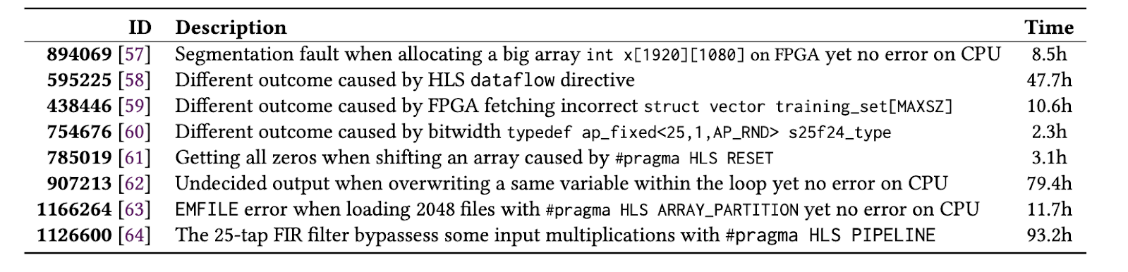
Existing testing approach cannot find errors efficiently.
Quantum
FPGA
MLIR
AFL (American Fuzzy Lop), a well-known fuzz testing framework,
needs extremely long time to find bugs [1].
1. Q. Zhang, J. Wang, and M. Kim, “Heterofuzz: Fuzz testing to detect platform dependent divergence for heterogeneous applications", FSE2021
Notes:
Existing testing approach cannot find kernel errors efficiently. My co-authored previous work HeteroFuzz measured the running time of AFL on the CPU and FPGA errors reported on Xilinx . It would take up to 93 hours–over 4 days of fuzzing time to find such kernel errors. Why? In the HLS/ FPGA domain, there are several technical challenges that make AFL-like fuzzing techniques not easily applicable. Let me describe 2 technical challenges in the next slides.

Slide 35
We need a new guidance and a fast mutation.
Quantum
FPGA
MLIR
Pick
Mutate
Input
Input
Input
Input'
Input
Execute
Add Input'
Feedback
Yes
New Branch Coverage?
Program
Notes:
First grey-box fuzzing requires having a feedback mechanism to distinguish test inputs leading to different behavior. In AFL like fuzzing, we typically use branch coverage as a feedback. However measuring branch coverage is not very meaningful at the kernel, because at HW gate level all the branches will be executed. Moreover, kernel code is often treated as black box during execution, makes it even harder to get meaningful feedback from the hw. Second, the input size of heterogeneous application is usually very large. typical input mutations on CPU such as bit-level or byte-level mutations are unlikely to be effective and highly in-efficient.

Slide 36
Key Question
Quantum
FPGA
MLIR
Can we use FPGAs to
help testing heterogeneous applications?
Notes:
We want to answer the key question with our work: can we use FPGAs to help testing heterogeneous applications?

Slide 37
HFuzz’s Approach
Quantum
FPGA
MLIR
Challenges
HFuzz’s Approach
Mutation on CPU is too slow.
In-kernel parallel
input mutations on FPGAs.
Branch coverage cannot be derived directly.
In-kernel probes to monitor channel usages and accelerator value spectra.
Kernel code is often treated as a black box.
Notes:
Font size is too small
We reinvent fuzz testing for the heterogeneous applications, by leveraging FPGAs to address two challenges. We push mutation into the kernel to avoid redundant data transition and speed up the mutation by better parallelism on FPGAs. To get useful feedback to guide test case generation, we insert in-kernel probes with FPGAs, to monitor the runtime channel usage between kernel and kernel, kernel and host, and other accelerator's value spectra like in-kernel variable value range. Also,

Slide 38
Approach 1: In-kernel Mutation
Quantum
FPGA
MLIR
Mutation Operators | Description | Mutation on CPU | In-kernel Mutation
Sparsity Mutation | Replace each element from index s to e to zero | for i in s..e do {vector[i] = 0} | h.parallel(range{e-s}, [=](auto i) {vector[i+s]=0});
Copy Mutation | Replace each element from index s to e with element at s | for i in s..e do {vector[i] = vector[s]} | h.parallel(range{e-s}, [=](auto i) {vector[i+s]=vector[s]});
Change Mutation | Add constant a to each element from index s to e | for i in s..e do {vector[i] = vector[i]+a} | h.parallel(range{e-s}, [=](auto i) {vector[i+s]=vector[i+s]+a});
... | ... | ...
We rewrite mutations as a separate kernel job and enable parallelism in HW accelerators for each mutation operator.
Notes:
We rewrite mutations as a sperate kernel job and enable parallelism in HW accelerators for each mutation operator. For example, for the Sparsity Mutation that Replace each element from index
s to e to zero, we rewrite the mutation from CPU version to FPGAs version with h.parallel to enable parallism.

Slide 39

Approach 2: In-kernel Probe Insertion
Quantum
FPGA
MLIR
… (Kernel Code)
int divisor = KToKFIFO::read();
KToKFIFOSize--;
DeviceToHostKToKPipe::write(KToKFIFOSize);
…
We conduct code analysis with the AST tool [1]. The in-kernel probes are automatically added to monitor channel size and range of variable value by instrumentation.
1.Bendersky, E. "PyCParser C Parser and AST Generator Written in Python." (2012).
Notes:
We conduct code analysis with the AST tool Pycparser [1] and, therefore, locate the channel usage in the kerenl code. The in-kernel probes are automatically added to monitor channel size and range of variable value by source-to-source code instrumentation. For example, in our transform kernel, we first locate the in-kernel variable integer divisor and channel usage KToKFIFO::read() at the blue line, then we automatically add probes with pre-written code patterns.
//Overhead: In-kernel probe insertion uses 24% extra LUT, 29% extra FF, 8% extra RAM, and reduces frequency by 5%

Slide 40
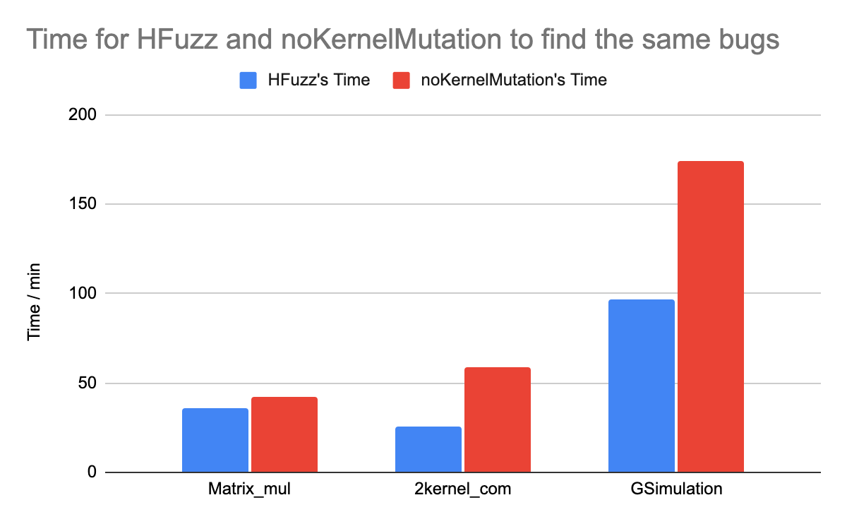
Evaluation
Quantum
FPGA
MLIR
Effectiveness of Probe
With in-kernel probe, HFuzz finds bugs 4.1x faster.
Speed up from HW mutations
By pushing mutation into FPGAs, HFuzz generates 4.3x more test cases, and finds bugs 2.4x faster.
Notes:
We evaluate HFuzz on seven DPC++ heterogeneous applications. These benchmarks cover a representative set of optimizations used in kernel (e.g., custom bitwidth, loop unrolling, etc.) and different memory usages (e.g., buffer memory, unified shared memory, FIFO)
We evaluate our two improvement, and compared to the baseline, with in-kernel probe, Hfuzz finds bugs 4.1x faster; and by pushing mutation into kernels, Hfuzz finds bugs 2.4x faster.
(purely by papalism, 1.8X speedup on matrix-multiplication)

Slide 41



Testing to expose a bug is not the last step…
Quantum
FPGA
MLIR
HFuzz finds 33 bugs!
That’s great! But where is the bug? Should we investigate all the code in the heterogeneous application and compiler?
Notes:
Testing to expose a bug is not the last step. During our collaboration with Intel, Hfuzz find bugs in their benchmark. However, the heterogeneous compiler and application are very complex. It is nearly impossible for developers to investigate all the code to debug. We need to provide more information

Slide 42
Quantum
FPGA
MLIR
DuoReduce: Bug Isolation for Multi-Layer Extensible Compilation
Jiyuan Wang, Yuxin Qiu, Ben Limpanukorn, Hong Jin Kang, Qian Zhang, Miryung Kim
Explore the relation between code and compilation
FSE’25
Notes:
Now let me introduce my third work, Duoreduce, bug isolation for multi-layer extensible compilation. The key insight of this work, is to use the dependency between code and compilation, to bug isolation at both code dimension, and compilation dimension

Slide 43
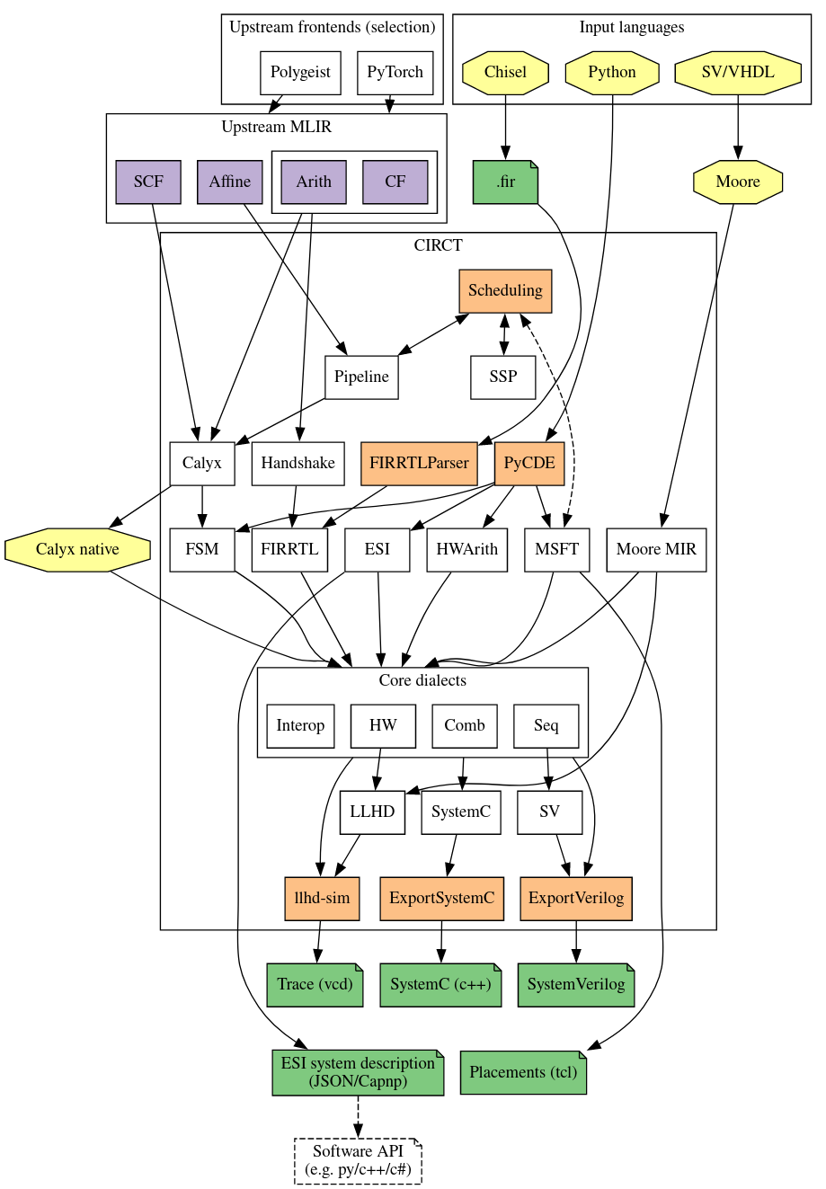
Heterogeneous compilation is complex.
Quantum
FPGA
MLIR
CIRCT: MLIR-based Heterogeneous Compiler [1]
Multiple layers
Multiple compilation passes
Multiple transformations and optimizations
Eldridge, Schuyler, et al. "MLIR as hardware compiler infrastructure." Workshop on Open-Source EDA Technology (WOSET). Vol. 3. 2021.
Notes:
Take CIRCT, a famous open-source heterogeneous compilers as an example. CIRCT transforms high-level language code such as Python and C into Verilog. It defines multiple layers from high-level code to lowe level Verilog code. It defines 206 compilation passes, including multiple optimizations and transformations. For example, It can convert high-level Python constructs into optimized Verilog code by utilizing 15 distinct compilation passes.

Slide 44




Background: Multi Layer Intermediate Representation (MLIR)
Quantum
FPGA
MLIR
Dialect
Different Level of Abstraction
Compilation passes
Notes:
So what is MLIR? MLIR stands for multi layer intermediate representation. It use dialect to represent different level of abstraction. And it has compilation passes, to bridge different level of abstraction, act as transformation. It is widely used as ML compiler and heterogenous compiler
Q: TVM is an end-to-end compiler for deep learning workloads, and MLIR is a reusable and extensible compilation infrastructure. Although their core ideas differ, the ecosystems built are comparable. TVM’s extensibility feature originates from the tensor representation and optimization mechanism and provides a powerful automated design to achieve high performance. However, the domain scalability is relatively limited. MLIR’s extensibility feature originates from IR design and LLVM integration. The powerful IR extension mechanism allows a larger ecosystem. However, the specific implementation requires sufficient domain knowledge and experience to achieve the expected result.

Slide 45
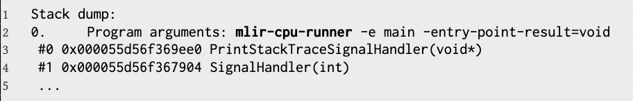
Need to localize the bug at both code level and compilation level.
Quantum
FPGA
MLIR
func.func @main() {
…
call @matmul(%2, %0, %1):(memref<128x128xf32>, memref<128x128xf32>, memref<128x128xf32>) -> ()
scf.for %arg0 = %c0 to %c128 step %c1 {
scf.for %arg1 = %c0 to %c128 step %c1 {
%3 = memref.load %2[%arg0, %arg1] : memref<128x128xf32>
%4 = arith.cmpf oeq, %3, %cst_0 : f32 -> i1
cf.assert %4, ”Wrong output"}}
...
return}}
P1: -convert-linalg-to-loops
P2: - affine-loop-unroll
P3: -convert-scf-to-cf
P4: -convert-arith-to-llvm
P5: -convert-linalg-to-llvm
P6: -convert-memref-to-llvm
P7: -convert-func-to-llvm
P8: -reconcile-unrealizedcasts
Notes:
Take one real-word bug report on github as an example. With the simple matrix multiplication programs with around 50 lines of high-level IR code, it will go through 8 compilation passes, and then generate RTL programs in verilog code from LLVM. We can find bugs with HFuzz, but which layers of compilation and which part of the code is responsible to the bug?

Slide 46
Delta-Debugging (DD) : Traditional Debugging Method
Quantum
FPGA
MLIR
func.func @main() {
…
call @matmul(%2, %0, %1):(memref<128x128xf32>, memref<128x128xf32>, memref<128x128xf32>) -> ()
scf.for %arg0 = %c0 to %c128 step %c1 {
scf.for %arg1 = %c0 to %c128 step %c1 {
%3 = memref.load %2[%arg0, %arg1] : memref<128x128xf32>
%4 = arith.cmpf oeq, %3, %cst_0 : f32 -> i1
cf.assert %4, ”Wrong output"}}
...
return}}
Bug preserved after reduction!
1-minimal: no more code can be removed
Notes:
Traditional debugging method, like delta-debugging, help the bug isolation. The approach is straightforward. Strating from the original code and bug, it will try to remove the code segement from the original code, and check whether still preserved, and keep doing this until no more code can be removed. The final reduced code is called: 1-minimal code.

Slide 47
Challenge 1: 1-minimal is not enough.
Quantum
FPGA
MLIR
func.func @main() {
…
call @matmul(%2, %0, %1):(memref<128x128xf32>, memref<128x128xf32>, memref<128x128xf32>) -> ()
scf.for %arg0 = %c0 to %c128 step %c1 {
scf.for %arg1 = %c0 to %c128 step %c1 {
%3 = memref.load %2[%arg0, %arg1] : memref<128x128xf32>
%4 = arith.cmpf oeq, %3, %cst_0 : f32 -> i1
cf.assert %4, ”Wrong output"}}
...
return}}
Wrong implementation of @matmul?
Incorrect compilation for nested for loop?
Incorrect memory load operation?
Notes:
However, 1-minmal

Slide 48
Challenge 2: Compilation path isolation is time consuming.
Quantum
FPGA
MLIR
P1: -convert-linalg-to-loops
[ ]
[P1]
[P1,P2]
[P1]
[ ]
[ ]
Start
1st Layer
[P2]
2nd Layer
n^th Layer
...
...
...
...
...
...
...
2^n
P2: -affine-loop-unroll
P3: -convert-scf-to-cf
P4: -convert-arith-to-llvm
P5: -convert-linalg-to-llvm
P6: -convert-memref-to-llvm
P7: -convert-func-to-llvm
P8: -reconcile-unrealizedcasts
Notes:
The second challenge is,

Slide 49
Key Question
Quantum
FPGA
MLIR
Can we explore the
relation between code
and compilation to
help bug isolation?

Slide 50



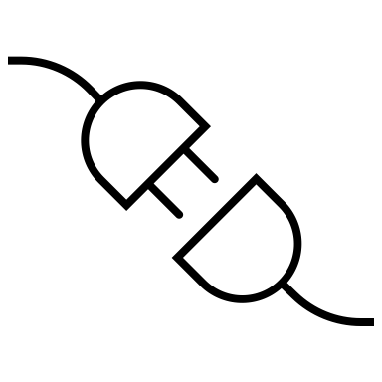



DuoReduce: 2-Dimensional Bug Isolation
Quantum
FPGA
MLIR
IR code
IR-Transformation based DD
Reduced IR code
Final IR code
Dual-dimensional Reduction
Final
Compilation Path
Dependency-aware Reduction
Reduced Compilation Path
Compilation Path
Notes:
To localize bugs at both dimensions, DuoReduce redesign the delta-debugging by relating the IR code with compilation pass. Starting with the original IR code and compilation path, DuoReduce applies IR-trasformatiomn based delta-debugging to push the limit for 1-minimal, and apply dependency-aware reduction on compilation path. After We get a a reduced IR code and reduced compilation path, we will apply further reduction with dual-dimensional reduction, by leveraging the connection between IR code and compilation pass. And then getthee final results. Let’s take a look at each component

Slide 51

Approach 1: IR-Transformation based Delta-Debugging
Quantum
FPGA
MLIR
func.func @main() {
…
call @matmul(%2, %0, %1):(memref<128x128xf32>, memref<128x128xf32>, memref<128x128xf32>) -> ()
scf.for %arg0 = %c0 to %c128 step %c1 {
scf.for %arg1 = %c0 to %c128 step %c1 {
%3 = memref.load %2[%arg0, %arg1] : memref<128x128xf32>
%4 = arith.cmpf oeq, %3, %cst_0 : f32 -> i1
cf.assert %4, ”Wrong output"}}
...
return}}
%0
@matmul
%1
%2
memref.load
%3
arith.cmpf
%4
cf.assert
Notes:
IR-Transformation based delta-debugging. The key insight behind this approach is, by code transformation, we can further push the limit of 1-minimal. For example, the above ir code is 1-minimal – no more line of code can be removed due to the data dependency among each variable. However, the bug is only related with the wrong implmementation of cf.assert. So, how to enable further reduction?

Slide 52
Approach 1: IR-Transformation based Delta-Debugging
Quantum
FPGA
MLIR
func.func @main() {
…
call @matmul(%2, %0, %1):(memref<128x128xf32>, memref<128x128xf32>, memref<128x128xf32>) -> ()
scf.for %arg0 = %c0 to %c128 step %c1 {
scf.for %arg1 = %c0 to %c128 step %c1 {
%3 = memref.load %2[%arg0, %arg1] : memref<128x128xf32>
%4 = 1 : i1
cf.assert %4, ”Wrong output"}}
...
return}}
%0
@matmul
%1
%2
memref.load
%3
arith.cmpf
%4 = 1
cf.assert
Notes:
DuoReduce applies different IR transformation to break down the data dependency among these variables. For example, if we replace %4 with a random variable, like 1, then %4 does not depend on %3 anymore, which means we can remove all the previous variables, thus achieve more reduction

Slide 53
Approach 2: Dependency-Aware Compilation Path Reduction
Quantum
FPGA
MLIR
P1: -convert-linalg-to-loops
Pi might depend on Pj to reproduce the bug, if i>j
P2: -affine-loop-unroll
P3: -convert-scf-to-cf
Pj cannot depend on Pi
P4: -convert-arith-to-llvm
P5: -convert-linalg-to-llvm
P1: -convert-linalg-to-loops
P6: -convert-memref-to-llvm
P2: - affine-loop-unroll
P7: -convert-func-to-llvm
P8: -reconcile-unrealizedcasts
Notes:
On another dimension, we apply Dependency-Aware Compilation Path Reduction. The insight behind is, the post compilation pass may depend on the previous compilation pass to reproduce the error, but it cannot be opposite. For example,

Slide 54
Approach 2: Dependency-Aware Compilation Path Reduction
Quantum
FPGA
MLIR
P1: -convert-linalg-to-loops
P8 depends on P7?
[P1, P2, P3, P4, P5, P6, P7, P8]
P2: -affine-loop-unroll
P3: -convert-scf-to-cf
P8 depends on P6?
[P1, P2, P3, P4, P5, P6, P7, P8]
P4: -convert-arith-to-llvm
P5: -convert-linalg-to-llvm
P8 depends on P5?
[P1, P2, P3, P4, P5, P6, P7, P8]
P6: -convert-memref-to-llvm
P7: -convert-func-to-llvm
…
P8: -reconcile-unrealizedcasts
Time complexity: O(2^n) -> O(n^2)
Notes:
Based on this insight, we figure out the dependency of a compilation pass based on back tracing. Starting from the last compilation pass P8, we try to figure out whether P8 depends on P7, by executing P1, P2, P3, P4, P5, P6 and P8 (original compilation path without p7). If the original bug does not preserved, it means P8 need P7 to reproduce the bug, so we keep P7 in the following compilation trails. Then we try P6, if we find P6 is not need to trigger the bug, we will remove P6 from the compilation path. Then we check P5, P4, P3.. By doing this ,we can get the shortest path ending with P8 but still preserved the bug.

Slide 55
Approach 3: Dual Dimensional Reduction
Quantum
FPGA
MLIR
func.func @main() {
…
call @matmul(%2, %0, %1):(memref<128x128xf32>, memref<128x128xf32>, memref<128x128xf32>) -> ()
scf.for %arg0 = %c0 to %c128 step %c1 {
scf.for %arg1 = %c0 to %c128 step %c1 {
%3 = memref.load %2[%arg0, %arg1] : memref<128x128xf32>
%4 = arith.cmpf oeq, %3, %cst_0 : f32 -> i1
cf.assert %4, ”Wrong output"}}
...
return}}
P1: -convert-linalg-to-loops
P2: -affine-loop-unroll
P3: -convert-scf-to-cf
P4: -convert-arith-to-llvm
P5: -convert-linalg-to-llvm
P6: -convert-memref-to-llvm
Reduction in one dimension can lead to
reduction in another dimension!
P7: -convert-func-to-llvm
P8: -reconcile-unrealizedcasts
Notes:
The third part of the approach is to build the connection between compilation and code. For example, we can relate the left for loop with the for-loop compilation pass. After we have a reduced compilation path, If we found the for loop is not related with the bug, we can also remove the for-loop related compilation pass.

Slide 56



Evaluation: Reduction Rate Improvement & Speed Up
Quantum
FPGA
MLIR
All reproducible GitHub bug issues
for CIRCT, MLIR, and onnx-mlir
21.6% more reduction
vs. Vulcan [1] (SoTA DD tools)
901x speedup by
dependency-aware compilation path reduction
1. Xu, Zhenyang, et al. "Pushing the limit of 1-minimality of language-agnostic program reduction." OOPSLA1 (2023).
Notes:
We evaluate

Slide 57
Software Support for Heterogeneous Computing
QDiff (ASE’21)
HFuzz (FSE’23)
DuoReduce (FSE’25)
Understand Hardware
Leverage Hardware
Beyond Testing
Notes:
Now let's talk about the future work, how to further lower the barriers between software developer to hardware accelerators
Customized system stacks => backends

Slide 58

Future Plan: where is the barrier?
Hard to Test / Debug / Repair
Hard to Optimize
Notes:
Add long term version
Three future work, in one long term version
What's the barrier between the software developers and hardware accelerators? As we mentioned before, the heterogeneous application are hard to test, hard to debug, and hard to repair. Besides that, to leverage hardware accelerators, it also require software developer learn a new language or library, and understand the accelerators, including the memory and bandwith, which makes them hard to program.

Slide 59


Next Generation of Heterogeneous Computing Stacks
Hard to Test / Debug / Repair
Software
QDiff (ASE’21)
HeteroFuzz (FSE’21)
HFuzz (FSE’23)
SynthFuzz (ICSE’25)
DuoReduce (FSE’25)
HeteroGen (ASPLOS’22)
Compiler & System
Hard to Optimize
Hardware
Notes:
Compilation, robust, scalability
For the first part, testing, debugging, and repair, these can be handled by developing new software tools, as that's what I did during my phd. However, for the other problems, software might not be enough. We need to take a look at compilers and systems, and even hardware. For my future plan, I want to focus on developing the next generation of software and compilers for heteorgenous computing

Slide 60
Future Plan: a Profiling-Guided Allocator
Hard to Optimize
User’s Application
: which compilation path?
Host code: on CPU
Call Kernel code
Kernel code:
- Heavy task
- On accelerator
- Hard to write
Get results from kernel
…
- Heterogeneous compiler offers multiple compilation paths
- Each compilation path has different optimization passes
Notes:
Regression testing for system stacks
allocator
Depends on platform / application characteristics, how to choose the wise path to compile
To target at another barrier: hard to optimizeI want to build an universal compiler. During my early PhD study. I found it’s very hard for traditional SE developers, like me, to use FPGA or quantum computer. At that time, I hoped there was an universal compiler, that magically take my C/C++ programs, and turns out to be programs that can run on hardware accelerator. The more research I did in this domain, more practical I found this idea can be. It is because, all heterogeneous application share the same design logic. They all contains host code and kernel code. While the host code running on CPU, it will offload the heavy computation task to the kernel code, which runs on hardware acceleratros like GPUs and FPGAs.

Slide 61


Future Plan: a Profiling-Guided Allocator
Hard to Optimize
User’s Application
: which compilation path?
Hardware Execution Behavior
Profiling-Guided Allocator + Multi-Layer Heterogeneous Compiler
Host code: on CPU
Call Kernel code
Kernel code:
- Heavy task
- On accelerator
- Hard to write
Get results from kernel
…
Choose one compilation path
based on feedback
Profiling & Collect Feedback
No performance boost?
Ex. Processing units are not fully utilized?
More loop unrolling!

Slide 62
Summary
QDiff (ASE’21) : redesign differential testing by understanding quantum
HFuzz (FSE’23) : redesign fuzz testing by using FPGA
DuoReduce (FSE’25) : redesign delta-debugging for multi-layer compilers
Future work: redesign compilers & systems with hardware feedback
Notes:
Transition from previous slides, pick the publications from the previous slides
So for today’s agenda , I’ll introduce two of my works, to illustrate how to redesign the traditional software approach with hardware accelerators
Qdiff, redesigning differential testing for quantum compilers, by understating the quantum hardware
Hfuzz, redesigning fuzz testing for FPGA applications, by leveraging the powerful parallesm in FPGA
I’ll briefly introduce my third work, DuoReduce, which is a debugging tool for multi-layer heterogeneous compilers by redesigning traditional delta-debugging
In the end, I’ll talk about the future work, how to further lower the barrier between software developers and hardware accelerators by developing compiler and systems.

Slide 63
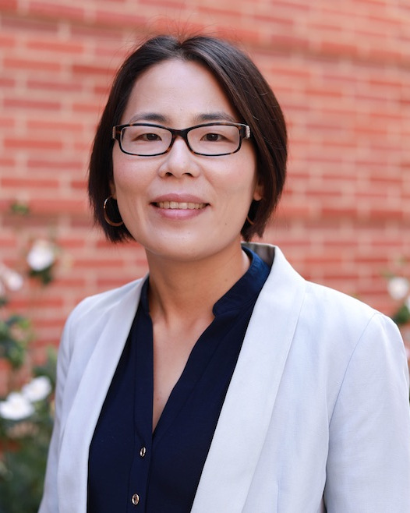
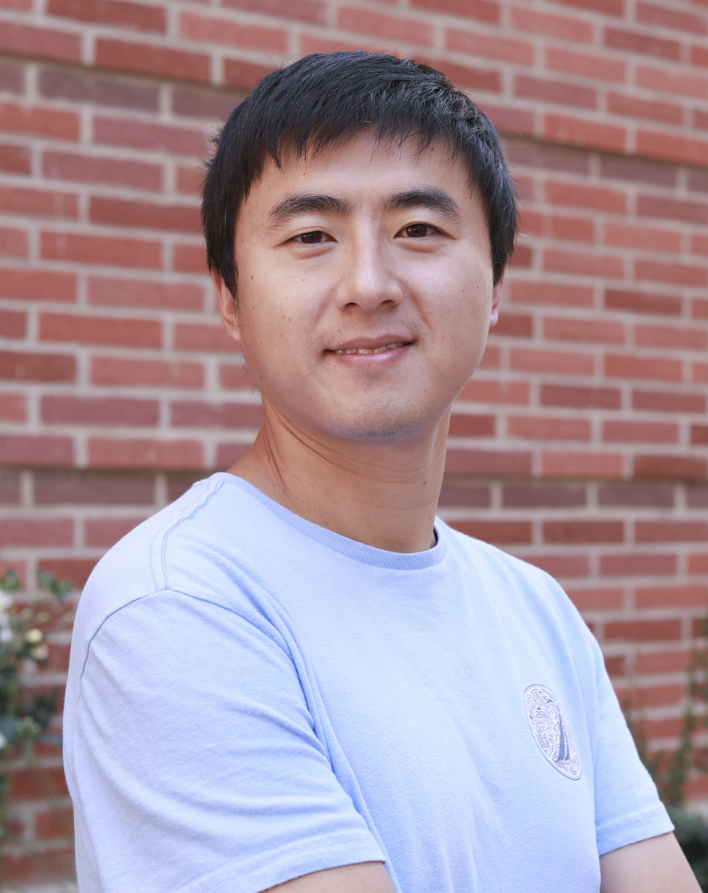
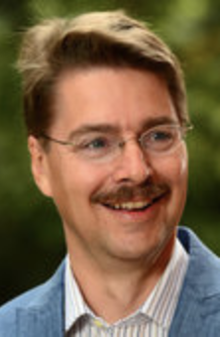

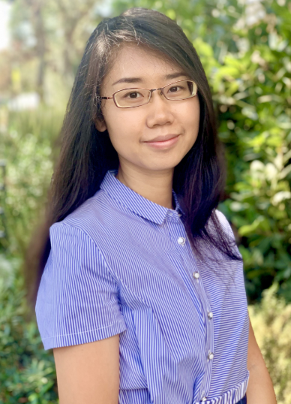
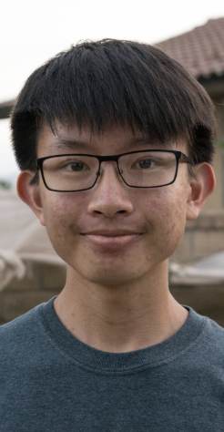
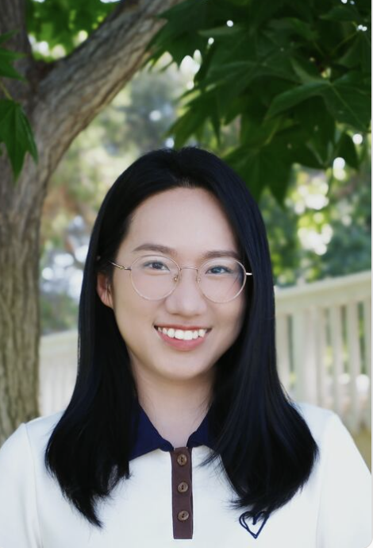
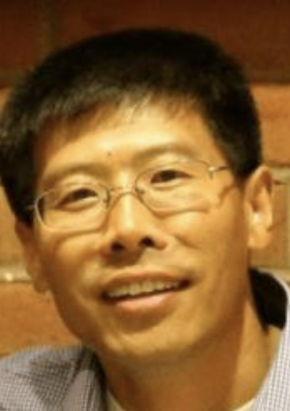
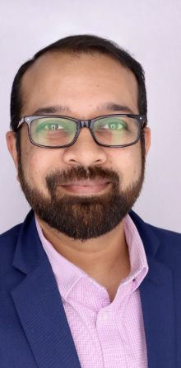
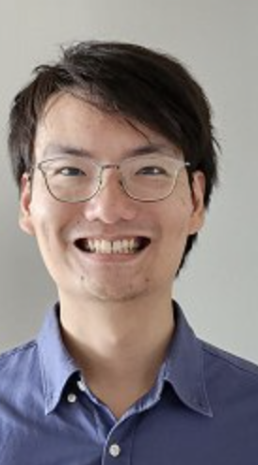
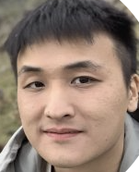
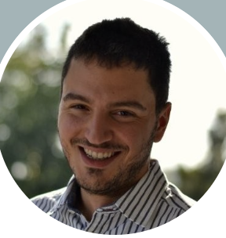
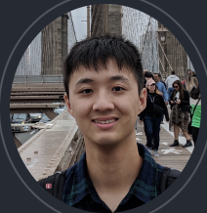
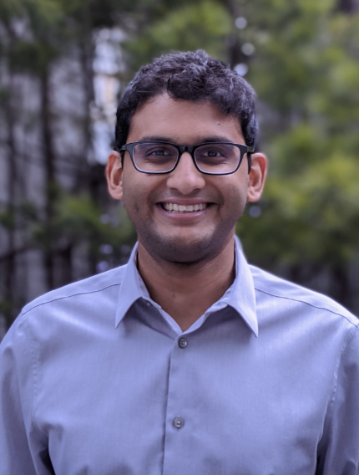

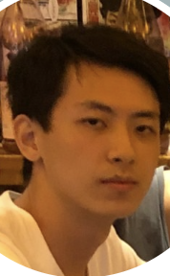
Acknowledgement
Notes:
Before getting into the QA, I want to use this opportunity to # thank my advisors, Miryung and Harry. # I also want to thank Qian Zhang which server as my mentor during my PhD. # I want to acknowledge all my collaborators as well, without whom, none of the projects I presented will be possible.

