Slide 1
An Excursion into Computational Geometry:
Voronoi Diagrams
&
Delaunay Triangulations (2)
Carola Wenk

Slide 2
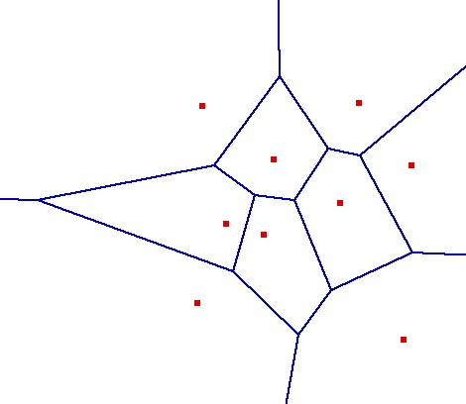
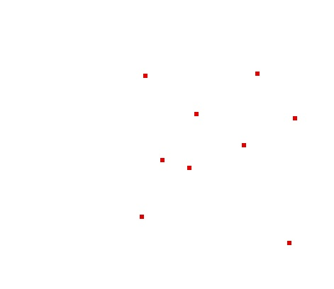

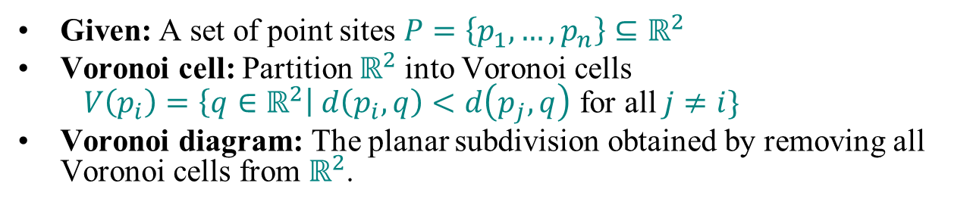
Voronoi Diagram
(Dirichlet Tesselation)
Given: A set of point sites $P=\left\{p_{1},…,p_{n}\right\}⊆ℝ^{2}$
Voronoi cell: Partition $ℝ^{2}$into Voronoi cells
$V\left(p_{i}\right)=\left\{q∈ℝ^{2}\right| d\left(p_{i},q\right)<d\left(p_{j},q\right)$ for all $j≠i\}$
Voronoi diagram: The planar subdivision obtained by removing all Voronoi cells from $ℝ^{2}$.
How can we compute VD(P)?
Voronoi Diagram Video:

Slide 3

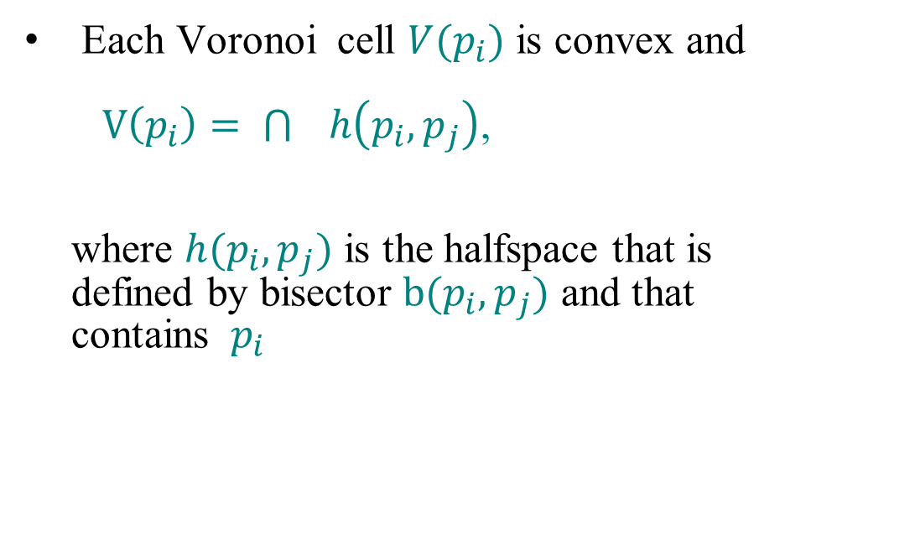
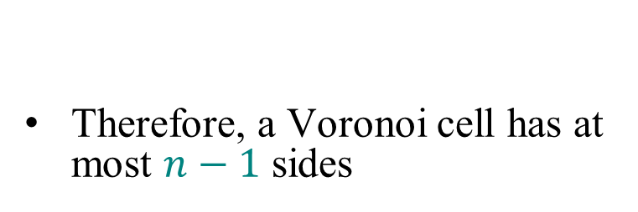

Voronoi Cells
Therefore, a Voronoi cell has at most $n−1$ sides
Each Voronoi cell $V(p_{i})$ is convex and
$V\left(p_{i}\right)= \bigcap{ h\left(p_{i},p_{j}\right)}$,
where $h(p_{i},p_{j})$ is the halfspace that is
defined by bisector $b(p_{i},p_{j})$ and that
contains $p_{i}$
$$\begin{aligned}p_{j}∈P \\ j≠i\end{aligned}$$
p_{j}
p_{i}
$$h(p_{i},p_{j})$$

Slide 4
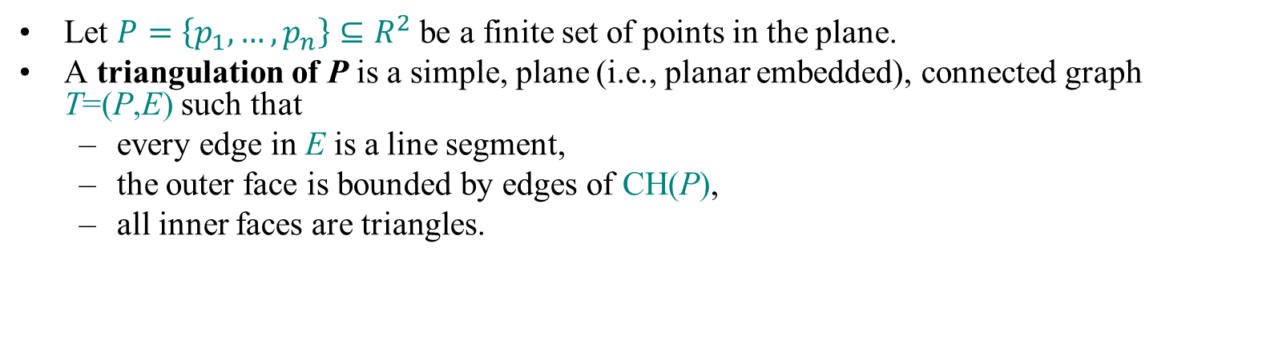
Triangulation
Let $P=\left\{p_{1},…,p_{n}\right\}⊆R^{2}$ be a finite set of points in the plane.
A triangulation of P is a simple, plane (i.e., planar embedded), connected graph T=(P,E) such that
  every edge in E is a line segment,
  the outer face is bounded by edges of CH(P),
  all inner faces are triangles.

Slide 5

Triangulation

Slide 6

Dual Graph
Let $G=(V,E)$ be a plane graph. The dual graph G* has
  a vertex for every face of G,
  an edge for every edge of G, between the two faces incident to the original edge

Slide 7
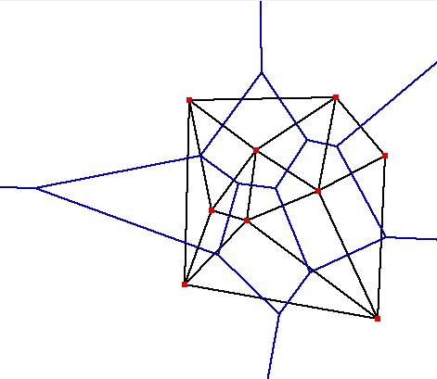
Delaunay Triangulation
Let G be the plane graph for the Voronoi diagram VD(P) . Then the dual graph G* is called the Delaunay Triangulation DT(P).
Canonical straight-line embedding for DT(P):
VD(P)
P
DT(P)

Slide 8
Delaunay Triangulation
Let G be the plane graph for the Voronoi diagram VD(P) . Then the dual graph G* is called the Delaunay Triangulation DT(P).
Canonical straight-line embedding for DT(P):
Does DT(P) always have to be a triangulation?
P
DT(P)
If P is in general position (no three points on a line, no four points on a circle) then every inner face of DT(P) is indeed a triangle.
DT(P) can be stored as an abstract graph, without geometric information. (No such obvious storing scheme for VD(P).)

Slide 9
Characterization I of DT(P)
Lemma: Let p,q,r∈P let Δ be the triangle they define. Then the following statements are equivalent:
  Δ belongs to DT(P)
  The circumcenter c of Δ is a vertex in VD(P)
  The circumcircle of Δ is empty (i.e., contains no other point of P)
  Proof sketch: All follow directly from the definition of DT(P) in VD(P). By definition of VD(P), we know that p,q,r are c’s nearest neighbors.
Characterization I: Let T be a triangulation of P.
Then T=DT(P) ⇔ The circumcircle of any triangle in T is empty.
non-empty circumcircle
p_{l}
p_{i}
p_{j}
p_{k}

Slide 10
Illegal Edges
Definition: Let p_{i} , p_{j} , p_{k} , p_{l}∈P .
Then p_{i} p_{j} is an illegal edge ⇔ p_{l} lies in the interior of the circle through p_{i} , p_{j} , p_{k} .
Lemma: Let p_{i} , p_{j} , p_{k} , p_{l}∈P .
Then p_{i} p_{j} is illegal ⇔ min α_{i} < min α’_{i}
p_{l}
p_{i}
p_{j}
p_{k}
illegal edge
p_{l}
1≤i≤6
1≤i≤6
p_{l}
p_{i}
α₅
α₃
p_{j}
edge flip
p_{i}
α’₄
α’₂
p_{j}
α₁
α₄
α’₆
α’₅
α₂
s
α₆
α’₃
α’₁
p
q
p_{k}
p_{k}
Theorem (Thales): Let a, b, p, q be four points on a circle, and let r be inside and let s be outside of the circle, such that p,q,r,s lie on the same side of the line through a, b.
Then ∠a,s,b < ∠a,q,b = ∠a,p,b < ∠a,r,b
So, α₁ = ∠ p_{j} , p_{i} , p_{l} < ∠ p_{j} , p_{k} , p_{l} = α’₁ and
α₃ = ∠ p_{l} , p_{j} , p_{i} < ∠ p_{l} , p_{k} , p_{i} = α’₃ , etc.
r
a
b

Slide 11
Characterization II of DT(P)
Definition: A triangulation is called legal if it does not contain any illegal edges.
Characterization II: Let T be a triangulation of P.
Then T=DT(P) ⇔ T is legal.
Algorithm Legal_Triangulation(T):
  Input: A triangulation T of a point set P
  Output: A legal triangulation of P
  while T contains an illegal edge p_{i}p_{j} do
  //Flip p_{i}p_{j}
  Let p_{i}, p_{j}, p_{k}, p_{l} be the quadrilateral containing p_{i}p_{j}
  Remove p_{i}p_{j} and add p_{k}p_{l}
  return T
  Runtime analysis:
  In every iteration of the loop the angle vector of T (all angles in T sorted by increasing value) increases
  With this one can show that a flipped edge never appears again
  There are O(n²) edges, therefore the runtime is O(n²)
p_{l}
p_{i}
p_{j}
p_{k}
edge flip
p_{l}
p_{i}
p_{j}
p_{k}

Slide 12
Applications of DT
All nearest neighbors: Find for each p∈P its nearest neighbor q∈P; q≠p.
  Empty circle property: p,q∈P are connected by an edge in DT(P)
  ⇔ there exists an empty circle passing through p and q.
  Proof: “⇒”: For the Delaunay edge pq there must be a Voronoi edge.
  Center a circle through p and q at any point on the Voronoi edge,
  this circle must be empty.
  “⇐”: If there is an empty circle through p and q, then its center c
  has to lie on the Voronoi edge because it is equidistant to p and q
  and there is no site closer to c.
  Claim: In DT(P), every p∈P is adjacent to its nearest neighbors.
  Proof: Let q∈P be a nearest neighbor adjacent to p in DT(P). Then
  the circle centered at p with q on its boundary has to be empty, so
  the circle with diameter pq is empty and pq is a Delaunay edge.
  Algorithm: Find all nearest neighbors in O(n) time: Check for
  each p∈P all points connected to p with a Delaunay edge.
Minimum spanning tree: The edges of every Euclidean minimum spanning tree of P are a subset of the edges of DT(P).
p
q
p
q

Slide 13
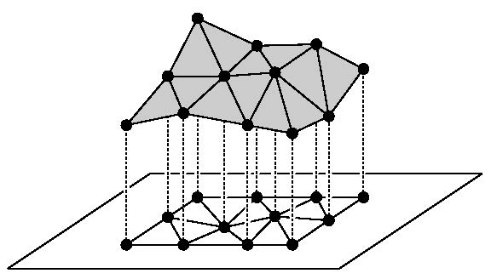
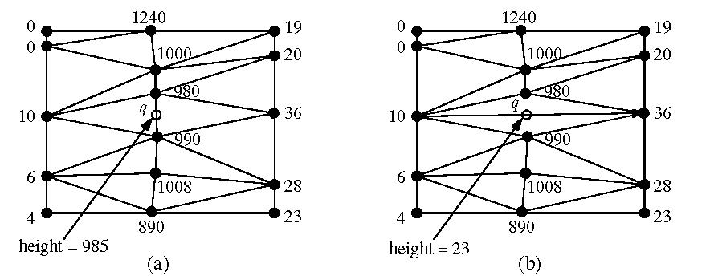
Applications of DT
Terrain modeling:
  Model a scanned terrain surface by interpolating the height using a piecewise linear function over R².
  Angle-optimal triangulations give better approximations / interpolations since they avoid skinny triangles

Slide 14
Randomized Incremental Construction of DT(P)
Start with a large triangle containing P.
Insert points of P incrementally:
  Find the containing triangle
  Add new edges
  Flip all illegal edges until every edge is legal.
Goal: Expected runtime O(n log n)

Slide 15
Randomized Incremental Construction of DT(P)
Goal: Expected runtime O(n log n)
p
p
An edge can become illegal only if one of its incident triangles changes.
Check only edges of new triangles.
Every new edge created is incident to p.
Every old edge is legal.
Every new edge is legal (since it has been created from flipping a previously illegal edge).
flip
p
p

Slide 16
