Slide 1
An Excursion into Computational Geometry:
Voronoi Diagrams
&
Delaunay Triangulations (I)
Carola Wenk

Slide 2

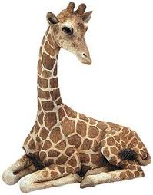
What is Computational Geometry?
It’s a subarea of algorithms concerned with algorithm design and analysis paradigms for geometric objects.
It covers new geometric algorithms and data structures that are used in various CS disciplines, such as databases, machine learning, computer graphics, and data visualization.
Voronoi diagram &
Delaunay triangulation:
Closest pair:
Convex hull:

Slide 3
Geometric Algorithms
Algorithm design techniques:
Divide and conquer
Sweep line algorithms
b
c
a
e
d
c
b
d
c
b
e
d
c
e
b
d
e
c
d

Slide 4
Geometric Data Structures
Range trees for database queries
5/8
5/8
8
5/8
8
2/7
2/7
7
2/7
6/6
5
6/6
6
6/6
3/5
3/5
5
3/5
7
2
1
6
9/3
3
5
9/3
3
7/2
7/2
2
7/2
1/1
1/1
1/1
5
2
7
1
3
6
9/3
1/1
2/7
3/5
5/8
6/6
7/2
Primary tree

Slide 5

Computational Geometry
Related areas:
Algorithms, graph theory,
combinatorics, topology
Applied areas:
Databases, sensor networks, robotics,
GIS, computer graphics, geometric
modeling
Class:
CMPS 6130/3130
Intro to Computational Geometry
Computational Geometry Concept Videos:

Slide 6
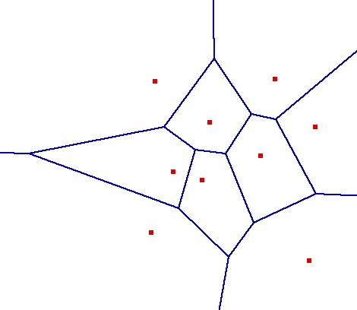
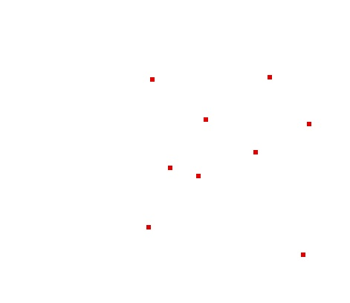

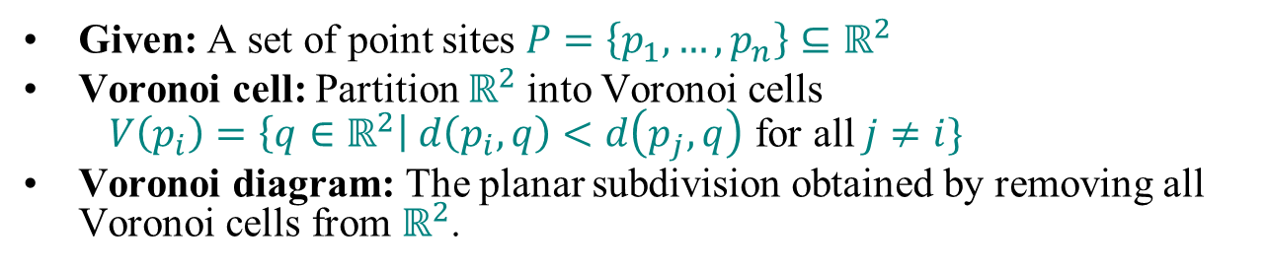
Voronoi Diagram
(Dirichlet Tesselation)
Given: A set of point sites $P=\left\{p_{1},…,p_{n}\right\}⊆ℝ^{2}$
Voronoi cell: Partition $ℝ^{2}$into Voronoi cells
$V\left(p_{i}\right)=\left\{q∈ℝ^{2}\right| d\left(p_{i},q\right)<d\left(p_{j},q\right)$ for all $j≠i\}$
Voronoi diagram: The planar subdivision obtained by removing all Voronoi cells from $ℝ^{2}$.
Voronoi Diagram Video:

Slide 7
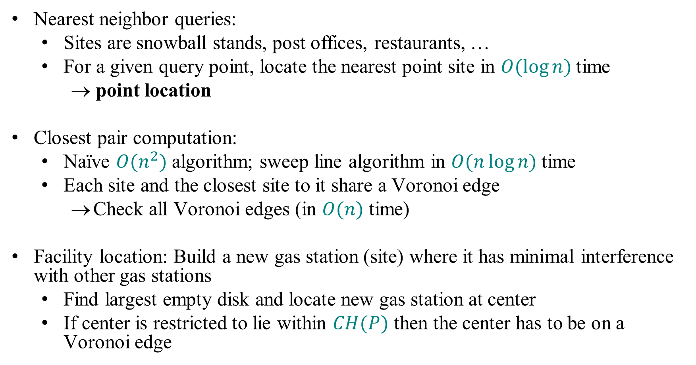
Applications of Voronoi Diagrams
Nearest neighbor queries:
  Sites are snowball stands, post offices, restaurants, …
  For a given query point, locate the nearest point site in $O(\log{n)}$time
    → point location
Closest pair computation:
  Naïve $O(n^{2})$ algorithm; sweep line algorithm in $O(n\log{n)}$time
  Each site and the closest site to it share a Voronoi edge
    Check all Voronoi edges (in $O(n)$ time)
Facility location: Build a new gas station (site) where it has minimal interference with other gas stations
  Find largest empty disk and locate new gas station at center
  If center is restricted to lie within $CH(P)$ then the center has to be on a Voronoi edge

Slide 8
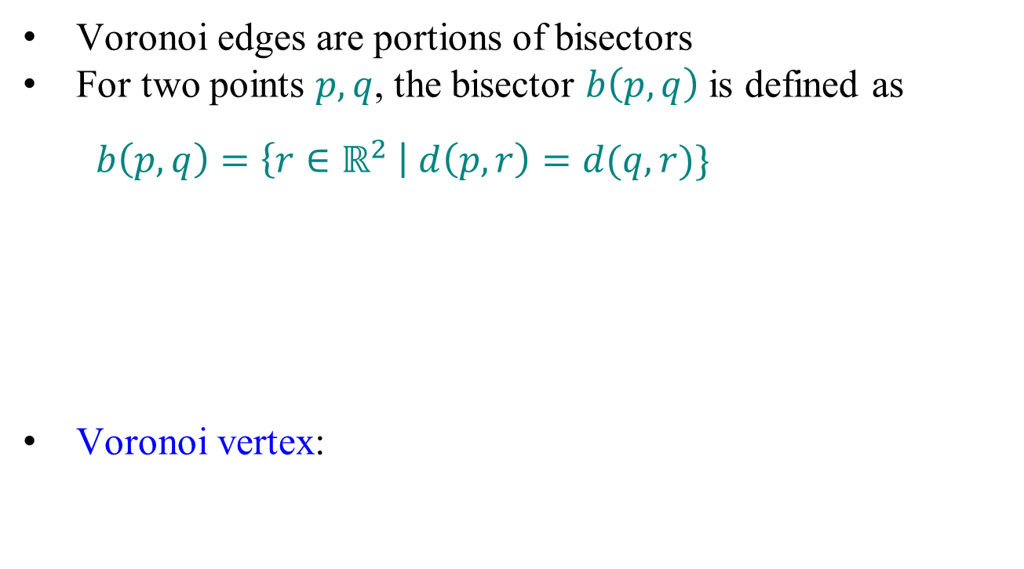
Bisectors
Voronoi edges are portions of bisectors
For two points $p,q$, the bisector $b\left(p,q\right)$ is defined as
$b\left(p,q\right)=\left\{r∈ℝ^{2} \right| d\left(p,r\right)=d(q,r)\}$
Voronoi vertex:
r
q
p
s
q
p

Slide 9

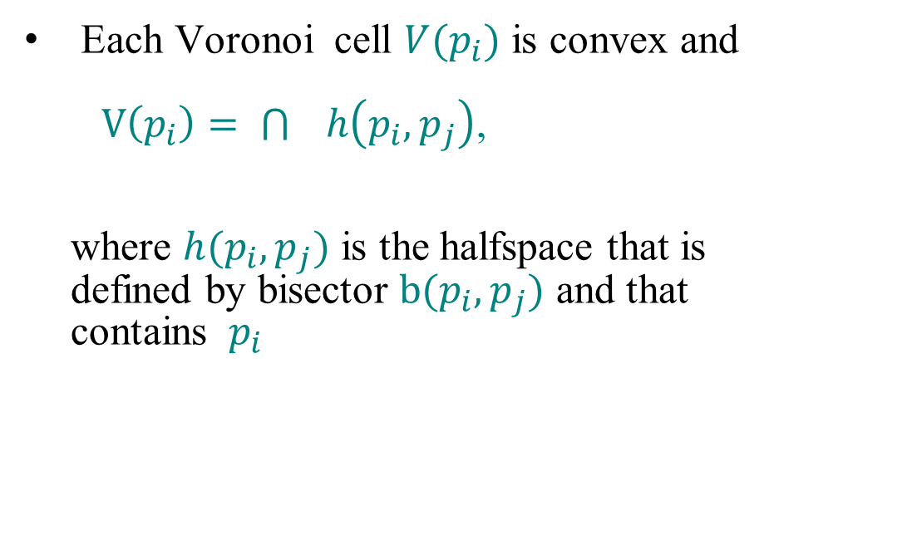
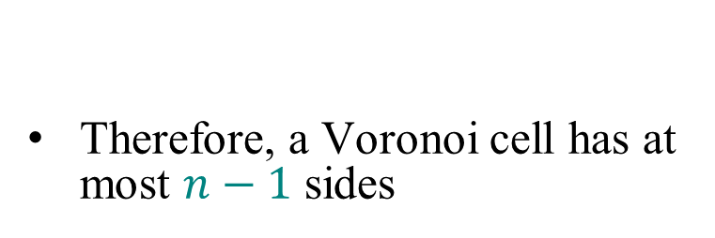

Voronoi Cells
Therefore, a Voronoi cell has at most $n−1$ sides
Each Voronoi cell $V(p_{i})$ is convex and
$V\left(p_{i}\right)= \bigcap{ h\left(p_{i},p_{j}\right)}$,
where $h(p_{i},p_{j})$ is the halfspace that is
defined by bisector $b(p_{i},p_{j})$ and that
contains $p_{i}$
$$\begin{aligned}p_{j}∈P \\ j≠i\end{aligned}$$
p_{j}
p_{i}
$$h(p_{i},p_{j})$$

Slide 10
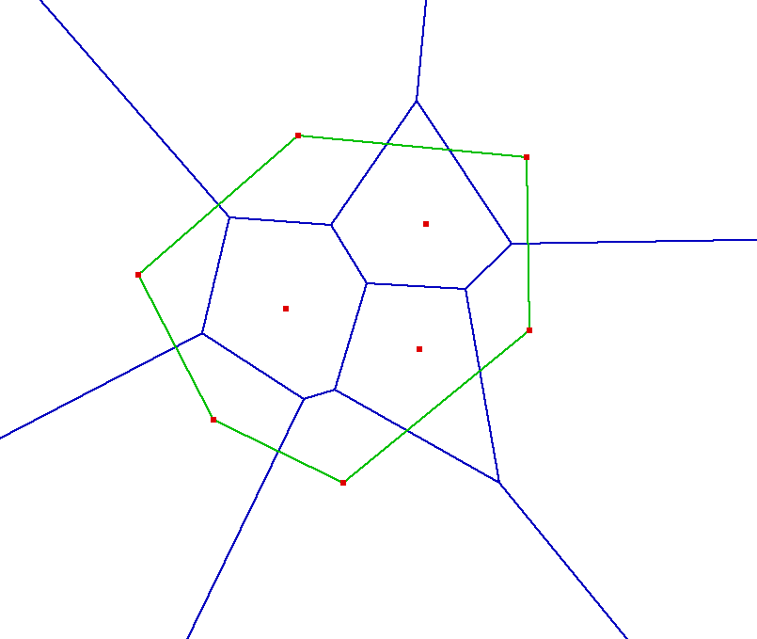

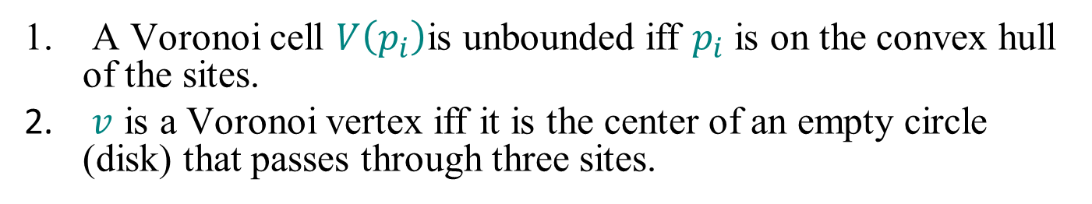
Properties
A Voronoi cell $V\left(p_{i}\right)$is unbounded iff $p_{i}$ is on the convex hull of the sites.
$v$ is a Voronoi vertex iff it is the center of an empty circle (disk) that passes through three sites.
Site with bounded Voronoi cell
Site with unbounded Voronoi cell
Voronoi Geogebra App:
Smaller empty disk centered on Voronoi edge
Larger empty disk centered on Voronoi vertex

Slide 11
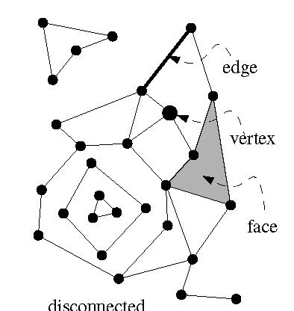
Complexity of a Planar Subdivision
The complexity of a planar subdivision (planar, embedded graph) is:
#vertices + #edges + #faces = n_{v} + n_{e} + n_{f}
Euler’s formula for planar (embedded) graphs:
  n_{v} - n_{e} + n_{f} ≥ 2
  n_{e} ≤ 3n_{v} – 6
  2) follows from 1):
  Count edges. Every face is bounded by ≥ 3 edges.
  Every edge bounds ≤ 2 faces.
  ⇒ 3n_{f} ≤ 2n_{e} ⇒ n_{f} ≤ 2/3n_{e}
  ⇒ 2 ≤ n_{v} - n_{e} + n_{f} ≤ n_{v} - n_{e} + 2/3 n_{e} = n_{v} – 1/3 n_{e}
  ⇒ 2 ≤ n_{v} – 1/3 n_{e}
Hence, the complexity of a planar subdivision is O(n_{v}), i.e., linear in the number of vertices.

Slide 12
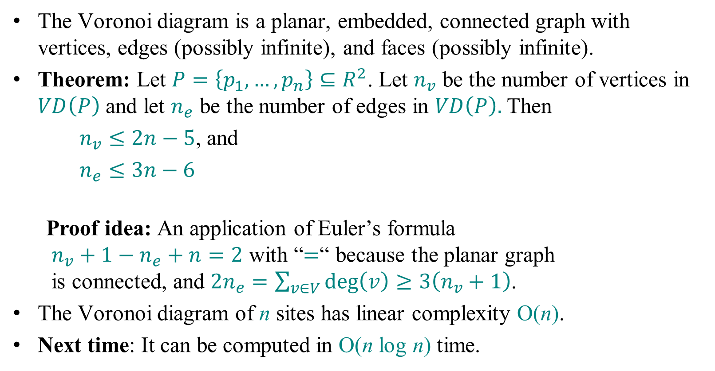
Complexity of a Voronoi Diagram
  The Voronoi diagram is a planar, embedded, connected graph with vertices, edges (possibly infinite), and faces (possibly infinite).
Theorem: Let $P=\left\{p_{1},…,p_{n}\right\}⊆R^{2}$. Let $n_{v}$ be the number of vertices in $VD\left(P\right)$ and let $n_{e}$ be the number of edges in $VD\left(P\right).$Then
  $n_{v}≤2n−5$, and
  $n_{e}≤3n−6$
Proof idea: An application of Euler’s formula
$n_{v}+1−n_{e}+n=2$ with “$=$“ because the planar graph
is connected, and $2n_{e}=\sum_{v∈V}{\deg\left(v\right)≥3\left(n_{v}+1\right)}$.
The Voronoi diagram of n sites has linear complexity O(n).
Next time: It can be computed in O(n log n) time.
Add vertex at infinity

