Slide 1
CMPS 3130/6130 Computational Geometry Spring 2020
p
Planar Subdivisions and Point Location III
Carola Wenk
Based on: Computational Geometry: Algorithms and Applications and David Mount’s lecture notes

Slide 2
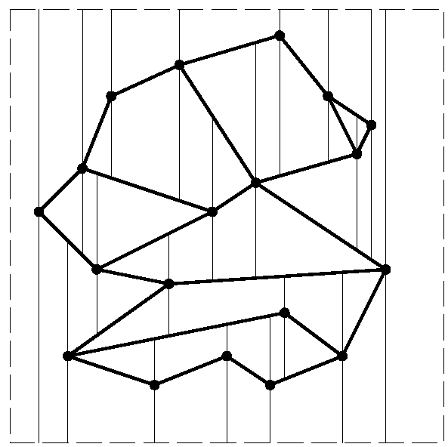
Trapezoidal map
Input: Set S={s₁,…,s_{n}} of non-intersecting line segments.
Query: Given point p, report the segment directly above p.
Create trapezoidal map by shooting two rays vertically (up and down) from each vertex until a segment is hit. [Assume no segment is vertical.]
Trapezoidal map = rays + segments
Enclose S into bounding box to avoid infinite rays.
All faces in subdivision are trapezoids, with vertical sides.
The trapezoidal map has at most 6n+4 vertices and 3n+1 trapezoids:
Each vertex shoots two rays, so, 2n(1+2) vertices, plus 4 for the bounding box.
Count trapezoids by vertex that creates its left boundary segment: Left segment end- point for at most two trapezoids, right segment endpoint for one trapezoid, corner of box for one trapezoid. → 3n+1

Slide 3
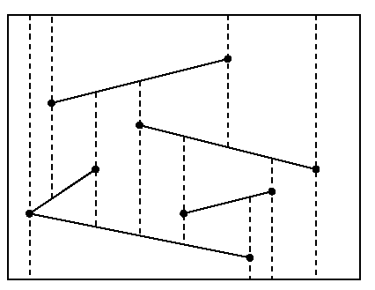
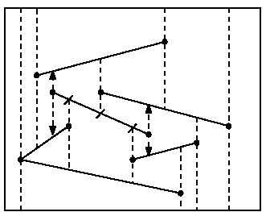
Construction
Randomized incremental construction
Start with outer box which is a single trapezoid. Then add one segment s_{i} at a time, in random order.
Let S_{i}={s₁,…, s_{i}}, and let T_{i} be the trapezoidal map for S_{i}.
Add s_{i} to T_{i-1} as follows:
Find trapezoid containing left endpoint of s_{i} . [Point location; details later]
Thread s_{i} through T_{i-1}, by walking through it and identifying trapezoids that are cut.
“Fix trapezoids up” by shooting rays from left and right endpoint of s_{i} and trim earlier rays that are cut by s_{i}.
s_{i}

Slide 4
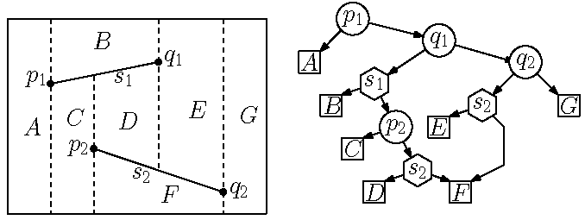
Point Location
Build a point location data structure; a DAG, similar to Kirkpatrick’s
DAG has two types of internal nodes:
x-node (circle): contains the x-coordinate of a segment endpoint.
y-node (hexagon): pointer to a segment
The DAG has one leaf for each trapezoid.
Children of x-node: Space to the left and right of x-coordinate
Children of y-node: Space above and below the segment
y-node is only searched when the query’s x-coordinate is within the segment’s span.
⇒ Encodes trapezoidal decomposition and enables point location during construction.
←
→
←
→
↑
←
→
↓
↑
←
↓
→
↑
↓

Slide 5
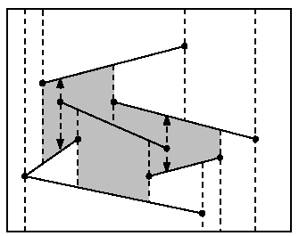
Analysis
Observation: The final trapezoidal map T_{i} does not depend on the order in which the segments were inserted.
Lemma: Ignoring the time spent for point location, the insertion of s_{i} takes O(k_{i}) time, where k_{i} is the number of newly created trapezoids.
Proof:
Let k be the number of ray shots interrupted by s_{i}.
Each endpoint of s_{i} shoots two rays → k_{i} =k+4 rays need to be processed
If k=0, we get 4 new trapezoids.
Create a new trapezoid for each interrupted ray shot; takes O(1) time with DCEL
s_{i}
s_{i}

Slide 6
Analysis
n/2+1
n/2+2
n
1
2
3
n/2
Insert segments in random order:
Π = {all possible permutations/orders of segments}; |Π| = n! for n segments
k_{i} = k_{i}(π) for some random order π∈Π
We will show that E(k_{i}) = O(1)
⇒ Expected runtime for all insertions, without point location, E(T_{all except point location}) = E(∑_{i=1}k_{i}) = ∑_{i=1}E(k_{i}) = O(∑_{i=1} 1) = O(n)
n
n
n
linearity of expectation

Slide 7
Analysis
Theorem: E(k_{i}) = O(1), where k_{i} is the number of newly created trapezoids created upon insertion of s_{i}, and the expectation is taken over all segment permutations of S_{i}={s₁,…, s_{i}}.
Proof:
T_{i} does not depend on the order in which segments s₁,…, s_{i} were added.
Of s₁,…, s_{i} , what is the probability that a particular segment s was added last?
1/i
We want to compute the number of trapezoids that would have been created if s was added last.

Slide 8
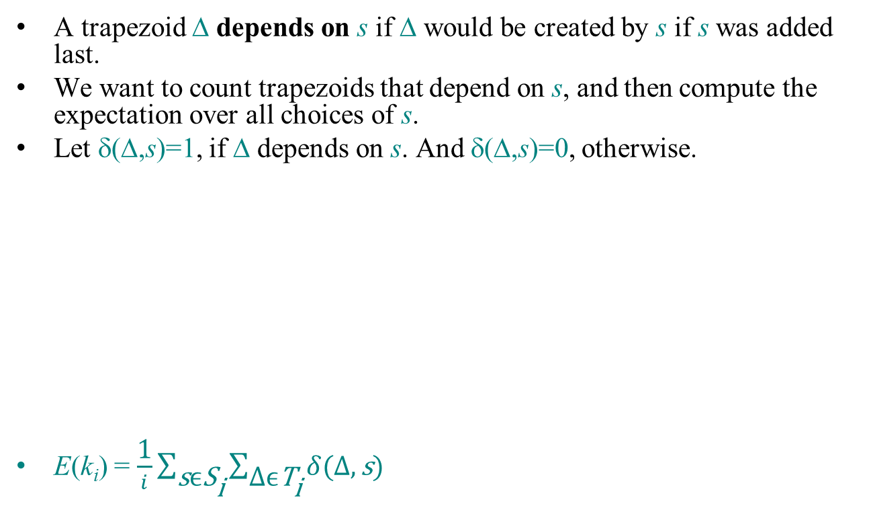
Analysis
Random variable k_{i}(s)= #trapezoids added when s was inserted last in S_{i}.
k_{i}(s)=$\sum_{∆∈T_{i}}{δ(∆,s)}$
E(k_{i})=$\sum_{s∈S_{i}}{{\text{k}}_{i}(s) P(s)= \frac{1}{i}\sum_{s∈S_{i}}{{\text{k}}_{i}\left(s\right)=\frac{1}{i}\sum_{s∈S_{i}}{\sum_{∆∈T_{i}}{δ(∆,s)}}}}$

Slide 9
Analysis
Random variable k_{i}(s)= #trapezoids added when s was inserted last in S_{i}.
k_{i}(s)=$\sum_{∆∈T_{i}}{δ(∆,s)}$
E(k_{i})=$\sum_{s∈S_{i}}{{\text{k}}_{i}(s) P(s)= \frac{1}{i}\sum_{s∈S_{i}}{{\text{k}}_{i}\left(s\right)=\frac{1}{i}\sum_{s∈S_{i}}{\sum_{∆∈T_{i}}{δ(∆,s)}}}}$
=$\frac{1}{i}\sum_{∆∈T_{i}}{\sum_{s∈S_{i}}{δ(∆,s)}}$
How many segments does Δ depend on? At most 4.
Also, T_{i} has O(i) trapezoids (by Euler’s formula).
E(k_{i})=$\frac{1}{i}\sum_{∆∈T_{i}}{\sum_{s∈S_{i}}{δ(∆,s)}}$= $\frac{1}{i}\sum_{∆∈T_{i}}{4=\frac{1}{i}4|T_{i}}|=\frac{1}{i}O\left(i\right)=O(1)$

Slide 10
Analysis
n/2+1
n/2+2
n
1
2
3
n/2
Insert segments in random order:
Π = {all possible permutations/orders of segments}; |Π| = n! for n segments
k_{i} = k_{i}(π) for some random order π∈Π
We will show that E(k_{i}) = O(1)
⇒ Expected runtime for all insertions, without point location, E(T_{all except point location}) = E(∑_{i=1}k_{i}) = ∑_{i=1}E(k_{i}) = O(∑_{i=1} 1) = O(n)
n
n
n
linearity of expectation

Slide 11
Point Location
Build a point location data structure; a DAG, similar to Kirkpatrick’s
DAG has two types of internal nodes:
x-node (circle): contains the x-coordinate of a segment endpoint.
y-node (hexagon): pointer to a segment
The DAG has one leaf for each trapezoid.
Children of x-node: Space to the left and right of x-coordinate
Children of y-node: Space above and below the segment
y-node is only searched when the query’s x-coordinate is within the segment’s span.
⇒ Encodes trapezoidal decomposition and enables point location during construction.
←
→
←
→
↑
←
→
↓
↑
←
↓
→
↑
↓

Slide 12
Construction
Incremental construction during trapezoidal map construction.
When a segment s is added, modify the DAG.
Some leaves will be replaced by new subtrees.
Each old trapezoid will overlap O(1) new trapezoids.
Each trapezoid appears exactly once as a leaf.
s
X
s
A
Y
Changes are highly local.
If s passes entirely through trapezoid t, then t is replaced with two new trapezoids t’ and t’’ .
Add new y-node as parent of t’ and t’’ , in order to facilitate search later.
↑
↓

Slide 13
Construction
Incremental construction during trapezoidal map construction.
When a segment s is added, modify the DAG.
Some leaves will be replaced by new subtrees.
Each old trapezoid will overlap O(1) new trapezoids.
Each trapezoid appears exactly once as a leaf.
←
→
↑
↓
Changes are highly local.
If s passes entirely through trapezoid t, then t is replaced with two new trapezoids t’ and t’’ .
Add new y-node as parent of t’ and t’’ , in order to facilitate search later.
If an endpoint of s lies in trapezoid t, then add an x-node to decide left/right and a y-node for the segment.
←
→
←
→
↑
↓

Slide 14
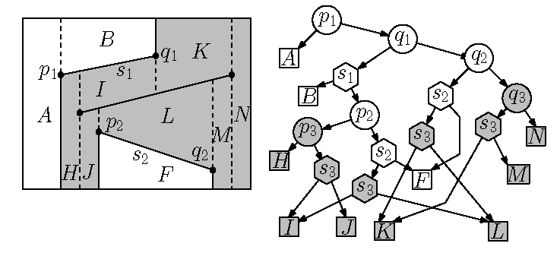
Inserting a Segment
Insert segment s₃.
←
→
←
→
s₃
q₃
↑
←
→
p₃
↓
↑
←
↓
→
↑
↓
←
→
←
→
q₃
↑
←
→
s₃
↓
↑
←
↓
←
→
p₃
←
→
→
↑
↓
↑
↓
↑
↓
↑
↓
↓
↑

Slide 15
Analysis
Space: Expected O(n)
Size of data structure = number of trapezoids = O(n) in expectation, since an expected O(1) trapezoids are created during segment insertion
Query time: Expected O(log n)
Construction time: Expected O(n log n) follows from query time
Proof that the query time is expected O(log n):
Fix a query point Q.
Consider how Q moves through the trapezoidal map as it is being constructed as new segments are inserted.
Search complexity = number of trapezoids encountered by Q
s₃
s₃
Q

Slide 16
Query Time
Let Δ_{i} be the trapezoid containing Q after the insertion of ith segment.
If Δ_{i} = Δ_{i-1} then the insertion does not affect Q’s trapezoid (E.g., Q∈B).
If Δ_{i} ≠ Δ_{i-1} then the insertion deleted Q’s trapezoid, and Q needs to be located among the at most 4 new trapezoids.
Q could fall 3 levels in the DAG.
s₃
s₃
Q
?
?

Slide 17
Query Time
Let X_{i} be the # nodes on path created in iteration i, and let P_{i} be the probability that Q is in a new node in iteration i, i.e., Δ_{i} ≠ Δ_{i-1}
The expected search path length is $E\left(\sum_{i=1}^{n}{X_{i}}\right)=\sum_{i=1}^{n}{E\left(X_{i}\right) }≤\sum_{i=1}^{n}{3 P_{i}}$ by lin. of expectation and since Q can drop at most 3 levels.
Claim: P_{i} ≤ 4/i .
Backwards analysis: Consider deleting segments, instead of inserting.
Trapezoid Δ_{i} depends on ≤ 4 segments. The probability that the ith segment is one of these 4 is ≤ 4/i .
The expected search path length is at most
$\sum_{i=1}^{n}{3 P_{i}=\sum_{i=1}^{n}{3 \frac{4}{i}=12\sum_{i=1}^{n}{ \frac{1}{i}=Θ(log n)}}}$ Harmonic number
s₃
s₃

