Slide 1
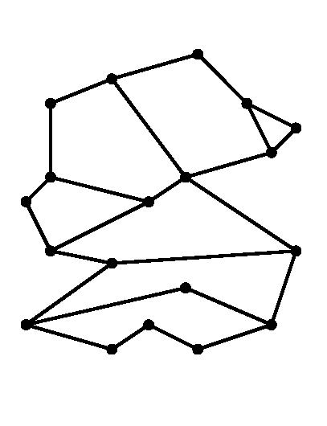

CMPS 3130/6130 Computational Geometry
Spring 2020
p
Planar Subdivisions and Point Location II
Carola Wenk
Based on:
Computational Geometry: Algorithms and Applications
and David Mount’s lecture notes

Slide 2
Kirkpatrick’s Point Location Algorithm
Needs a triangulation as input.
One can convert a planar subdivision with n vertices into a triangulation:
  Triangulate each face, keep same label as original face.
  If the outer face is not a triangle:
    Compute the convex hull of the subdivision.
    Triangulate pockets between the subdivision and the convex hull.
    Add a large triangle (new vertices
    a, b, c) around the convex hull, and triangulate the space in-between.
b
p
a
c
The size of the triangulated planar subdivision is still O(n), by Euler’s formula.
The conversion can be done in O(n log n) time.
Given p, if we find a triangle containing p we also know the (label of) the original subdivision face containing p.

Slide 3
Kirkpatrick’s Hierarchy
Compute a sequence T₀, T₁, …, T_{k} of increasingly coarser triangulations such that the last one has constant complexity.
The sequence T₀, T₁, …, T_{k} should have the following properties:
  T₀ is the input triangulation, T_{k} is the outer triangle
  k ∈ O(log n)
  Each triangle in T_{i+1} overlaps O(1) triangles in T_{i}
How to build such a sequence?
  Need to delete vertices from T_{i} .
  Vertex deletion creates holes, which need
  to be re-triangulated.
How do we go from T₀ of size O(n) to
T_{k} of size O(1) in k=O(log n) steps?
  In each step, delete a constant fraction
  of vertices from T_{i} .
We also need to ensure that each new triangle in T_{i+1} overlaps with only O(1) triangles in T_{i} .

Slide 4
Vertex Deletion and Independent Sets
When creating T_{i+1} from T_{i} , delete vertices from T_{i} that have the following properties:
  Constant degree:
  Each vertex v to be deleted has O(1) degree in the graph T_{i} .
    If v has degree d, the resulting hole can be re-triangulated with d-2 triangles
    Each new triangle in T_{i+1} overlaps at most d original triangles in T_{i}
  Independent sets:
  No two deleted vertices are adjacent.
    Each hole can be re-triangulated independently.

Slide 5
Independent Set Lemma
Lemma: Every triangulated planar graph on n≥4 vertices for contains an independent vertex set of size n/18 in which each vertex has degree at most 8. Such a set can be computed in O(n) time.
Use this lemma to construct Kirkpatrick’s hierarchy:
Start with T₀, and select an independent set S of size n/18 in which each vertex has maximum degree 8. [Never pick the outer triangle vertices a, b, c.]
Remove vertices of S, and re-triangulate holes.
The resulting triangulation, T₁, has at most 17/18n vertices.
Repeat the process to build the hierarchy, until T_{k} equals the outer triangle with vertices a, b, c.
The depth of the hierarchy is k = log_{18/17} n
b
a
c

Slide 6
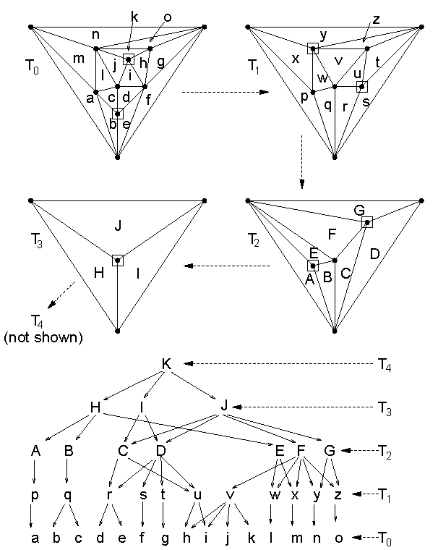
Hierarchy Example
Use this lemma to construct Kirkpatrick’s hierarchy:
Start with T₀, and select an independent set S of size n/18 in which each vertex has maximum degree 8. [Never pick the outer triangle vertices a, b, c.]
Remove vertices of S, and re-triangulate holes.
The resulting triangulation, T₁, has at most 17/18n vertices.
Repeat the process to build the hierarchy, until T_{k} equals the outer triangle with vertices a, b, c.
The depth of the hierarchy is
k = log_{18/17} n

Slide 7
Hierarchy Data Structure
Store the hierarchy as a DAG:
The root is T_{k} .
Nodes in each level correspond to triangles T_{i} .
Each node for a triangle in T_{i+1} stores pointers to all triangles of T_{i} that it overlaps.
How to locate point p in the DAG:
Start at the root. If p is outside of T_{k} then p is in exterior face; done.
Else, set Δ to be the triangle at the current level that contains p.
Check each of the at most 6 = 8-2 triangles of T_{k-1} that overlap with Δ, whether they contain p. Update Δ and descend in the hierarchy until reaching T₀ .
Output Δ .
p

Slide 8
Analysis
Query time is O(log n): There are O(log n) levels and it takes constant time to move between levels.
Space complexity is O(n):
  Sum up sizes of all triangulations in hierarchy.
  Because of Euler’s formula, it suffices to sum up the number of vertices.
  Total number of vertices:
  n + 17/18 n + (17/18)² n + (17/18)³ n + …
  ≤ 1/(1-17/18) n = 18 n
Preprocessing time is O(n log n):
  Triangulating the subdivision takes O(n log n) time.
  The time to build the DAG is proportional to its size.
p
8

Slide 9
Independent Set Lemma
Lemma: Every triangulated planar graph on n≥4 vertices contains an independent vertex set of size n/18 in which each vertex has degree at most 8. Such a set can be computed in O(n) time.
Proof:
Greedy algorithm to construct an independent set:
Mark all vertices of degree ≥ 9
While there is an unmarked vertex
  Let v be an unmarked vertex
  Add v to the independent set
  Mark v and all its neighbors
Can be implemented in O(n) time: Keep list of unmarked vertices, and store the triangulation in a data structure (DCEL) that allows finding neighbors in O(1) time.
v

Slide 10
Independent Set Lemma
Still need to prove existence of a large independent set.
Euler’s formula for a triangulated planar graph on n vertices:
#edges = 3n – 6
Sum over vertex degrees:
Σ deg(v) = 2 #edges = 6n – 12 < 6n
Claim: At least n/2 vertices have degree ≤ 8.
Proof: By contradiction. So, suppose otherwise.
→ n/2 vertices have degree ≥ 9. The remaining have degree ≥ 3.
→ The sum of the degrees is ≥ 9 n/2 + 3 n/2 = 6n. Contradiction.
In the beginning of the algorithm, at least n/2 nodes are unmarked. Each picked vertex v marks ≤ 8 other vertices, so including itself 9.
Therefore, the while loop can be repeated at least n/18 times.
This shows that there is an independent set of size at least n/18 in which each node has degree ≤ 8.
v

Slide 11
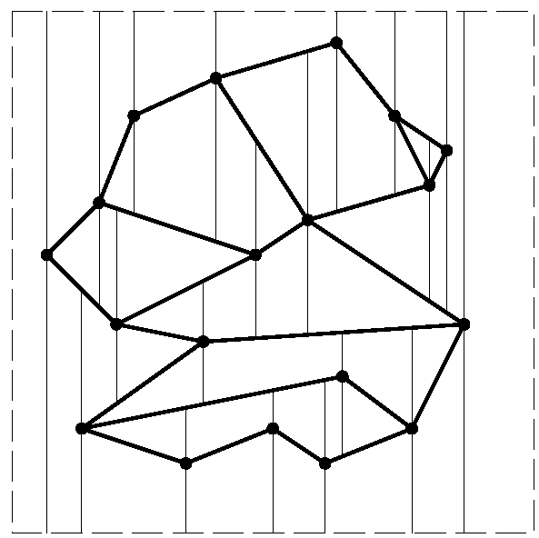
Summing Up
Kirkpatrick’s point location data structure needs O(n log n) preprocessing time, O(n) space, and has O(log n) query time.
It involves high constant factors though.
Next we will discuss a randomized point location scheme (based on trapezoidal maps) which is more efficient in practice.

