Slide 1
CMPS 3130/6130 Computational Geometry Spring 2020
p
Planar Subdivisions and Point Location I
Carola Wenk
Based on: Computational Geometry: Algorithms and Applications and David Mount’s lecture notes

Slide 2
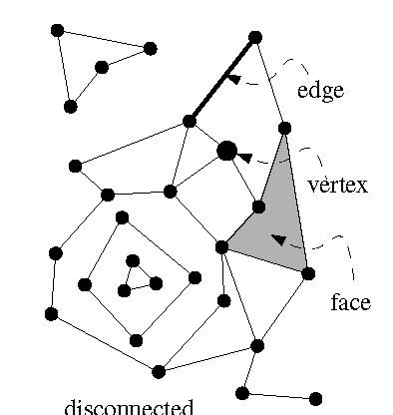
Planar Subdivision
Let G=(V,E) be an undirected graph.
G is planar if it can be embedded in the plane without edge crossings.
planar
K₅, not planar
K_{3,3}, not planar
A planar embedding (=drawing) of a planar graph G induces a planar subdivision consisting of vertices, edges, and faces.

Slide 3
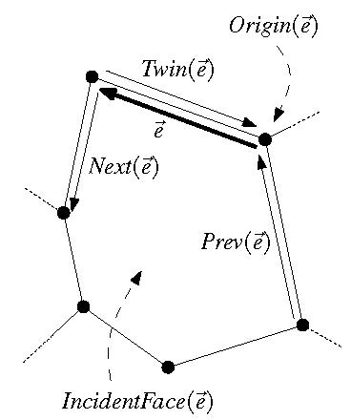
Doubly-Connected Edge List
The doubly-connected edge list (DCEL) is a popular data structure to store the geometric and topological information of a planar subdivision.
It contains records for each face, edge, vertex
(Each record might also store additional application-dependent attribute information.)
It should enable us to perform basic operations needed in algorithms, such as walk around a face, or walk from one face to a neighboring face
The DCEL consists of:
For each vertex v, its coordinates are stored in Coordinates(v) and a pointer IncidentEdge(v) to a half-edge that has v as its origin.
Two oriented half-edges per edge, one in each direction. These are called twins. Each of them has an origin and a destination. Each half-edge e stores a pointer Origin(e), a pointer Twin(e), a pointer IncidentFace(e) to the face that it bounds (on its left), and pointers Next (e) and Prev(e) to the next and previous half-edge on the boundary of IncidentFace(e).
For each face f, OuterComponent(f) is a pointer to some half-edge on its outer boundary (null for unbounded faces). It also stores a list InnerComponents(f) which contains for each hole in the face a pointer to some half-edge on the boundary of the hole.

Slide 4
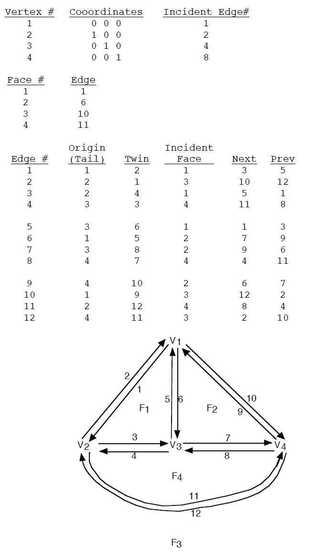
Doubly-Connected Edge List
For each vertex v, its coordinates are stored in Coordinates(v) and a pointer IncidentEdge(v) to a half-edge that has v as its origin.
Two oriented half-edges per edge, one in each direction. These are called twins. Each of them has an origin and a destination. Each half-edge e stores a pointer Origin(e), a pointer Twin(e), a pointer IncidentFace(e) to the face that it bounds (on its left), and pointers Next (e) and Prev(e) to the next and previous half-edge on the boundary of IncidentFace(e).
For each face f, OuterComponent(f) is a pointer to some half-edge on its outer boundary (null for unbounded faces). It also stores a list InnerComponents(f) which contains for each hole in the face a pointer to some half-edge on the boundary of the hole.
(OuterComponent)
DCEL example from: http://ranger.uta.edu/~weems/NOTES5319/DCEL.pdf

Slide 5
Complexity of a Planar Subdivision
The complexity of a planar subdivision is: #vertices + #edges + #faces = n_{v} + n_{e} + n_{f}
Euler’s formula for planar (embedded) graphs:
n_{v} - n_{e} + n_{f} ≥ 2
n_{e} ≤ 3n_{v} – 6
2) follows from 1):
Count edges. Every face is bounded by ≥ 3 edges.
Every edge bounds ≤ 2 faces.
⇒ 3n_{f} ≤ 2n_{e} ⇒ n_{f} ≤ 2/3n_{e}
⇒ 2 ≤ n_{v} - n_{e} + n_{f} ≤ n_{v} - n_{e} + 2/3 n_{e} = n_{v} – 1/3 n_{e}
⇒ 2 ≤ n_{v} – 1/3 n_{e}
Hence, the complexity of a planar subdivision is O(n_{v}), i.e., linear in the number of vertices.

Slide 6
Euler’s Formula
Theorem: For any planar (embedded) graph with n_{v} ≥ 1 vertices, n_{e} edges, and n_{f} faces holds: n_{v} - n_{e} + n_{f} ≥ 2
Proof: Induction on n_{e}.
Base cases: n_{e} = 0. Then n_{f} = 1. Therefore n_{v} ≥ 1 ⇔ n_{v} - 0 + 1 ≥ 2 . n_{e} = 1. Then n_{f} = 1 and 2 ≤ n_{v} = n_{v} - 1 + 1 .
Inductive step: n_{e} → n_{e}+1=: $n_{e}^{′}$
Consider G’ with $n_{v}^{′}$, $n_{e}^{′}$, $n_{f}^{′}$. We will construct G with $n_{e}^{}=n_{e}^{′}−1$ edges by deleting one edge (with its vertices) from G’. Then we use the inductive hypothesis on G.
Case 1:
So, $n_{v}^{′}−n_{e}^{′}+n_{f}^{′}={(n}_{v}^{}+2)−\left(n_{e}^{}+1\right)+n_{f}^{}=n_{v}^{} −n_{e}^{}+n_{f}^{}+1≥2+1$ $≥2$.
n_{e} = 0
n_{e} = 1
G’
G
$$n_{e}^{}=n_{e}^{′}−1$$
$$n_{v}^{}=n_{v}^{′}−2 \\ n_{f}^{}=n_{f}^{′}$$
inductive hypothesis

Slide 7
Euler’s Formula
G’
G
Case 2:
So, $n_{v}^{′}−n_{e}^{′}+n_{f}^{′}=n_{v}^{}+1 −\left(n_{e}^{}+1\right)+n_{f}^{}=n_{v}^{} −n_{e}^{}+n_{f}^{} ≥2$.
$$n_{e}^{}=n_{e}^{′}−1$$
$$n_{v}^{}=n_{v}^{′}−1 \\ n_{f}^{}=n_{f}^{′}$$
inductive hypothesis
G’
G
$$n_{e}^{}=n_{e}^{′}−1$$
$$n_{v}^{}=n_{v}^{′} \\ n_{f}^{}=n_{f}^{′}−1$$
Case 3:
So, $n_{v}^{′}−n_{e}^{′}+n_{f}^{′}=n_{v}^{}−\left(n_{e}^{}+1\right)+(n_{f}^{}+1)=n_{v}^{} −n_{e}^{}+n_{f}^{} ≥2$.
inductive hypothesis

Slide 8
Point Location
Point location task: Preprocess a planar subdivision to efficiently answer point-location queries of the type: Given a point p=(p_{x},p_{y}), find the face it lies in.
p
Important metrics:
Time complexity for preprocessing = time to construct the data structure
Space needed to store the data structure
Time complexity for querying the data structure

Slide 9
Slab Method
Slab method: Draw a vertical line through each vertex. This decomposes the plane into slabs.
p
p
p
In each slab, the vertical order of the line segments remains constant.
If we know in which slab p lies, we can perform binary search, using the sorted order of the segments in the slab.
Find slab that contains p by binary search on x among slab boundaries.
A second binary search in thr slab determines the face containing p.
Search complexity O(log n), but space complexity O(n²) .

