Slide 1
CMPS 3130/6130 Computational Geometry
Spring 2020
Plane Sweep Algorithms
Carola Wenk

Slide 2
Closest Pair
Problem: Given P⊆R², |P|=n, find the distance between the closest pair in P
Naïve algorithm: Check all pairs of points in time O(n²)

Slide 3
Plane Sweep: An Algorithm Design Technique
Simulate sweeping a vertical line from left to right across the plane.
Maintain cleanliness property: At any point in time, to the left of the sweep line everything is clean, i.e., properly processed.
Sweep line status: Store information along the sweep line
Events: Discrete points in time when the sweep line status needs to be updated

Slide 4
Plane Sweep: An Algorithm Design Technique
Simulate sweeping a vertical line from left to right across the plane.
Maintain cleanliness property: At any point in time, to the left of the sweep line everything is clean, i.e., properly processed.
Sweep line status: Store information along the sweep line
Events: Discrete points in time when the sweep line status needs to be updated
Algorithm Generic_Plane_Sweep:
Initialize sweep line status S at time x=-∞
Store initial events in event queue Q, a priority queue ordered by x-coordinate
while Q ≠ ∅
// extract next event e:
e = Q.extractMin();
// handle event:
Update sweep line status
Discover new upcoming events and insert them into Q

Slide 5
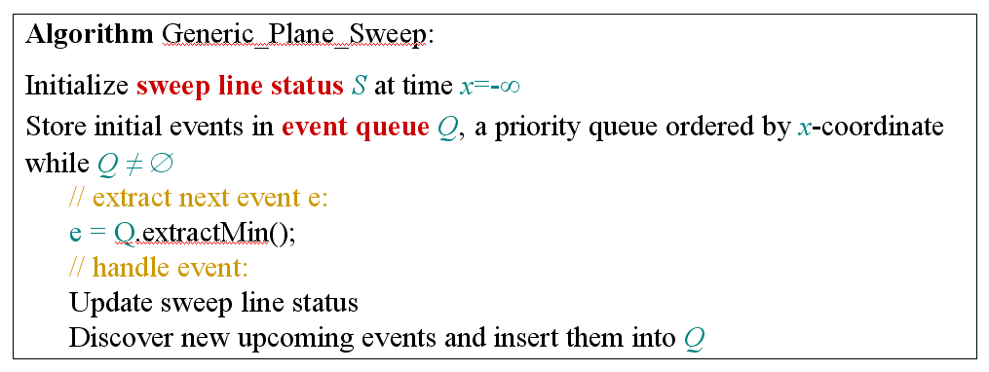
Plane Sweep for
Closest Pair
Problem: Given P⊆R², |P|=n, find the distance of the closest pair in P
Sweep line status:
  Store current distance Δ of closest pair of points to the left of the sweep line
  Store points in the Δ-strip left of the sweep line
  Store pointer to the leftmost point in the strip
Events: All points in P. No new events will be added during the sweep.
→ Presort P by x-coordinate.
Cleanliness property

Slide 6
Plane Sweep for
Closest Pair
O(n log n)
Presort P by x-coordinate
How to store points in Δ-strip?
  Store points in Δ-strip left of sweep line in a balanced binary search tree, ordered by y-coordinate
  → Add point, delete point, and search in O(log n) time
Event handling:
  New event: Sweep line advances to point p∈P
  Update sweep line status:
    Delete points outside Δ-strip from search tree by using previous leftmost point in strip and x-order on P
    Compute candidate points that may have distance ≤ Δ from p:
      Perform a search in the search tree to find points in Δ–strip whose y-coordinates are at most Δ away from p.y.
      → Δ x 2Δ rectangle
      Because of the cleanliness property each pair of points to the left of the previous sweep line has distance ≥Δ.
      → A Δ x 2Δ rectangle can contain at most 6 such points.
    Check distance of these points to p, and possibly update Δ
  No new events necessary to discover
O(n log n) total
1
2
O(n log n + 6n) total
O(6n) total
3
Δ
Total runtime: O(n log n)
Δ
Δ

Slide 7
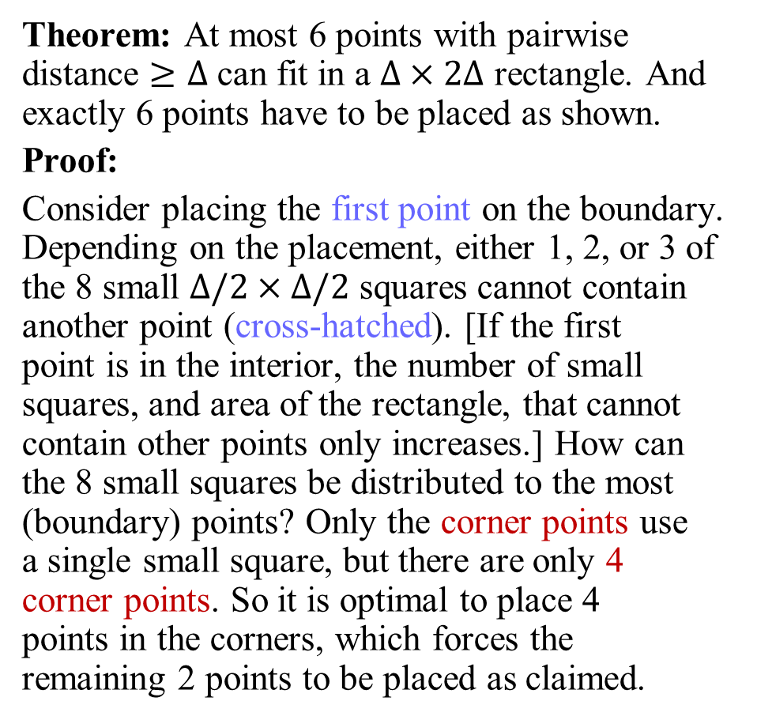
Six Points
Theorem: At most 6 points with pairwise distance $≥Δ$ can fit in a $Δ×2Δ$ rectangle. And exactly 6 points have to be placed as shown.
Proof:
Consider placing the first point on the boundary. Depending on the placement, either 1, 2, or 3 of the 8 small $Δ/2×Δ/2$ squares cannot contain another point (cross-hatched). [If the first
point is in the interior, the number of small squares, and area of the rectangle, that cannot contain other points only increases.] How can the 8 small squares be distributed to the most (boundary) points? Only the corner points use
a single small square, but there are only 4
corner points. So it is optimal to place 4
points in the corners, which forces the remaining 2 points to be placed as claimed.
Δ
<Δ
Δ
Δ
Δ
Δ
<Δ
<Δ
Δ
Δ
Δ
Δ
Δ
Δ
<Δ
<Δ
Δ
Δ
Δ
Δ

Slide 8
Balanced Binary Search Tree
-- a bit different
1
17
43
6
8
12
14
26
35
41
42
59
61
key[x] is the maximum key of any leaf in the left subtree of x.

Slide 9
Balanced Binary Search Tree
-- a bit different
x
17
≤ x
> x
8
42
1
14
35
43
1
6
12
17
26
41
43
59
6
8
12
14
26
35
41
42
59
61
key[x] is the maximum key of any leaf in the left subtree of x.

Slide 10
Balanced Binary Search Tree
-- a bit different
x
17
≤ x
> x
8
42
1
14
14
35
43
6
12
12
17
17
26
1
26
41
43
59
6
8
8
12
12
14
14
26
26
35
35
41
41
42
59
61
RANGE-QUERY([7, 41])

Slide 11
General 1D range query
root
split node

Slide 12
Plane Sweep for
Closest Pair
O(n log n)
Presort P by x-coordinate
How to store points in Δ-strip?
  Store points in Δ-strip left of sweep line in a balanced binary search tree, ordered by y-coordinate
  → Add point, delete point, and search in O(log n) time
Event handling:
  New event: Sweep line advances to point p∈P
  Update sweep line status:
    Delete points outside Δ-strip from search tree by using previous leftmost point in strip and x-order on P
    Compute candidate points that may have distance ≤ Δ from p:
      Perform a search in the search tree to find points in Δ–strip whose y-coordinates are at most Δ away from p.y.
      → Δ x 2Δ rectangle
      Because of the cleanliness property each pair of points to the left of the previous sweep line has distance ≥Δ.
      → A Δ x 2Δ rectangle can contain at most 6 such points.
    Check distance of these points to p, and possibly update Δ
  No new events necessary to discover
O(n log n) total
1
2
O(n log n + 6n) total
O(6n) total
3
Δ
Total runtime: O(n log n)
Δ
Δ

Slide 13
Plane Sweep: An Algorithm Design Technique
Plane sweep algorithms (also called sweep line algorithms) are a special kind of incremental algorithms
Their correctness follows inductively by maintaining the cleanliness property
Common runtimes in the plane are O(n log n):
  n events are processed
  Update of sweep line status takes O(log n)
  Update of event queue: O(log n) per event

Slide 14
Geometric Intersections
Important and basic problem in Computational Geometry
Solid modeling: Build shapes by applying set operations (intersection, union).
Robotics: Collision detection and avoidance
Geographic information systems: Overlay two subdivisions (e.g., road network and river network)
Computer graphics: Ray shooting to render scenes

Slide 15
Line Segment Intersection
Input: A set S={s₁, …, s_{n}} of (closed) line segments in R²
Output: All intersection points between segments in S

Slide 16
Line Segment Intersection
n line segments can intersect as few as 0 and as many as
=O(n²) times
Simple algorithm: Try out all pairs of line segments
→ Takes O(n²) time
→ Is optimal in the worst case
Challenge: Develop an output-sensitive algorithm
  Runtime depends on size k of the output
  Here: 0 ≤ k ≤ c n² , where c is a constant
  Our algorithm will have runtime: O( (n+k) log n)
  Best possible runtime: O(n log n + k)
  → O(n²) in worst case, but better in general
n
2

Slide 17
Complexity
Why is runtime O(n log n + k) optimal?
The element uniqueness problem requires Ω(n log n) time in algebraic decision tree model of computation (Ben-Or ’83)
Element uniqueness: Given n real numbers, are all of them distinct?
Solve element uniqueness using line segment intersection:
  Take n numbers, convert into vertical line segments. There is an intersection iff there are duplicate numbers.
  If we could solve line segment intersection in o(n log n) time, i.e., strictly faster than Θ(n log n), then element uniqueness could be solved faster. Contradiction.

Slide 18
Plane sweep algorithm
Cleanliness property:
  All intersections to the left of the sweep line l have been reported
Sweep line status:
  Store segments that intersect the sweep line l, ordered along the intersection with l .
Events:
  Points in time when sweep line status changes combinatorially (i.e., the order of segments intersecting l changes)
  → Endpoints of segments (insert in beginning)
  → Intersection points (compute on the fly during plane sweep)

Slide 19
General position
Assume that “nasty” special cases don’t happen:
  No line segment is vertical
  Two segments intersect in at most one point
  No three segments intersect in a common point

Slide 20
Event Queue
Need to keep events sorted:
  Lexicographic order (first by x-coordinate, and if two events have same x-coordinate then by y-coordinate)
Need to be able to remove next point, and insert new points in O(log n) time
Need to make sure not to process same event twice
Use a priority queue (heap), and possibly extract multiples
Or, use balanced binary search tree

Slide 21
Sweep Line Status
Store segments that intersect the sweep line l, ordered along the intersection with l.
Need to insert, delete, and find adjacent neighbor in O(log n) time
Use balanced binary search tree, storing the order in which segments intersect l in leaves
b
c
e
d
c
b
e
d

Slide 22
Event Handling
Left segment endpoint
  Add new segment to the sweep line status
  Test adjacent segments on the sweep line l for intersection with new segment (see Lemma)
  Add new intersection points to the event queue
b
c
a
e
d
c
b
d
c
b
e
d

Slide 23
Event Handling
2. Intersection point
  Report new intersection point
  Two segments change order along l
  → Test new adjacent segments for new intersection points (to insert into event queue)
b
c
a
e
d
Note: “new” intersection might have been already detected earlier.
c
b
e
d
c
e
b
d

Slide 24
Event Handling
3. Right segment endpoint
  Delete segment from sweep line status
  Two segments become adjacent. Check for intersection points (to insert in event queue)
b
c
a
e
d
e
c
b
d
e
c
d

Slide 25
Intersection Lemma
Lemma: Let s, s’ be two non-vertical segments whose interiors intersect in a single point p. Assume there is no third segment passing through p. Then there is an event point to the left of p where s and s’ become adjacent (and hence are tested for intersection).
Proof: Consider placement of sweep line infinitesimally left of p. Segments s and s’ are adjacent along sweep line. Hence there must have been a previous event point where s and s’ become adjacent.
s’
p
s

Slide 26
Runtime
Sweep line status updates: O(log n)
Event queue operations: O(log n), as the total number of stored events is ≤ 2n + k, and each operation takes time
O(log(2n+k)) = O(log n²) = O(log n)
There are O(n+k) events. Hence the total runtime is O((n+k) log n)
k = O(n²)

