Slide 1
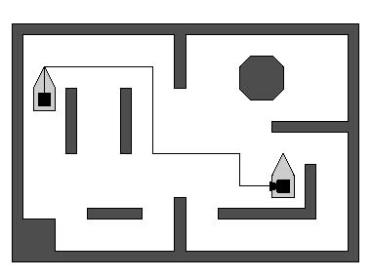
CMPS 3130/6130 Computational Geometry
Spring 2020
Motion Planning
Carola Wenk

Slide 2
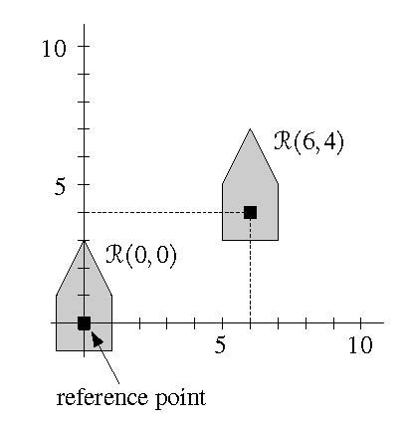
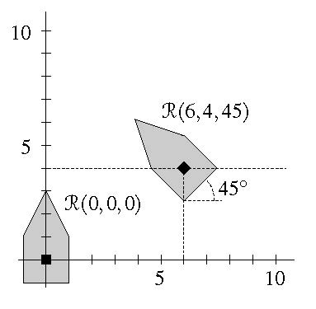
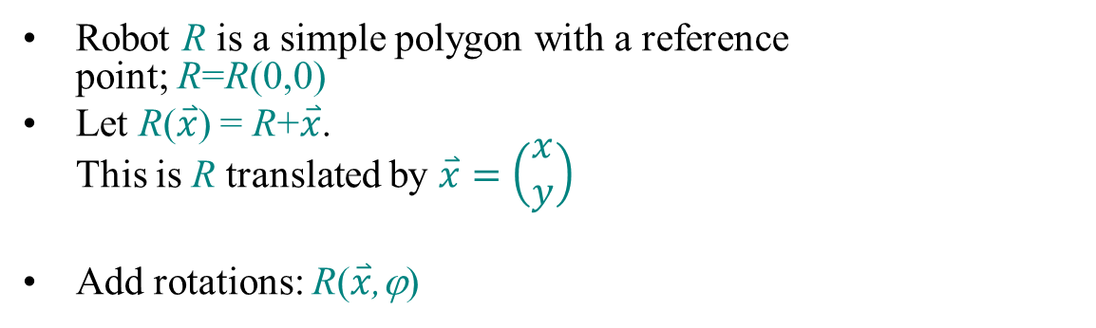
Robot motion planning
Given: A floor plan (2d polygonal region with obstacles), and a robot (2D simple polygon)
Task: Find a collision-free path from start to end
Robot R is a simple polygon with a reference
point; R=R(0,0)
Let R($\overset{⃑}{x}$) = R+$\overset{⃑}{x}$.
This is R translated by $\overset{⃑}{x}=\left(\begin{aligned}x \\ y\end{aligned}\right)$
Add rotations: R($\overset{⃑}{x}$,ϕ)

Slide 3
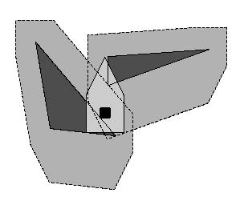
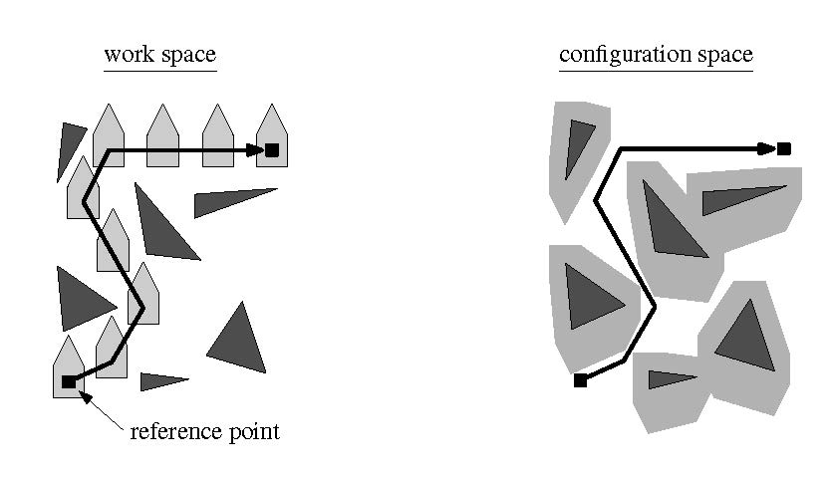
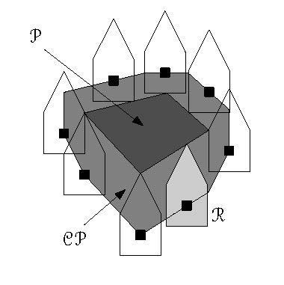
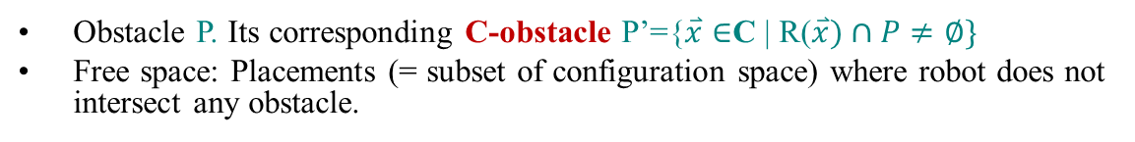
Configuration space
# parameters = degrees of freedom (DOF)
Parameter space = “Configuration space” C:
  2D translations: configuration space is C = R²
  2D translations and rotations: configuration space is C = R² x [0,2π)
space of translations
P’
Obstacle P. Its corresponding C-obstacle P’={$\overset{⃑}{x}∈$C | R($\overset{⃑}{x})∩P≠∅\}$
Free space: Placements (= subset of configuration space) where robot does not intersect any obstacle.

Slide 4
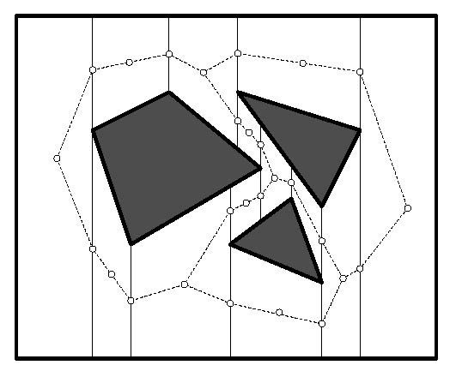
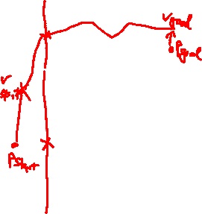
Translating a point robot
Work space = configuration space
Compute trapezoidal map of disjoint polygonal obstacles in O(n log n) expected time (where n = total # edges), including point location data structure
Construct road map in trapezoidal map:
  One vertex on each vertical edge
  One vertex in center of each trapezoid
  Edges between center-vertex and
  edge-vertex of same trapezoid
  O(n) time and space

Slide 5
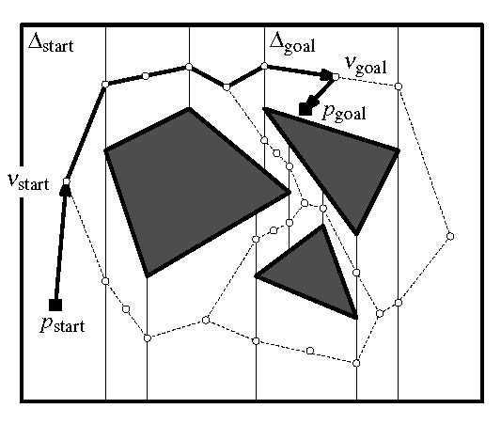
Translating a point robot
Work space = configuration space
Compute trapezoidal map of disjoint polygonal obstacles in O(n log n) expected time (where n = total # edges), including point location data structure
Construct road map in trapezoidal map:
  One vertex on each vertical edge
  One vertex in center of each trapezoid
  Edges between center-vertex and
  edge-vertex of same trapezoid
  O(n) time and space
Compute path:
  Locate trapezoids containing start and end
  Traverse this road map using DFS or BFS to
  find path from start to end
Theorem: One can preprocess a set of obstacles (with n = total # edges) in O(n log n) expected time, such that for any (start/end) query a collision-free path can be computed in O(n) time.

Slide 6
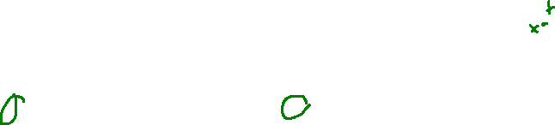
Configuration space
# parameters = degrees of freedom (DOF)
Parameter space = “Configuration space” C:
  2D translations: configuration space is C = R²
  2D translations and rotations: configuration space is C = R² x [0,2π)
space of translations
P’
Obstacle P. Its corresponding C-obstacle P’={$\overset{⃑}{x}∈$C | R($\overset{⃑}{x})∩P≠∅\}$
Free space: Placements (= subset of configuration space) where robot does not intersect any obstacle.

Slide 7
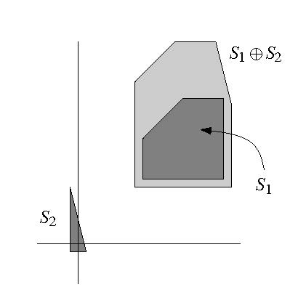
Minkowski sums
space of translations
P’

Slide 8
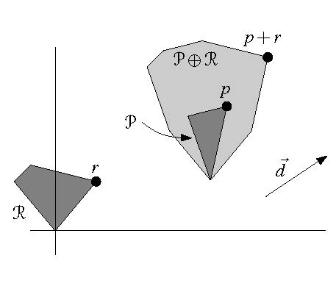
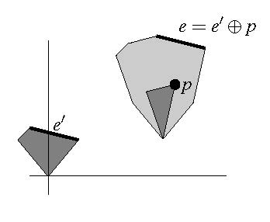



Extreme points
$$\vec{d}$$
$$\vec{d}$$
$$\vec{d}$$

Slide 9

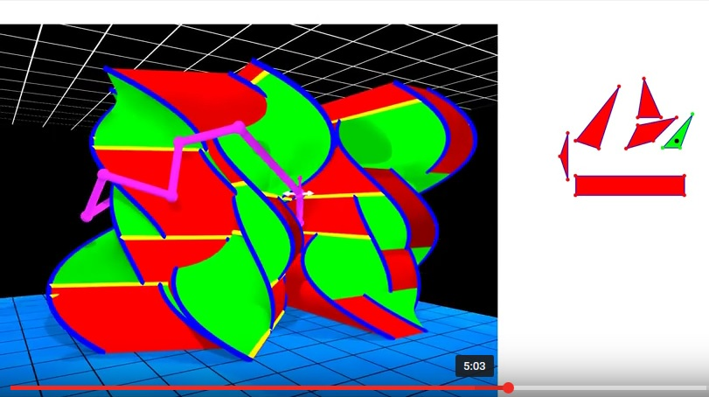
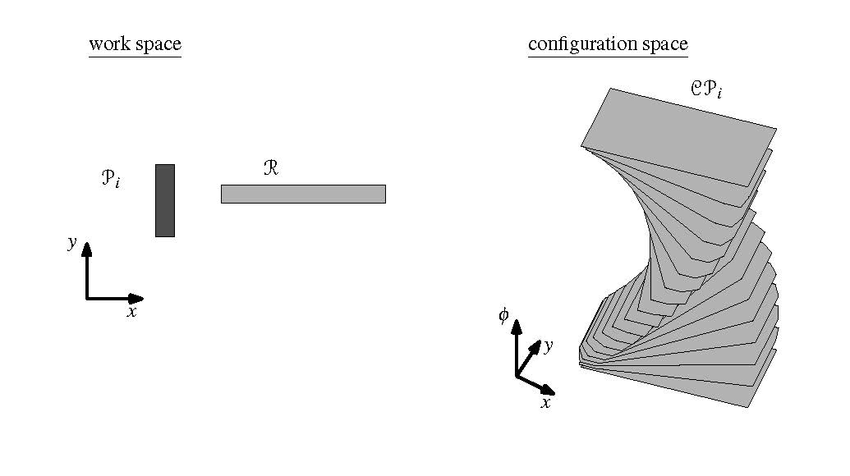
Configuration space with translations and rotations
D. Ataria, G. Rote, “Configuration Space Visualization”,
Symposium on Computational Geometry, 2012

Slide 10
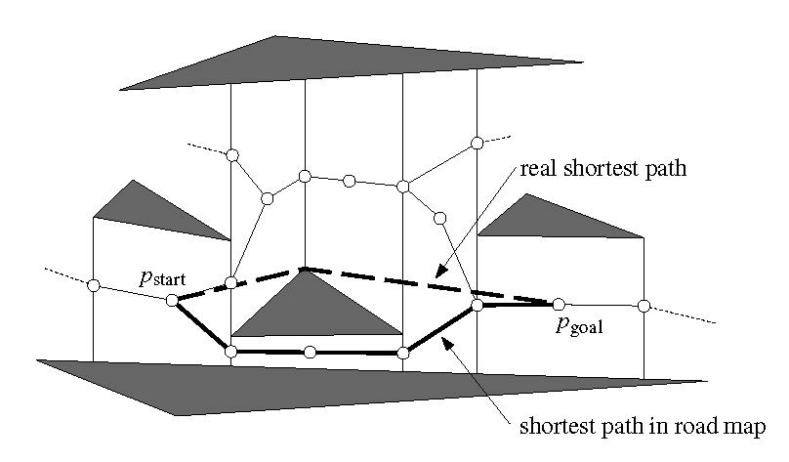
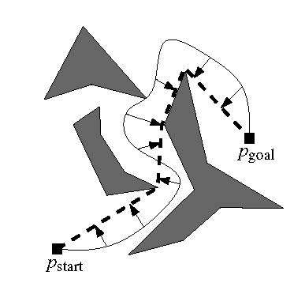
Shortest path for a robot
Pull rubber band tight:

Slide 11
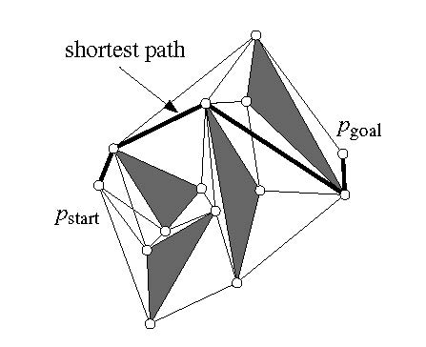
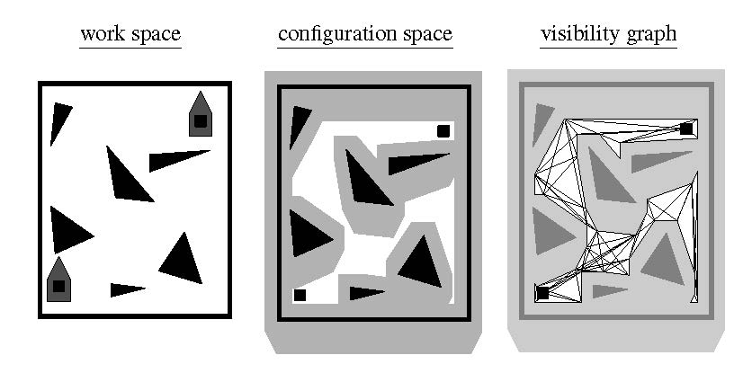
Visibility graph

