Slide 1
CMPS 3130/6130 Computational Geometry
Spring 2020
Windowing
Carola Wenk

Slide 2
Windowing
Input: A set S of n line segments in the plane
Query: Report all segments in S that
intersect a given query window
Subproblem: Process a set of intervals on the line
into a data structure which supports queries of the
type: Report all intervals that contain a query point.
Interval trees
Segment trees

Slide 3
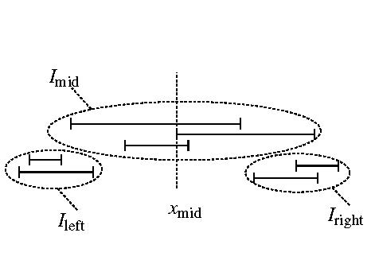
Interval Trees
Input: A set I of n intervals on the line.
.
.
disjoint union
Idea: Partition I into I_{left}∪ I_{mid} ∪ I_{right} where x_{mid} is the median of the 2n endpoints.
Store I_{mid} twice as two lists of intervals: L_{left} sorted by left endpoint and as L_{right} sorted by right endpoint.
I_{mid} stored as
L_{left} , L_{right}
interval
tree for
I_{left}
interval
tree for
I_{right}

Slide 4
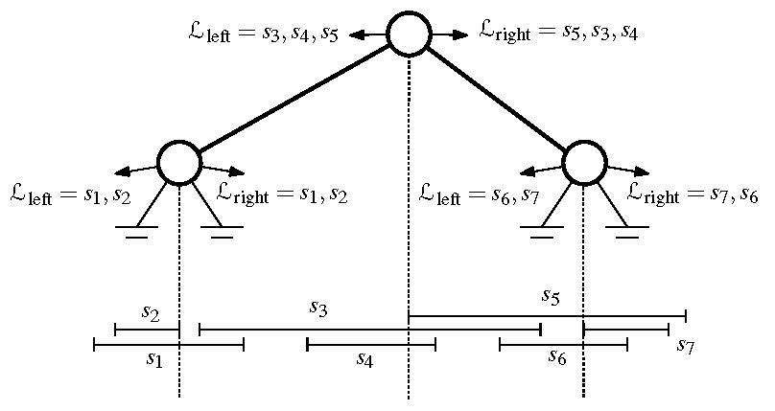
Interval Trees
Lemma: An interval tree on a set of n intervals uses O(n) space and has height O(log n). It can be constructed recursively in O(n log n). time.
Proof: Each interval is stored in a set I_{mid} only once, hence O(n) space. In the worst case half the intervals are to the left and right each of x_{mid}, hence the height is O(log n). Constructing the (sorted) lists takes O(|I^{v}| + |I^{v}_{mid}| log |I^{v}_{mid}|) time per vertex v.

Slide 5
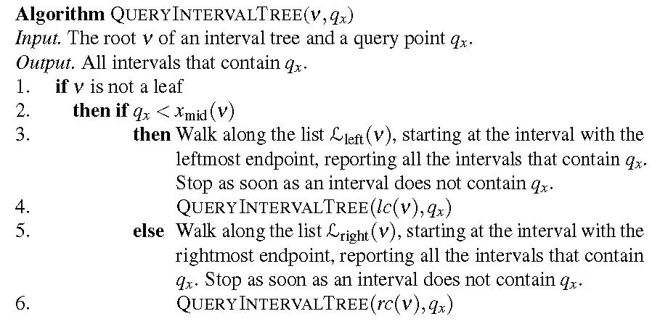
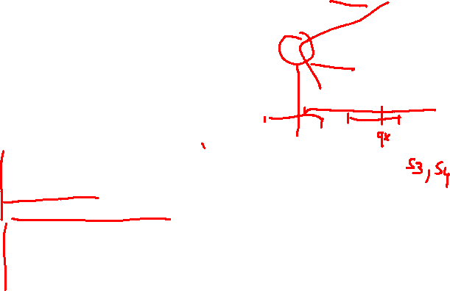
Interval Tree Query
Theorem: An interval tree on a set of n intervals can be constructed in O(n log n) time and uses O(n) space. All intervals that contain a query point can be reported in O(log n + k) time, where k = #reported intervals.
Proof: We spend O(1+k_{v}) time at vertex v, where k_{v} = #intervals reported at v. We visit at most 1 node at any depth.

Slide 6
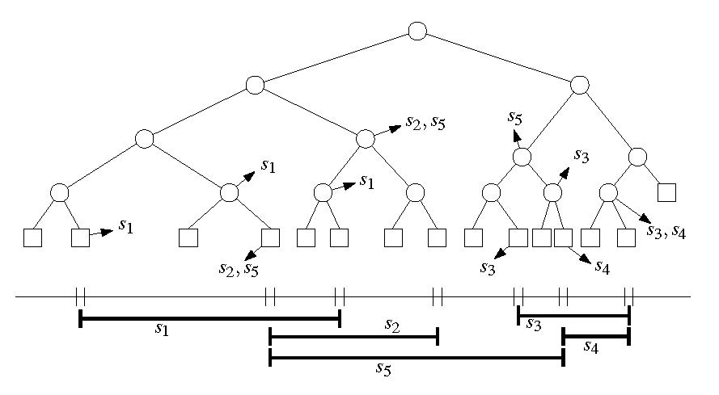
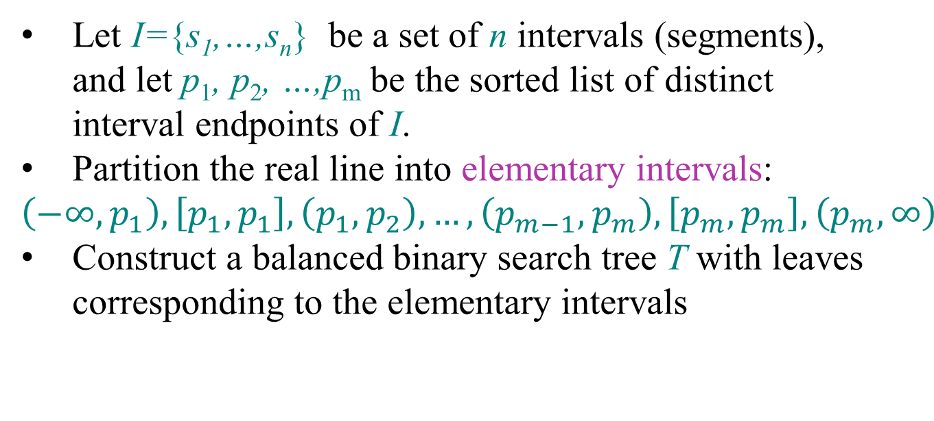
Segment Trees
Let I={s₁,…,s_{n}} be a set of n intervals (segments), and let p₁, p₂, …,p_{m} be the sorted list of distinct interval endpoints of I.
Partition the real line into elementary intervals:
$$\left(−∞,p_{1}\right),\left[p_{1},p_{1}\right],\left(p_{1},p_{2}\right),…,\left(p_{m−1},p_{m}\right),\left[p_{m},p_{m}\right],\left(p_{m},∞\right)$$
Construct a balanced binary search tree T with leaves corresponding to the elementary intervals
p₁
p₂
p₃
p₄
p₅
p₆
p₇

Slide 7
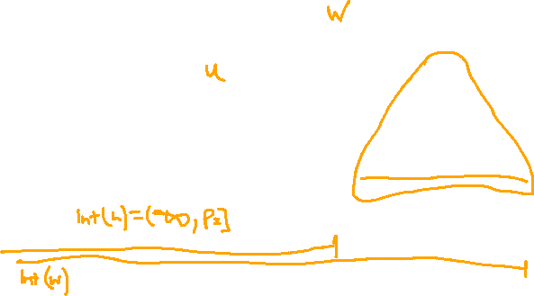
Elementary Intervals
Int(μ):=elementary interval corresponding to leaf μ
Int(v):=union of Int(μ) of all leaves in subtree rooted at v
v
Int(v)=(p₂, p₄]
p₁
p₂
p₃
p₄
p₅
p₆
p₇

Slide 8
Segment Trees
Store segments as high as possible
Each vertex v stores (1) Int(v) and (2) the canonical subset I(v)⊆I:
I(v):= {s∈I | Int(v) ⊆ s and Int(parent(v)) ⊄ s}
0
1
2
s₁
3
4
s₂
5
6
s₃
7
8
9
10
11
12
13
s₄
14
15
16
17
18
19
20
21
22
23
24
25
26
27
s₅
p₁
p₂
p₃
p₄
p₅
p₆
p₇

Slide 9
Segment Trees
Store segments as high as possible
Each vertex v stores (1) Int(v) and (2) the canonical subset I(v)⊆I:
I(v):= {s∈I | Int(v) ⊆ s and Int(parent(v)) ⊄ s}
0
1
2
3
4
5
6
7
8
9
10
11
12
13
14
15
16
17
18
19
20
21
22
23
24
25
26
27
p₁
p₂
p₃
p₄
p₅
p₆
p₇

Slide 10
Space
?
Lemma: A segment tree on n intervals uses __________ space.
p₁
p₂
p₃
p₄
p₅
p₆
p₇
Notes:
Poll: log n ,n, n log n, n^2

Slide 11
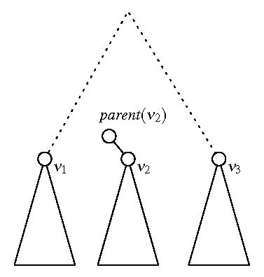
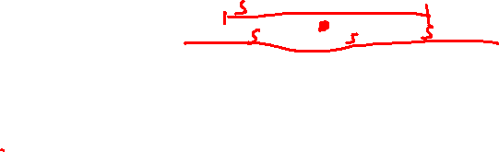
Space
Lemma: A segment tree on n intervals uses O(n log n) space.
Proof: Any interval s is stored in at most two sets I(v₁), I(v₂) for two different vertices v₁, v₂ at the
same level (depth) of T. [If s was stored in
I(v₃) for a third vertex v₃, then s would
have to span from left to right, and
Int(parent(v₂))⊆s, hence s is cannot be
stored in v₂.]
The tree is a balanced tree of height
O(log n).
s

Slide 12
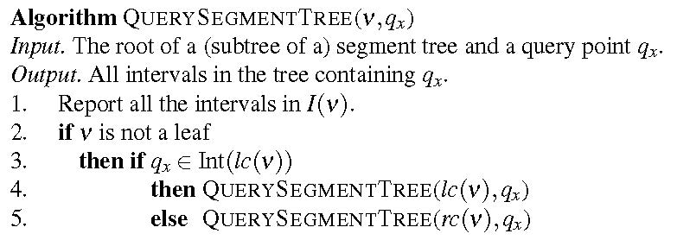
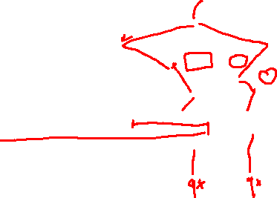
Segment Tree Query
Runtime Analysis:
Visit one node per level.
Spend O(1+k_{v}) time per node v.
⇒ Runtime____________
?
Notes:
Poll: log n, \sqrt{n}, n

Slide 13
Segment Tree Query
Runtime Analysis:
Visit one node per level.
Spend O(1+k_{v}) time per node v.
⇒ Runtime O(log n + k)

Slide 14
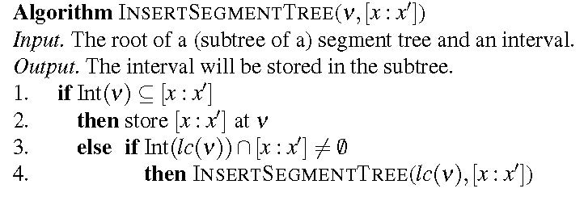
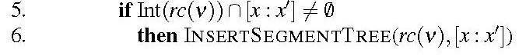
Segment Tree Construction
Sort interval endpoints of I. → elementary intervals
Construct balanced BST on elementary intervals.
Determine Int(v) bottom-up.
Compute canonical subsets by incrementally inserting intervals s=[x,x’]∈I into T using InsertSegmentTree:
O(n log n)
s )
s
s
s
s )
s
s )
Notes:
Example: s3

Slide 15
Segment Trees
Runtime:
Each interval stored at most twice per level
At most one node per level that contains the left endpoint of s (same with right endpoint)
Visit at most 4 nodes per level
O(log n) per interval, and O(n log n) total
Theorem: A segment tree for a set of n intervals can be built in O(n log n) time and uses O(n log n) space. All k intervals that contain a query point can be reported in O(log n + k) time.

Slide 16
2D Windowing Revisited
Input: A set S of n disjoint line segments in the plane
Task: Process S into a data structure such that all segments intersecting a
vertical query segment q:=q_{x} × [q_{y},q’_{y}]
can be reported efficiently.
q’_{y}
q_{y}
q_{x}

Slide 17
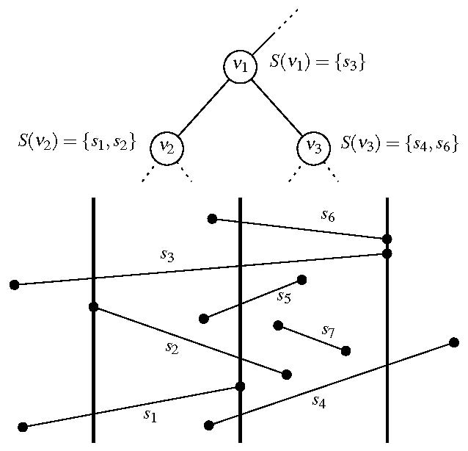
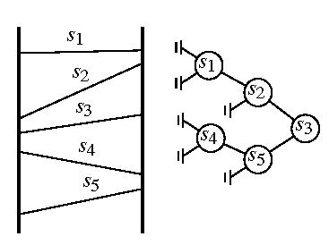
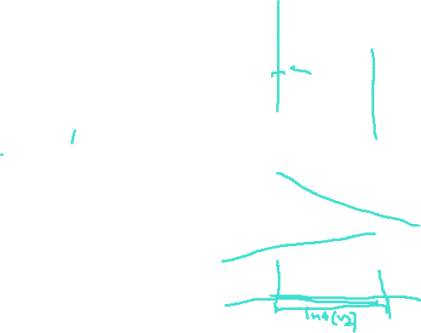
2D Windowing Revisited
Solution:
Segment tree with nested range tree
Build segment tree T based on x-intervals of segments in S.
→ each Int(v)≅ Int(v)×(-∞,∞)
vertical slab
I(v)≅S(v) canonical set of segments spanning vertical slab
Store S(v) in 1D range tree (binary search tree) T(v) based on vertical order of segments

Slide 18
2D Windowing Revisited
Query algorithm:
Search regularly for q_{x} in T
In every visited vertex v, report segments in T(v) between q_{y} and q’_{y} (1D range query)
⇒ O(log n + k_{v}) time for T(v)
O(log²n + k) total
q’_{y}
q_{y}
q’_{y}
q_{x}
T(v₂):
q_{y}
q’_{y}
s₂
s₂
s₁
q_{x}
q_{y}
s₁

Slide 19
2D Windowing Summary
Theorem: Let S be a set of (interior-) disjoint line segments in the plane. The segments intersecting a vertical query segment (or an axis-parallel rectangular query window) can be reported in O(log² n + k) time, with O(n log n) preprocessing time and O(n log n) space.
q’_{y}
q_{y}
q_{x}

