Slide 1
CMPS 3130/6130 Computational Geometry
Spring 2020
Orthogonal Range Searching II
Carola Wenk

Slide 2
Orthogonal range searching
Input: A set P of n points in d dimensions
Task: Process P into a data structure that allows fast orthogonal range queries. Given an axis-aligned box (in 2D, a rectangle)
  Report on the points inside the box:
    Are there any points?
    How many are there?
    List the points.

Slide 3
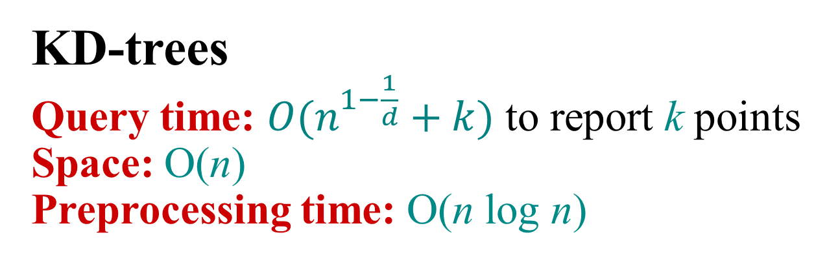
Summary Orthogonal Range Searching
Range trees
Query time: O(k + log^{d} n) to report k points
(or O(k + log^{d-1} n) using fractional cascading in the last dimension)
Space: O(n log^{d – 1} n)
Preprocessing time: O(n log^{d – 1} n)
KD-trees
Query time: $O(n^{1−\frac{1}{d}}+k)$ to report k points
Space: O(n)
Preprocessing time: O(n log n)

Slide 4
Orthogonal range searching: KD-trees
Let us start in 2D:
Input: A set P of n points in 2 dimensions
Task: Process P into a data structure that allows fast 2D orthogonal range queries:
Report all points in P that lie in the query rectangle [x,x’] × [y,y’]
y'
y
x
x'

Slide 5
KD trees
Idea: Recursively split P into two sets of the same size, alternatingly along a vertical or horizontal line through the median in x- or y-coordinates.
←
l₁
→
l₅
l₁
l₇
{p₁, p₂, p₃, p₄,p₅}
{p₆, p₇, p₈, p₉,p₁₀}
p₄
l₂
l₃
p₅
p₉
↓
↑
↓
↑
{p₁, p₂, p₃}
{p₄,p₅}
{p₆, p₇, p₈}
{p₉,p₁₀}
p₁₀
l₄
l₅
l₆
l₇
l₂
p₂
l₃
←
→
→
←
→
{p₁, p₂}
←
{p₆, p₇}
←
→
l₈
p₁
p₇
l₈
p₈
p₃
p₄
p₅
l₉
p₈
p₉
p₁₀
↓
↑
↓
↑
p₃
l₉
p₆
p₁
p₂
p₆
p₇
l₄
l₆

Slide 6
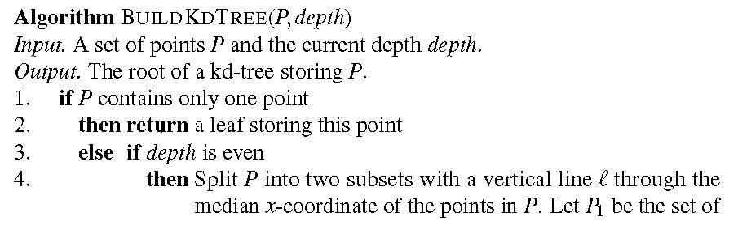
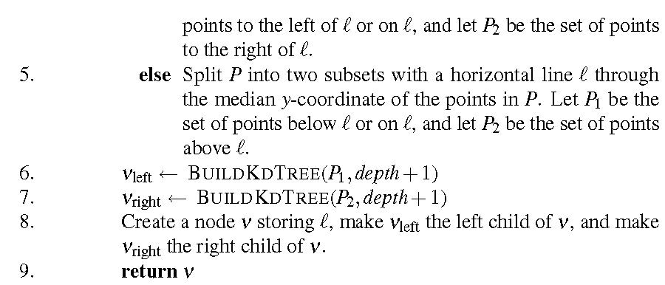
BuildKDTree
Idea: Recursively split P into two sets of the same size, alternatingly along a vertical or horizontal line through the median in x- or y-coordinates.
l₅
l₁
l₇
p₄
p₅
p₉
p₁₀
l₂
p₂
l₃
l₈
p₁
p₇
p₈
p₃
l₉
p₆
l₄
l₆
←
l₁
→
l₂
l₃
↓
↑
↓
↑
l₄
l₅
l₆
l₇
←
→
←
→
←
→
←
→
l₈
p₃
p₄
p₅
↓
l₉
p₈
p₉
p₁₀
↓
↑
↑
p₁
p₂
p₆
p₇
Notes:
Can do a poll here to ask what the first call is: BuildKdTree(P,0) or BuildKdTree(P,1) or BuildKdTree(P,n) where n=|P|

Slide 7
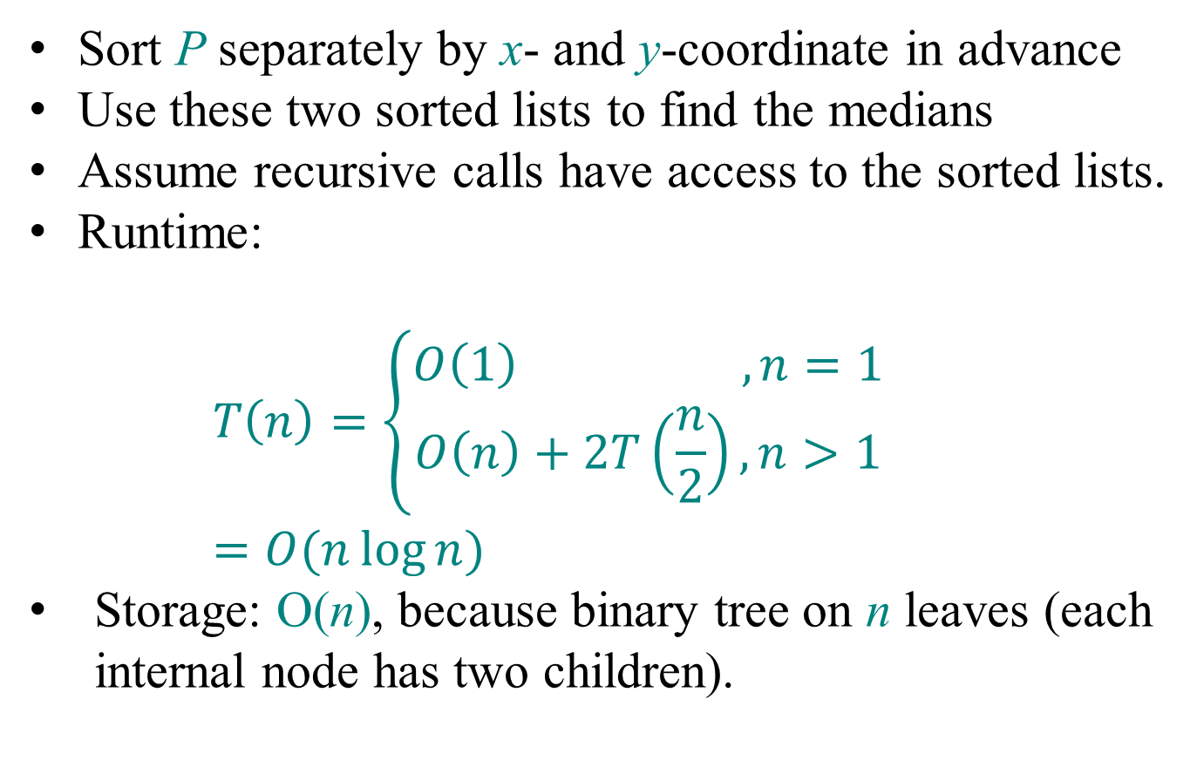
BuildKDTree Analysis
Sort P separately by x- and y-coordinate in advance
Use these two sorted lists to find the medians
Assume recursive calls have access to the sorted lists.
Runtime:
$$T\left(n\right)=\left\{\begin{aligned}O\left(1\right) ,n=1 \\ O\left(n\right)+2T\left(\frac{n}{2}\right), n>1\end{aligned}\right. \\ =O(n\log{n) }$$
Storage: O(n), because binary tree on n leaves (each internal node has two children).

Slide 8
Regions
l₁
←
→
l₅
l₁
l₇
l₂
l₃
p₄
p₉
p₅
↓
↑
↓
↑
v
p₁₀
l₄
l₅
l₆
l₇
l₂
p₂
l₃
←
→
←
→
←
→
←
→
l₈
p₇
p₁
p₈
l₈
p₃
p₄
p₅
l₉
p₈
p₉
p₁₀
p₃
↓
↑
l₉
↓
↑
p₆
p₁
p₂
p₆
p₇
l₄
l₆
region(v)

Slide 9
Regions
l₁
←
→
l₅
l₁
l₇
l₂
l₃
p₄
p₉
p₅
↓
↑
↓
↑
v
p₁₀
l₄
l₅
l₆
l₇
l₂
p₂
l₃
←
→
←
→
←
→
←
→
l₈
p₇
p₁
p₈
l₈
p₃
p₄
p₅
l₉
lc(v)
p₈
↓
p₉
p₁₀
p₃
l₉
↓
↑
↑
p₆
p₁
p₂
p₆
p₇
l₄
l₆
region(v)
region(lc(v))
lc(v)=left_child(v)
region(lc(v))=
Line stored in v
region(v)∩l(v)^{left}
Halfspace on the left
⇒ Can be computed on the fly in constant time

Slide 10
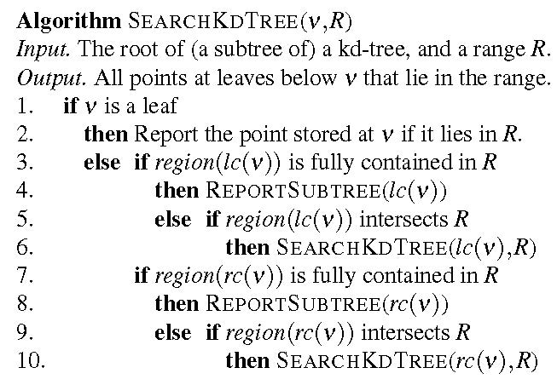
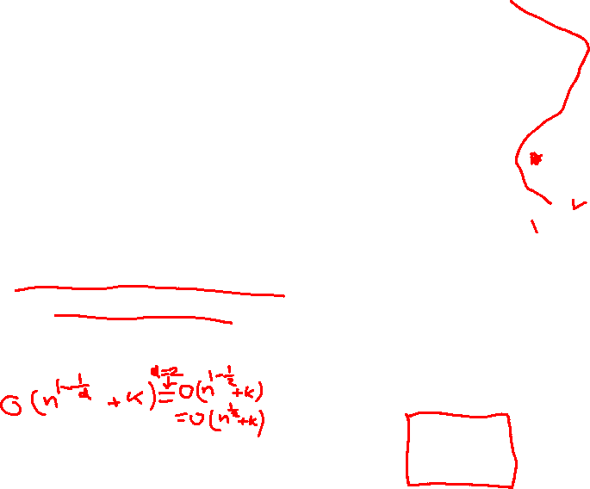
SearchKDTree
l₁
←
→
l₂
l₃
↓
↑
↓
↑
l₄
l₅
l₆
l₇
←
→
←
→
←
→
←
→
l₈
p₃
p₄
p₅
l₉
p₈
p₉
p₁₀
↓
↑
↓
↑
p₁
p₂
p₆
l₁₀
←
→
l₁₁
l₁₂
↓
↑
↓
↑
l₅
l₁
l₇
p₁₁
p₇
p₁₂
p₁₃
p₄
p₉
p₅
p₁₀
l₂
p₂
p₇
l₃
How many nodes does a search touch?
l₈
p₁
l₁₁
p₁₃
p₈
p₁₁
l₁₂
p₃
l₁₀
p₁₂
l₉
p₆
l₄
l₆

Slide 11
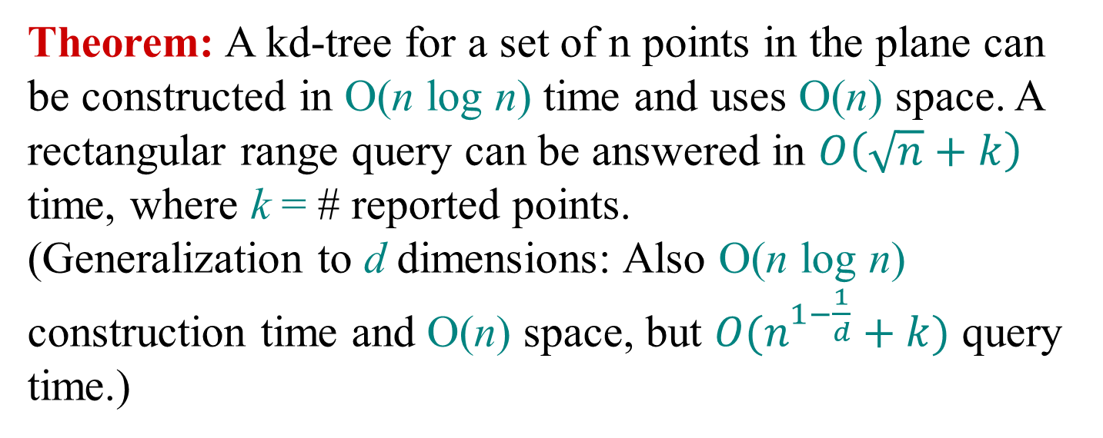
SearchKDTree Analysis
Theorem: A kd-tree for a set of n points in the plane can be constructed in O(n log n) time and uses O(n) space. A rectangular range query can be answered in $O\left(\sqrt{n}+k\right)$ time, where k = # reported points.
(Generalization to d dimensions: Also O(n log n) construction time and O(n) space, but $O(n^{1−\frac{1}{d}}+k)$ query time.)

Slide 12

SearchKDTree Analysis
Proof Sketch:
Sum of # visited vertices in ReportSubtree is O(k)
# visited vertices that are not in one of the reported subtrees = O(# regions(v) intersected by a query line)
Consider intersections with a vertical line only.
Let Q(n) = # intersected regions in kd-tree of n points whose root contains a vertical splitting line
Q(n) = 1 + 2Q(n/4), for n>1
upper bound
output size
=# points in R
l₃
l₁
l₁
←
→
l₂
l₂
↓
↑
↓
↑
l₃
l₄
l₄

Slide 13
Master Theorem
T(n) = a T(n/b) + f (n)
CASE 1:
f (n) = O(n^{logba – ε}) ⇒ T(n) = Θ(n^{logba})
for some ε>0
CASE 2:
f (n) = Θ(n^{logba} log^{k}n) ⇒ T(n) = Θ(n^{logba} log^{k+1}n)
for some k≥0
CASE 3:
(i) f (n) = Ω(n^{logba + ε})
for some ε>0 ⇒ T(n) = Θ( f (n))
and (ii) a f (n/b) ≤ c f (n)
for some c < 1

Slide 14
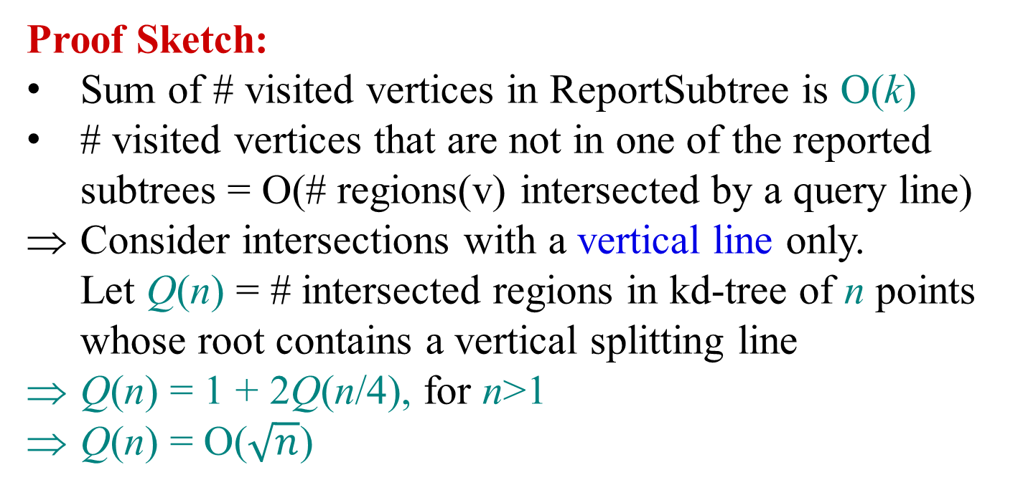
SearchKDTree Analysis
Proof Sketch:
Sum of # visited vertices in ReportSubtree is O(k)
# visited vertices that are not in one of the reported subtrees = O(# regions(v) intersected by a query line)
Consider intersections with a vertical line only.
Let Q(n) = # intersected regions in kd-tree of n points whose root contains a vertical splitting line
Q(n) = 1 + 2Q(n/4), for n>1
Q(n) = O($\sqrt{n}$)
upper bound
output size
=# points in R
l₃
l₁
l₁
←
→
l₂
l₂
↓
↑
↓
↑
l₃
l₄
l₄

Slide 15
Summary Orthogonal Range Searching
Range trees
Query time: O(k + log^{d} n) to report k points
(or O(k + log^{d-1} n) using fractional cascading in the last dimension)
Space: O(n log^{d – 1} n)
Preprocessing time: O(n log^{d – 1} n)
KD-trees
Query time: $O(n^{1−\frac{1}{d}}+k)$ to report k points
Space: O(n)
Preprocessing time: O(n log n)

