Slide 1
CMPS 3130/6130 Computational Geometry
Spring 2020
Orthogonal Range Searching I
Carola Wenk

Slide 2
Orthogonal range searching
Input: n points in d dimensions
  E.g., representing a database of n records
  each with d numeric fields
Query: Axis-aligned box (in 2D, a rectangle)
  Report on the points inside the box:
    Are there any points?
    How many are there?
    List the points.

Slide 3
Orthogonal range searching
Input: n points in d dimensions
Query: Axis-aligned box (in 2D, a rectangle)
  Report on the points inside the box
Goal: Preprocess points into a data structure
to support fast queries
  Primary goal: Static data structure
  In 1D, we will also obtain a
  dynamic data structure
  supporting insert and delete

Slide 4
1D range searching
In 1D, the query is an interval:
First solution:
  Sort the points and store them in an array
    Solve query by binary search on endpoints.
    Obtain a static structure that can list
    k answers in a query in O(k + log n) time.
Goal: Obtain a dynamic structure that can list
k answers in a query in O(k + log n) time.

Slide 5
1D range searching
In 1D, the query is an interval:
New solution that extends to higher dimensions:
  Balanced binary search tree
    New organization principle:
    Store points in the leaves of the tree.
    Internal nodes store copies of the leaves
    to satisfy binary search property:
      Node x stores in key[x] the maximum
      key of any leaf in the left subtree of x.

Slide 6
Example of a 1D range tree
1
17
43
6
8
12
14
26
35
41
42
59
61
key[x] is the maximum key of any leaf in the left subtree of x.

Slide 7
Example of a 1D range tree
Note: # internal nodes
= #leaves – 1 = n – 1
So, O(n) complexity.
x
17
≤ x
> x
8
42
1
14
35
43
1
6
12
17
26
41
43
59
6
8
12
14
26
35
41
42
59
61
key[x] is the maximum key of any leaf in the left subtree of x.

Slide 8
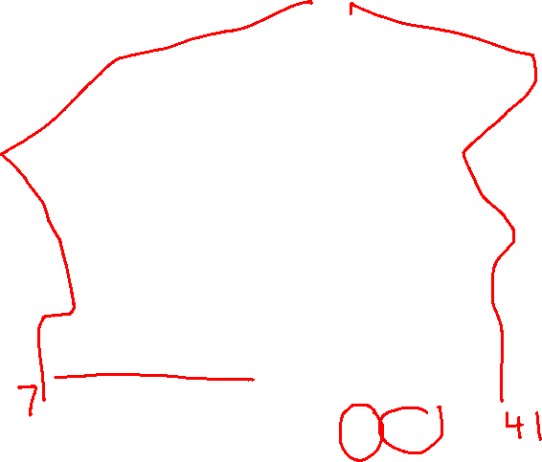

Example of a 1D range query
x
17
≤ x
> x
8
42
1
14
14
35
43
6
12
12
17
17
26
1
26
41
43
59
6
8
8
12
12
14
14
26
26
35
35
41
41
42
59
61
RANGE-QUERY([7, 41])

Slide 9
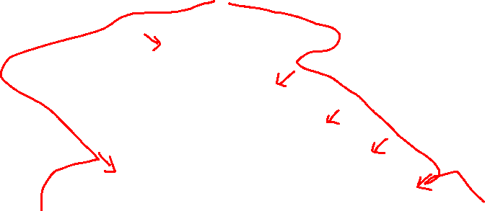
General 1D range query
root
split node

Slide 10
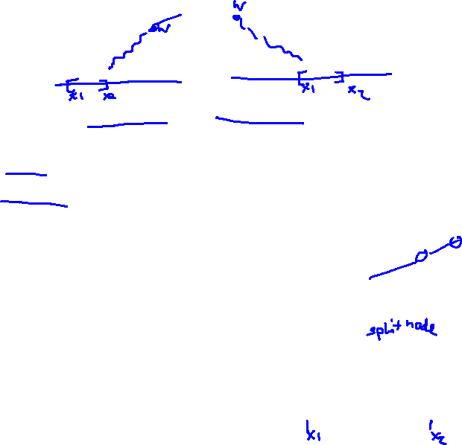
Pseudocode, part 1:
Find the split node
1D-RANGE-QUERY(T, [x₁, x₂])
  w ← T.root
  while w is not a leaf and (x₂ ≤ w.key or w.key < x₁)
    do if x₂ ≤ w.key
      then w ← w.left
      else w ← w.right
  // w is now the split node
  [traverse left and right from w and report relevant subtrees]
w

Slide 11

Pseudocode, part 2: Traverse left and right from split node
1D-RANGE-QUERY(T, [x₁, x₂])
  [find the split node]
  // w is now the split node
  if w is a leaf
  then output the leaf w if x₁ ≤ w.key ≤ x₂
  else v ← w.left // Left traversal
    while v is not a leaf
      do if x₁ ≤ v.key
      then output all leaves in the subtree rooted at v.right
      v ← v.left
      else v ← v.right
    output the leaf v if x₁ ≤ v.key ≤ x₂
    [symmetrically for right traversal]
w

Slide 12


Analysis of 1D-RANGE-QUERY
Query time: Answer to range query represented
by O(log n) subtrees found in O(log n) time.
Thus:
  Can test for points in interval in O(log n) time.
  Can report all k points in interval in
  O(k + log n) time.
  Can count points in interval in
  O(log n) time
Space: O(n)
Preprocessing time: O(n log n)

Slide 13
2D range trees

Slide 14
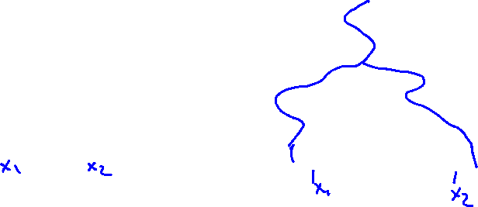
2D range trees
Store a primary 1D range tree for all the points
based on x-coordinate.
Thus in O(log n) time we can find O(log n) subtrees
representing the points with proper x-coordinate.
How to restrict to points with proper y-coordinate?

Slide 15
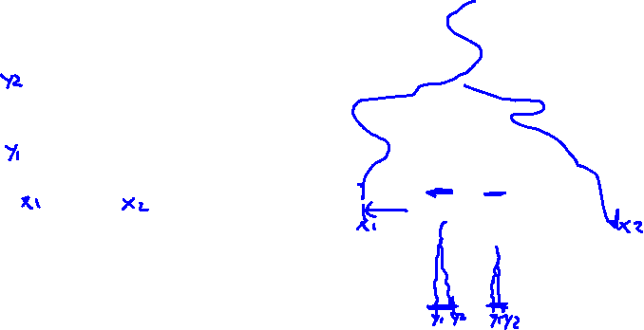
2D range trees
Idea: In primary 1D range tree of x-coordinates,
every node stores a secondary 1D range tree
based on y-coordinates for all points in the subtree
of the node. Recursively search within each.

Slide 16
2D range tree example
Secondary trees
5/8
5/8
8
5/8
8
2/7
2/7
7
2/7
6/6
5
6/6
6/6
3/5
6
7
2
3/5
1
5
3/5
6
9/3
3
5
9/3
3
7/2
7/2
2
7/2
1/1
1/1
1/1
5
2
7
1
3
6
9/3
1/1
2/7
3/5
5/8
6/6
7/2
Primary tree

Slide 17
Analysis of 2D range trees
Query time: In O(log² n) = O((log n)²) time, we can
represent answer to range query by O(log² n) subtrees.
Total cost for reporting k points: O(k + (log n)²).
Space: The secondary trees at each level of the
primary tree together store a copy of the points.
Also, each point is present in each secondary
tree along the path from the leaf to the root.
Either way, we obtain that the space is O(n log n).
Preprocessing time: O(n log n)

Slide 18
d-dimensional range trees
Each node of the secondary
y-structure stores a tertiary
z-structure representing the points in the subtree rooted at the node, etc.
Save one log factor using fractional cascading
Query time: O(k + log^{d} n) to report k points.
Space: O(n log^{d – 1} n)
Preprocessing time: O(n log^{d – 1} n)

Slide 19
Search in Subsets
Given: Two sorted arrays A₁ and A, with A₁⊆A
A query interval [l,r]
Task: Report all elements e in A₁ and A with l ≤ e ≤ r
Idea: Add pointers from A to A₁:
→ For each a∈A add a pointer to the smallest element b∈ A₁ with b≥a
Query: Find l∈A, follow pointer to A₁. Both in A and A₁ sequentially output all elements in [l,r].
A
Query:
[15,40]
3 10 19 23 30 37 59 62 80 90
A₁
10 19 30 62 80
Runtime: O((log n + k) + (1 + k)) = O(log n + k)

Slide 20
Search in Subsets (cont.)
Given: Three sorted arrays A_{1,} A₂, and A,
with A₁ ⊆A and A₂⊆A
A
Query:
[15,40]
3 10 19 23 30 37 59 62 80 90
A₂
A₁
3 23 37 62 90
10 19 30 62 80
Runtime: O((log n + k) + (1+k) + (1+k)) = O(log n + k))
Range trees:
Y₁∪Y₂
Y₁
Y₂
X

Slide 21
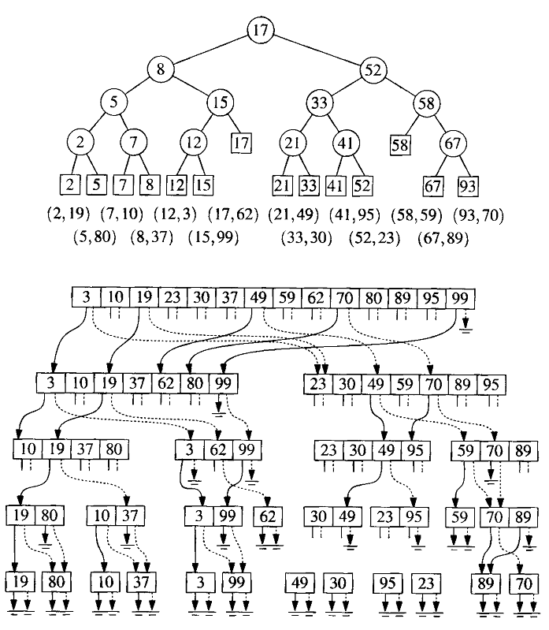
Fractional Cascading:
Layered Range Tree
Replace 2D range tree with a layered range tree, using sorted arrays and pointers instead of the secondary range trees.
Preprocessing:
O(n log n)
Query:
O(log n + k)

Slide 22
Fractional Cascading:
Layered Range Tree
[12,67]x[19,70]
Replace 2D range tree with a layered range tree, using sorted arrays and pointers instead of the secondary range trees.
Preprocessing:
O(n log n)
Query:
O(log n + k)
x
x
x
x
x
x
x
x
x

Slide 23
d-dimensional range trees
Query time: O(k + log^{d-1} n) to report k points,
uses fractional cascading in the
last dimension
Space: O(n log^{d – 1} n)
Preprocessing time: O(n log^{d – 1} n)
Best data structure to date:
Query time: O(k + log^{d – 1} n) to report k points.
Space: O(n (log n / log log n)^{d – 1})
Preprocessing time: O(n log^{d – 1} n)

