Slide 1
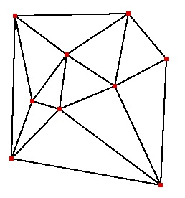

CMPS 3130/6130 Computational Geometry
Spring 2020
Delaunay Triangulations
Carola Wenk
Based on:
Computational Geometry: Algorithms and Applications

Slide 2
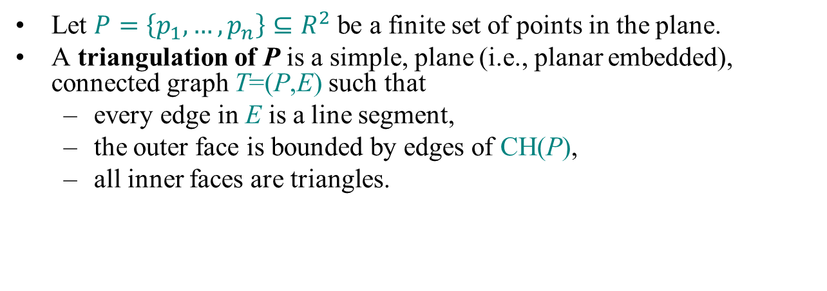
Triangulation
Let $P=\left\{p_{1},…,p_{n}\right\}⊆R^{2}$ be a finite set of points in the plane.
A triangulation of P is a simple, plane (i.e., planar embedded), connected graph T=(P,E) such that
  every edge in E is a line segment,
  the outer face is bounded by edges of CH(P),
  all inner faces are triangles.

Slide 3

Dual Graph
Let $G=(V,E)$ be a plane graph. The dual graph G* has
  a vertex for every face of G,
  an edge for every edge of G, between the two faces incident to the original edge

Slide 4
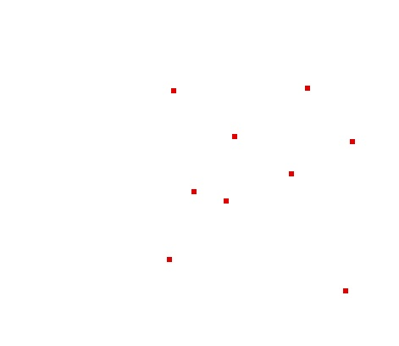
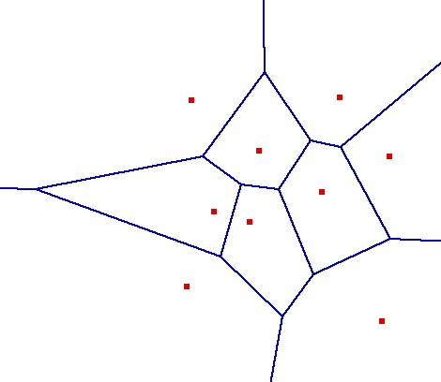
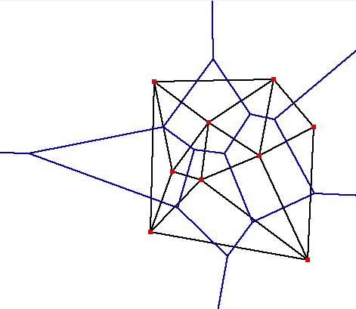
Delaunay Triangulation
Let G be the plane graph for the Voronoi diagram VD(P) . Then the dual graph G* is called the Delaunay Triangulation DT(P).
Canonical straight-line embedding for DT(P):
VD(P)
P
DT(P)
If P is in general position (no three points on a line, no four points on a circle) then every inner face of DT(P) is indeed a triangle.
DT(P) can be stored as an abstract graph, without geometric information. (No such obvious storing scheme for VD(P).)

Slide 5
Delaunay Triangulation
Let G be the plane graph for the Voronoi diagram VD(P) . Then the dual graph G* is called the Delaunay Triangulation DT(P).
Canonical straight-line embedding for DT(P):
P
DT(P)
If P is in general position (no three points on a line, no four points on a circle) then every inner face of DT(P) is indeed a triangle.
DT(P) can be stored as an abstract graph, without geometric information. (No such obvious storing scheme for VD(P).)

Slide 6
Straight-Line Embedding
Lemma: DT(P) is a plane graph, i.e., the straight-line edges do not intersect.
Proof:
q
p
  pp’ is an edge of DT(P) ⇔ There is an empty closed disk D_{p} with p and p’ on its boundary, and its center c on the bisector.
  Let qq’ be another Delaunay edge that intersects pp’
    ⇒ q and q’ lie outside of D_{p} , therefore qq’ also intersects pc or p’c
  Symmetrically, pp’ also intersects qc’ or q’c’
  (pc or p’c’) and (qc’ or q’c’) intersect
  The edges do not lie in different Voronoi cells.
  Contradiction
D_{p}
pc ⊂ V(p)
p’c ⊂ V(p’)
c
p’
q’
p
q
qc' ⊂ V(q)
q’c’ ⊂ V(q’)
D_{q}
c’
q’
p’

Slide 7
Characterization I of DT(P)
Lemma: Let p,q,r∈P let Δ be the triangle they define. Then the following statements are equivalent:
  Δ belongs to DT(P)
  The circumcenter c of Δ is a vertex in VD(P)
  The circumcircle of Δ is empty (i.e., contains no other point of P)
  Proof sketch: All follow directly from the definition of DT(P) in VD(P). By definition of VD(P), we know that p,q,r are c’s nearest neighbors.
Characterization I: Let T be a triangulation of P.
Then T=DT(P) ⇔ The circumcircle of any triangle in T is empty.
non-empty circumcircle
p_{l}
p_{i}
p_{j}
p_{k}

Slide 8
Illegal Edges
Definition: Let p_{i} , p_{j} , p_{k} , p_{l}∈P .
Then p_{i} p_{j} is an illegal edge ⇔ p_{l} lies in the interior of the circle through p_{i} , p_{j} , p_{k} .
Lemma: Let p_{i} , p_{j} , p_{k} , p_{l}∈P .
Then p_{i} p_{j} is illegal ⇔ min α_{i} < min α’_{i}
p_{l}
p_{i}
p_{j}
p_{k}
illegal edge
p_{l}
1≤i≤6
1≤i≤6
p_{l}
p_{i}
α₅
α₃
p_{j}
edge flip
p_{i}
α’₄
α’₂
p_{j}
α₁
α₄
α’₆
α’₅
α₂
s
α₆
α’₃
α’₁
p
q
p_{k}
p_{k}
Theorem (Thales): Let a, b, p, q be four points on a circle, and let r be inside and let s be outside of the circle, such that p,q,r,s lie on the same side of the line through a, b.
Then ∠a,s,b < ∠a,q,b = ∠a,p,b < ∠a,r,b
So, α₁ = ∠ p_{j} , p_{i} , p_{l} < ∠ p_{j} , p_{k} , p_{l} = α’₁ and
α₃ = ∠ p_{l} , p_{j} , p_{i} < ∠ p_{l} , p_{k} , p_{i} = α’₃ , etc.
r
a
b

Slide 9
Characterization II of DT(P)
Definition: A triangulation is called legal if it does not contain any illegal edges.
Characterization II: Let T be a triangulation of P.
Then T=DT(P) ⇔ T is legal.
Algorithm Legal_Triangulation(T):
  Input: A triangulation T of a point set P
  Output: A legal triangulation of P
  while T contains an illegal edge p_{i}p_{j} do
  //Flip p_{i}p_{j}
  Let p_{i}, p_{j}, p_{k}, p_{l} be the quadrilateral containing p_{i}p_{j}
  Remove p_{i}p_{j} and add p_{k}p_{l}
  return T
  Runtime analysis:
  In every iteration of the loop the angle vector of T (all angles in T sorted by increasing value) increases
  With this one can show that a flipped edge never appears again
  There are O(n²) edges, therefore the runtime is O(n²)
p_{l}
p_{i}
p_{j}
p_{k}
edge flip
p_{l}
p_{i}
p_{j}
p_{k}

Slide 10
Characterization III of DT(P)
Definition: Let T be a triangulation of P and let α₁, α₂,…, α_{3m} be the angles of the m triangles in T sorted by increasing value. Then A(T)=(α₁,α₂,…,α_{3m}) is called the angle vector of T.
Definition: A triangulation T is called angle optimal ⇔ A(T) > A(T’) for any other triangulation T’ of the same point set P.
Let T’ be a triangulation that contains an illegal edge, and let T’’ be the resulting triangulation after flipping this edge. Then A(T’’) > A(T’) .
T is angle optimal ⇒ T is legal ⇒ T=DT(P)
Characterization III: Let T be a triangulation of P.
Then T=DT(P) ⇔ T is angle optimal.
(If P is not in general position, then any triangulation obtained by triangulating the faces maximizes the minimum angle.)

Slide 11
Applications of DT
All nearest neighbors: Find for each p∈P its nearest neighbor q∈P; q≠p.
  Empty circle property: p,q∈P are connected by an edge in DT(P)
  ⇔ there exists an empty circle passing through p and q.
  Proof: “⇒”: For the Delaunay edge pq there must be a Voronoi edge.
  Center a circle through p and q at any point on the Voronoi edge,
  this circle must be empty.
  “⇐”: If there is an empty circle through p and q, then its center c
  has to lie on the Voronoi edge because it is equidistant to p and q
  and there is no site closer to c.
  Claim: In DT(P), every p∈P is adjacent to its nearest neighbors.
  Proof: Let q∈P be a nearest neighbor adjacent to p in DT(P). Then
  the circle centered at p with q on its boundary has to be empty, so
  the circle with diameter pq is empty and pq is a Delaunay edge.
  Algorithm: Find all nearest neighbors in O(n) time: Check for
  each p∈P all points connected to p with a Delaunay edge.
Minimum spanning tree: The edges of every Euclidean minimum spanning tree of P are a subset of the edges of DT(P).
p
q
p
q

Slide 12
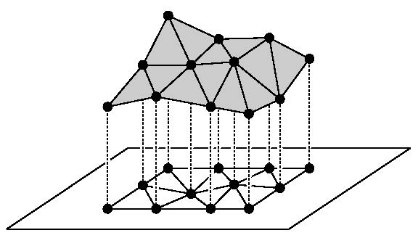
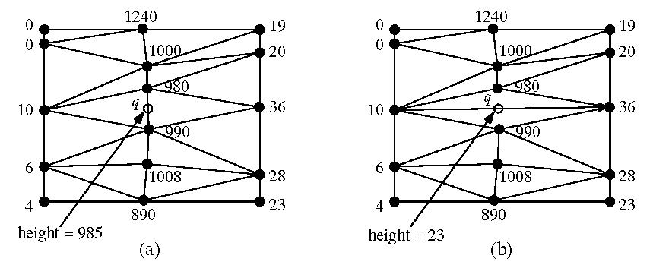
Applications of DT
Terrain modeling:
  Model a scanned terrain surface by interpolating the height using a piecewise linear function over R².
  Angle-optimal triangulations give better approximations / interpolations since they avoid skinny triangles

Slide 13
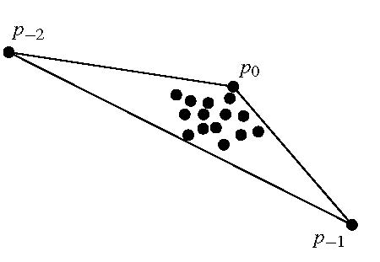
Randomized Incremental Construction of DT(P)
Start with a large triangle containing P.
Insert points of P incrementally:
  Find the containing triangle
  Add new edges
  Flip all illegal edges until every edge is legal.

Slide 14
Randomized Incremental Construction of DT(P)
p_{r}
p_{r}
An edge can become illegal only if one of its incident triangles changes.
Check only edges of new triangles.
Every new edge created is incident to p_{r}.
Every old edge is legal (if p_{r} is on one of the incident triangles, the edge would have been flipped if it were illegal).
Every new edge is legal (since it has been created from flipping a previously legal edge).
flip
shrink
circle
empty circle
⇒ Delaunay edge
p_{r}
p_{r}
p_{r}

Slide 15
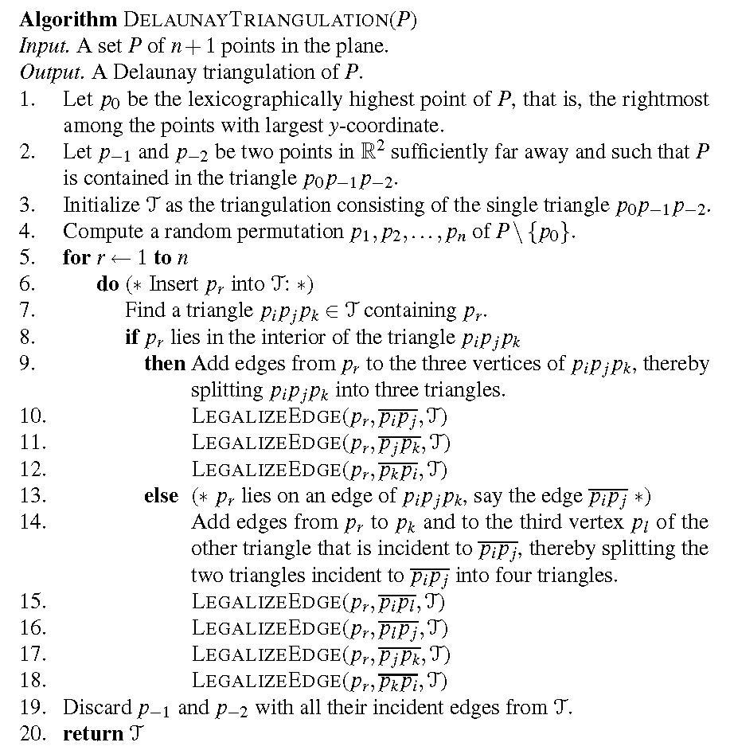
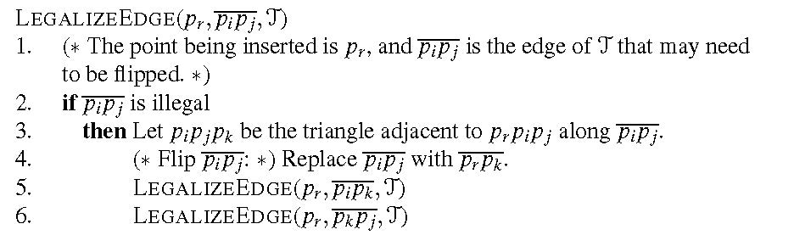
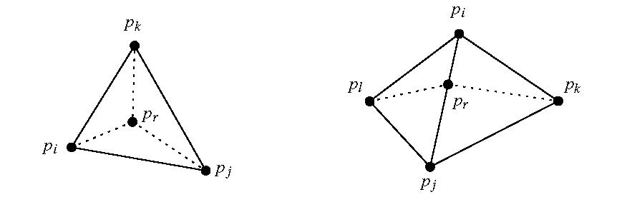
Pseudo Code

Slide 16
History
The algorithm stores the history of the constructed triangles. This allows to easily locate the triangle containing a new point by following pointers.
Division of a triangle:
Flip:
Store pointers from the old triangle
to the three new triangles.
Store pointers from both old triangles
to both new triangles.

Slide 17
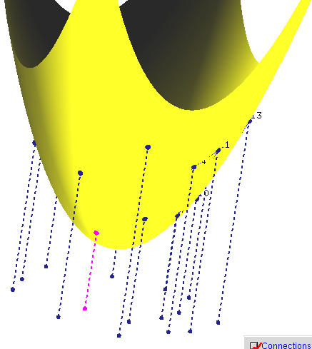
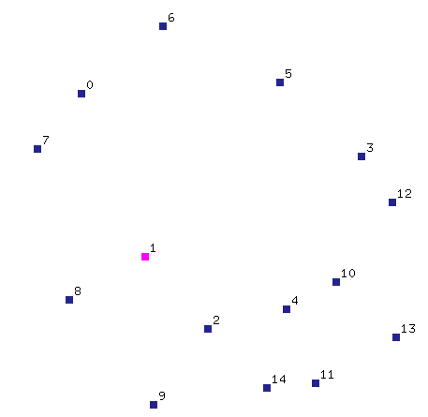
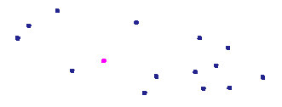
DT and 3D CH
Theorem: Let P={p₁,…,p_{n}} with p_{i}=(a_{i}, b_{i},0). Let p*_{i} =(a_{i}, b_{i}, a²_{i}+ b²_{i}) be the vertical projection of each point p_{i} onto the paraboloid z=x²+ y². Then DT(P) is the orthogonal projection onto the plane z=0 of the lower convex hull of P*={p*₁,…,p*_{n}} .
P*
P
Pictures generated with Hull2VD tool available at http://www.cs.mtu.edu/~shene/NSF-2/DM2-BETA

Slide 18
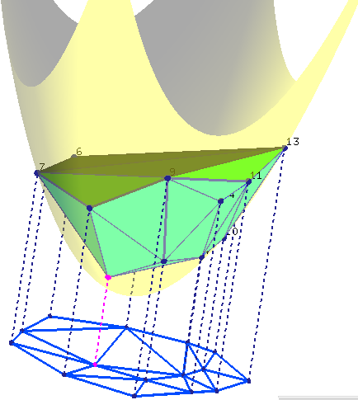
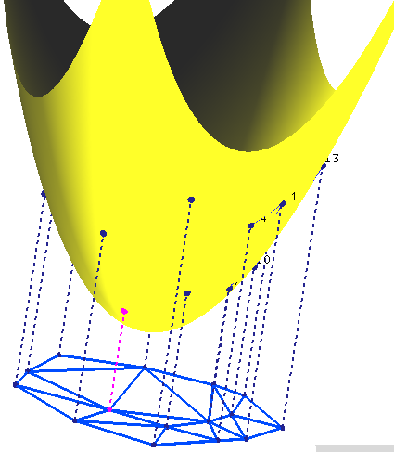
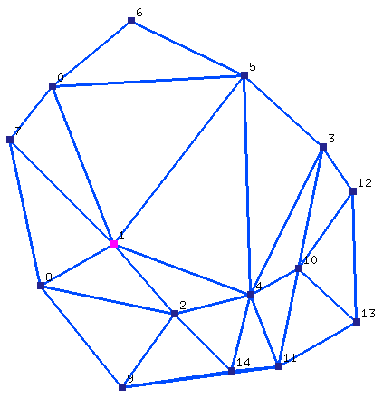
DT and 3D CH
Theorem: Let P={p₁,…,p_{n}} with p_{i}=(a_{i}, b_{i},0). Let p’_{i} =(a_{i}, b_{i}, a²_{i}+ b²_{i}) be the vertical projection of each point p_{i} onto the paraboloid z=x²+ y². Then DT(P) is the orthogonal projection onto the plane z=0 of the lower convex hull of P’={p’₁,…,p’_{n}} .
Pictures generated with Hull2VD tool available at http://www.cs.mtu.edu/~shene/NSF-2/DM2-BETA

Slide 19
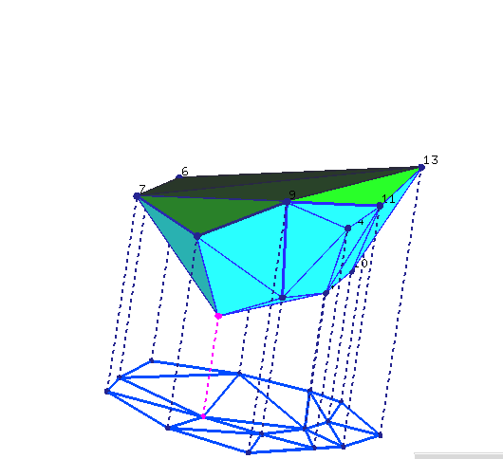
DT and 3D CH
Theorem: Let P={p₁,…,p_{n}} with p_{i}=(a_{i}, b_{i},0). Let p’_{i} =(a_{i}, b_{i}, a²_{i}+ b²_{i}) be the vertical projection of each point p_{i} onto the paraboloid z=x²+ y². Then DT(P) is the orthogonal projection onto the plane z=0 of the lower convex hull of P’={p’₁,…,p’_{n}} .
Pictures generated with Hull2VD tool available at http://www.cs.mtu.edu/~shene/NSF-2/DM2-BETA

Slide 20
DT and 3D CH
Theorem: Let P={p₁,…,p_{n}} with p_{i}=(a_{i}, b_{i},0). Let p’_{i} =(a_{i}, b_{i}, a²_{i}+ b²_{i}) be the vertical projection of each point p_{i} onto the paraboloid z=x²+ y². Then DT(P) is the orthogonal projection onto the plane z=0 of the lower convex hull of P’={p’₁,…,p’_{n}} .
p’_{i,} p’_{j,} p’_{k} form a (triangular) face of LCH(P’)
⇔
The plane through p’_{i,} p’_{j,} p’_{k} leaves all remaining points of P above it
⇔
The circle through p_{i,} p_{j,} p_{k} leaves all remaining points of P in its exterior
⇔
p_{i,} p_{j,} p_{k} form a triangle of DT(P)
property
of unit
paraboloid
Slide adapted from slides by Vera Sacristan.

