Slide 1
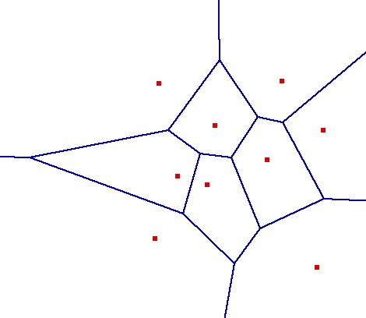

CMPS 3130/6130 Computational Geometry
Spring 2020
Voronoi Diagrams
Carola Wenk
Based on:
Computational Geometry: Algorithms and Applications

Slide 2
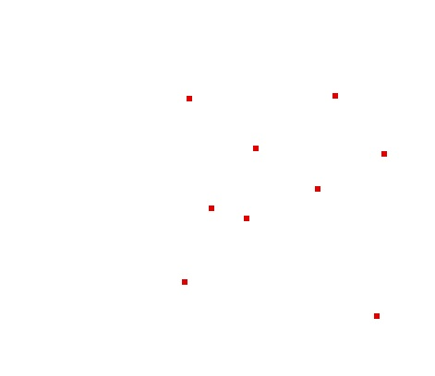
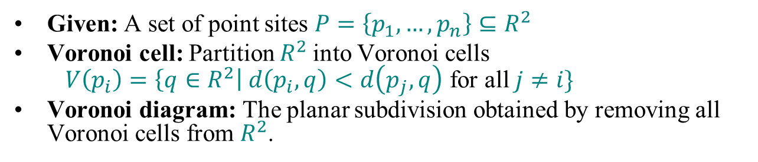
Voronoi Diagram
(Dirichlet Tesselation)
Given: A set of point sites $P=\left\{p_{1},…,p_{n}\right\}⊆R^{2}$
Voronoi cell: Partition $R^{2}$into Voronoi cells
$V\left(p_{i}\right)=\left\{q∈R^{2}\right| d\left(p_{i},q\right)<d\left(p_{j},q\right)$ for all $j≠i\}$
Voronoi diagram: The planar subdivision obtained by removing all Voronoi cells from $R^{2}$.

Slide 3
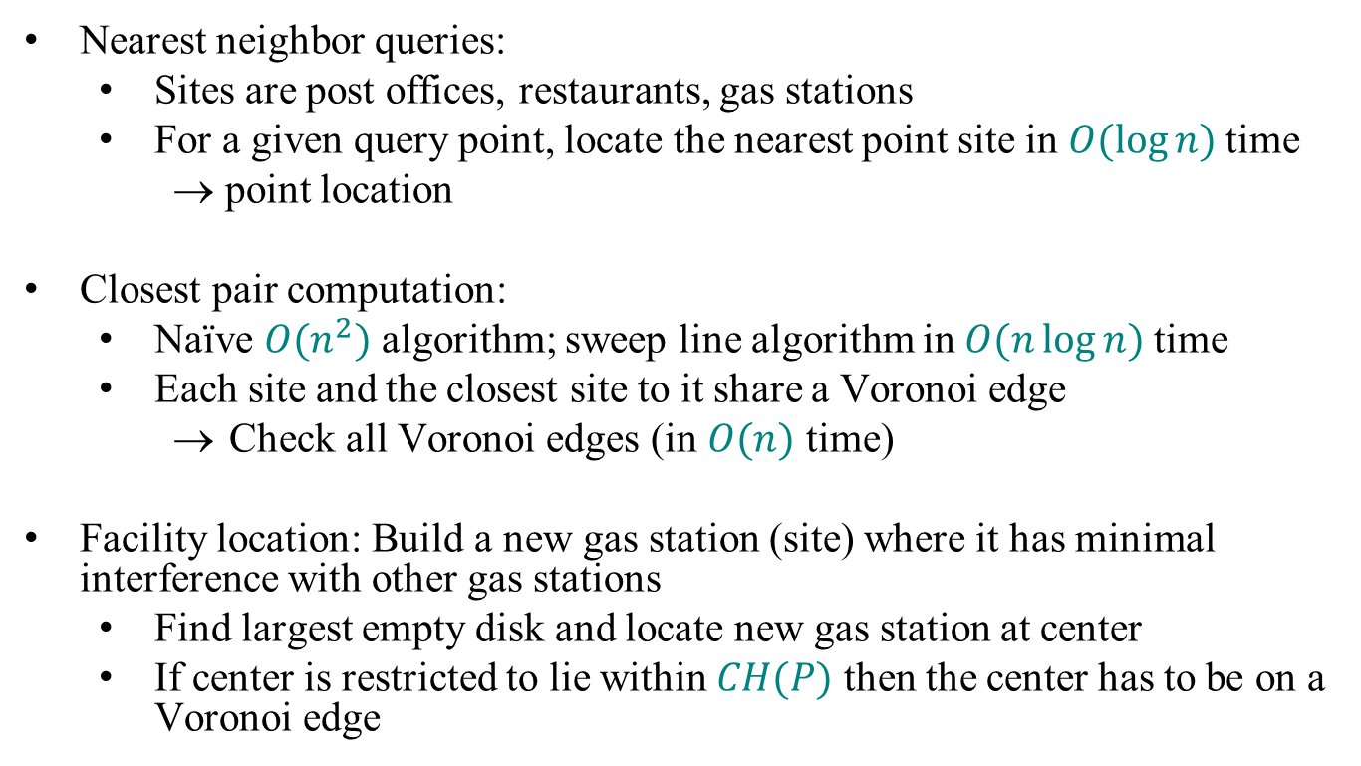
Applications of Voronoi Diagrams
Nearest neighbor queries:
  Sites are post offices, restaurants, gas stations
  For a given query point, locate the nearest point site in $O(\log{n)}$time
    → point location
Closest pair computation:
  Naïve $O(n^{2})$ algorithm; sweep line algorithm in $O(n\log{n)}$time
  Each site and the closest site to it share a Voronoi edge
    Check all Voronoi edges (in $O(n)$ time)
Facility location: Build a new gas station (site) where it has minimal interference with other gas stations
  Find largest empty disk and locate new gas station at center
  If center is restricted to lie within $CH(P)$ then the center has to be on a Voronoi edge

Slide 4

Bisectors
Voronoi edges are portions of bisectors
For two points p, q, the bisector $b\left(p,q\right)$ is defined as
$b\left(p,q\right)=\left\{r∈R^{2} \right| d\left(p,r\right)=d(q,r)\}$
Voronoi vertex:
r
q
p
s
q
p

Slide 5



Voronoi cell
Each Voronoi cell $V(p_{i})$ is convex and
$V\left(p_{i}\right)= \bigcap{ h\left(p_{i},p_{j}\right)}$,
where $h(p_{i},p_{j})$ is the halfspace that is defined by bisector $b(p_{i},p_{j})$ and that contains $p_{i}$
⇒ A Voronoi cell has at most $n−1$ sides
$$\begin{aligned}p_{j}∈P \\ j≠i\end{aligned}$$
p_{j}
p_{i}
$$h(p_{i},p_{j})$$

Slide 6
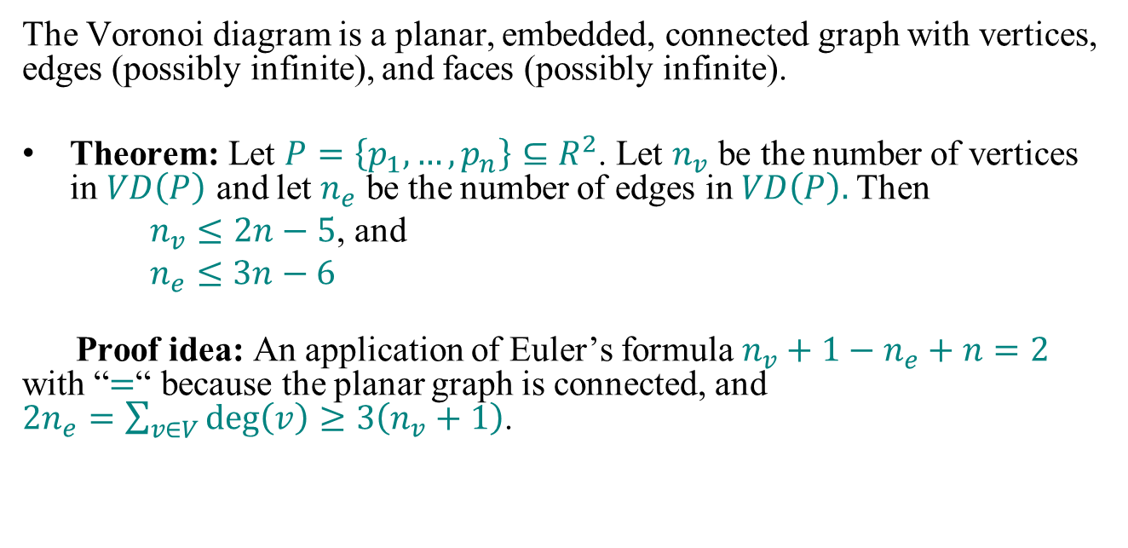
Voronoi Diagram
  The Voronoi diagram is a planar, embedded, connected graph with vertices, edges (possibly infinite), and faces (possibly infinite).
Theorem: Let $P=\left\{p_{1},…,p_{n}\right\}⊆R^{2}$. Let $n_{v}$ be the number of vertices in $VD\left(P\right)$ and let $n_{e}$ be the number of edges in $VD\left(P\right).$Then
  $n_{v}≤2n−5$, and
  $n_{e}≤3n−6$
Proof idea: An application of Euler’s formula $n_{v}+1−n_{e}+n=2$ with “$=$“ because the planar graph is connected, and
$2n_{e}=\sum_{v∈V}{\deg\left(v\right)≥3\left(n_{v}+1\right)}$.
Add vertex at infinity

Slide 7
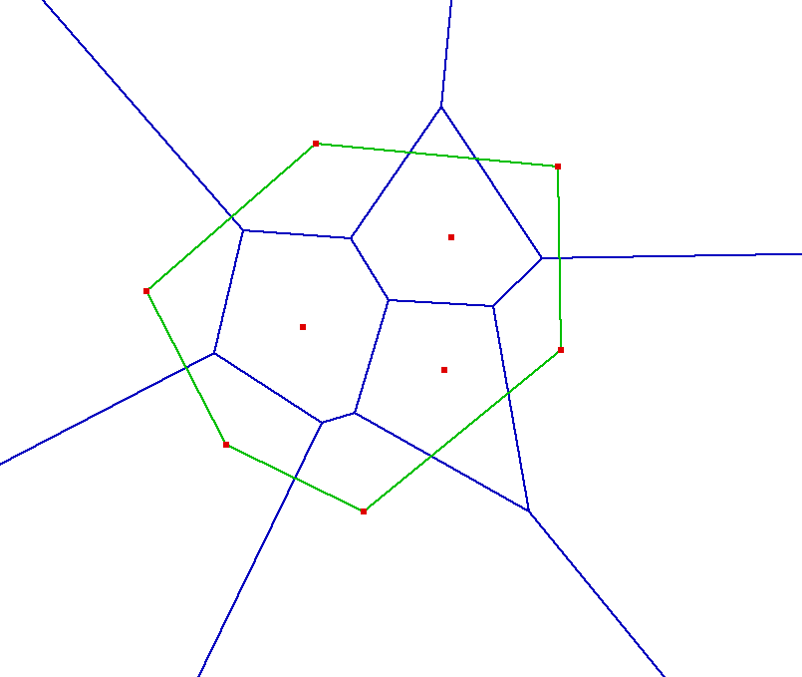
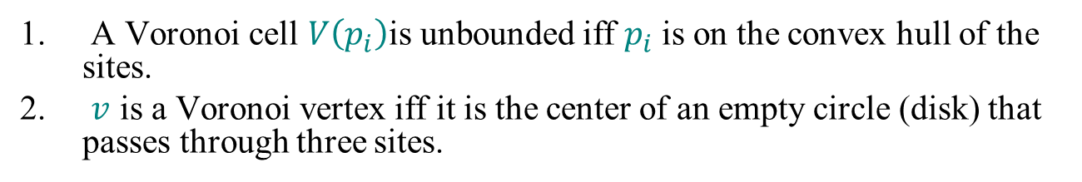
Properties
A Voronoi cell $V\left(p_{i}\right)$is unbounded iff $p_{i}$ is on the convex hull of the sites.
$v$ is a Voronoi vertex iff it is the center of an empty circle (disk) that passes through three sites.
Site with bounded Voronoi cell
Site with unbounded Voronoi cell
Smaller empty disk centered on Voronoi edge
Larger empty disk centered on Voronoi vertex

Slide 8
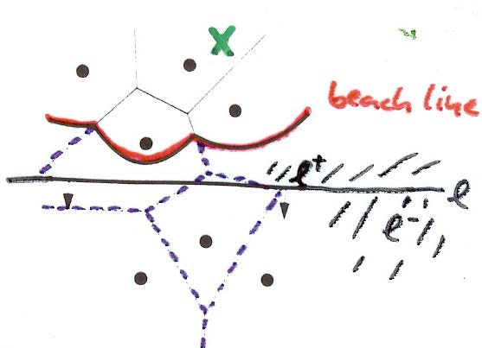
Fortune’s sweep to construct the VD
Problem: We cannot maintain the intersection of the VD with sweepline l since the VD above l depends on the sites below l.
Sweep line status: “Beach line”
  Identify points q∈l⁺ for which we know their
  closest site.
  If there is a site p_{i}∈l⁺ s.t. dist(q,p_{i})≤dist(q, l)
  then the site closest to q lies above l.
  Define the “beach line” as the boundary of the
  set of points q∈l⁺ that are closer to a site above
  l than to l.
    The beach line is a sequence of parabolic arcs
    The breakpoints (beach line vertices) lie on edges of the VD, such that they trace out the VD as the sweep line moves.

Slide 9
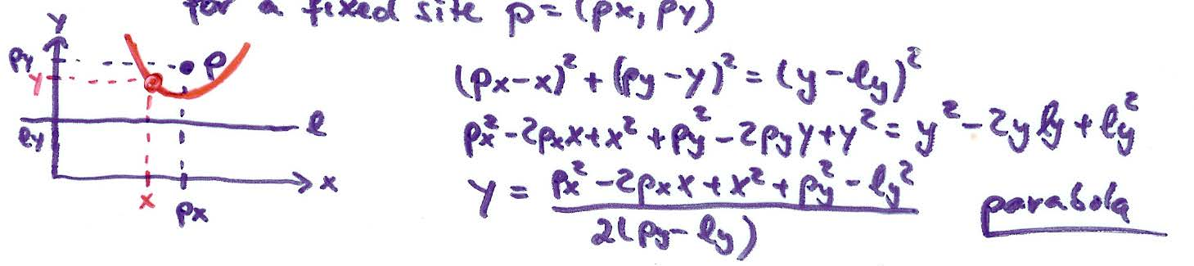
Parabola
Set of points (x,y) such that dist((x,y), p) = dist(l) for a fixed site p = (p_{x},p_{y})

Slide 10
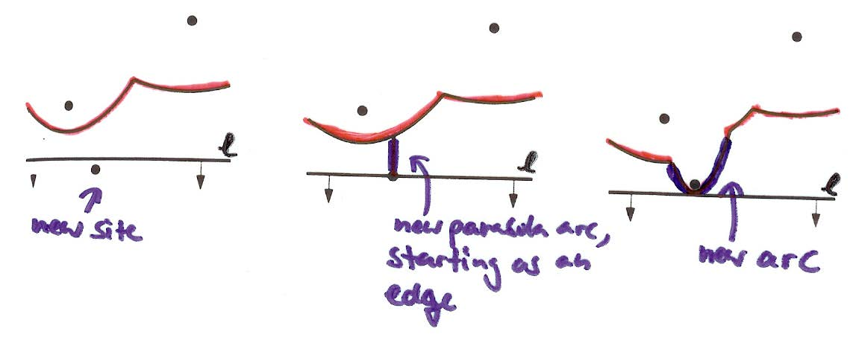
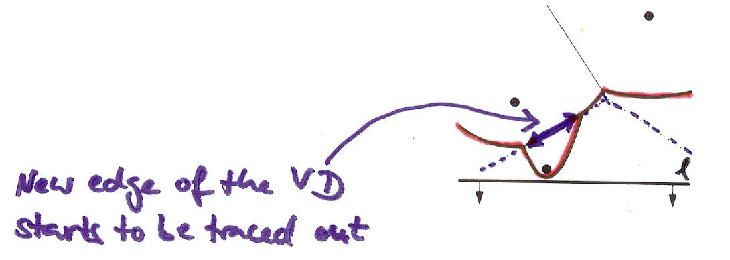
Site Events
Site event: The sweep line l reaches a new site
A new arc appears on the beach line…
… which traces out a new VD edge

Slide 11
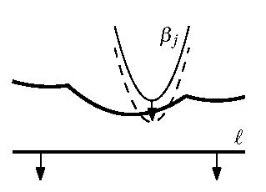
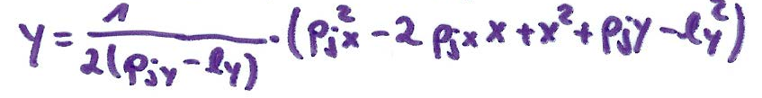
Site Events
Lemma: The only way in which a new arc can appear on the beach line is through a site event.
Proof:
Case 1: Assume the existing parabola β_{j} (defined by site p_{j}) breaks through β_{i}
Formula for parabola β_{j} :
Using p_{jy}>l_{y} and p_{iy}>l_{y} one can show that it is impossible that β_{i} and β_{j} have only one intersection point. Contradiction.
… which traces out a new VD edge
β_{i}

Slide 12
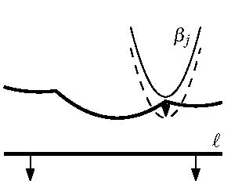
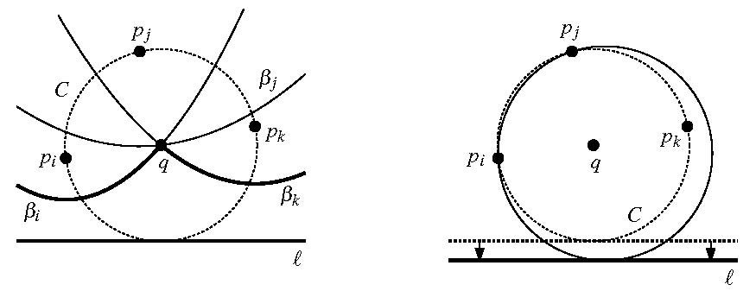
Site Events
Case 2: Assume β_{j} appears on the break point q between β_{i} and β_{k}
⇒ There is a circle C that passes through p_{i}, p_{j,} p_{k} and is tangent to l:
But for an infinitesimally small motion of l, either p_{i} or p_{k} penetrates the interior of C. Therefore β_{j} cannot appear on l.
β_{k}
β_{i}

Slide 13
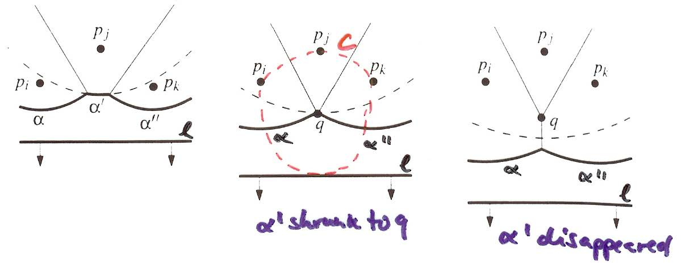
Circle Events
Circle event: Arc α’ shrinks to a point q, and then arc α’ disappears
There is a circle C that passes through p_{i}, p_{j,} p_{k} and touches l (from above).
There is no site in the interior of C. (Otherwise this site would be closer to q than q is to l, and q would not be on the beach line.)
q is a Voronoi vertex (two edges of the VD meet in q).
Note: The only way an arc can disappear from the beach line is through a circle event.
But for an infinitesimally small motion of l, either p_{i} or p_{k} penetrates the interior of C. Therefore β_{j} cannot appear on l.

Slide 14
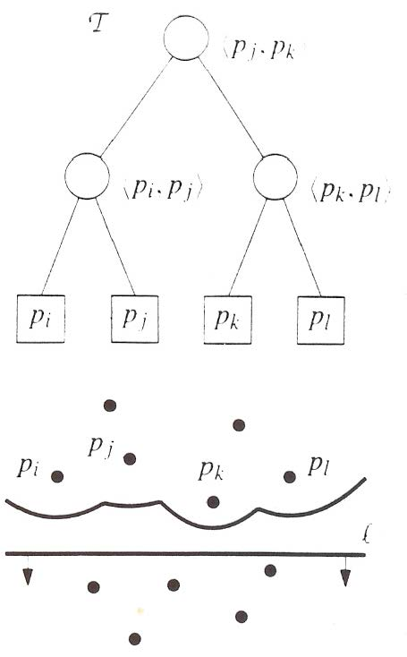
Data Structures
Store the VD under construction in a DCEL
Sweep line status (sweep line):
  Use a balanced binary search tree T, in which the
  leaves correspond to the arcs on the beach line.
  Each leaf stores the site defining the arc (it only
  stores the site and not the arc)
  Each internal node corresponds to a break point
  on the beach line
Event queue:
  Priority queue Q (ordered by y-coordinate)
  Store each point site as a site event.
  Circle event:
    Store the lowest point of a circle as an event point
    Store a point to the leaf/arc in the tree that will disappear

Slide 15
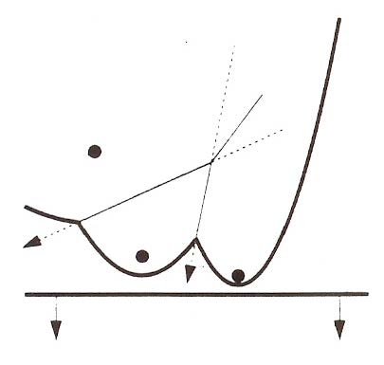
How to Detect Circle Events?
  Make sure that for any three consecutive arcs on the beach line the potential circle event they define is stored in the queue.
  Consecutive triples with breakpoints that do not converge do not yield a circle event.
  Note that a triple could disappear (e.g., due to the appearance of a new site) before the event takes place. This yields a false alarm.

Slide 16
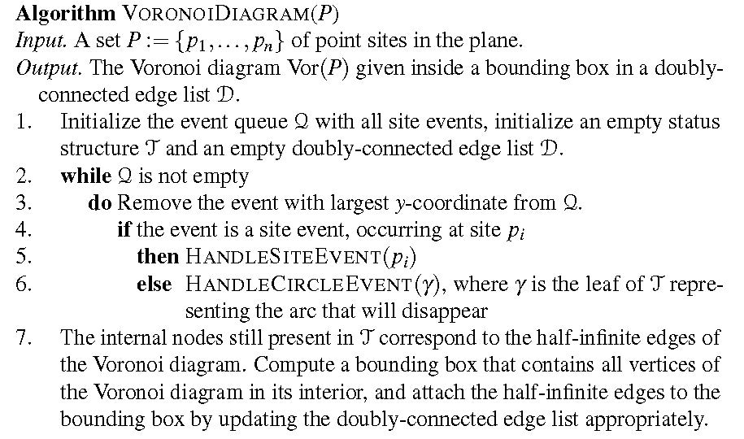

Sweep Code

Slide 17
Sweep Code
Degeneracies:
  If two points have the same y-coordinate, handle them in any order.
  If there are more than three sites on one circle, there are several coincident circle events that can be handled in any order. The algorithm produces several degree-3 vertices at the same location.
Theorem: Fortune’s sweep runs in O(n log n) time and O(n) space.

Slide 18
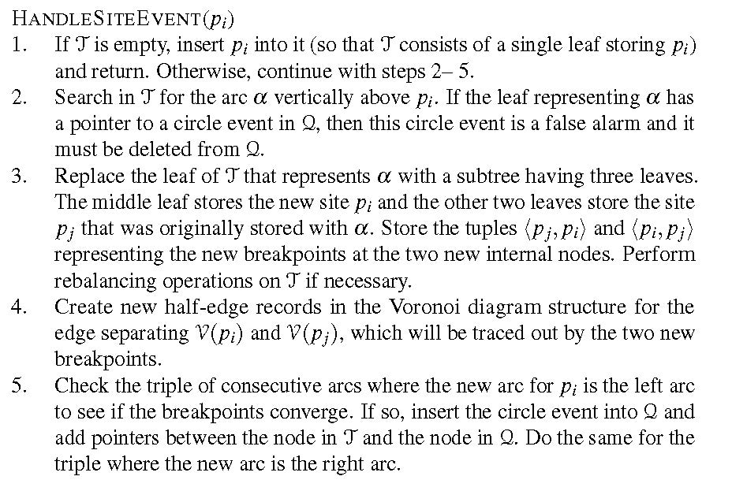
Handling a Site Event
Runs in O(log n) time per event, and there are n events.

Slide 19
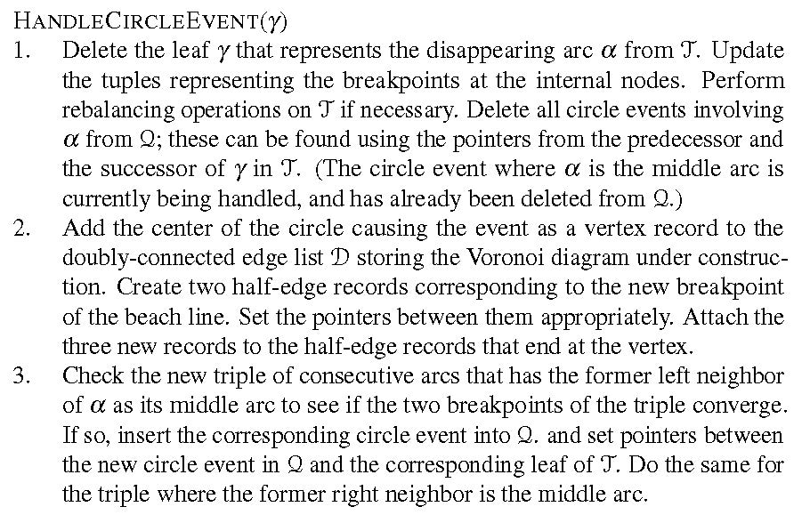
Handling a Circle Event
Runs in O(log n) time per event, and there are O(n) events because each event defines a Voronoi vertex. False alarms are deleted before they are processed.

