Slide 1
CMPS 3130/6130 Introduction to Computational Geometry
Carola Wenk
Department of Computer Science

Slide 2
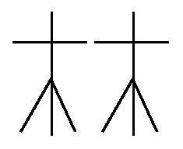
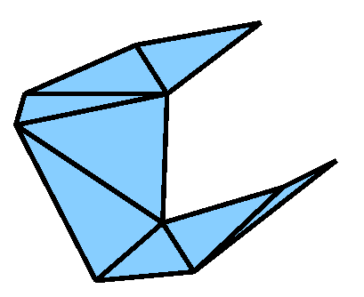
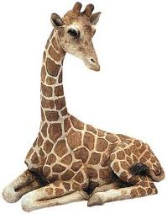
Computational Geometry
Algorithms and data structures for geometric objects
Convex hull: Snap rubber band tight around pins
Voronoi diagram & Delaunay triangulation: Partition plane into regions closest to post offices
Art gallery: Guard art gallery with few guards

Slide 3
Geometric Algorithms
Algorithm design techniques: Divide and conquer
Sweep line algorithms
b
c
a
e
d
c b d
c b e d
c e b d
e c d

Slide 4
Geometric Data Structures
Geometric data structures: Range trees for database queries
5/8
5/8
8
5/8
8
2/7
2/7
7
2/7
6/6
5
6/6
6
6/6
3/5
3/5
5
3/5
7
2
1
6
9/3
3
5
9/3
3
7/2
7/2
2
7/2
1/1
1/1
1/1
5
2
7
1
3
6
9/3
1/1
2/7
3/5
5/8
6/6
7/2
Primary tree

Slide 5
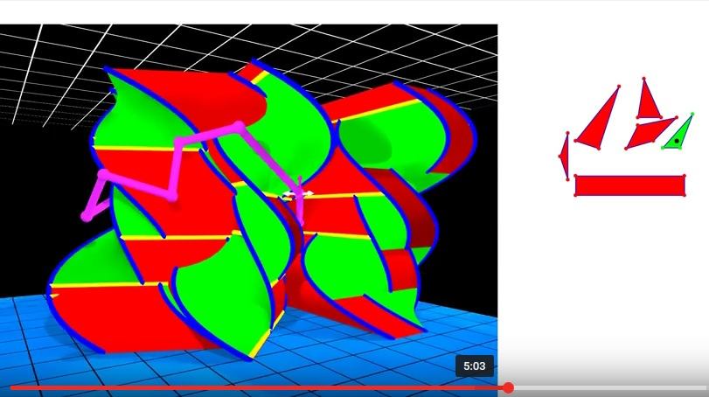
CMPS 3130/6130 Introduction to Computational Geometry
Related areas: Algorithms, graph theory, combinatorics, topology
Applied areas: Databases, sensor networks, robotics, GIS, computer graphics, geometric modelling
Prerequisites: CMPS 2200. Familiarity with linear algebra preferred.
D. Ataria, G. Rote, “Configuration Space Visualization”, Symposium on Computational Geometry, 2012
Class webpage: www.cs.tulane.edu/~carola/teaching/cmps3130-6130/spring20/

