Slide 1
CMPS 3130/6130 Computational Geometry Spring 2020
$conv\left(P_{r−1}\right)$
3D Convex Hulls
Carola Wenk
(based on BCKO)

Slide 2
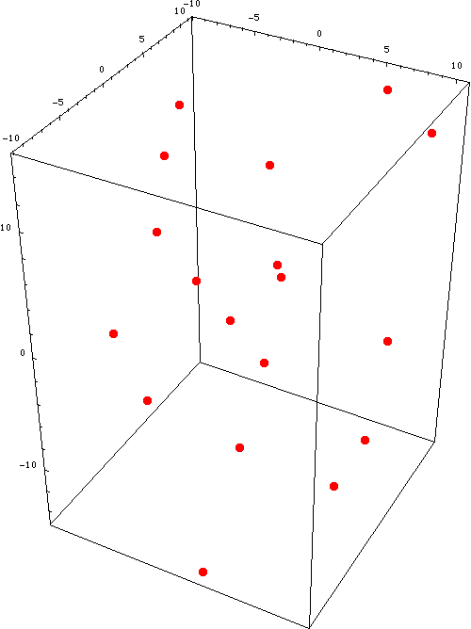
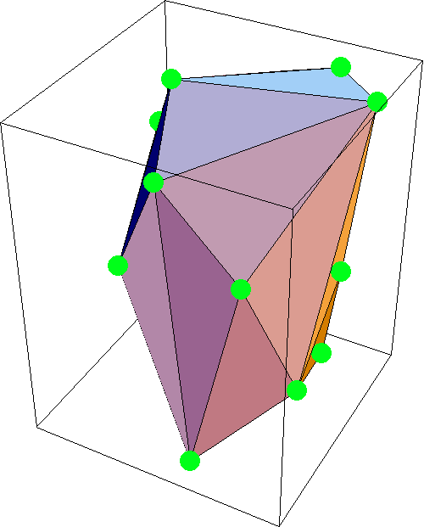
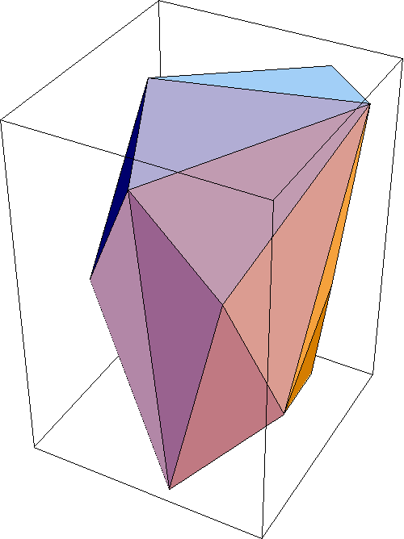
3D CH: Problem Statement
Images from http://xlr8r.info/
Given a set $P=\left\{p_{1},…, p_{n}\right\}⊆ ℝ^{3},$ compute $conv\left(P\right)$
Use a DCEL to represent the boundary $∂ conv\left(P\right)$

Slide 3
Clarkson & Shor’s Randomized Incremental Construction (RIC)
Choose 4 points in $P$ that do not lie in a common plane. (Otherwise apply planar CH algorithm.) Wlog, let these points be $p_{1}, p_{2}, p_{3}, p_{4}$
Let $p_{5}, …, p_{n}$ be a random permutation of the remaining points in $P$.
Define $P_{r}=\left\{p_{1}, …, p_{r}\right\}$ for $r≥1$ for r$=5$; $r≤n$; $r$++ Compute $conv(P_{r})$ by inserting $p_{r}$ into $conv(P_{r−1})$

Slide 4
Visible and Invisible Regions
inside the convex polytope
If $p_{r}∈conv(P_{r−1})$, then $conv\left(P_{r}\right)=conv(P_{r−1})$
Now, consider the other case $p_{r}∉conv\left(P_{r−1}\right)$
outside the convex polytope
Look at $conv\left(P_{r−1}\right)$ from $p_{r}$
visible region and invisible region
$conv\left(P_{r−1}\right)$
The visible region and invisible region are connected regions on$conv\left(P_{r−1}\right)$, separated by the horizon.
The horizon is a closed curve consisting of edges on $conv\left(P_{r−1}\right) .$

Slide 5
Horizon
$$conv\left(P_{r−1}\right)$$
Project $conv\left(P_{r−1}\right)$ onto a plane with $p_{r}$ as the center of projection. ⇒ Convex polygon that “equals” the horizon.

Slide 6
Visibility
$conv\left(P_{r−1}\right)$
A facet $f$ on $conv\left(P_{r−1}\right)$ is visible from $p_{r}$ :⇔ $p_{r}$ lies in $h_{f}^{+}$, where $h_{f}$is the plane containing $f$, and $h_{f}^{+}$ is the open halfspace that does not contain $conv\left(P_{r−1}\right)$

Slide 7
Storage Data Structure
Store the boundary of $conv(P)$, and of all intermediate $conv(P_{r})$, as a DCEL. The vertices are 3D points.
Wlog, half-edges bounding a face that is seen from the outside of the polytope form a counter-clockwise cycle.
without loss of generality

Slide 8
Compute $conv\left(P_{r}\right)$from $conv\left(P_{r−1}\right)$
$conv\left(P_{r−1}\right)$
$conv\left(P_{r}\right)$
Keep invisible facets
Replace visible facets ⇒ How to find all visible facets in time linear to their number? ($O\left(r−1\right)$ time is trivial but leads to an $O\left(n^{2}\right)$ algorithm.)

Slide 9
Conflict/Visibility Lists
Maintain conflict lists for each facet $f$ on $conv\left(P_{r−1}\right)$ and point (vertex) $p_{t}$ for $t>r$:
$P_{conflict}\left(f\right)⊆\{p_{r},…, p_{n}\}$ consists of all points that can see $f$
$F_{conflict}(p_{t})$ consists of all facets of $conv\left(P_{r−1}\right)$ visible from $p_{t}$
Note that ${p∈P}_{conflict}\left(f\right)$ is in conflict with $f$ because $p$ and $f$ cannot be part of the same convex hull
$conv\left(P_{r−1}\right)$

Slide 10
Conflict Graph
Store all conflict lists in the conflict graph:
Bipartite graph
Node for every point in $P$ that is not inserted yet
Node for every facet of $conv\left(P_{r−1}\right)$
Arc between $f$ and p if $f$ is in conflict with (i.e., visible from) $p$
conflicts

Slide 11
Maintaining the Conflict Graph
Initialize conflict graph $G$ for $conv\left(P_{4}\right)$ in linear time
Update $G$ after adding $p_{r}$:
Discard from $G$:
All neighbors of $p_{r}$ in $G$. These are the facets visible from $p_{r}$.
$p_{r}$
Insert nodes in $G$ for newly created facets (those facets which connect $p_{r}$ to the horizon)
Find conflict lists for each newly created facet $f$:
A point $p_{t}$ that sees $f$ must also see $e$
But then $p_{t}$ must have seen one of the faces $f_{1}$ or $f_{2}$ incident to $e$ in $conv(P_{r−1})$
⇒ Test all points in the conflict lists of $f_{1}$ and $f_{2}$

Slide 12
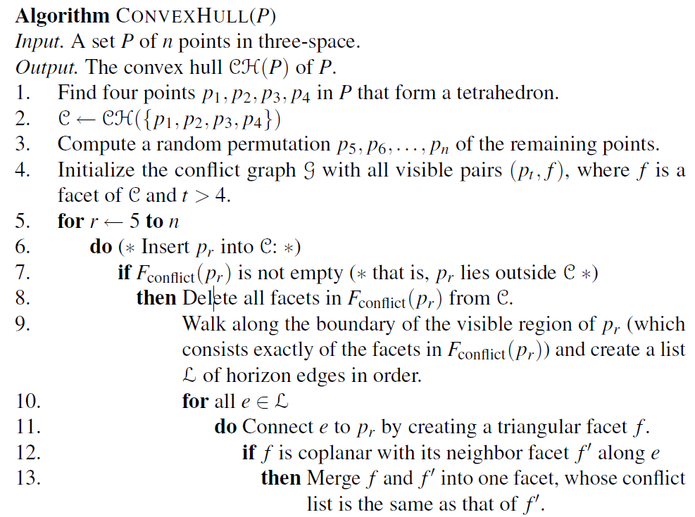
Algorithm (part 1)
$conv\left(P_{r−1}\right)$
$conv\left(P_{r}\right)$
$O(n$)
$$O({|F}_{conflict}(p_{r})|)$$
Face can only be deleted if it has been created. → Delete at most once

Slide 13
Algorithm (part 2)
$conv\left(P_{r−1}\right)$
$conv\left(P_{r}\right)$
$$O({\sum_{e∈ℒ}{|P\left(e\right)|})}_{}$$
$$Charge to node \\ and arc creation$$
Need to bound:
$E(\sum_{r=5}^{n}{{|F}_{conflict}(p_{r})|})$
$E(\sum_{e}{|P(e)|})$ where the summation is over all horizon edges that ever appear during the algorithm
$$O(n)$$
$$O(n\log{n)}$$
proof in book

Slide 14
Backwards Analysis
Instead of incrementally inserting points into the convex hull (which creates new facets), consider for runtime analysis purposes to “play the movie backwards” and incrementally remove points from the convex hull (which causes facets to disappear).
Lemma: The expected number of facets created by the algorithm, $E(\sum_{r=1}^{n}{{|F}_{conflict}(p_{r})|})$, is at most $6n−20$.
Proof: = # facets connecting $p_{r}$ to its horizon on $conv\left(P_{r−1}\right)$ (these are the newly created facets)
= # facets that disappear when removing $p_{r}$ from $conv\left(P_{r}\right)$
=: $deg⁡(p_{r}, conv\left(P_{r}\right))$ degree of $p_{r}$ in $conv\left(P_{r}\right)$
$E(\deg\left(p_{r}, conv\left(P_{r}\right)\right)=\frac{1}{r−4}\sum_{i=5}^{r}{\deg\left(p_{i},conv\left(P_{r}\right)\right)}$
$≤\frac{1}{r−4}$ [($\sum_{i=1}^{r}{\deg{(p_{i},conv\left(P_{r}\right))}}$) -12]
$≤$ $\frac{1}{r−4}$ [$2\left(3r−6\right)−12]= \frac{6r−12−12}{r−4}$ = 6
Thus $4+E\left(\sum_{r=5}^{n}{{|F}_{conflict}(p_{r})|}\right)≤4+6\left(n−4\right)=6n−20$
$${|F}_{conflict}(p_{r})|$$
Total degree of $p_{1},…, p_{4}$ is at least 12

Slide 15
Convex Hull Runtime
Theorem: The convex hull of a set of $n$ points in $ℝ^{3}$ can be computed in randomized expected $O(n\log{n) }$time.
Theorem (higher dimensions): The complexity of the convex hull of $n$ points in $ℝ^{d}$ is $Θ(n^{\left\lfloor \left.d/2\right\rfloor \right.})$. It can be computed in randomized expected $O(n^{\left\lfloor \left.d/2\right\rfloor \right.}+n\log{n) }$time.

