Slide 1
CMPS 3120/6120
Introduction to Computational
Geometry
Carola Wenk
Department of Computer Science

Slide 2
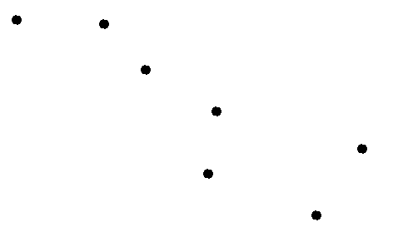
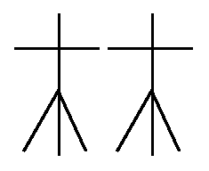
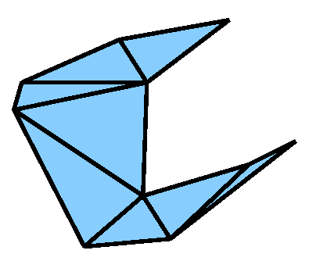
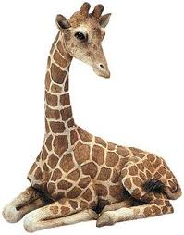
Computational Geometry
Algorithms and data structures for geometric objects
Convex hull:
Snap rubber band tight around pins
Voronoi diagram &
Delaunay triangulation:
Partition plane into regions
closest to post offices
Art gallery:
Guard art gallery with few guards

Slide 3
Introduction to Geometric Algorithms
Algorithm design techniques:
Divide and conquer
Sweep line algorithms
b
c
a
e
d
c
b
d
c
b
e
d
c
e
b
d
e
c
d

Slide 4
Introduction to Geometric Algorithms
Geometric data structures:
Range trees for database queries
5/8
5/8
8
5/8
8
2/7
2/7
7
2/7
6/6
5
6/6
6
6/6
3/5
3/5
5
3/5
7
2
1
6
9/3
3
5
9/3
3
7/2
7/2
2
7/2
1/1
1/1
1/1
5
2
7
1
3
6
9/3
1/1
2/7
3/5
5/8
6/6
7/2
Primary tree

Slide 5
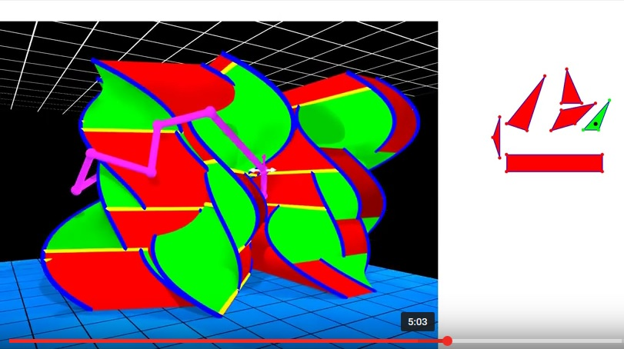

CMPS 3120/6120
Introduction to Computational Geometry
Related areas:
Algorithms, graph theory, combinatorics,
topology
Applied areas:
Databases, sensor networks, robotics,
computer graphics
Prerequisites:
CMPS 2200. Familiarity with linear
algebra preferred.
D. Ataria, G. Rote, “Configuration Space Visualization”,
Symposium on Computational Geometry, 2012
Class webpage:
www.cs.tulane.edu/~carola/teaching/cmps3120-6120/spring17

