Slide 1
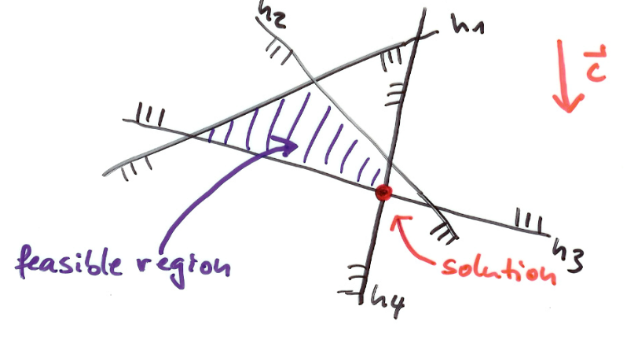
CMPS 3130/6130 Computational Geometry
Spring 2017
Linear Programming
& Halfplane Intersection
Carola Wenk

Slide 2
Optimization Problem
A company produces tables and chairs. The profit for a chair is $2, and for a table $4.
Machine group A needs 4 hours to produce a chair, and 6 hours for a table.
Machine group B needs 2 hours to produce a chair, and 6 hours for a table.
Per day there are at most 120 working hours for group A, and 72 working ours for group B.
How many chairs and tables should the company produce per day in order to maximize the profit?
Variables: c_{A}: # chairs produced on machine group A
c_{B}: # chairs produced on machine group B
t_{A}: # tables produced on machine group A
t_{B}: # tables produced on machine group B
Constraints: 4 c_{A} + 6 t_{A} ≤ 120
2 c_{B} + 6 t_{B} ≤ 72
Objective function (profit): Maximize 2(c_{A} + c_{B}) + 4(t_{A} + t_{B})

Slide 3
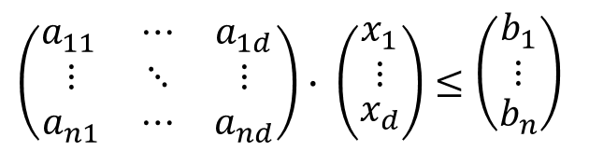
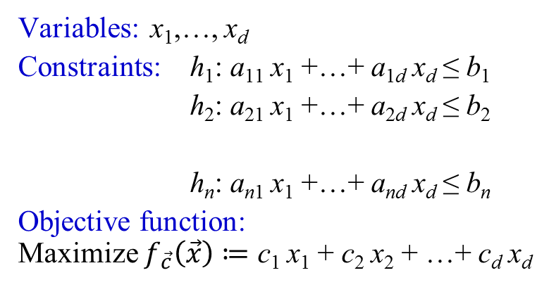


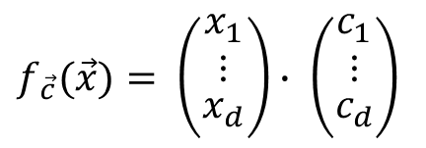
Linear Program (LP)
$$A∙\vec{x}≤\vec{b}$$
Variables: x₁,…, x_{d}
Constraints: h₁: a₁₁ x₁ +…+ a_{1d} x_{d} ≤ b₁
h₂: a₂₁ x₁ +…+ a_{2d} x_{d} ≤ b₂
h_{n}: a_{n1} x₁ +…+ a_{nd} x_{d} ≤ b_{n}
Objective function:
Maximize $f_{\vec{c}}\left(\vec{x}\right)≔$ c₁ x₁ + c₂ x₂ + …+ c_{d} x_{d}
$$\left(\begin{matrix}a_{11 } & ⋯ & a_{1d} \\ ⋮ & ⋱ & ⋮ \\ a_{n1} & ⋯ & a_{nd}\end{matrix}\right)∙ \left({\begin{aligned}x_{1} \\ ⋮\end{aligned} \atop x_{d}}\right)≤\left({\begin{aligned}b_{1} \\ ⋮\end{aligned} \atop b_{n}}\right)$$
…
…
$$f_{\vec{c}}(\vec{x})= \left({\begin{aligned}x_{1} \\ ⋮\end{aligned} \atop x_{d}}\right)∙ \left({\begin{aligned}c_{1} \\ ⋮\end{aligned} \atop c_{d}}\right)$$
$$\vec{x}∙\vec{c}$$
Linear Program in d variables with n constraints.

Slide 4
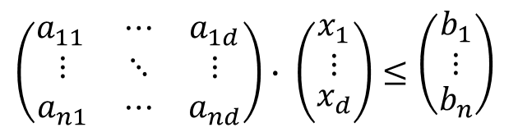
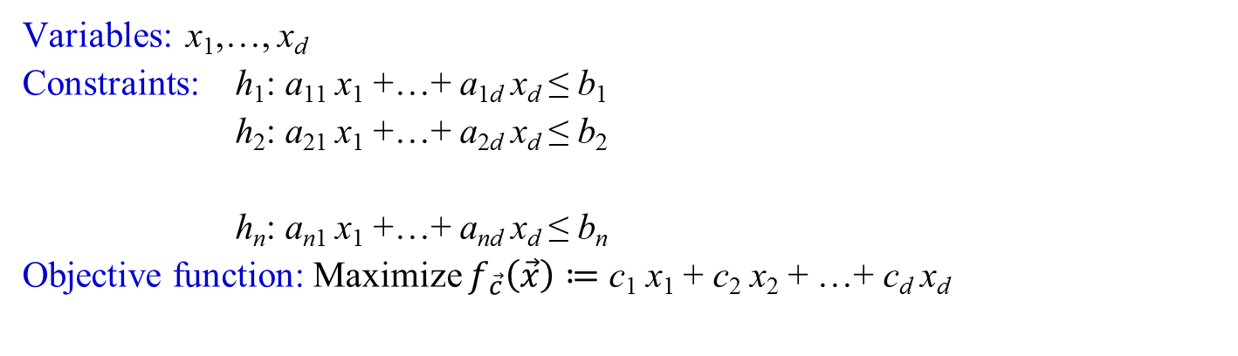
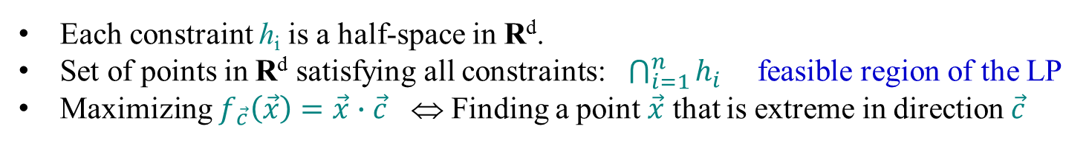

Linear Program (LP)
$$A∙\vec{x}≤\vec{b}$$
Variables: x₁,…, x_{d}
Constraints: h₁: a₁₁ x₁ +…+ a_{1d} x_{d} ≤ b₁
h₂: a₂₁ x₁ +…+ a_{2d} x_{d} ≤ b₂
h_{n}: a_{n1} x₁ +…+ a_{nd} x_{d} ≤ b_{n}
Objective function: Maximize $f_{\vec{c}}\left(\vec{x}\right)≔$ c₁ x₁ + c₂ x₂ + …+ c_{d} x_{d}
$$\left(\begin{matrix}a_{11 } & ⋯ & a_{1d} \\ ⋮ & ⋱ & ⋮ \\ a_{n1} & ⋯ & a_{nd}\end{matrix}\right)∙ \left({\begin{aligned}x_{1} \\ ⋮\end{aligned} \atop x_{d}}\right)≤\left({\begin{aligned}b_{1} \\ ⋮\end{aligned} \atop b_{n}}\right)$$
…
…
Each constraint h_{i} is a half-space in R^{d}.
Set of points in R^{d} satisfying all constraints: $\bigcap_{i=1}^{n}{h_{i}}$ feasible region of the LP
Maximizing $f_{\vec{c}}\left(\vec{x}\right)=\vec{x}∙\vec{c}$ ⇔ Finding a point $\vec{x}$ that is extreme in direction $\vec{c}$

Slide 5
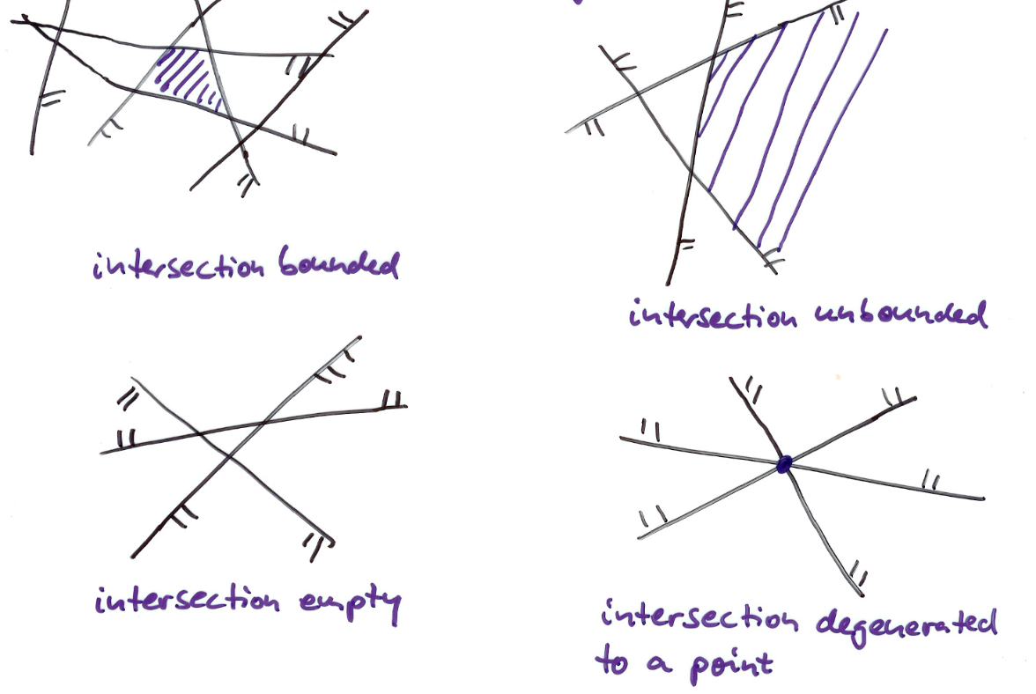
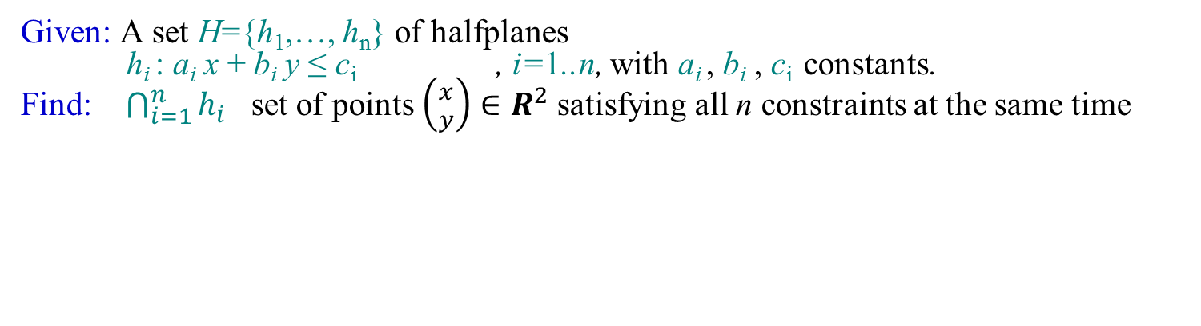
Subproblem: Half-Plane Intersection
Given: A set H={h₁,…, h_{n}} of halfplanes
h_{i} : a_{i} x + b_{i} y ≤ c_{i} , i=1..n, with a_{i} , b_{i} , c_{i} constants.
Find: $\bigcap_{i=1}^{n}{h_{i}}$ set of points $\left({x \atop y}\right)∈R^{2}$ satisfying all n constraints at the same time
Convex polygonal region bounded by at most n edges

Slide 6
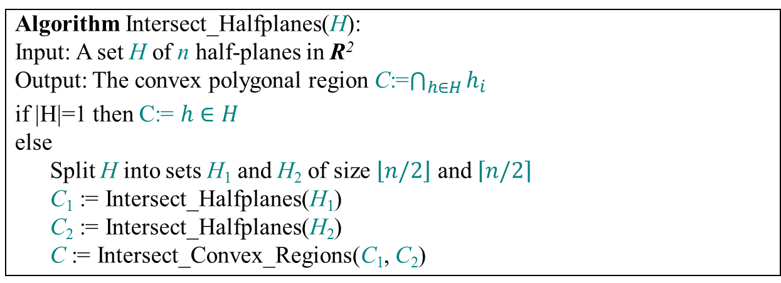
Divide & Conquer Algorithm
Algorithm Intersect_Halfplanes(H):
Input: A set H of n half-planes in R²
Output: The convex polygonal region C:=$\bigcap_{h∈H}{h_{i}}$
if |H|=1 then C:= $h∈H$
else
Split H into sets H₁ and H₂ of size $\left\lfloor n/2\right\rfloor$ and $\left\lceil n/2\right\rceil$
C₁ := Intersect_Halfplanes(H₁)
C₂ := Intersect_Halfplanes(H₂)
C := Intersect_Convex_Regions(C₁, C₂)
Can implement Intersect_Convex_Regions using a sweep in O(n) time: Just update constant-complexity interval intersecting the sweep line
Runtime recurrence is T(n)=2T(n/2)+n, and hence the runtime is O(n log n)

Slide 7
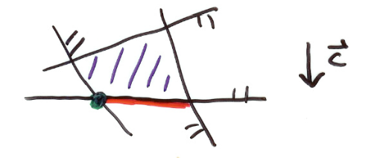
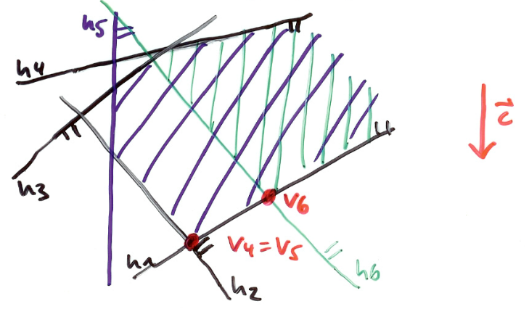
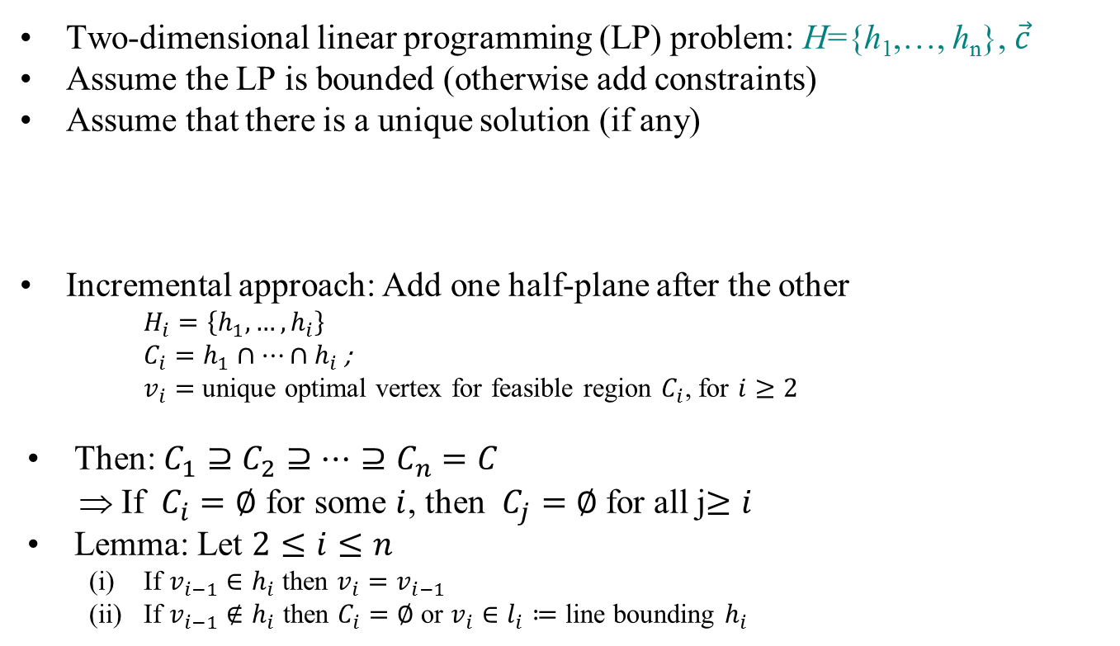
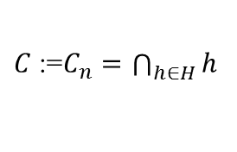
Incremental Linear Programming
Two-dimensional linear programming (LP) problem: H={h₁,…, h_{n}}, $\vec{c}$
Assume the LP is bounded (otherwise add constraints)
Assume that there is a unique solution (if any)
Incremental approach: Add one half-plane after the other
$H_{i}=\left\{h_{1},…, h_{i}\right\}$
$C_{i}=h_{1}∩…∩h_{i}$ ;
$v_{i}=$ unique optimal vertex for feasible region $C_{i}$, for $i≥2$
Then: $C_{1}⊇C_{2}⊇…⊇C_{n}=C$
⇒ If $C_{i}=∅$ for some $i$, then $C_{j}=∅$ for all j$≥i$
Lemma: Let $2≤i≤n$
  If $v_{i−1}∈h_{i}$ then $v_{i}=v_{i−1}$
  If $v_{i−1}∉h_{i}$ then $C_{i}=∅$ or $v_{i}∈l_{i}≔$ line bounding $h_{i}$
Take lexicographically smallest solution
$C$:=$C_{n}=\bigcap_{h∈H}{h}$

Slide 8
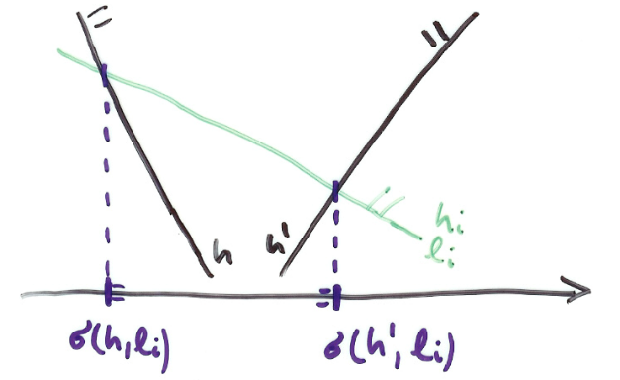
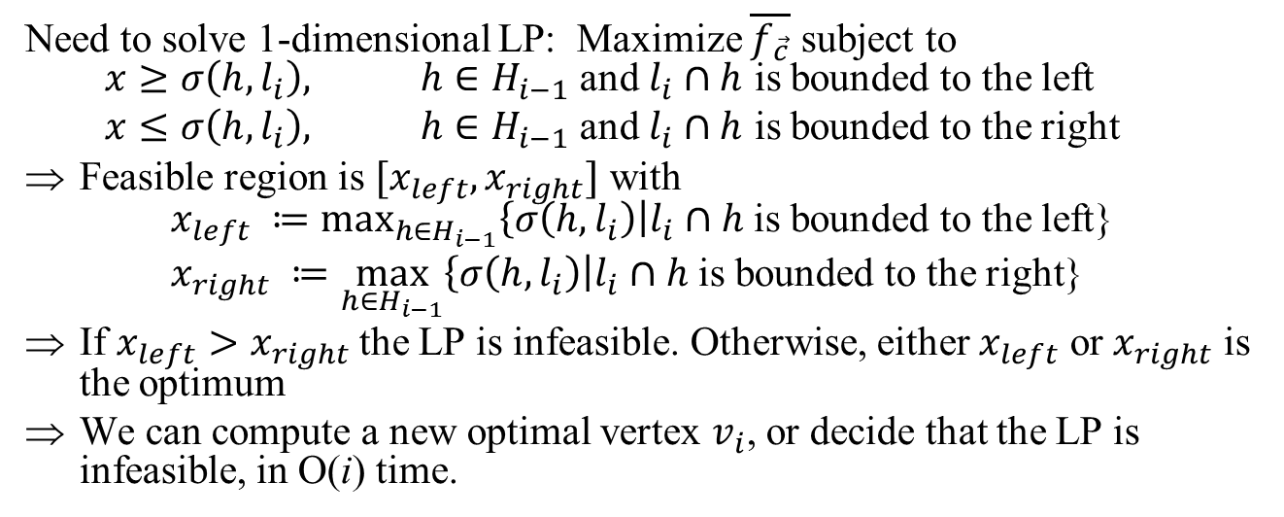

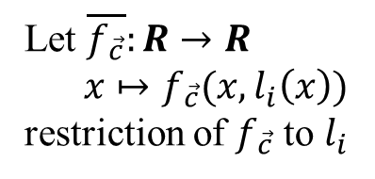
Handle case (ii):$v_{i−1}∉h_{i}$
Let $\overline{f_{\vec{c}}}:R→R$
$x↦f_{\vec{c}}(x,l_{i}\left(x\right))$
restriction of $f_{\vec{c}}$ to $l_{i}$
Need to solve 1-dimensional LP: Maximize $\overline{f_{\vec{c}}}$ subject to
$x≥σ\left(h,l_{i}\right), h∈H_{i−1}$ and $l_{i}∩h$ is bounded to the left
$x≤σ\left(h,l_{i}\right), h∈H_{i−1}$ and $l_{i}∩h$ is bounded to the right
Feasible region is $[x_{left}, x_{right}]$ with
$x_{left} ≔\max_{h∈H_{i−1}}\left\{σ\left(h,l_{i}\right)\right|l_{i}∩h$is bounded to the left}
$x_{right} ≔\max_{h∈H_{i−1}}\left\{σ\left(h,l_{i}\right)\right|l_{i}∩h$is bounded to the right}
If $x_{left}>x_{right}$the LP is infeasible. Otherwise, either $x_{left}$ or $x_{right}$ is the optimum
We can compute a new optimal vertex $v_{i}$, or decide that the LP is infeasible, in O(i) time.

Slide 9
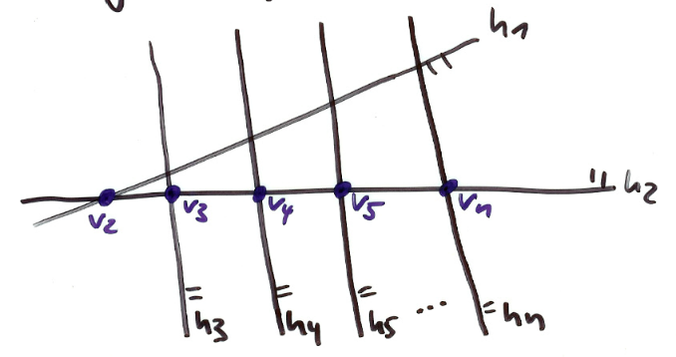
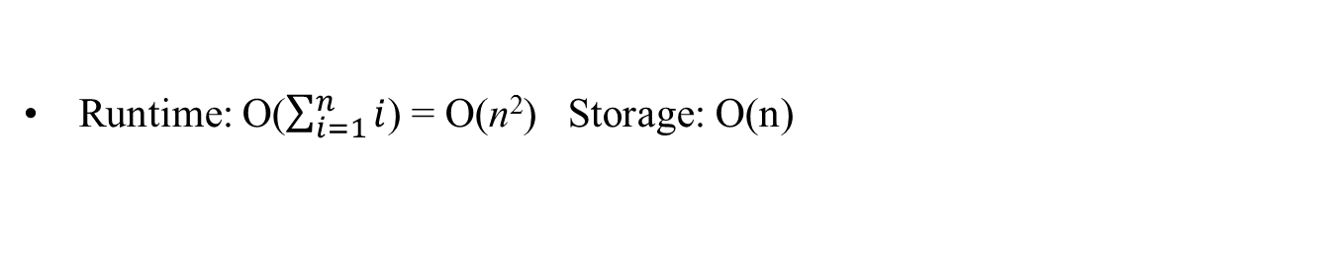
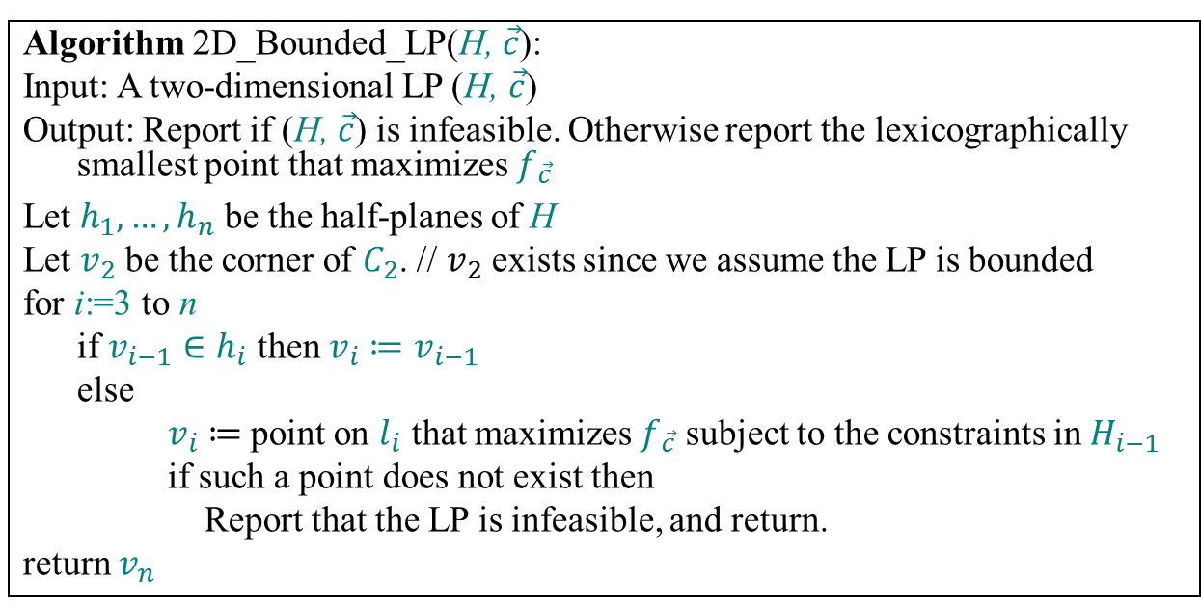

Algorithm
Algorithm 2D_Bounded_LP(H, $\vec{c}$):
Input: A two-dimensional LP (H, $\vec{c}$)
Output: Report if (H, $\vec{c}$) is infeasible. Otherwise report the lexicographically smallest point that maximizes $f_{\vec{c}}$
Let $h_{1}, …, h_{n}$ be the half-planes of H
Let $v_{2}$ be the corner of $C_{2}$. // $v_{2}$ exists since we assume the LP is bounded
for i:=3 to n
if $v_{i−1}∈h_{i}$ then ${v_{i}≔v}_{i−1}$
else
$v_{i}≔$point on $l_{i}$ that maximizes $f_{\vec{c}}$ subject to the constraints in $H_{i−1}$
if such a point does not exist then
Report that the LP is infeasible, and return.
return $v_{n}$
O(1)
O(i)
Runtime: O($\sum_{i=1}^{n}{i}$) = O(n²) Storage: O(n)
In this example, each step takes O(i) time
$$\vec{c}$$

Slide 10
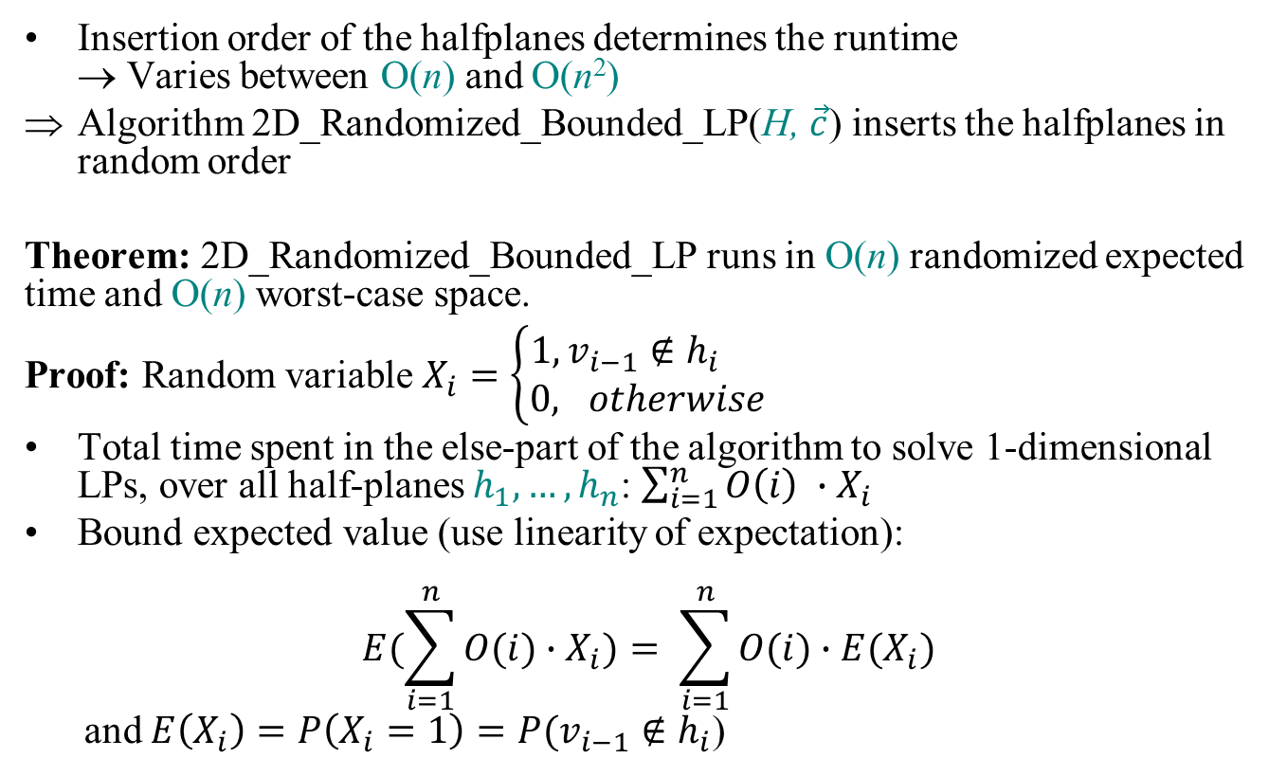
Randomized Incremental Linear Programming
Insertion order of the halfplanes determines the runtime
→ Varies between O(n) and O(n²)
Algorithm 2D_Randomized_Bounded_LP(H, $\vec{c}$) inserts the halfplanes in random order
Theorem: 2D_Randomized_Bounded_LP runs in O(n) randomized expected time and O(n) worst-case space.
Proof: Random variable $X_{i}=\left\{\begin{aligned}1, v_{i−1}∉h_{i} \\ 0, otherwise\end{aligned}\right.$
Total time spent in the else-part of the algorithm to solve 1-dimensional LPs, over all half-planes $h_{1}, …, h_{n}$: $\sum_{i=1}^{n}{O\left(i\right) ∙X_{i}}$
Bound expected value (use linearity of expectation):
$$E(\sum_{i=1}^{n}{O(i)∙X_{i})= \sum_{i=1}^{n}{O(i)∙E(X_{i})}}$$
and $E\left(X_{i}\right)=P\left(X_{i}=1\right)=P(v_{i−1}∉h_{i}$)

Slide 11
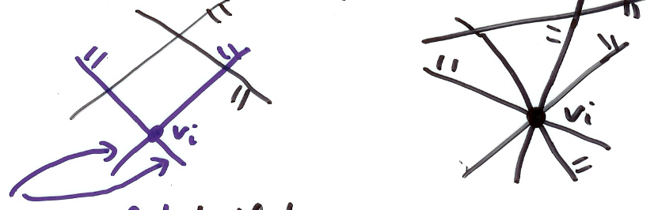
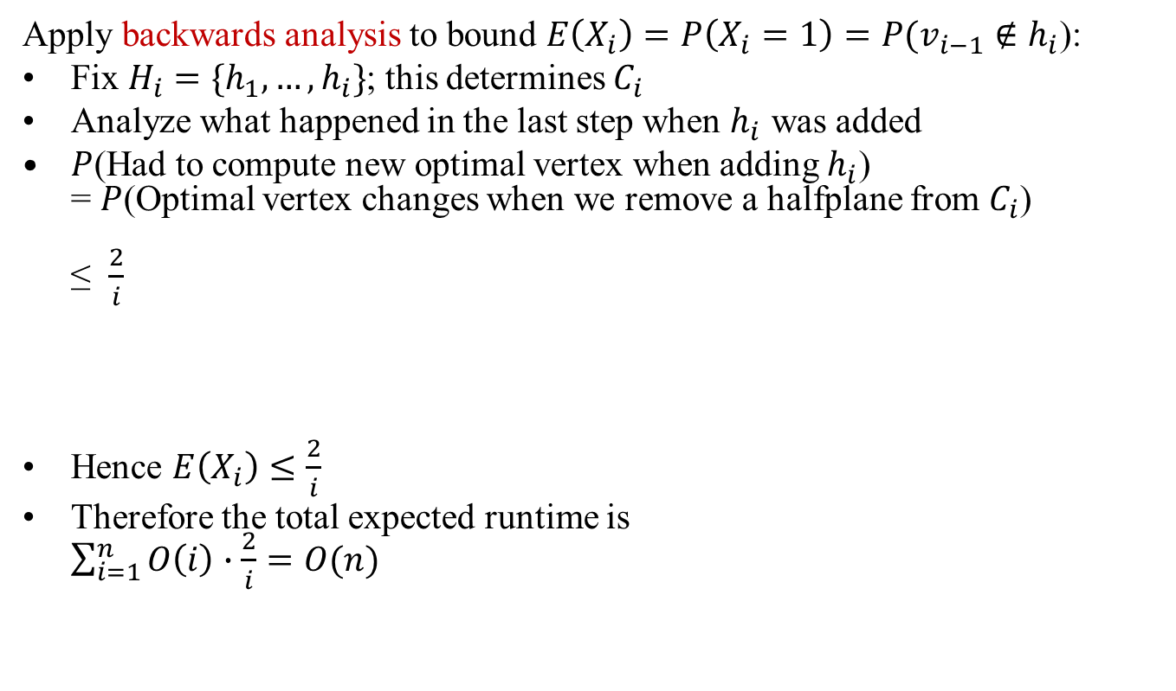



Randomized Incremental Linear Programming
Apply backwards analysis to bound $E\left(X_{i}\right)=P\left(X_{i}=1\right)=P(v_{i−1}∉h_{i}$):
Fix $H_{i}=\{h_{1},…, h_{i}\}$; this determines $C_{i}$
Analyze what happened in the last step when $h_{i}$ was added
$P$(Had to compute new optimal vertex when adding $h_{i}$)
= $P$(Optimal vertex changes when we remove a halfplane from $C_{i}$)
≤ $\frac{2}{i}$
Hence $E\left(X_{i}\right)≤\frac{2}{i}$
Therefore the total expected runtime is
$\sum_{i=1}^{n}{O\left(i\right)∙\frac{2}{i}=O(n)}$
$$\frac{2}{i}$$
$$0$$
2 out of $i$ halfplanes defining $v_{i}$

