Slide 1
CMPS 3130/6130 Computational Geometry Spring 2017
Delaunay Triangulations II
Carola Wenk
Based on: Computational Geometry: Algorithms and Applications

Slide 2
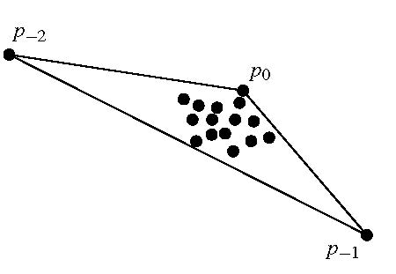
Randomized Incremental Construction of DT(P)
Start with a large triangle containing P.
Insert points of P incrementally:
Find the containing triangle
Add new edges
Flip all illegal edges until every edge is legal.

Slide 3
Randomized Incremental Construction of DT(P)
p_{r}
p_{r}
An edge can become illegal only if one of its incident triangles changes.
Check only edges of new triangles.
Every new edge created is incident to p_{r}.
Every old edge is legal (if p_{r} is on on one of the incident triangles, the edge would have been flipped if it were illegal).
Every new edge is legal (since it has been created from flipping a previously legal edge).
flip
shrink circle
empty circle ⇒ Delaunay edge
p_{r}
p_{r}
p_{r}

Slide 4
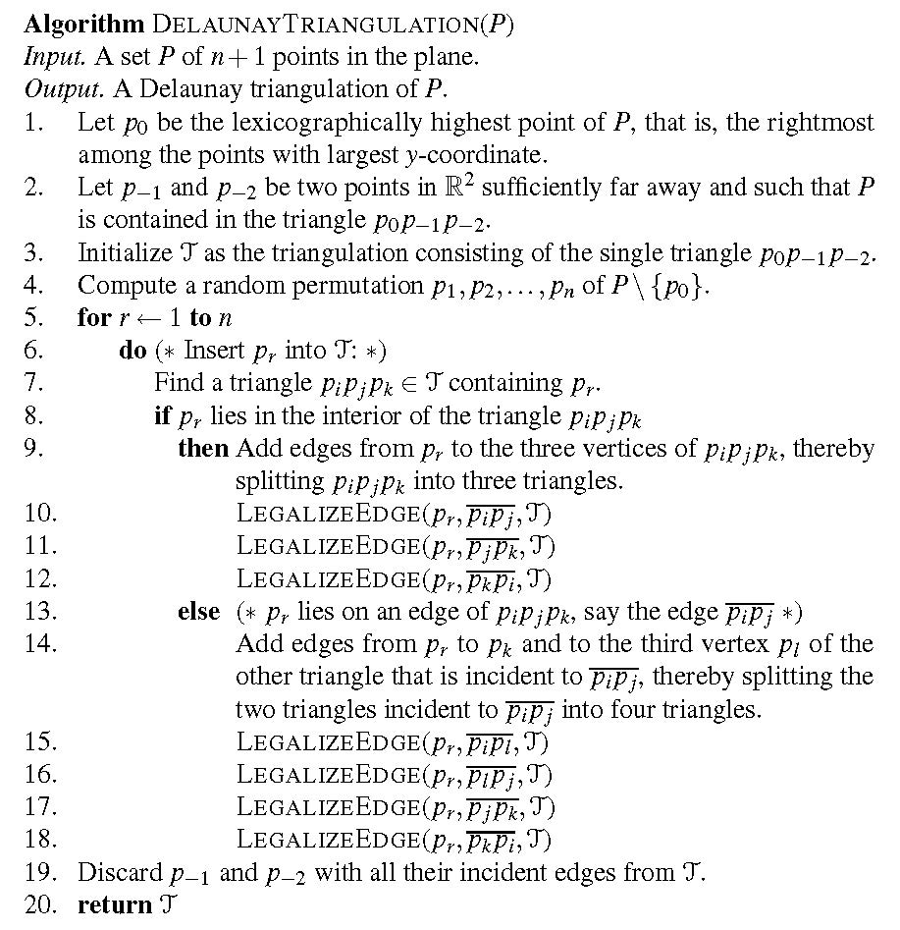
Pseudo Code

Slide 5
History
The algorithm stores the history of the constructed triangles. This allows to easily locate the triangle containing a new point by following pointers.
Division of a triangle:
Flip:
Store pointers from the old triangle to the three new triangles.
Store pointers from both old triangles to both new triangles.

Slide 6
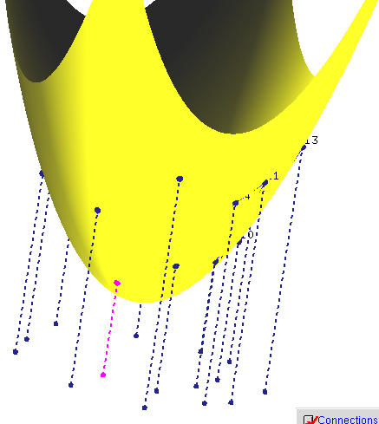
DT and 3D CH
Theorem: Let P={p₁,…,p_{n}} with p_{i}=(a_{i}, b_{i},0). Let p*_{i} =(a_{i}, b_{i}, a²_{i}+ b²_{i}) be the vertical projection of each point p_{i} onto the paraboloid z=x²+ y². Then DT(P) is the orthogonal projection onto the plane z=0 of the lower convex hull of P*={p*₁,…,p*_{n}} .
P*
P
Pictures generated with Hull2VD tool available at http://www.cs.mtu.edu/~shene/NSF-2/DM2-BETA

Slide 7
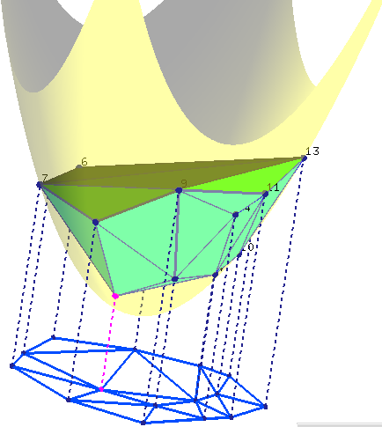
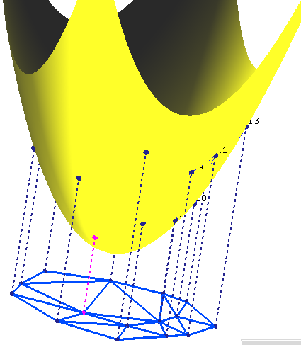
DT and 3D CH
Theorem: Let P={p₁,…,p_{n}} with p_{i}=(a_{i}, b_{i},0). Let p’_{i} =(a_{i}, b_{i}, a²_{i}+ b²_{i}) be the vertical projection of each point p_{i} onto the paraboloid z=x²+ y². Then DT(P) is the orthogonal projection onto the plane z=0 of the lower convex hull of P’={p’₁,…,p’_{n}} .
Pictures generated with Hull2VD tool available at http://www.cs.mtu.edu/~shene/NSF-2/DM2-BETA

Slide 8
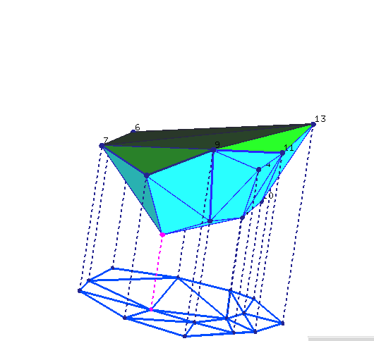
DT and 3D CH
Theorem: Let P={p₁,…,p_{n}} with p_{i}=(a_{i}, b_{i},0). Let p’_{i} =(a_{i}, b_{i}, a²_{i}+ b²_{i}) be the vertical projection of each point p_{i} onto the paraboloid z=x²+ y². Then DT(P) is the orthogonal projection onto the plane z=0 of the lower convex hull of P’={p’₁,…,p’_{n}} .
Pictures generated with Hull2VD tool available at http://www.cs.mtu.edu/~shene/NSF-2/DM2-BETA

Slide 9
DT and 3D CH
Theorem: Let P={p₁,…,p_{n}} with p_{i}=(a_{i}, b_{i},0). Let p’_{i} =(a_{i}, b_{i}, a²_{i}+ b²_{i}) be the vertical projection of each point p_{i} onto the paraboloid z=x²+ y². Then DT(P) is the orthogonal projection onto the plane z=0 of the lower convex hull of P’={p’₁,…,p’_{n}} .
P’_{i,} p’_{j,} p’_{k} form a (triangular) face of LCH(P’)
⇔
The plane through p’_{i,} p’_{j,} p’_{k} leaves all remaining points of P above it ⇔
The circle through p_{i,} p_{j,} p_{k} leaves all remaining points of P in its exterior ⇔
p_{i,} p_{j,} p_{k} form a triangle of DT(P)
property of unit paraboloid
Slide adapted from slides by Vera Sacristan.

