Slide 1
CMPS 3130/6130 Computational Geometry Spring 2017
Delaunay Triangulations I
Carola Wenk
Based on: Computational Geometry: Algorithms and Applications

Slide 2
Triangulation
Let $P=\left\{p_{1},…,p_{n}\right\}⊆R^{2}$ be a finite set of points in the plane.
A triangulation of P is a simple, plane (i.e., planar embedded), connected graph T=(P,E) such that
every edge in E is a line segment,
the outer face is bounded by edges of CH(P),
all inner faces are triangles.

Slide 3
Dual Graph
Let $G=(V,E)$ be a plane graph. The dual graph G* has
a vertex for every face of G,
an edge for every edge of G, between the two faces incident to the original edge

Slide 4
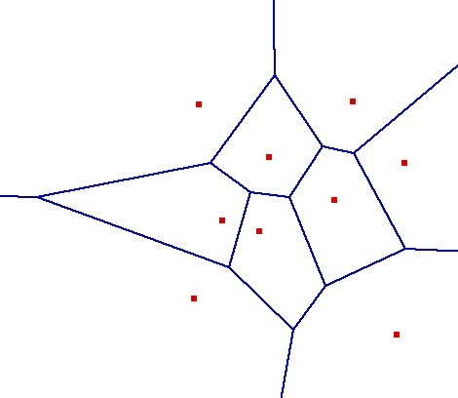
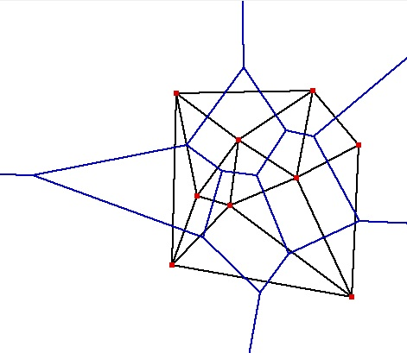
Delaunay Triangulation
Let $G$be the plane graph for the Voronoi diagram VD(P) . Then the dual graph G* is called the Delaunay Triangulation DT(P).
Canonical straight-line embedding for DT(P):
VD(P)
P
DT(P)
If P is in general position (no three points on a line, no four points on a circle) then every inner face of DT(P) is indeed a triangle.
DT(P) can be stored as an abstract graph, without geometric information. (No such obvious storing scheme for VD(P).)

Slide 5
Straight-Line Embedding
Lemma: DT(P) is a plane graph, i.e., the straight-line edges do not intersect.
Proof:
q
p
pp’ is an edge of DT(P) ⇔ There is an empty closed disk D_{p} with p and p’ on its boundary, and its center c on the bisector.
Let qq’ be another Delaunay edge that intersects pp’
⇒ q and q’ lie outside of D_{p} , therefore qq’ also intersects pc or p’c
Symmetrically, pp’ also intersects qc’ or q’c’
(pc or p’c’) and (qc’ or q’c’) intersect
The edges do not lie in different Voronoi cells.
Contradiction
D_{p}
pc ⊂ V(p) p’c ⊂ V(p’)
c
p’
q’
p
q
qc' ⊂ V(q) q’c’ ⊂ V(q’)
D_{q}
c’
q’
p’

Slide 6
Characterization I of DT(P)
Lemma: Let p,q,r∈P let Δ be the triangle they define. Then the following statements are equivalent:
Δ belongs to DT(P)
The circumcenter c of Δ is a vertex in VD(P)
The circumcircle of Δ is empty (i.e., contains no other point of P)
Proof sketch: All follow directly from the definition of DT(P) in VD(P). By definition of VD(P), we know that p,q,r are c’s nearest neighbors.
Characterization I: Let T be a triangulation of P. Then T=DT(P) ⇔ The circumcircle of any triangle in T is empty.
non-empty circumcircle
p_{l}
p_{i}
p_{j}
p_{k}

Slide 7
Illegal Edges
Definition: Let p_{i}, p_{j}, p_{k}, p_{l}∈P . Then p_{i} p_{j} is an illegal edge ⇔ p_{l} lies in the interior of the circle through p_{i}, p_{j}, p_{k} .
Lemma: Let p_{i}, p_{j}, p_{k}, p_{l}∈P . Then p_{i} p_{j} is illegal ⇔ min α_{i} < min α’_{i}
p_{l}
p_{i}
p_{j}
p_{k}
illegal edge
p_{l}
1≤i≤6
1≤i≤6
p_{l}
p_{i}
α₆
α₅
p_{j}
edge flip
p_{i}
α’₆
α’₅
p_{j}
α₁
α₄
α’₁
α’₄
α₂
s
α₃
α’₂
α’₃
p
q
p_{k}
p_{k}
Theorem (Thales): Let a, b, p, q be four points on a circle, and let r be inside and let s be outside of the circle, such that p,q,r,s lie on the same side of the line through a, b. Then ∠a,s,b < ∠a,q,b = ∠a,p,b < ∠a,r,b
r
a
b

Slide 8
Characterization II of DT(P)
Definition: A triangulation is called legal if it does not contain any illegal edges.
Characterization II: Let T be a triangulation of P. Then T=DT(P) ⇔ T is legal.
Algorithm Legal_Triangulation(T):
Input: A triangulation T of a point set P
Output: A legal triangulation of P
while T contains an illegal edge p_{i}p_{j} do //Flip p_{i}p_{j} Let p_{i}, p_{j}, p_{k}, p_{l} be the quadrilateral containing p_{i}p_{j} Remove p_{i}p_{j} and add p_{k}p_{l}
return T
Runtime analysis:
In every iteration of the loop the angle vector of T (all angles in T sorted by increasing value) increases
With this one can show that a flipped edge never appears again
There are O(n²) edges, therefore the runtime is O(n²)
p_{l}
p_{i}
p_{j}
p_{k}
edge flip
p_{l}
p_{i}
p_{j}
p_{k}

Slide 9
Characterization III of DT(P)
Definition: Let T be a triangulation of P and let α₁, α₂,…, α_{3m} be the angles of the m triangles in T sorted by increasing value. Then A(T)=(α₁,α₂,…,α_{3m}) is called the angle vector of T.
Definition: A triangulation T is called angle optimal ⇔ A(T) > A(T’) for any other triangulation of the same point set P.
Let T’ be a triangulation that contains an illegal edge, and let T’’ be the resulting triangulation after flipping this edge. Then A(T’’) > A(T’) .
T is angle optimal ⇒ T is legal ⇒ T=DT(P)
Characterization III: Let T be a triangulation of P. Then T=DT(P) ⇔ T is angle optimal. (If P is not in general position, then any triangulation obtained by triangulating the faces maximizes the minimum angle.)

Slide 10
Applications of DT
All nearest neighbors: Find for each p∈P its nearest neighbor q∈P; q≠p.
Empty circle property: p,q∈P are connected by an edge in DT(P) ⇔ there exists an empty circle passing through p and q. Proof: “⇒”: For the Delaunay edge pq there must be a Voronoi edge. Center a circle through p and q at any point on the Voronoi edge, this circle must be empty. “⇐”: If there is an empty circle through p and q, then its center c has to lie on the Voronoi edge because it is equidistant to p and q and there is no site closer to c.
Claim: In DT(P), every p∈P is adjacent to its nearest neighbors. Proof: Let q∈P be a nearest neighbor adjacent to p in DT(P). Then the circle centered at p with q on its boundary has to be empty, so the circle with diameter pq is empty and pq is a Delaunay edge.
Algorithm: Find all nearest neighbors in O(n) time: Check for each p∈P all points connected to p with a Delaunay edge.
Minimum spanning tree: The edges of every Euclidean minimum spanning tree of P are a subset of the edges of DT(P).
p
q
p
q

Slide 11
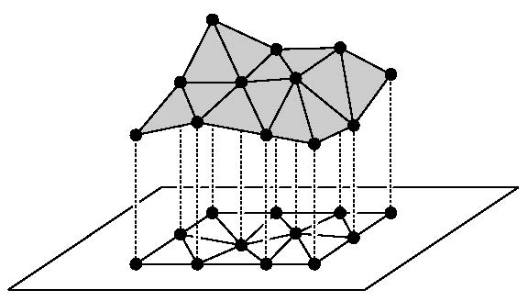
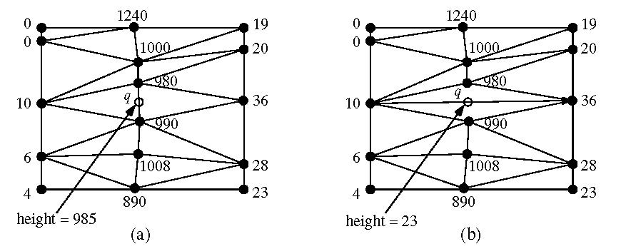
Applications of DT
Terrain modeling:
Model a scanned terrain surface by interpolating the height using a piecewise linear function over R².
Angle-optimal triangulations give better approximations / interpolations since they avoid skinny triangles

