Slide 1
CMPS 3130/6130 Computational Geometry
Spring 2015
B
A
δ→(B,A)
Shape Matching
Carola Wenk

Slide 2
Are these shapes similar?
When are two shapes similar?
Translate

Slide 3
Are these shapes similar?
When are two shapes similar?
Translate
Translate & Rotate

Slide 4
Are these shapes similar?
When are two shapes similar?
Translate
Translate & Rotate
Translate & Scale

Slide 5
Are these shapes similar?
When are two shapes similar?
Translate
Translate & Rotate
Translate & Scale
Translate & Reflect

Slide 6
Are these shapes similar?
When are two shapes similar?
Translate
Translate & Rotate
Translate & Scale
Translate & Reflect
Partial Matching

Slide 7
Are these shapes similar?
When are two shapes similar?
Translate
Translate & Rotate
Translate & Scale
Translate & Reflect
Partial Matching

Slide 8

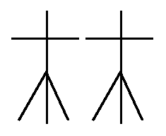
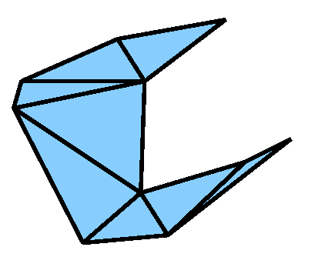
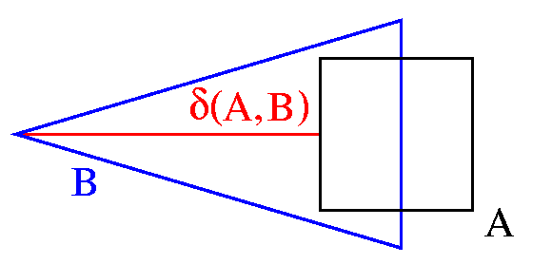
Geometric Shape Matching
Given:
Two geometric shapes, each composed of a number of basic objects such as
points
line segments
triangles
An application dependant distance measure δ, e.g., the Hausdorff distance
A set of transformations T, e.g., translations, rigid motions, or none
Matching Task: Compute
min δ(T(A),B)
Τ∈Τ

Slide 9
Hausdorff distance
Directed Hausdorff distance
δ→(A,B) = max min || a-b ||
Undirected Hausdorff-distance
  δ(A,B) = max (δ→(A,B) , δ→(B,A) )
B
A
a ∈A b∈B
δ→(B,A)
δ→(A,B)
If A, B are discrete point sets, |A|=m, |A|=n
  In d dimensions: Compute in O(mn) time brute-force
  In 2 dimensions: Compute in O((m+n) log (m+n) time
    Compute δ→(A,B) by computing VD(B) and performing nearest neighbor search for every point in A

Slide 10
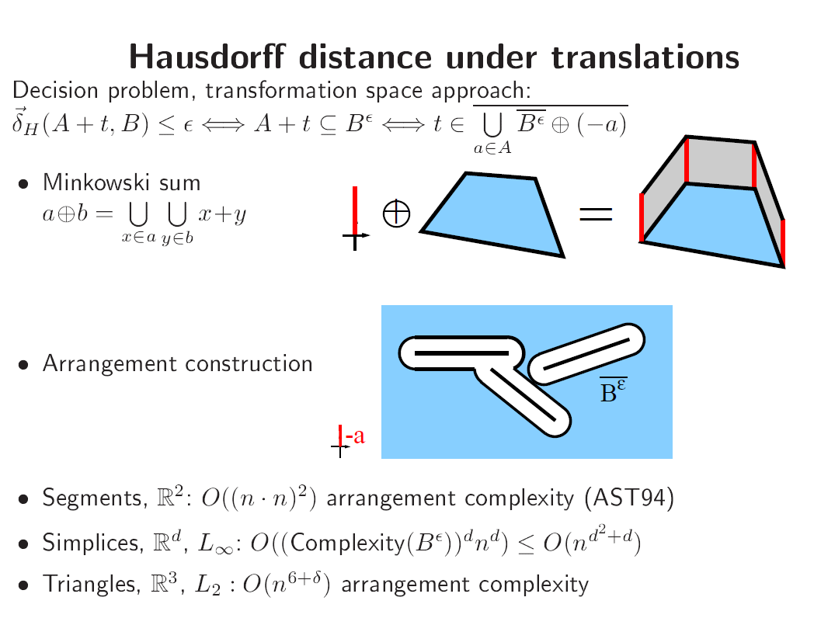
Shape Matching - Applications
Character Recognition
Fingerprint Identification
Molecule Docking, Drug Design
Image Interpretation and Segmentation
Quality Control of Workpieces
Robotics
Pose Determination of Satellites
Puzzling
. . .

Slide 11
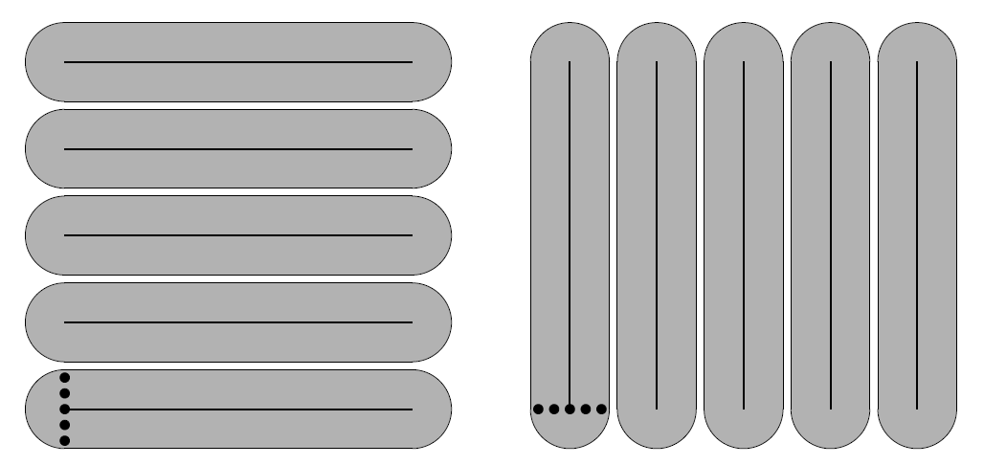
Hausdorff distance
Ω(m²n²) lower bound construction for directed Hausdorff distance of line segments under translations

Slide 12
Comparing Curves and Trajectories

Slide 13
Polygonal Curves
Let f,g:[0,1] → R^{d} be two polygonal curves (i.e., piecewise linear curves)
What are good distance measures for curves?
  Hausdorff distance?
  Fréchet distance?
f
g

Slide 14
When Are Two Curves „Similar“?
Directed Hausdorff distance
δ_{Η}→(A,B) = max min || a-b ||
Undirected Hausdorff-distance
  δ_{Η} (A,B) = max (δ_{Η}→(A,B) , δ_{Η}→(B,A) )
  But:
B
A
a ∈A b∈B
δ_{Η}→(B,A)
δ_{Η}→(A,B)
Small Hausdorff distance
When considered as curves the distance should be large
The Fréchet distance takes the continuity of the curves into account

Slide 15
Fréchet Distance for Curves
δ_{F}(f,g) = inf max ||f(α(t))-g(β(t))||
α,β:[0,1] [0,1] t ∈[0,1]
where α and β range over continuous monotone increasing reparameterizations only.
Man and dog walk on one curve each
They hold each other at a leash
They are only allowed to go forward
δ_{F} is the minimal possible leash length
f
g
[F06] M. Fréchet, Sur quelques points de calcul fonctionel, Rendiconti del Circolo Mathematico di Palermo 22: 1-74, 1906.

Slide 16
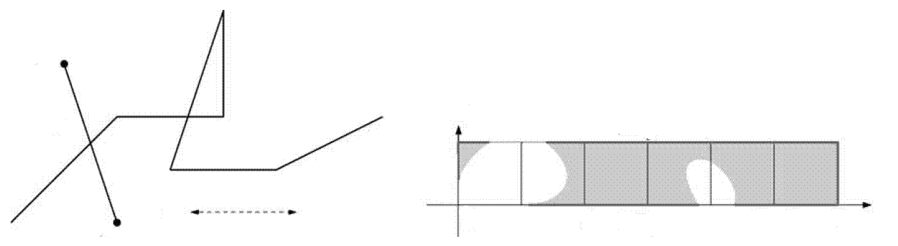
Free Space Diagram
g
>ε
f
g
1
≤ε
ε
0
1
2
3
4
5
6
f
Let ε > 0 fixed (eventually solve decision problem)
F_{ε}(f,g) = { (s,t)∈[0,1]² | || f(s) - g(t)|| ≤ ε } white points
free space of f and g
The free space in one cell is an ellipse.

Slide 17
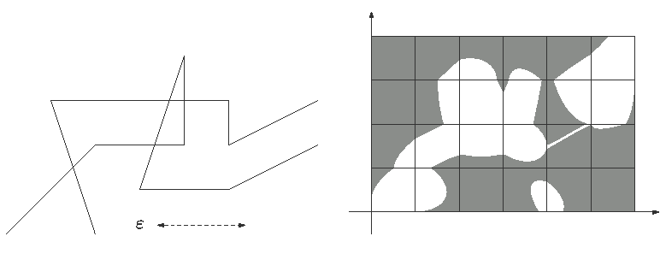
Free Space Diagram
g
g
f
f
Let ε > 0 fixed (eventually solve decision problem)
F_{ε}(f,g) = { (s,t)∈[0,1]² | || f(s) - g(t)|| ≤ ε } white points
free space of f and g
The free space in one cell is an ellipse.

Slide 18
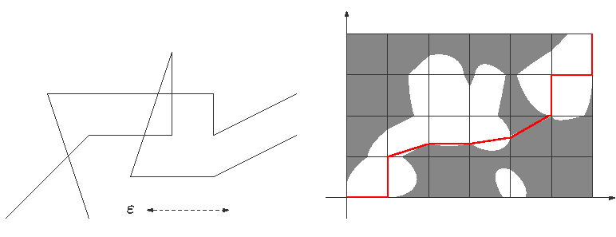
Free Space Diagram
g
α
g
β
f
f
Monotone path encodes reparametrizations of f and g
δ_{F}(f,g) ≤ ε iff there is a monotone path in the free space from (0,0) to (1,1)

Slide 19
Compute the Fréchet Distance
g
1
Solve the decision problem
δ_{F}(f,g) ≤ ε in O(mn) time:
  Find monotone path using DP:
  On each cell boundary compute the interval of all points that are reachable by a monotone path from (0,0)
  Compute a monotone path by backtracking
α
β
f
0
0
1
Solve the optimization problem
  In practice in O(mn log b) time with binary search and b-bit precision
  In O(mn log mn) time [AG95] using parametric search (using Cole‘s sorting trick)
  In O(mn log²mn) expected time [CW09] with randomized red/blue intersections
[AG95] H. Alt, M. Godau, Computing the Fréchet distance between two polygonal curves, IJCGA 5: 75-91, 1995.
[CW10] A.F. Cook IV, C. Wenk, Geodesic Fréchet Distance Inside a Simple Polygon, ACM TALG 7(1), 19 pages, 2010.

Slide 20
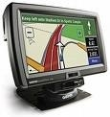
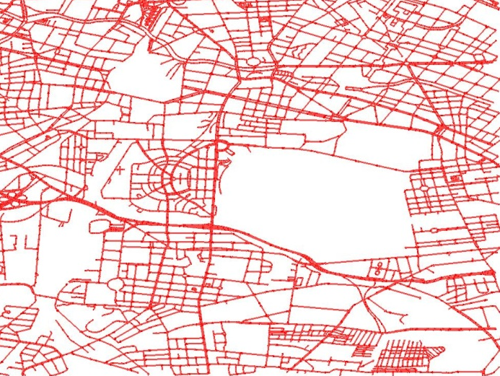
GPS Trajectories for Dynamic Routing
Navigation systems answer shortest path queries based on travel times on road segments
Usually based on static travel-time weights derived from speed limits
Goal: Develop a navigation system which answers routing queries based on the current traffic situation
B
A
Current traffic situation:
  Database of current travel times per road segment
  Use GPS trajectory data from vehicle fleets

Slide 21
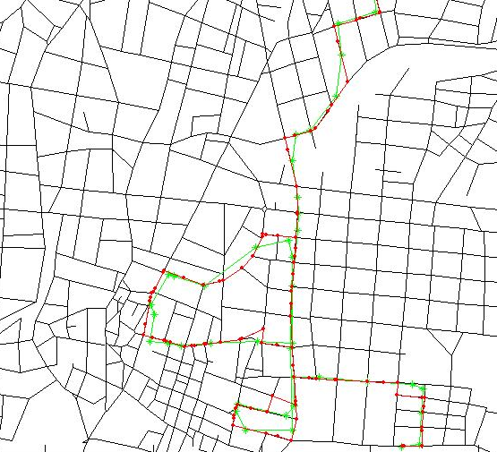
GPS Trajectories from Vehicles
Measurement error: GPS points generally do not lie on the road map
Sampling error:
The GPS trajectory is a by-product and is usually sampled every 30s
⇒ The GPS trajectory does not lie on the road map
Map matching:
Find a path in the graph which corresponds to the GPS trajectory (curve).
Find a path in the graph with minimal distance to the GPS curve (partial matching)
Road map of
Athens
GPS trajectoriy
Corresponding path in the road map

Slide 22
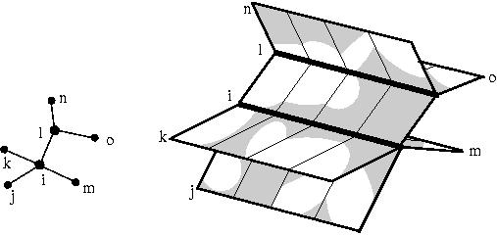
Free Space Surface
G
Glue the free space diagrams FD_{i,j} together according to adjacency information in G
Free space surface of f and G
[AERW03] H. Alt, A. Efrat, G. Rote, C. Wenk, Matching Planar Maps, J. of Algorithms 49: 262-283, 2003.
[BPSW05] S. Brakatsoulas, D. Pfoser, R. Salas, C. Wenk, On Map-Matching Vehicle Tracking Data , VLDB 853-864 , 2005.
[WSP06] C. Wenk, R. Salas, D. Pfoser, Adressing the Need for Map-Matching Speed…, SSDBM: 379-388, 2006.

Slide 23
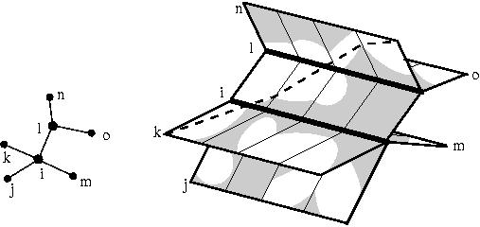
Free Space Surface
G
Task: Find a monotone path in the free space surface that
  starts in a lower left corner
  and ends in an upper right corner
[AERW03] H. Alt, A. Efrat, G. Rote, C. Wenk, Matching Planar Maps, J. of Algorithms 49: 262-283, 2003.
[BPSW05] S. Brakatsoulas, D. Pfoser, R. Salas, C. Wenk, On Map-Matching Vehicle Tracking Data , VLDB 853-864 , 2005.
[WSP06] C. Wenk, R. Salas, D. Pfoser, Adressing the Need for Map-Matching Speed…, SSDBM: 379-388, 2006.

Slide 24
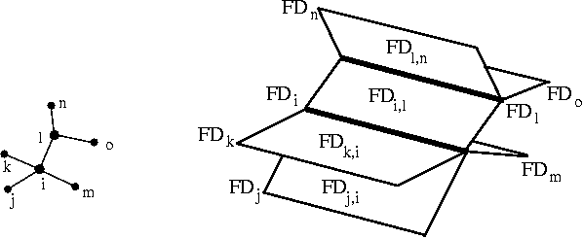
Sweep
G
Sweep all FD_{i,j} with a sweep line from left to right
[AERW03] H. Alt, A. Efrat, G. Rote, C. Wenk, Matching Planar Maps, J. of Algorithms 49: 262-283, 2003.
[BPSW05] S. Brakatsoulas, D. Pfoser, R. Salas, C. Wenk, On Map-Matching Vehicle Tracking Data , VLDB 853-864 , 2005.
[WSP06] C. Wenk, R. Salas, D. Pfoser, Adressing the Need for Map-Matching Speed…, SSDBM: 379-388, 2006.

Slide 25
Sweep
G
Sweep all FD_{i,j} with a sweep line from left to right
[AERW03] H. Alt, A. Efrat, G. Rote, C. Wenk, Matching Planar Maps, J. of Algorithms 49: 262-283, 2003.
[BPSW05] S. Brakatsoulas, D. Pfoser, R. Salas, C. Wenk, On Map-Matching Vehicle Tracking Data , VLDB 853-864 , 2005.
[WSP06] C. Wenk, R. Salas, D. Pfoser, Adressing the Need for Map-Matching Speed…, SSDBM: 379-388, 2006.

Slide 26
Sweep
G
Sweep all FD_{i,j} with a sweep line from left to right
[AERW03] H. Alt, A. Efrat, G. Rote, C. Wenk, Matching Planar Maps, J. of Algorithms 49: 262-283, 2003.
[BPSW05] S. Brakatsoulas, D. Pfoser, R. Salas, C. Wenk, On Map-Matching Vehicle Tracking Data , VLDB 853-864 , 2005.
[WSP06] C. Wenk, R. Salas, D. Pfoser, Adressing the Need for Map-Matching Speed…, SSDBM: 379-388, 2006.

Slide 27
Sweep
G
Sweep all FD_{i,j} with a sweep line from left to right
[AERW03] H. Alt, A. Efrat, G. Rote, C. Wenk, Matching Planar Maps, J. of Algorithms 49: 262-283, 2003.
[BPSW05] S. Brakatsoulas, D. Pfoser, R. Salas, C. Wenk, On Map-Matching Vehicle Tracking Data , VLDB 853-864 , 2005.
[WSP06] C. Wenk, R. Salas, D. Pfoser, Adressing the Need for Map-Matching Speed…, SSDBM: 379-388, 2006.

Slide 28
Sweep
G
Sweep all FD_{i,j} with a sweep line from left to right
[AERW03] H. Alt, A. Efrat, G. Rote, C. Wenk, Matching Planar Maps, J. of Algorithms 49: 262-283, 2003.
[BPSW05] S. Brakatsoulas, D. Pfoser, R. Salas, C. Wenk, On Map-Matching Vehicle Tracking Data , VLDB 853-864 , 2005.
[WSP06] C. Wenk, R. Salas, D. Pfoser, Adressing the Need for Map-Matching Speed…, SSDBM: 379-388, 2006.

Slide 29
Sweep
G
Sweep all FD_{i,j} with a sweep line from left to right
[AERW03] H. Alt, A. Efrat, G. Rote, C. Wenk, Matching Planar Maps, J. of Algorithms 49: 262-283, 2003.
[BPSW05] S. Brakatsoulas, D. Pfoser, R. Salas, C. Wenk, On Map-Matching Vehicle Tracking Data , VLDB 853-864 , 2005.
[WSP06] C. Wenk, R. Salas, D. Pfoser, Adressing the Need for Map-Matching Speed…, SSDBM: 379-388, 2006.

Slide 30
Sweep
G
Sweep all FD_{i,j} with a sweep line from left to right
[AERW03] H. Alt, A. Efrat, G. Rote, C. Wenk, Matching Planar Maps, J. of Algorithms 49: 262-283, 2003.
[BPSW05] S. Brakatsoulas, D. Pfoser, R. Salas, C. Wenk, On Map-Matching Vehicle Tracking Data , VLDB 853-864 , 2005.
[WSP06] C. Wenk, R. Salas, D. Pfoser, Adressing the Need for Map-Matching Speed…, SSDBM: 379-388, 2006.

Slide 31
Compute Reachable Points
G
During the sweep:
  Compute points on the free space surface, to the left of the sweep line, which are reachable by a monotone path from a lower left corner.
[AERW03] H. Alt, A. Efrat, G. Rote, C. Wenk, Matching Planar Maps, J. of Algorithms 49: 262-283, 2003.
[BPSW05] S. Brakatsoulas, D. Pfoser, R. Salas, C. Wenk, On Map-Matching Vehicle Tracking Data , VLDB 853-864 , 2005.
[WSP06] C. Wenk, R. Salas, D. Pfoser, Adressing the Need for Map-Matching Speed…, SSDBM: 379-388, 2006.

Slide 32
Compute Reachable Points
G
During the sweep:
  Compute points on the free space surface, to the left of the sweep line, which are reachable by a monotone path from a lower left corner.
[AERW03] H. Alt, A. Efrat, G. Rote, C. Wenk, Matching Planar Maps, J. of Algorithms 49: 262-283, 2003.
[BPSW05] S. Brakatsoulas, D. Pfoser, R. Salas, C. Wenk, On Map-Matching Vehicle Tracking Data , VLDB 853-864 , 2005.
[WSP06] C. Wenk, R. Salas, D. Pfoser, Adressing the Need for Map-Matching Speed…, SSDBM: 379-388, 2006.

Slide 33
Compute Reachable Points
G
During the sweep:
  Compute points on the free space surface, to the left of the sweep line, which are reachable by a monotone path from a lower left corner.
[AERW03] H. Alt, A. Efrat, G. Rote, C. Wenk, Matching Planar Maps, J. of Algorithms 49: 262-283, 2003.
[BPSW05] S. Brakatsoulas, D. Pfoser, R. Salas, C. Wenk, On Map-Matching Vehicle Tracking Data , VLDB 853-864 , 2005.
[WSP06] C. Wenk, R. Salas, D. Pfoser, Adressing the Need for Map-Matching Speed…, SSDBM: 379-388, 2006.

Slide 34
Compute Reachable Points
G
During the sweep:
  Compute points on the free space surface, to the left of the sweep line, which are reachable by a monotone path from a lower left corner.
[AERW03] H. Alt, A. Efrat, G. Rote, C. Wenk, Matching Planar Maps, J. of Algorithms 49: 262-283, 2003.
[BPSW05] S. Brakatsoulas, D. Pfoser, R. Salas, C. Wenk, On Map-Matching Vehicle Tracking Data , VLDB 853-864 , 2005.
[WSP06] C. Wenk, R. Salas, D. Pfoser, Adressing the Need for Map-Matching Speed…, SSDBM: 379-388, 2006.

Slide 35
Update Reachable Points
G
During the sweep:
  Update reachable points Dijkstra-style
  Use a data structure which supports reachability queries in the free space surface
[AERW03] H. Alt, A. Efrat, G. Rote, C. Wenk, Matching Planar Maps, J. of Algorithms 49: 262-283, 2003.
[BPSW05] S. Brakatsoulas, D. Pfoser, R. Salas, C. Wenk, On Map-Matching Vehicle Tracking Data , VLDB 853-864 , 2005.
[WSP06] C. Wenk, R. Salas, D. Pfoser, Adressing the Need for Map-Matching Speed…, SSDBM: 379-388, 2006.

Slide 36
Update Reachable Points
G
During the sweep:
  Update reachable points Dijkstra-style
  Use a data structure which supports reachability queries in the free space surface
[AERW03] H. Alt, A. Efrat, G. Rote, C. Wenk, Matching Planar Maps, J. of Algorithms 49: 262-283, 2003.
[BPSW05] S. Brakatsoulas, D. Pfoser, R. Salas, C. Wenk, On Map-Matching Vehicle Tracking Data , VLDB 853-864 , 2005.
[WSP06] C. Wenk, R. Salas, D. Pfoser, Adressing the Need for Map-Matching Speed…, SSDBM: 379-388, 2006.

Slide 37
Update Reachable Points
G
During the sweep:
  Update reachable points Dijkstra-style
  Use a data structure which supports reachability queries in the free space surface
[AERW03] H. Alt, A. Efrat, G. Rote, C. Wenk, Matching Planar Maps, J. of Algorithms 49: 262-283, 2003.
[BPSW05] S. Brakatsoulas, D. Pfoser, R. Salas, C. Wenk, On Map-Matching Vehicle Tracking Data , VLDB 853-864 , 2005.
[WSP06] C. Wenk, R. Salas, D. Pfoser, Adressing the Need for Map-Matching Speed…, SSDBM: 379-388, 2006.

Slide 38
Update Reachable Points
G
During the sweep:
  Update reachable points Dijkstra-style
  Use a data structure which supports reachability queries in the free space surface
[AERW03] H. Alt, A. Efrat, G. Rote, C. Wenk, Matching Planar Maps, J. of Algorithms 49: 262-283, 2003.
[BPSW05] S. Brakatsoulas, D. Pfoser, R. Salas, C. Wenk, On Map-Matching Vehicle Tracking Data , VLDB 853-864 , 2005.
[WSP06] C. Wenk, R. Salas, D. Pfoser, Adressing the Need for Map-Matching Speed…, SSDBM: 379-388, 2006.

Slide 39
Update Reachable Points
G
During the sweep:
  Update reachable points Dijkstra-style
  Use a data structure which supports reachability queries in the free space surface
[AERW03] H. Alt, A. Efrat, G. Rote, C. Wenk, Matching Planar Maps, J. of Algorithms 49: 262-283, 2003.
[BPSW05] S. Brakatsoulas, D. Pfoser, R. Salas, C. Wenk, On Map-Matching Vehicle Tracking Data , VLDB 853-864 , 2005.
[WSP06] C. Wenk, R. Salas, D. Pfoser, Adressing the Need for Map-Matching Speed…, SSDBM: 379-388, 2006.

Slide 40
Update Reachable Points
G
During the sweep:
  Update reachable points Dijkstra-style
  Use a data structure which supports reachability queries in the free space surface
[AERW03] H. Alt, A. Efrat, G. Rote, C. Wenk, Matching Planar Maps, J. of Algorithms 49: 262-283, 2003.
[BPSW05] S. Brakatsoulas, D. Pfoser, R. Salas, C. Wenk, On Map-Matching Vehicle Tracking Data , VLDB 853-864 , 2005.
[WSP06] C. Wenk, R. Salas, D. Pfoser, Adressing the Need for Map-Matching Speed…, SSDBM: 379-388, 2006.

Slide 41
Update Reachable Points
G
During the sweep:
  Update reachable points Dijkstra-style
  Use a data structure which supports reachability queries in the free space surface
[AERW03] H. Alt, A. Efrat, G. Rote, C. Wenk, Matching Planar Maps, J. of Algorithms 49: 262-283, 2003.
[BPSW05] S. Brakatsoulas, D. Pfoser, R. Salas, C. Wenk, On Map-Matching Vehicle Tracking Data , VLDB 853-864 , 2005.
[WSP06] C. Wenk, R. Salas, D. Pfoser, Adressing the Need for Map-Matching Speed…, SSDBM: 379-388, 2006.

Slide 42
Update Reachable Points
G
During the sweep:
  Update reachable points Dijkstra-style
  Use a data structure which supports reachability queries in the free space surface
[AERW03] H. Alt, A. Efrat, G. Rote, C. Wenk, Matching Planar Maps, J. of Algorithms 49: 262-283, 2003.
[BPSW05] S. Brakatsoulas, D. Pfoser, R. Salas, C. Wenk, On Map-Matching Vehicle Tracking Data , VLDB 853-864 , 2005.
[WSP06] C. Wenk, R. Salas, D. Pfoser, Adressing the Need for Map-Matching Speed…, SSDBM: 379-388, 2006.

Slide 43
Update Reachable Points
G
During the sweep:
  Update reachable points Dijkstra-style
  Use a data structure which supports reachability queries in the free space surface
[AERW03] H. Alt, A. Efrat, G. Rote, C. Wenk, Matching Planar Maps, J. of Algorithms 49: 262-283, 2003.
[BPSW05] S. Brakatsoulas, D. Pfoser, R. Salas, C. Wenk, On Map-Matching Vehicle Tracking Data , VLDB 853-864 , 2005.
[WSP06] C. Wenk, R. Salas, D. Pfoser, Adressing the Need for Map-Matching Speed…, SSDBM: 379-388, 2006.

Slide 44
Backtracking
G
After the sweep:
  Construct a monotone path via backtracking
[AERW03] H. Alt, A. Efrat, G. Rote, C. Wenk, Matching Planar Maps, J. of Algorithms 49: 262-283, 2003.
[BPSW05] S. Brakatsoulas, D. Pfoser, R. Salas, C. Wenk, On Map-Matching Vehicle Tracking Data , VLDB 853-864 , 2005.
[WSP06] C. Wenk, R. Salas, D. Pfoser, Adressing the Need for Map-Matching Speed…, SSDBM: 379-388, 2006.

Slide 45
Map-Matching
Algorithm for decision problem takes O(mn log(mn)) time and O(mn) space.
Optimization problem with parametric search:
O(mn log²(mn)) time
[AERW03] H. Alt, A. Efrat, G. Rote, C. Wenk, Matching Planar Maps, J. of Algorithms 49: 262-283, 2003.
[BPSW05] S. Brakatsoulas, D. Pfoser, R. Salas, C. Wenk, On Map-Matching Vehicle Tracking Data , VLDB 853-864 , 2005.
[WSP06] C. Wenk, R. Salas, D. Pfoser, Adressing the Need for Map-Matching Speed…, SSDBM: 379-388, 2006.

