Slide 1
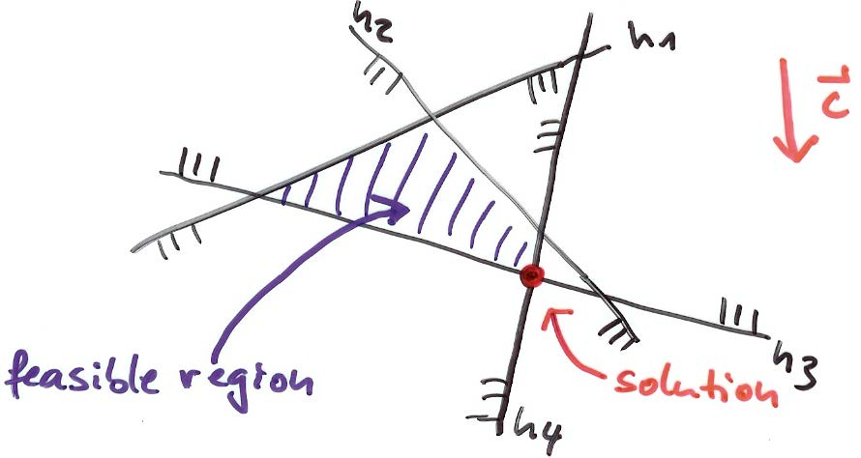
CMPS 3130/6130 Computational Geometry Spring 2015
Linear Programming and Halfplane Intersection Carola Wenk

Slide 2
Word Problem
A company produces tables and chairs. The profit for a chair is $2, and for a table $4. Machine group A needs 4 hours to produce a chair, and 6 hours to produce a table. Machine group B needs 2 hours to produce a chair, and 6 hours to produce a table. Per day there are at most 120 working hours for group A and at most 72 hours for group B.
How can the company maximize profit?
Variables: c_{A} = # chairs produced on machine group A c_{B} = # chairs produced on machine group B t_{A} = # tables produced on machine group A t_{B} = # tables produced on machine group B
Constraints: 4c_{A} +6t_{A} ≤ 120
2c_{B} +6t_{B} ≤ 72
Objective function (profit): Maximize 2(c_{A}+c_{B})+4(t_{A}+t_{B})

Slide 3
Linear Programming
Variables: x₁,…,x_{d}
Constraints: h₁: a₁₁ x₁+…+a_{1d} x_{d} ≤ b₁
h₂: a₂₁ x₁+…+a_{2d} x_{d} ≤ b₂
. . .
h_{n}: a_{n1} x₁+…+a_{nd} x_{d} ≤ b_{n}
Objective function: Maximize f_{c} (x) = c₁ x₁+…+c_{d} x_{d}
Linear program in d variables with
n constraints
Each constraint h_{i} is a half-space in R^{d}
$\bigcap_{i=1}^{n}{h_{i}}$ is the feasible region of the linear program
Maximizing f_{c} (x) corresponds to finding a point x that is extreme in direction c.

Slide 4
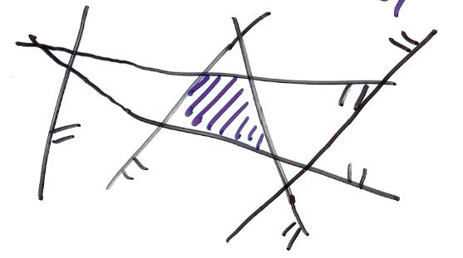
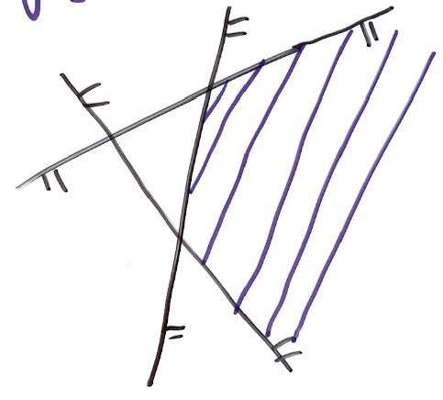
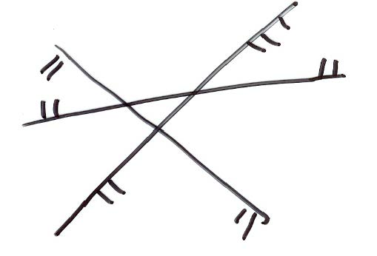
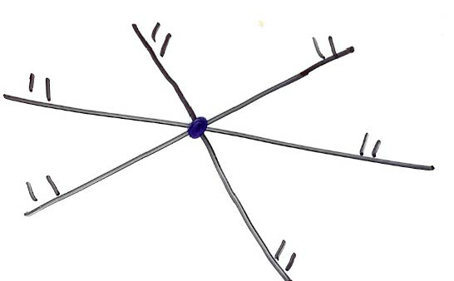
Sub-Problem: Halfspace Intersection (in R²: Halfplane Intersection)
Given: A set H={h₁, h₂, …, h_{n}} of halfplanes h_{i}: a_{i} x + b_{i} y ≤ c_{i} with constants a_{i}, b_{i}, c_{i} ; for i=1,…,n .
Find: $\bigcap_{i=1}^{n}{h_{i}}$ , i.e., the feasible region of all points (x,y)∈R² satisfying all n constraints at the same time. This is a convex polygonal region bounded by at most n edges.
intersection bounded
intersection degenerated to a point
intersection unbounded
intersection empty

Slide 5
D&C Halfplane Intersection
Algorithm Intersect_Halfplanes(H):
Input: A set H of n halfplanes in R²
Output: The convex polygonal region C= $\bigcap_{h∈H}{h}$
if |H|=1 then C = h , where H={h}
else
split H into two sets H₁ and H₂ of size n/2 each
C₁ = Intersect_Halfplanes(H₁)
C₂ = Intersect_Halfplanes(H₂)
C = Intersect_Convex_Regions(C₁, C₂)
return C
Use a plane-sweep to develop an O(n)-time algorithm for Intersect_Convex_Regions
T(n) = 2T(n/2)+n ⇒ T(n)∈O(n log n)

Slide 6
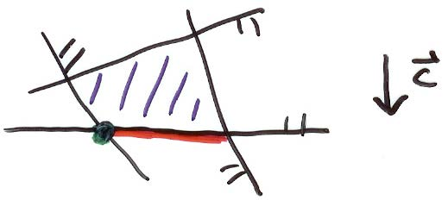
Incremental Linear Programming
2D linear program (LP)
Assume the LP is bounded (otherwise add constraints)
Assume there is one unique solution (if any); take the lexicographically smallest solution
Incremental approach: Add one halfplane after the other.
$H_{i}=\left\{h_{1},…,h_{i}\right\}$ $C_{i}=h_{1}∩…∩h_{i}$ $C=C_{n}=\bigcap_{h∈H}{h}$
Let v_{i} = unique optimal vertex for feasible region C_{i} , for $i≥2$ .
Then $C_{1}⊇C_{2}⊇ … ⊇C_{n}=C$ , and hence if $C_{i}=∅$ for some $i$ then $C_{j}=∅$ for all $j≥i$ .

Slide 7
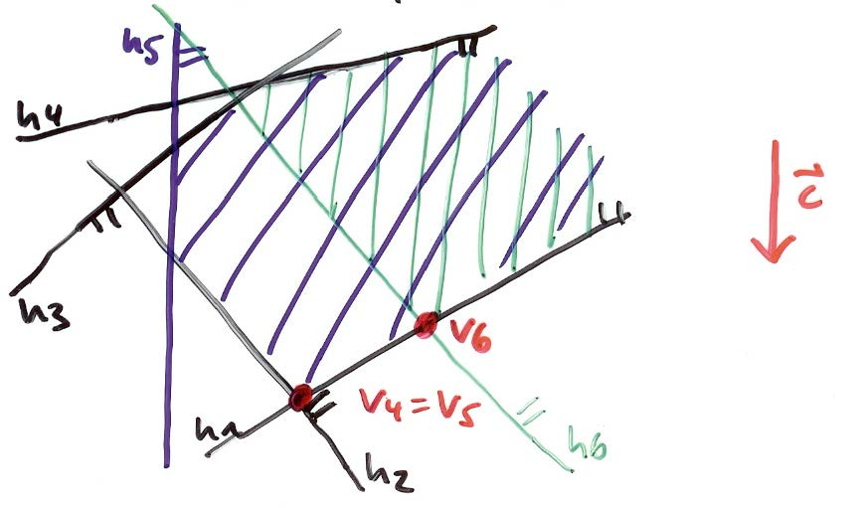
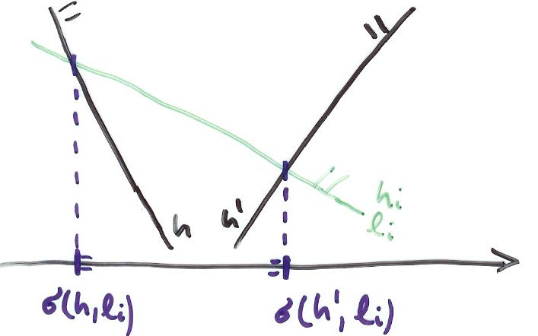
Incremental Linear Programming
Lemma: Let 2≤i≤n.
If $v_{i−1}∈h_{i}$ then ${v_{i}=v}_{i−1}$
If $v_{i−1}∉h_{i}$ then $C_{i}=∅$ or $v_{i}∈l_{i}=$the line bounding $h_{i}$
Handling case (ii) involves solving a 1-dimensional LP on $l_{i}$ :
The feasible region is just an interval, that can be computed in linear time [rightmost left-bounded halfplane, leftmost right-bounded halfplane]
⇒ We can compute a new $v_{i}$, or decide that the LP is infeasible, in O(i) time

Slide 8
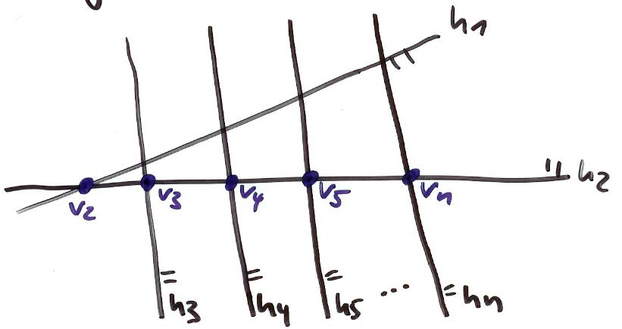
2D_Bounded_LP
Algorithm 2D_Bounded_LP(H , c ):
Input: A two-dimensional LP (H , c )
Output: Report if (H , c ) is infeasible. Otherwise report the lexicographically smallest point that maximizes f _{c} .
Let $h_{1},…,h_{n}$ be the halfplanes of H
Let $v_{2}$ be the corner of $C_{2}$, which exists because LP is bounded
for i=3 to n do
if $v_{i−1}∈h_{i}$then ${v_{i}=v}_{i−1}$
else // Case (ii)
$v_{i}=$ point on $l_{i}$ that maximizes f _{c} subject to constraints in $H_{i−1}$
if such a point does not exist then Report that the LP is infeasible break;
return $v_{n}$
Runtime: $\sum_{i=1}^{n}{O(i)}=O(n^{2})$ Storage: $O(n)$

Slide 9
Randomized Incremental LP
Depending on the insertion order of the halfplanes the runtime varies between O(n) and O(n²). ⇒ Randomize the input order of the halfplanes.
Theorem: 2D_Randomized_Bounded_LP runs in O(n) expected time and O(n) deterministic space.
Proof: Define a random variable $X_{i}=\left\{\begin{aligned}1, v_{i−1}∉h_{i} \\ 0, else \end{aligned}\right.$
The total time spent to resolve case (ii), over all $h_{1},…,h_{n}$is $$\sum_{i=1}^{n}{O\left(i\right)X_{i}}$$

Slide 10
Randomized Incremental LP
We now need to bound the expected value E($\sum_{i=1}^{n}{O\left(i\right)X_{i})=\sum_{i=1}^{n}{O\left(i\right){E(X}_{i}) }}$
and we know that ${E(X}_{i})=P\left(X_{i}\right)=P(v_{i−1}∉h_{i})$.
Apply backwards analysis to bound ${E(X}_{i})$:
Fix $H_{i}=\left\{h_{1},…,h_{i}\right\}$ which determines $C_{i}$.
Analyze what happened in last step when $h_{i}$ was added.
P(had to compute new optimal vertex when adding $h_{i}$) = P(optimal vertex changes when we remove a halfplane from $C_{i}$) $≤\frac{2}{i}$
⇒ $E(X_{i})≤\frac{2}{i}$
⇒ Total expected runtime is $\sum_{i=1}^{n}{O\left(i\right)\frac{2}{i}=O(n) }$
2 lines defining v_{i}

