Slide 1
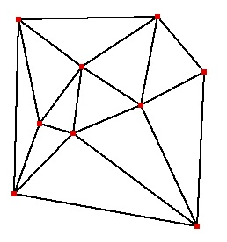

CMPS 3130/6130 Computational Geometry
Spring 2015
Delaunay Triangulations II
Carola Wenk
Based on:
Computational Geometry: Algorithms and Applications

Slide 2
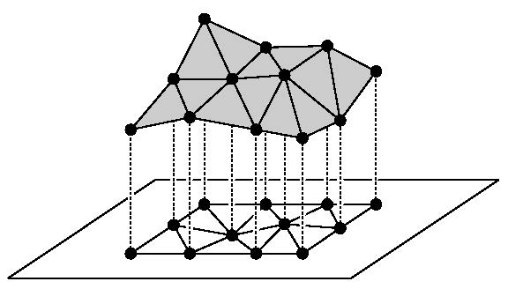
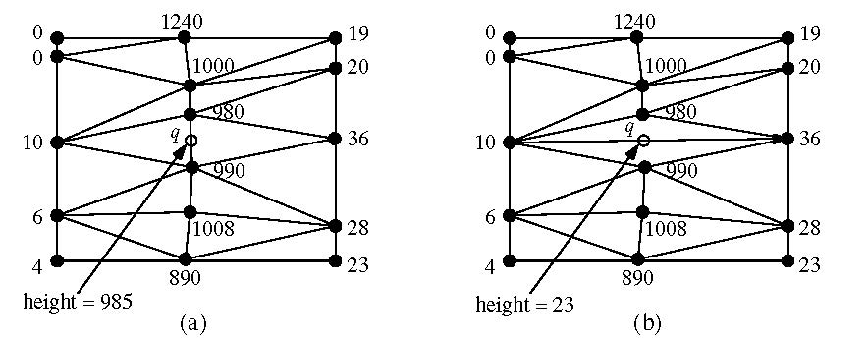
Applications of DT
Terrain modeling:
  Model a scanned terrain surface by interpolating the height using a piecewise linear function over R².
  Angle-optimal triangulations give better approximations / interpolations since they avoid skinny triangles

Slide 3
Applications of DT
All nearest neighbors: Find for each p∈P its nearest neighbor q∈P; q≠p.
  Empty circle property: p,q∈P are connected by an edge in DT(P)
  ⇔ there exists an empty circle passing through p and p.
  Proof: “⇒”: For the Delaunay edge pq there must be a Voronoi edge.
  Center a circle through p and q at any point on the Voronoi edge,
  this circle must be empty.
  “⇐”: If there is an empty circle through p and q, then its center c
  has to lie on the Voronoi edge because it is equidistant to p and q
  and there is no site closer to c.
  Claim: Every p∈P is adjacent in DT(P) to its nearest neighbor q∈P.
  Proof: The circle centered at p with q on its boundary has to be empty,
  so the circle with diameter pq is empty and pq is a Delaunay edge.
  Algorithm: Find all nearest neighbors in O(n) time: Check for
  each p∈P all points connected to p with a Delaunay edge.
Minimum spanning tree: The edges of every Euclidean minimum spanning tree of P are a subset of the edges of DT(P).
p
q
p
q

Slide 4
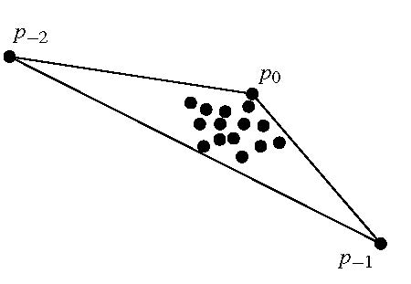
Randomized Incremental Construction of DT(P)
Start with a large triangle containing P.
Insert points of P incrementally:
  Find the containing triangle
  Add new edges
  Flip all illegal edges until every edge is legal.

Slide 5
Randomized Incremental Construction of DT(P)
p_{r}
p_{r}
An edge can become illegal only if one of its incident triangles changes.
Check only edges of new triangles.
Every new edge created is incident to p_{r}.
Every old edge is legal (if p_{r} is on on one of the incident triangles, the edge would have been flipped if it were illegal).
Every new edge is legal (since it has been created from flipping a legal edge).

Slide 6
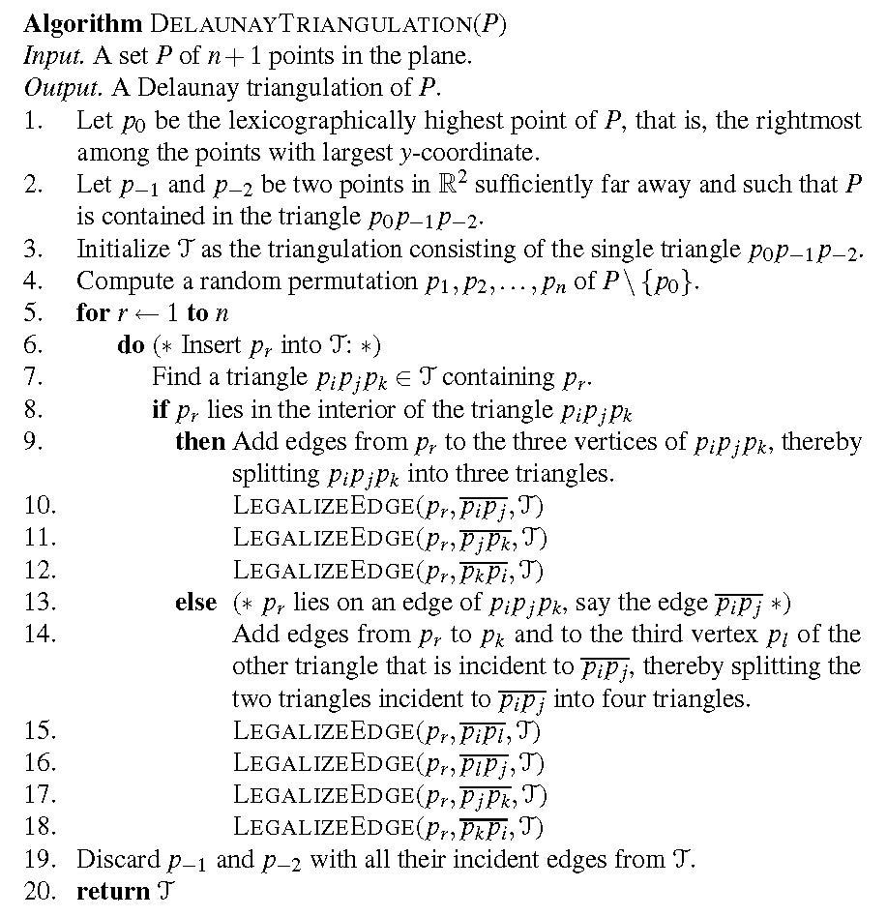
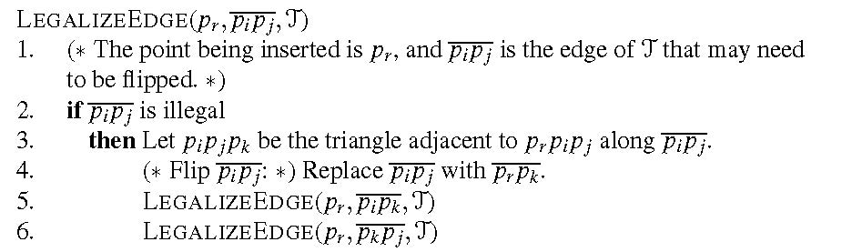
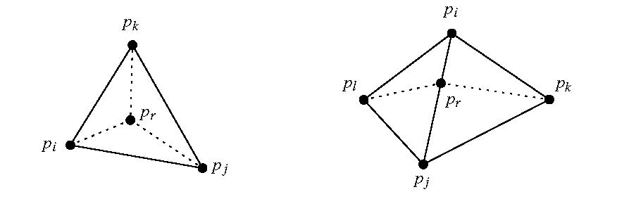
Pseudo Code

Slide 7
History
The algorithm stores the history of the constructed triangles. This allows to easily locate the triangle containing a new point by following pointers.
Division of a triangle:
Flip:
Store pointers from the old triangle
to the three new triangles.
Store pointers from both old triangles
to both new triangles.

Slide 8
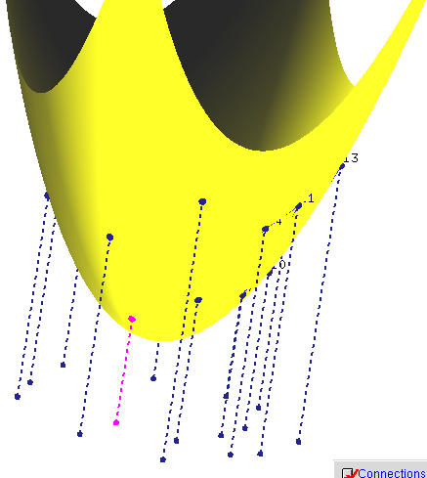
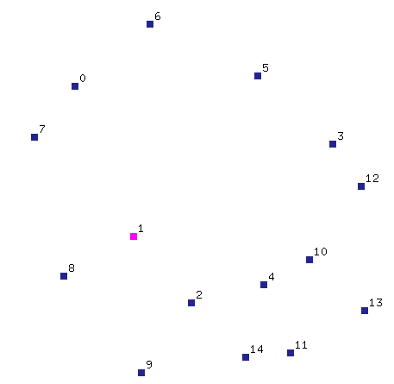
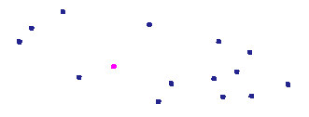
DT and 3D CH
Theorem: Let P={p₁,…,p_{n}} with p_{i}=(a_{i}, b_{i},0). Let p*_{i} =(a_{i}, b_{i}, a²_{i}+ b²_{i}) be the vertical projection of each point p_{i} onto the paraboloid z=x²+ y². Then DT(P) is the orthogonal projection onto the plane z=0 of the lower convex hull of P*={p*₁,…,p*_{n}} .
P*
P
Pictures generated with Hull2VD tool available at http://www.cs.mtu.edu/~shene/NSF-2/DM2-BETA

Slide 9
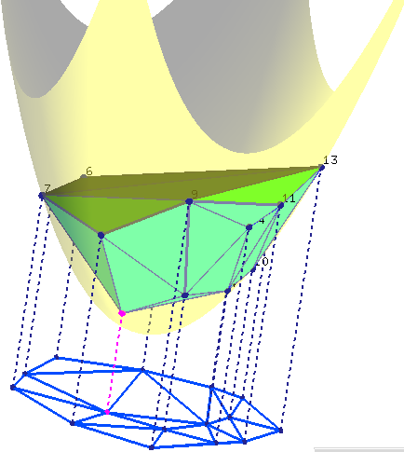
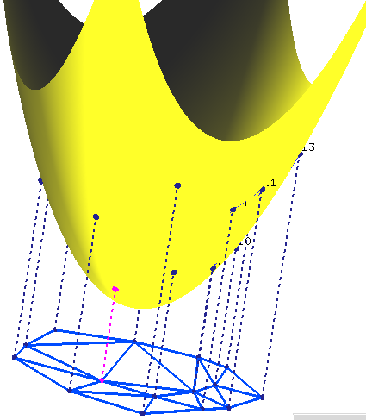
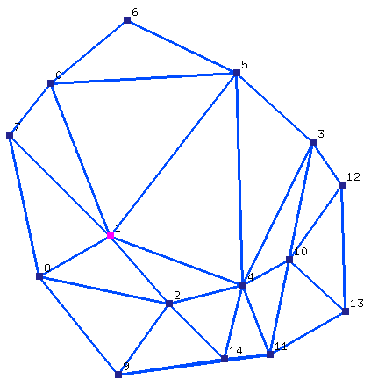
DT and 3D CH
Theorem: Let P={p₁,…,p_{n}} with p_{i}=(a_{i}, b_{i},0). Let p*_{i} =(a_{i}, b_{i}, a²_{i}+ b²_{i}) be the vertical projection of each point p_{i} onto the paraboloid z=x²+ y². Then DT(P) is the orthogonal projection onto the plane z=0 of the lower convex hull of P*={p*₁,…,p*_{n}} .
Pictures generated with Hull2VD tool available at http://www.cs.mtu.edu/~shene/NSF-2/DM2-BETA

Slide 10
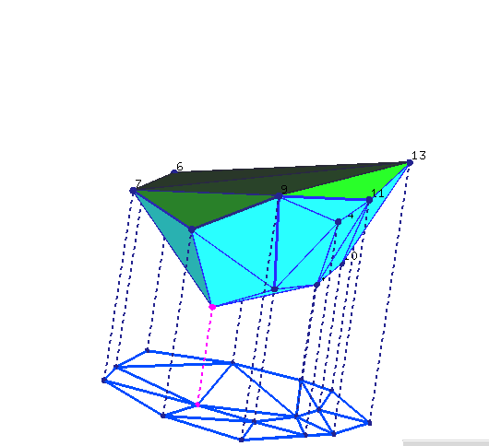
DT and 3D CH
Theorem: Let P={p₁,…,p_{n}} with p_{i}=(a_{i}, b_{i},0). Let p*_{i} =(a_{i}, b_{i}, a²_{i}+ b²_{i}) be the vertical projection of each point p_{i} onto the paraboloid z=x²+ y². Then DT(P) is the orthogonal projection onto the plane z=0 of the lower convex hull of P*={p*₁,…,p*_{n}} .
Pictures generated with Hull2VD tool available at http://www.cs.mtu.edu/~shene/NSF-2/DM2-BETA

Slide 11
DT and 3D CH
Theorem: Let P={p₁,…,p_{n}} with p_{i}=(a_{i}, b_{i},0). Let p*_{i} =(a_{i}, b_{i}, a²_{i}+ b²_{i}) be the vertical projection of each point p_{i} onto the paraboloid z=x²+ y². Then DT(P) is the orthogonal projection onto the plane z=0 of the lower convex hull of P*={p*₁,…,p*_{n}} .
p*_{i,} p*_{j,} p*_{k} form a (triangular) face of LCH(P*)
⇔
The plane through p*_{i,} p*_{j,} p*_{k} leaves all remaining points of P above it
⇔
The circle through p_{i,} p_{j,} p_{k} leaves all remaining points of P in its exterior
⇔
p_{i,} p_{j,} p_{k} form a triangle of DT(P)
property
of unit
paraboloid
Slide adapted from slides by Vera Sacristan.

