Slide 1
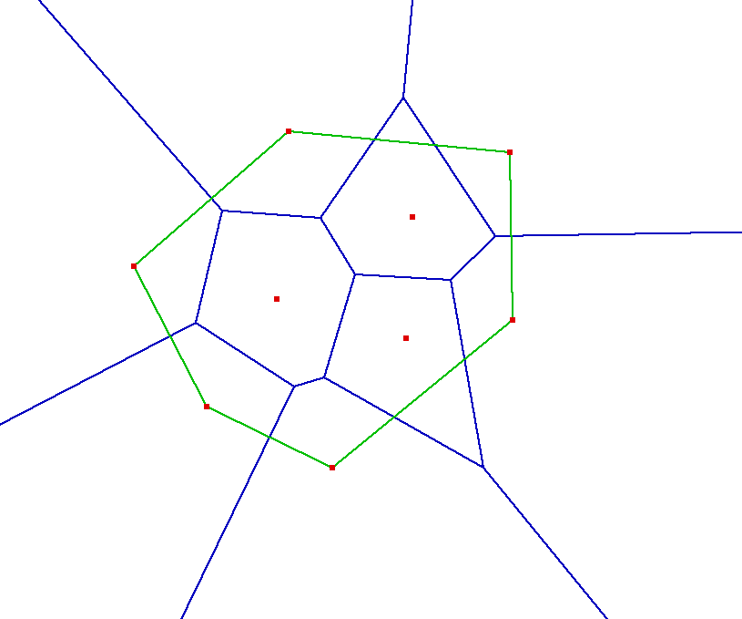
Smaller empty disk centered on Voronoi edge
Larger empty disk centered on Voronoi edge

Slide 2
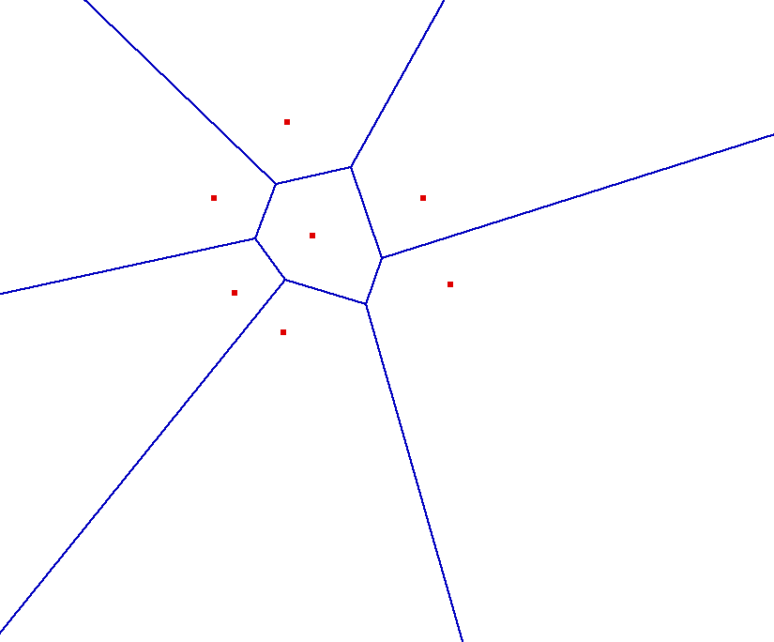
pi
Voronoi cell is intersection of halfspaces defined by bisectors

Slide 3
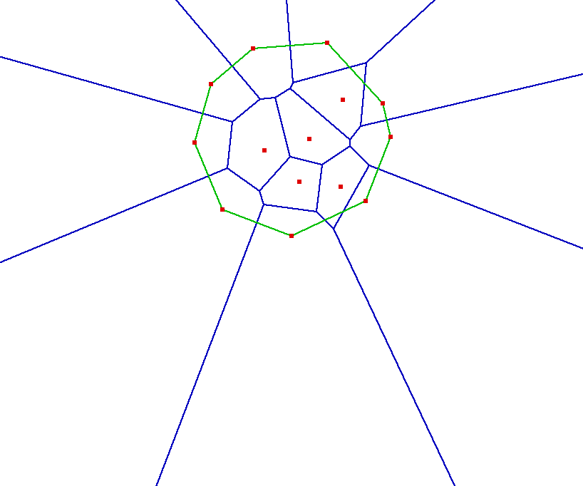
Site with unbounded Voronoi cell
Site with bounded Voronoi cell

