Slide 1
CMPS 3120: Computational Geometry
Spring 2013
B
A
δ→(B,A)
Shape Matching III

Slide 2
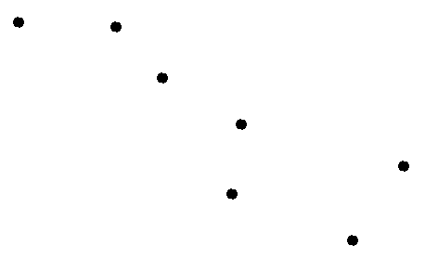
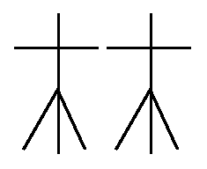
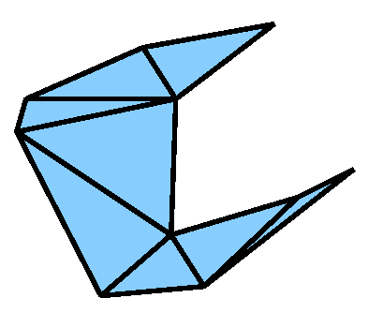
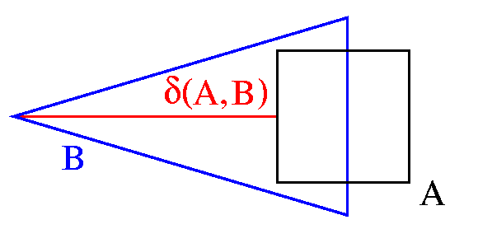
Geometric Shape Matching
Given:
Two geometric shapes, each composed of a number of basic objects such as
points
line segments
triangles
An application dependant distance measure δ, e.g., the Hausdorff distance
A set of transformations T, e.g., translations, rigid motions, or none
Matching Task: Compute
min δ(T(A),B)
Τ∈Τ

Slide 3
Hausdorff distance
Directed Hausdorff distance
δ→(A,B) = max min || a-b ||
Undirected Hausdorff-distance
  δ(A,B) = max (δ→(A,B) , δ→(B,A) )
B
A
a ∈A b∈B
δ→(B,A)
δ→(A,B)
If A, B are discrete point sets, |A|=m, |A|=n
  In d dimensions: Compute in O(mn) time brute-force
  In 2 dimensions: Compute in O((m+n) log (m+n) time
    Compute δ→(A,B) by computing VD(B) and performing nearest neighbor search for every point in A

Slide 4
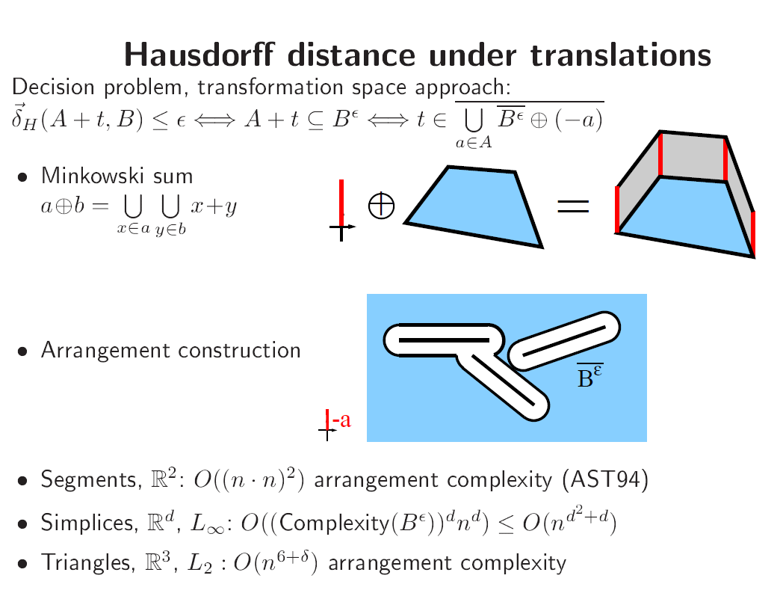
Shape Matching - Applications
Character Recognition
Fingerprint Identification
Molecule Docking, Drug Design
Image Interpretation and Segmentation
Quality Control of Workpieces
Robotics
Pose Determination of Satellites
Puzzling
. . .

Slide 5
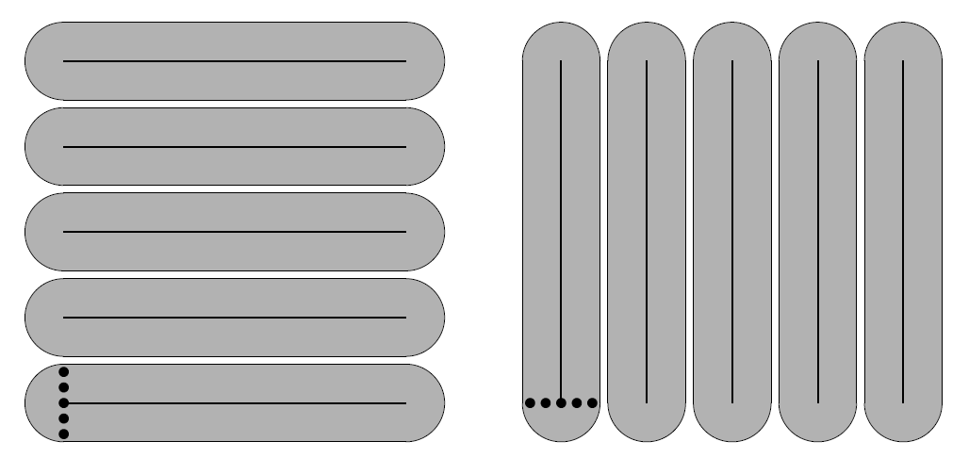
Hausdorff distance
Ω(m²n²) lower bound construction for directed Hausdorff distance of line segments under translations

Slide 6
Trajectories
p₃
t₃=3
p₂
t₂=2
p₄
t₄=4
p₆
t₆=6
p₁
t₁=1
p₅
t₅=5

Slide 7
Trajectories
A (geospatial) trajectory is a sequence of position samples: p₁,…,p_{n}
Each p_{i} minimally consists of:
  position measurement (e.g., latitude/longitude; (x,y)-coordinate)
  time stamp
  ⇒ e.g., p_{i} = (x_{i}, y_{i}, t_{i})
… and optionally of :
  speed
  acceleration
  noise estimate
  …
Example: GPS trajectories
p₃
t₃=3
p₂
t₂=2
p₄
t₄=4
p₆
t₆=6
p₁
t₁=1
p₅
t₅=5

Slide 8
Trajectories and Sampling
A trajectory is a sequence of position samples: p₁,…,p_{n}
Each p_{i} minimally consists of:
  position measurement (e.g., latitude/longitude; (x,y)-coordinate)
  time stamp
  ⇒ e.g., p_{i} = (x_{i}, y_{i}, t_{i})
Such a trajectory is a finite sample of a continuous curve f:[t₁, t_{n}] → R²
Clearly there are many possible
choices for f
There are also many possible choices
for parameterizations in between
sample points
For simplicity, f is often assumed to
be a piecewise linear interpolation.
f(3)=
p₃
t₃=3
f(3.5)?
p₆
t₆=15
f(2)=
p₂
t₂=2
p₄
t₄=8
=f(6)
=f(4)
p₁
t₁=1
f(3.5)?
p₅
t₅=14
f(1)=
=f(5)

Slide 9
Comparing Curves and Trajectories

Slide 10
Comparing Curves and Trajectories
Being able to compare trajectories and curves is an important prerequisite for most applications dealing with trajectories:
  Map-matching: Given a road network and a trajectory, find a path in the network that is most similar to the trajectory
  Clustering: Given a set of trajectories, find a cluster of similar (sub-) trajectories
  Simplification: Given a piecewise linear curve, find a curve with fewer vertices that is most similar to the original curve
How does one compare two curves or trajectories?

Slide 11
Polygonal Curves
Let f,g:[0,1] → R^{d} be two polygonal curves (i.e., piecewise linear curves)
What are good distance measures for curves?
  Hausdorff distance?
  Fréchet distance?
f
g

Slide 12
When Are Two Curves „Similar“?
Directed Hausdorff distance
δ_{Η}→(A,B) = max min || a-b ||
Undirected Hausdorff-distance
  δ_{Η} (A,B) = max (δ_{Η}→(A,B) , δ_{Η}→(B,A) )
  But:
B
A
a ∈A b∈B
δ_{Η}→(B,A)
δ_{Η}→(A,B)
Small Hausdorff distance
When considered as curves the distance should be large
The Fréchet distance takes the continuity of the curves into account

Slide 13
Fréchet Distance for Curves
δ_{F}(f,g) = inf max ||f(α(t))-g(β(t))||
α,β:[0,1] [0,1] t ∈[0,1]
where α and β range over continuous monotone increasing reparameterizations only.
Man and dog walk on one curve each
They hold each other at a leash
They are only allowed to go forward
δ_{F} is the minimal possible leash length
f
g
[F06] M. Fréchet, Sur quelques points de calcul fonctionel, Rendiconti del Circolo Mathematico di Palermo 22: 1-74, 1906.

Slide 14
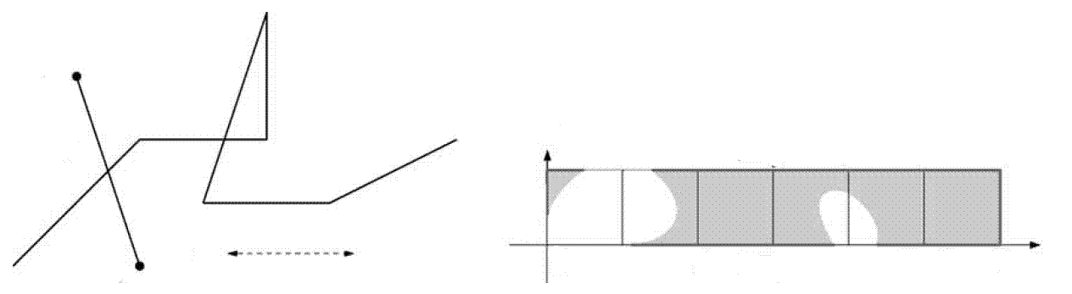
Free Space Diagram
g
>ε
f
g
1
≤ε
ε
0
1
2
3
4
5
6
f
Let ε > 0 fixed (eventually solve decision problem)
F_{ε}(f,g) = { (s,t)∈[0,1]² | || f(s) - g(t)|| ≤ ε } white points
free space of f and g
The free space in one cell is an ellipse.

Slide 15
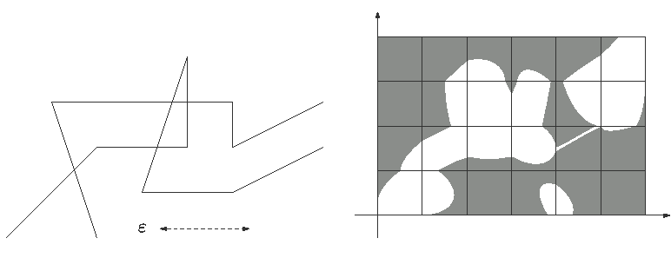
Free Space Diagram
g
g
f
f
Let ε > 0 fixed (eventually solve decision problem)
F_{ε}(f,g) = { (s,t)∈[0,1]² | || f(s) - g(t)|| ≤ ε } white points
free space of f and g
The free space in one cell is an ellipse.

Slide 16
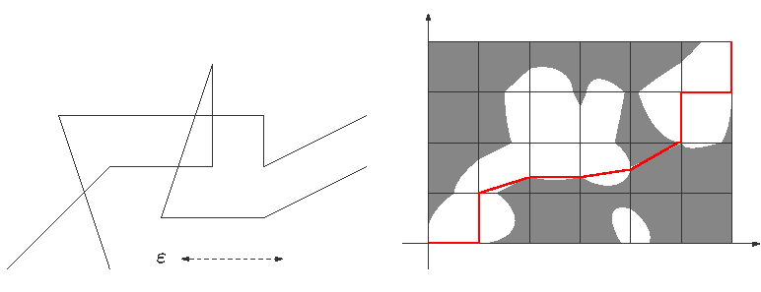
Free Space Diagram
g
α
g
β
f
f
Monotone path encodes reparametrizations of f and g
δ_{F}(f,g) ≤ ε iff there is a monotone path in the free space from (0,0) to (1,1)

Slide 17
Compute the Fréchet Distance
g
1
Solve the decision problem
δ_{F}(f,g) ≤ ε in O(mn) time:
  Find monotone path using DP:
  On each cell boundary compute the interval of all points that are reachable by a monotone path from (0,0)
  Compute a monotone path by backtracking
α
β
f
0
0
1
Solve the optimization problem
  In practice in O(mn log b) time with binary search and b-bit precision
  In O(mn log mn) time [AG95] using parametric search (using Cole‘s sorting trick)
  In O(mn log²mn) expected time [CW09] with randomized red/blue intersections
[AG95] H. Alt, M. Godau, Computing the Fréchet distance between two polygonal curves, IJCGA 5: 75-91, 1995.
[CW10] A.F. Cook IV, C. Wenk, Geodesic Fréchet Distance Inside a Simple Polygon, ACM TALG 7(1), 19 pages, 2010.

Slide 18
Fréchet Variants
Weak Fréchet distance
Discrete Fréchet distance
Fréchet distance with speed limits
Integral or summed Fréchet distance
Partial Fréchet distance

Slide 19
Weak Fréchet Distance
Fréchet distance:
δ_{F}(f,g) = inf max ||f(α(t))-g(β(t))||
α,β:[0,1] [0,1] t ∈[0,1]
where α and β range over continuous monotone increasing reparameterizations only.
Weak Fréchet distance δ_{F}(f,g): Allow any continuous reparameterizations α and β
δ_{H}(f,g) ≤ δ_{F}(f,g) ≤ δ_{F}(f,g)
~
~

Slide 20
Weak Fréchet Distance:
Free Space Cell
ε₁
<
ε₂
<
ε₃
<
ε₄
ε₁
ε₂
ε₃
ε₄
ε₃
Store ε₂ as the weight of the vertical free space boundary

Slide 21
Free Space Graph
Encodes connectivity information of the free space.
For each cell boundary store optimal ε as its weight
Weak Fréchet distance = maximum of all ε’s along an optimal path in the free space graph
Run Dijkstra’s algorithm to find a shortest path (with minimum total ε)
Runtime O(mn log mn) (or O(mn) for planar graphs)

Slide 22
Discrete Fréchet Distance
Given two sequences of points (→ trajectories), compute the discrete Fréchet distance by allowing only monotone assignments between points
(„couplings“)
Free space = grid of black and white points
Find path with dynamic programming
g
g
f
f
[EM94] Eiter, Mannila, technical report, Technical University Vienna,1994.

Slide 23
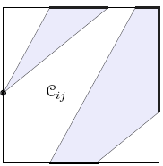
Fréchet Distance with Speed Limits
Given two polygonal curves, as well as a range [v_{min}(S),v_{max}(S)] of allowed speeds for each line segment S
In each free space cell, the speed ranges for the two involved line segments define a range for the allowed slope.
⇒ Only consider paths in the free space that obey the given slope range in each free space cell
⇒ Slope ranges can be incorporated in DP during
propagation of reachability information.
Runtime O(n³) for decision problem, since the
complexity of maintaining the reachable intervals on
the cell boundary has increased
[MSSZ11] Maheshwari, Sack, Shahbaz, Zarrabi-Zadeh, Fréchet Distance with Speed Limits”, CGTA 44(2):110-120, 2011.

Slide 24
Integral Fréchet Distance
Fréchet distances strongly affected by outliers, since they take the maximum over a set of distances:
δ_{F}(f,g) = inf max ||f(α(t))-g(β(t))||
α,β:[0,1] [0,1] t ∈[0,1]
Integral Fréchet distance: replace the maximum with a path integral over the reparameterization curve (α(t),β(t)):
δ_{F}(f,g) = inf ∫ ||f(α(t))-g(β(t))||
α,β:[0,1] [0,1] (α,β)
⇒ Hard to compute explicitly (variational calculus)
⇒ Does not fulfill triangle inequality.
⇒ Heuristically approximate using grid-sampling and summations.
[B07] M. Buchin, On the Computability of the Frechet Distance Between Triangulated Surfaces, PhD thesis, Free University Berlin, 2007.

Slide 25
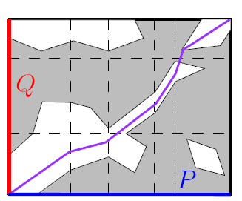
Partial Fréchet Distance
For a given ε>0, compute a monotone
path in the free space diagram
  that is allowed to pass through both white
  and black regions and
  that maximizes the portion of the path within
  the white regions.
Apply DP approach as before, but on each cell boundary maintain a function (instead of an interval). This function measures the maximum length of any monotone path from the lower left corner to the point on the boundary.
For technical reasons the L₁-distance is used to measure the Fréchet distance (hence the free space is polygonal)
Runtime O(n³ log n)
This partial distance identifies portions of the two curves that correspond to each other ⇒ helpful for subtrajectory clustering
[BBW09] K. Buchin, M. Buchin, Y. Wang, Exact Partial Curve Matching under the Fréchet Distance, SODA: 645-654, 2009.

Slide 26
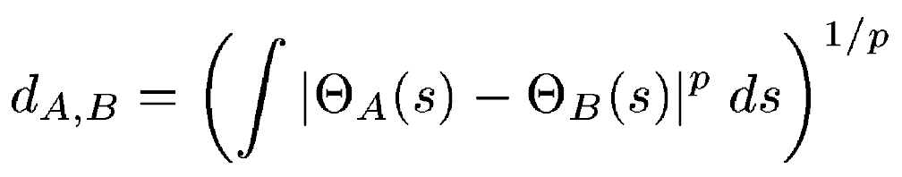
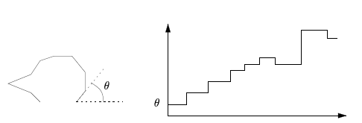
Other Distance Measures for Curves
Turn-angle distance:
L_{p}-distance of turning function
Invariant under translations
Dynamic time warping
Longest common subsequence
[VH01] R.C. Veltkamp, M. Hagedoorn, State-of-the-art … In M. Lew (eds), Principles of Visual Information Retrieval: 87-119, 2001.
[AG99] H. Alt, L. Guibas, Discrete Geometric Shapes…, Handbook of Computational Geometry: 121-153, 1999.
[KP00] E. Keogh, M. Pazzani, Scaling Up Dynamic Time Warping for Datamining Applications, PADKK: 285-289,2000.
[VGD04] M. Vlachos, D. Gunopulos, G. Das, Rotation invariant distance measure for trajectories, ACM SIGKDD: 707-712, 2004

Slide 27
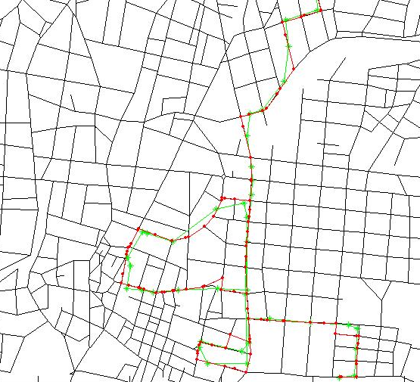
Map-Matching

Slide 28
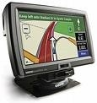
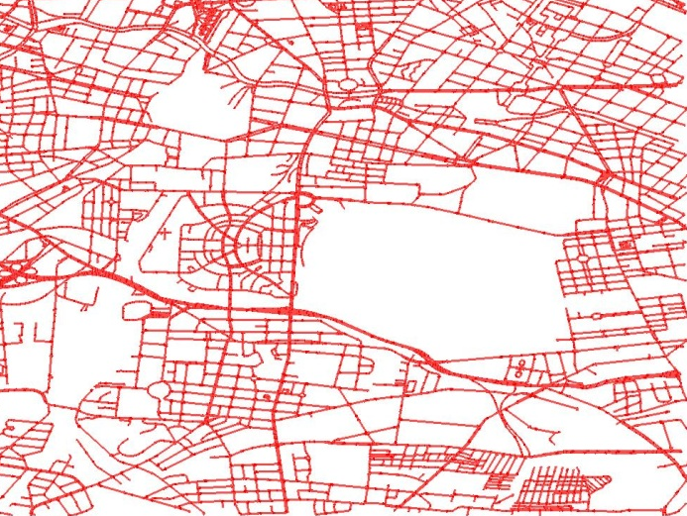
GPS Trajectories for Dynamic Routing
Navigation systems answer shortest path queries based on travel times on road segments
Usually based on static travel-time weights derived from speed limits
Goal: Develop a navigation system which answers routing queries based on the current traffic situation
B
A
Current traffic situation:
  Database of current travel times per road segment
  Use GPS trajectory data from vehicle fleets

Slide 29
GPS Trajectories from Vehicles
Measurement error: GPS points generally do not lie on the road map
Sampling error:
The GPS trajectory is a by-product and is usually sampled every 30s
⇒ The GPS trajectory does not lie on the road map
Map matching:
Find a path in the graph which corresponds to the GPS trajectory (curve).
Find a path in the graph with minimal distance to the GPS curve (partial matching)
Road map of
Athens
GPS trajectoriy
Corresponding path in the road map

Slide 30
Incremental Method
Position-by-position, edge-by-edge strategy to map-matching
  Initialization done using spatial range query
  Evaluate for each trajectory edge (GPS point) a finite number
  of edges of the road network graph. Roughly linear time.
α
i,1
α
i,3
c
1
c
d
3
d
3
1
p
l
p
i
i-1
i
d
2
c
2
α
i,2
[WSP06] C. Wenk, R. Salas, D. Pfoser, Adressing the Need for Map-Matching Speed…, SSDBM: 379-388, 2006.

Slide 31
Incremental Method
But: Incremental method can end up in dead-ends:
⇒ Find a path in the graph which minimizes the Fréchet distance to the GPS curve (partial matching)
[WSP06] C. Wenk, R. Salas, D. Pfoser, Adressing the Need for Map-Matching Speed…, SSDBM: 379-388, 2006.

Slide 32
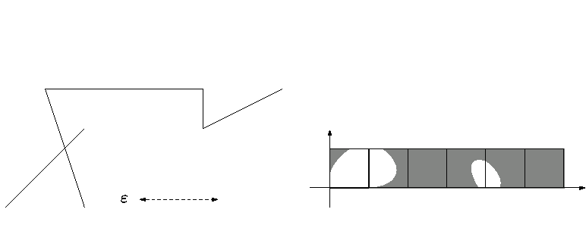
Map Matching: Free Space Diagram
j
FD_{i,j}
f
(i,j)
j
(i,j)
i
i
f
For every edge (i,j) in G: FD_{i,j} = FD( f, (i,j))
For every vertex i in G: sei FD_{i} = FD( f, i ) 1-dimensional
[AERW03] H. Alt, A. Efrat, G. Rote, C. Wenk, Matching Planar Maps, J. of Algorithms 49: 262-283, 2003.
[BPSW05] S. Brakatsoulas, D. Pfoser, R. Salas, C. Wenk, On Map-Matching Vehicle Tracking Data , VLDB 853-864 , 2005.
[WSP06] C. Wenk, R. Salas, D. Pfoser, Adressing the Need for Map-Matching Speed…, SSDBM: 379-388, 2006.

Slide 33
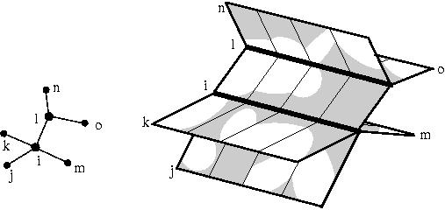
Free Space Surface
G
Glue the free space diagrams FD_{i,j} together according to adjacency information in G
Free space surface of f and G
[AERW03] H. Alt, A. Efrat, G. Rote, C. Wenk, Matching Planar Maps, J. of Algorithms 49: 262-283, 2003.
[BPSW05] S. Brakatsoulas, D. Pfoser, R. Salas, C. Wenk, On Map-Matching Vehicle Tracking Data , VLDB 853-864 , 2005.
[WSP06] C. Wenk, R. Salas, D. Pfoser, Adressing the Need for Map-Matching Speed…, SSDBM: 379-388, 2006.

Slide 34
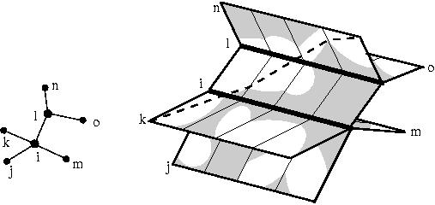
Free Space Surface
G
Task: Find a monotone path in the free space surface that
  starts in a lower left corner
  and ends in an upper right corner
[AERW03] H. Alt, A. Efrat, G. Rote, C. Wenk, Matching Planar Maps, J. of Algorithms 49: 262-283, 2003.
[BPSW05] S. Brakatsoulas, D. Pfoser, R. Salas, C. Wenk, On Map-Matching Vehicle Tracking Data , VLDB 853-864 , 2005.
[WSP06] C. Wenk, R. Salas, D. Pfoser, Adressing the Need for Map-Matching Speed…, SSDBM: 379-388, 2006.

Slide 35
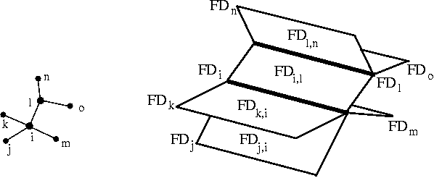
Sweep
G
Sweep all FD_{i,j} with a sweep line from left to right
[AERW03] H. Alt, A. Efrat, G. Rote, C. Wenk, Matching Planar Maps, J. of Algorithms 49: 262-283, 2003.
[BPSW05] S. Brakatsoulas, D. Pfoser, R. Salas, C. Wenk, On Map-Matching Vehicle Tracking Data , VLDB 853-864 , 2005.
[WSP06] C. Wenk, R. Salas, D. Pfoser, Adressing the Need for Map-Matching Speed…, SSDBM: 379-388, 2006.

Slide 36
Sweep
G
Sweep all FD_{i,j} with a sweep line from left to right
[AERW03] H. Alt, A. Efrat, G. Rote, C. Wenk, Matching Planar Maps, J. of Algorithms 49: 262-283, 2003.
[BPSW05] S. Brakatsoulas, D. Pfoser, R. Salas, C. Wenk, On Map-Matching Vehicle Tracking Data , VLDB 853-864 , 2005.
[WSP06] C. Wenk, R. Salas, D. Pfoser, Adressing the Need for Map-Matching Speed…, SSDBM: 379-388, 2006.

Slide 37
Sweep
G
Sweep all FD_{i,j} with a sweep line from left to right
[AERW03] H. Alt, A. Efrat, G. Rote, C. Wenk, Matching Planar Maps, J. of Algorithms 49: 262-283, 2003.
[BPSW05] S. Brakatsoulas, D. Pfoser, R. Salas, C. Wenk, On Map-Matching Vehicle Tracking Data , VLDB 853-864 , 2005.
[WSP06] C. Wenk, R. Salas, D. Pfoser, Adressing the Need for Map-Matching Speed…, SSDBM: 379-388, 2006.

Slide 38
Sweep
G
Sweep all FD_{i,j} with a sweep line from left to right
[AERW03] H. Alt, A. Efrat, G. Rote, C. Wenk, Matching Planar Maps, J. of Algorithms 49: 262-283, 2003.
[BPSW05] S. Brakatsoulas, D. Pfoser, R. Salas, C. Wenk, On Map-Matching Vehicle Tracking Data , VLDB 853-864 , 2005.
[WSP06] C. Wenk, R. Salas, D. Pfoser, Adressing the Need for Map-Matching Speed…, SSDBM: 379-388, 2006.

Slide 39
Sweep
G
Sweep all FD_{i,j} with a sweep line from left to right
[AERW03] H. Alt, A. Efrat, G. Rote, C. Wenk, Matching Planar Maps, J. of Algorithms 49: 262-283, 2003.
[BPSW05] S. Brakatsoulas, D. Pfoser, R. Salas, C. Wenk, On Map-Matching Vehicle Tracking Data , VLDB 853-864 , 2005.
[WSP06] C. Wenk, R. Salas, D. Pfoser, Adressing the Need for Map-Matching Speed…, SSDBM: 379-388, 2006.

Slide 40
Sweep
G
Sweep all FD_{i,j} with a sweep line from left to right
[AERW03] H. Alt, A. Efrat, G. Rote, C. Wenk, Matching Planar Maps, J. of Algorithms 49: 262-283, 2003.
[BPSW05] S. Brakatsoulas, D. Pfoser, R. Salas, C. Wenk, On Map-Matching Vehicle Tracking Data , VLDB 853-864 , 2005.
[WSP06] C. Wenk, R. Salas, D. Pfoser, Adressing the Need for Map-Matching Speed…, SSDBM: 379-388, 2006.

Slide 41
Sweep
G
Sweep all FD_{i,j} with a sweep line from left to right
[AERW03] H. Alt, A. Efrat, G. Rote, C. Wenk, Matching Planar Maps, J. of Algorithms 49: 262-283, 2003.
[BPSW05] S. Brakatsoulas, D. Pfoser, R. Salas, C. Wenk, On Map-Matching Vehicle Tracking Data , VLDB 853-864 , 2005.
[WSP06] C. Wenk, R. Salas, D. Pfoser, Adressing the Need for Map-Matching Speed…, SSDBM: 379-388, 2006.

Slide 42
Compute Reachable Points
G
During the sweep:
  Compute points on the free space surface, to the left of the sweep line, which are reachable by a monotone path from a lower left corner.
[AERW03] H. Alt, A. Efrat, G. Rote, C. Wenk, Matching Planar Maps, J. of Algorithms 49: 262-283, 2003.
[BPSW05] S. Brakatsoulas, D. Pfoser, R. Salas, C. Wenk, On Map-Matching Vehicle Tracking Data , VLDB 853-864 , 2005.
[WSP06] C. Wenk, R. Salas, D. Pfoser, Adressing the Need for Map-Matching Speed…, SSDBM: 379-388, 2006.

Slide 43
Compute Reachable Points
G
During the sweep:
  Compute points on the free space surface, to the left of the sweep line, which are reachable by a monotone path from a lower left corner.
[AERW03] H. Alt, A. Efrat, G. Rote, C. Wenk, Matching Planar Maps, J. of Algorithms 49: 262-283, 2003.
[BPSW05] S. Brakatsoulas, D. Pfoser, R. Salas, C. Wenk, On Map-Matching Vehicle Tracking Data , VLDB 853-864 , 2005.
[WSP06] C. Wenk, R. Salas, D. Pfoser, Adressing the Need for Map-Matching Speed…, SSDBM: 379-388, 2006.

Slide 44
Compute Reachable Points
G
During the sweep:
  Compute points on the free space surface, to the left of the sweep line, which are reachable by a monotone path from a lower left corner.
[AERW03] H. Alt, A. Efrat, G. Rote, C. Wenk, Matching Planar Maps, J. of Algorithms 49: 262-283, 2003.
[BPSW05] S. Brakatsoulas, D. Pfoser, R. Salas, C. Wenk, On Map-Matching Vehicle Tracking Data , VLDB 853-864 , 2005.
[WSP06] C. Wenk, R. Salas, D. Pfoser, Adressing the Need for Map-Matching Speed…, SSDBM: 379-388, 2006.

Slide 45
Compute Reachable Points
G
During the sweep:
  Compute points on the free space surface, to the left of the sweep line, which are reachable by a monotone path from a lower left corner.
[AERW03] H. Alt, A. Efrat, G. Rote, C. Wenk, Matching Planar Maps, J. of Algorithms 49: 262-283, 2003.
[BPSW05] S. Brakatsoulas, D. Pfoser, R. Salas, C. Wenk, On Map-Matching Vehicle Tracking Data , VLDB 853-864 , 2005.
[WSP06] C. Wenk, R. Salas, D. Pfoser, Adressing the Need for Map-Matching Speed…, SSDBM: 379-388, 2006.

Slide 46
Update Reachable Points
G
During the sweep:
  Update reachable points Dijkstra-style
  Use a data structure which supports reachability queries in the free space surface
[AERW03] H. Alt, A. Efrat, G. Rote, C. Wenk, Matching Planar Maps, J. of Algorithms 49: 262-283, 2003.
[BPSW05] S. Brakatsoulas, D. Pfoser, R. Salas, C. Wenk, On Map-Matching Vehicle Tracking Data , VLDB 853-864 , 2005.
[WSP06] C. Wenk, R. Salas, D. Pfoser, Adressing the Need for Map-Matching Speed…, SSDBM: 379-388, 2006.

Slide 47
Update Reachable Points
G
During the sweep:
  Update reachable points Dijkstra-style
  Use a data structure which supports reachability queries in the free space surface
[AERW03] H. Alt, A. Efrat, G. Rote, C. Wenk, Matching Planar Maps, J. of Algorithms 49: 262-283, 2003.
[BPSW05] S. Brakatsoulas, D. Pfoser, R. Salas, C. Wenk, On Map-Matching Vehicle Tracking Data , VLDB 853-864 , 2005.
[WSP06] C. Wenk, R. Salas, D. Pfoser, Adressing the Need for Map-Matching Speed…, SSDBM: 379-388, 2006.

Slide 48
Update Reachable Points
G
During the sweep:
  Update reachable points Dijkstra-style
  Use a data structure which supports reachability queries in the free space surface
[AERW03] H. Alt, A. Efrat, G. Rote, C. Wenk, Matching Planar Maps, J. of Algorithms 49: 262-283, 2003.
[BPSW05] S. Brakatsoulas, D. Pfoser, R. Salas, C. Wenk, On Map-Matching Vehicle Tracking Data , VLDB 853-864 , 2005.
[WSP06] C. Wenk, R. Salas, D. Pfoser, Adressing the Need for Map-Matching Speed…, SSDBM: 379-388, 2006.

Slide 49
Update Reachable Points
G
During the sweep:
  Update reachable points Dijkstra-style
  Use a data structure which supports reachability queries in the free space surface
[AERW03] H. Alt, A. Efrat, G. Rote, C. Wenk, Matching Planar Maps, J. of Algorithms 49: 262-283, 2003.
[BPSW05] S. Brakatsoulas, D. Pfoser, R. Salas, C. Wenk, On Map-Matching Vehicle Tracking Data , VLDB 853-864 , 2005.
[WSP06] C. Wenk, R. Salas, D. Pfoser, Adressing the Need for Map-Matching Speed…, SSDBM: 379-388, 2006.

Slide 50
Update Reachable Points
G
During the sweep:
  Update reachable points Dijkstra-style
  Use a data structure which supports reachability queries in the free space surface
[AERW03] H. Alt, A. Efrat, G. Rote, C. Wenk, Matching Planar Maps, J. of Algorithms 49: 262-283, 2003.
[BPSW05] S. Brakatsoulas, D. Pfoser, R. Salas, C. Wenk, On Map-Matching Vehicle Tracking Data , VLDB 853-864 , 2005.
[WSP06] C. Wenk, R. Salas, D. Pfoser, Adressing the Need for Map-Matching Speed…, SSDBM: 379-388, 2006.

Slide 51
Update Reachable Points
G
During the sweep:
  Update reachable points Dijkstra-style
  Use a data structure which supports reachability queries in the free space surface
[AERW03] H. Alt, A. Efrat, G. Rote, C. Wenk, Matching Planar Maps, J. of Algorithms 49: 262-283, 2003.
[BPSW05] S. Brakatsoulas, D. Pfoser, R. Salas, C. Wenk, On Map-Matching Vehicle Tracking Data , VLDB 853-864 , 2005.
[WSP06] C. Wenk, R. Salas, D. Pfoser, Adressing the Need for Map-Matching Speed…, SSDBM: 379-388, 2006.

Slide 52
Update Reachable Points
G
During the sweep:
  Update reachable points Dijkstra-style
  Use a data structure which supports reachability queries in the free space surface
[AERW03] H. Alt, A. Efrat, G. Rote, C. Wenk, Matching Planar Maps, J. of Algorithms 49: 262-283, 2003.
[BPSW05] S. Brakatsoulas, D. Pfoser, R. Salas, C. Wenk, On Map-Matching Vehicle Tracking Data , VLDB 853-864 , 2005.
[WSP06] C. Wenk, R. Salas, D. Pfoser, Adressing the Need for Map-Matching Speed…, SSDBM: 379-388, 2006.

Slide 53
Update Reachable Points
G
During the sweep:
  Update reachable points Dijkstra-style
  Use a data structure which supports reachability queries in the free space surface
[AERW03] H. Alt, A. Efrat, G. Rote, C. Wenk, Matching Planar Maps, J. of Algorithms 49: 262-283, 2003.
[BPSW05] S. Brakatsoulas, D. Pfoser, R. Salas, C. Wenk, On Map-Matching Vehicle Tracking Data , VLDB 853-864 , 2005.
[WSP06] C. Wenk, R. Salas, D. Pfoser, Adressing the Need for Map-Matching Speed…, SSDBM: 379-388, 2006.

Slide 54
Update Reachable Points
G
During the sweep:
  Update reachable points Dijkstra-style
  Use a data structure which supports reachability queries in the free space surface
[AERW03] H. Alt, A. Efrat, G. Rote, C. Wenk, Matching Planar Maps, J. of Algorithms 49: 262-283, 2003.
[BPSW05] S. Brakatsoulas, D. Pfoser, R. Salas, C. Wenk, On Map-Matching Vehicle Tracking Data , VLDB 853-864 , 2005.
[WSP06] C. Wenk, R. Salas, D. Pfoser, Adressing the Need for Map-Matching Speed…, SSDBM: 379-388, 2006.

Slide 55
Backtracking
G
After the sweep:
  Construct a monotone path via backtracking
[AERW03] H. Alt, A. Efrat, G. Rote, C. Wenk, Matching Planar Maps, J. of Algorithms 49: 262-283, 2003.
[BPSW05] S. Brakatsoulas, D. Pfoser, R. Salas, C. Wenk, On Map-Matching Vehicle Tracking Data , VLDB 853-864 , 2005.
[WSP06] C. Wenk, R. Salas, D. Pfoser, Adressing the Need for Map-Matching Speed…, SSDBM: 379-388, 2006.

Slide 56
Map-Matching
Algorithm for decision problem takes O(mn log(mn)) time and O(mn) space.
Optimization problem with parametric search:
O(mn log²(mn)) time
Not really practicable for road maps with m=200.000 edges
[AERW03] H. Alt, A. Efrat, G. Rote, C. Wenk, Matching Planar Maps, J. of Algorithms 49: 262-283, 2003.
[BPSW05] S. Brakatsoulas, D. Pfoser, R. Salas, C. Wenk, On Map-Matching Vehicle Tracking Data , VLDB 853-864 , 2005.
[WSP06] C. Wenk, R. Salas, D. Pfoser, Adressing the Need for Map-Matching Speed…, SSDBM: 379-388, 2006.

Slide 57
Using the Weak Fréchet Distance
Use the same algorithm as for the weak Frechet distance between curves:
  Consider any (non-monotone) path in the free space
  Convert the problem into a shortest-path problem in the free space graph
Run Dijkstra’s shortest paths algo. and construct free space on the fly. Runtime O(K log K) with K=size of traversed free space
→ Output-sensitive algorithm which needs much less space in practice and is extremely fast
→ Computes free space graph on the fly
[AERW09] H. Alt, A. Efrat, G. Rote, C. Wenk, Matching Planar Maps, J. of Algorithms 49: 262-283, 2003.
[BPSW05] S. Brakatsoulas, D. Pfoser, R. Salas, C. Wenk, On Map-Matching Vehicle Tracking Data , VLDB 853-864 , 2005.

Slide 58
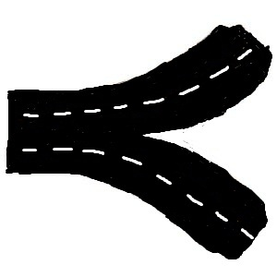
Reconciling Trajectory Sets
⇒

Slide 59
Reconciling Trajectory Sets
Given a set of trajectories
  Compute an average/mean or median trajectory
    Reconcile the set into one representative trajectory
    Prerequisite for k-means and k-medoid clustering
    Related: Curve Simplification (reduce complexity)
  Compute (sub-)trajectory clusters
    Find similar parts of the trajectories
    For each cluster, compute a reconciled representation
  Compute a road network
    Find a graph structure representing all trajectories

Slide 60
Average/Mean Curve
Given a set f₁,…,f_{k} :[0,1]→ R² of trajectories/curves, compute one reconciled curve that represents all curves in the set:
  Point-wise average: f(t) = 1/n ∑_{i=1} f_{i} for all t∈[0,1].
  ⇒ O(kn) time. But only works if parameterizations of curves correspond to each other!
  Compute k-dimensional free space (use concept of Fréchet distance for sets of curves). Instead of Euclidean distance use the radius of the minimum enclosing disk for k points.
  ⇒ O(n^{k}) time. Tries out all joint reparameterizations of curves.
^{n}
[DR04] A. Dumitrescu, G. Rote, On the Fréchet Distance of a Set of Curves, CCCG: 162-165, 2004.
[HR11] S. Har-Peled, B. Raichel, The Fréchet Distance Revisited and Extended, ACM SoCG: 448-457, 2011.

Slide 61
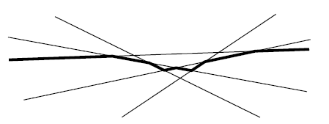
Average vs. Median
The average is allowed to introduce new vertices and curve pieces. Can one compute a median, which uses only existing curve pieces and which is central with respect to number of trajectories?
E.g., 2 hiking trajectories on one side of lake, 3 on other side of lake. Average trajectory would go through lake.
Median of k numbers is the k/2-smallest number.
k/2-level in arrangement of lines (has O(k^{4/3}) complexity):
[BBKLSWW12] K. & M. Buchin, M. van Kreveld, M. Löffler, R. Silveira, C. Wenk, L. Wiratma, Median Trajectories, Algorithmica, Online First, 2012.

Slide 62
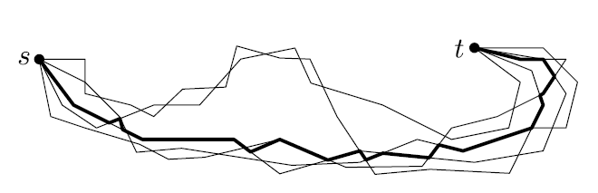
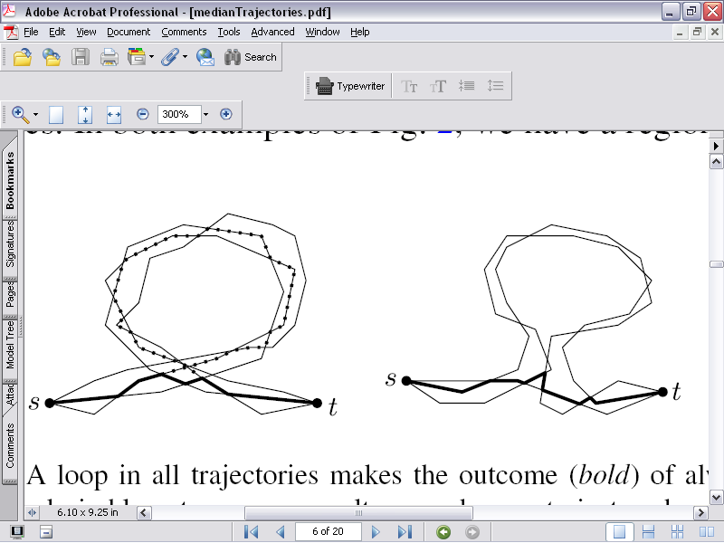
Median
Analogous to line arrangements, the number of trajectories that have to be crossed from any point on median trajectory to reach the outer face is k/2.
Simple median:
Switch trajectory
at every intersection.
But, bad behavior:
[BBKLSWW12] K. & M. Buchin, M. van Kreveld, M. Löffler, R. Silveira, C. Wenk, L. Wiratma, Median Trajectories, Algorithmica, Online First, 2012.

Slide 63
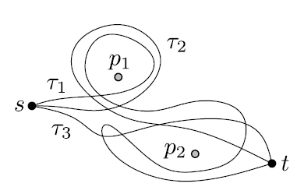
Homotopic Median
Places poles in large faces of arrangement,
and require median to go around the poles
in the same way as the input trajectories
(same homotopy class)
Two trajectories are homotopic, if they
can be continuously transformed into each
other without passing over any pole.
If all input trajectories are homotopic w.r.t. poles:
  Modify switching algorithm: At intersection with new trajectory f, only switch to f if median so far concatenated with f until the endpoint t has the same homotopy type as input trajectories.
[BBKLSWW12] K. & M. Buchin, M. van Kreveld, M. Löffler, R. Silveira, C. Wenk, L. Wiratma, Median Trajectories, Algorithmica, Online First, 2012.

Slide 64
Sub-Trajectory Clustering
Find similar portions in trajectories
Lots of algorithms for finding clusters in point sets
Harder for trajectories since you need to figure out where to break the trajectories into pieces

Slide 65
Sub-Trajectory Clustering
A. Asahara, A. Sato, and K. Maruyama. Evaluation of trajectory clustering based on
information criteria for human activity analysis. In 10th Int. Conf. on Mobile Data
Management: Systems, Services and Middleware (MDM), pages 329-337, 2009.
K. Buchin, M. Buchin, J. Gudmundsson, M. Löffler, and J. Luo. Detecting commuting
patterns by clustering subtrajectories. International Journal of Computational Geome-
try and Applications, special issue on 19th International Symposium on Algorithms and
Computation (ISAAC), 2010.
K. Buchin, M. Buchin, M. van Kreveld, and J. Luo. Finding long and similar parts
of trajectories. In 17th ACM SIGSPATIAL International Conference on Advances in
Geographic Information Systems (ACM GIS), pages 296-305, 2010.
A. Dahlbom and L. Niklasson. Trajectory clustering for coastal surveillance. In 10th
Int. Conf. on Information Fusion, pages 1-8, 2007.
J. Lee, J. Han, and K.-Y. Whang. Trajectory clustering: A partition-and-group framework.
In Proc. ACM SIGMOD International Conference on Management of Data, pages
593-604, 2007.

Slide 66
Sub-Trajectory Clustering
X. Li, W. Hu, and W. Hu. A coarse-to-ne strategy for vehicle motion trajectory
clustering. In 18th Int. Conf. on Pattern Recognition (ICPR), volume 1, pages 591-594,
2006.
Z. Li. Incremental clustering for trajectories. Master's thesis, University of Illinois at
Urbana-Champaign, 2010.
Z. Li, J.-G. Lee, X. Li, and J. Han. Incremental clustering for trajectories. In Proc.
15th Int. Conf. Database Systems for Advanced Applications (DASFAA), pages 32-46,
2010.
T.W. Liao. Clustering of time series data - a survey. Pattern Recognition, 38:1857-1874,
2005.
Y. Zhang and D. Pi. A trajectory clustering algorithm based on symmetric neighborhood.
In WRI World Congrees on Computer Science and Information Engineering,
volume 3, pages 640-645, 2009.

Slide 67
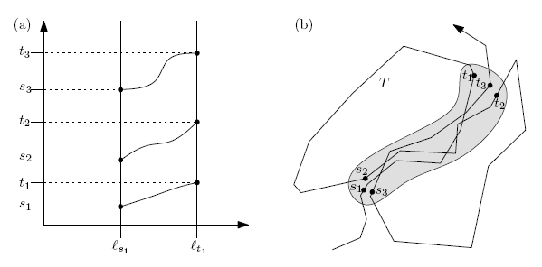
Fréchet-Based Clustering
Given an input set of trajectories, append them all to form a single trajectory f
Compute the free space diagram of f with itself (comparing f with f)
Find clusters of monotone curve pieces in the (white) free space
⇒ Sweep free space from left to right, maintain data structure
[BBGLL10] K. Buchin, M. Buchin, J. Gudmundsson, M. Löffler, J. Luo. Detecting commuting patterns…, IJCGA, 2010.

Slide 68
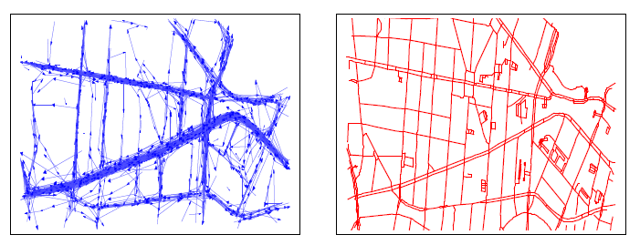
Map Construction
Given a set of trajectories, compute the underlying road network
Capturing constrained movement (explicit or implicit streets/routes, animal behavior)
OpenStreetMap

