Slide 1
CMPS 3120: Computational Geometry
Spring 2013
B
A
δ→(B,A)
Shape Matching II

Slide 2
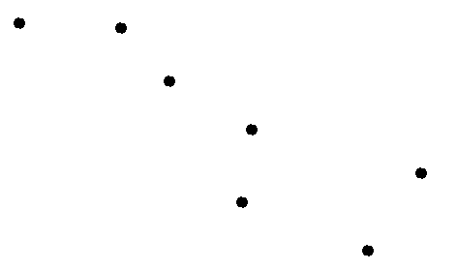
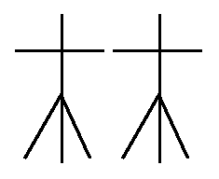
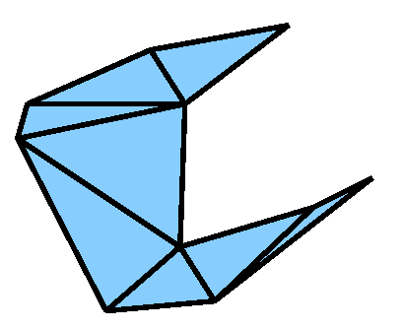
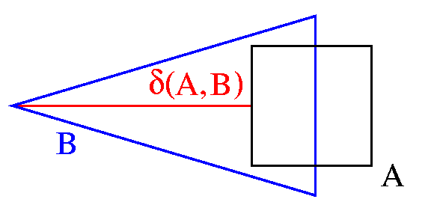
Geometric Shape Matching
Given:
Two geometric shapes, each composed of a number of basic objects such as
points
line segments
triangles
An application dependant distance measure δ, e.g., the Hausdorff distance
A set of transformations T, e.g., translations, rigid motions, or none
Matching Task: Compute
min δ(T(A),B)
Τ∈Τ

Slide 3
Hausdorff distance
Directed Hausdorff distance
δ→(A,B) = max min || a-b ||
Undirected Hausdorff-distance
  δ(A,B) = max (δ→(A,B) , δ→(B,A) )
B
A
a ∈A b∈B
δ→(B,A)
δ→(A,B)
If A, B are discrete point sets, |A|=m, |A|=n
  In d dimensions: Compute in O(mn) time brute-force
  In 2 dimensions: Compute in O((m+n) log (m+n) time
    Compute δ→(A,B) by computing VD(B) and performing nearest neighbor search for every point in A

Slide 4
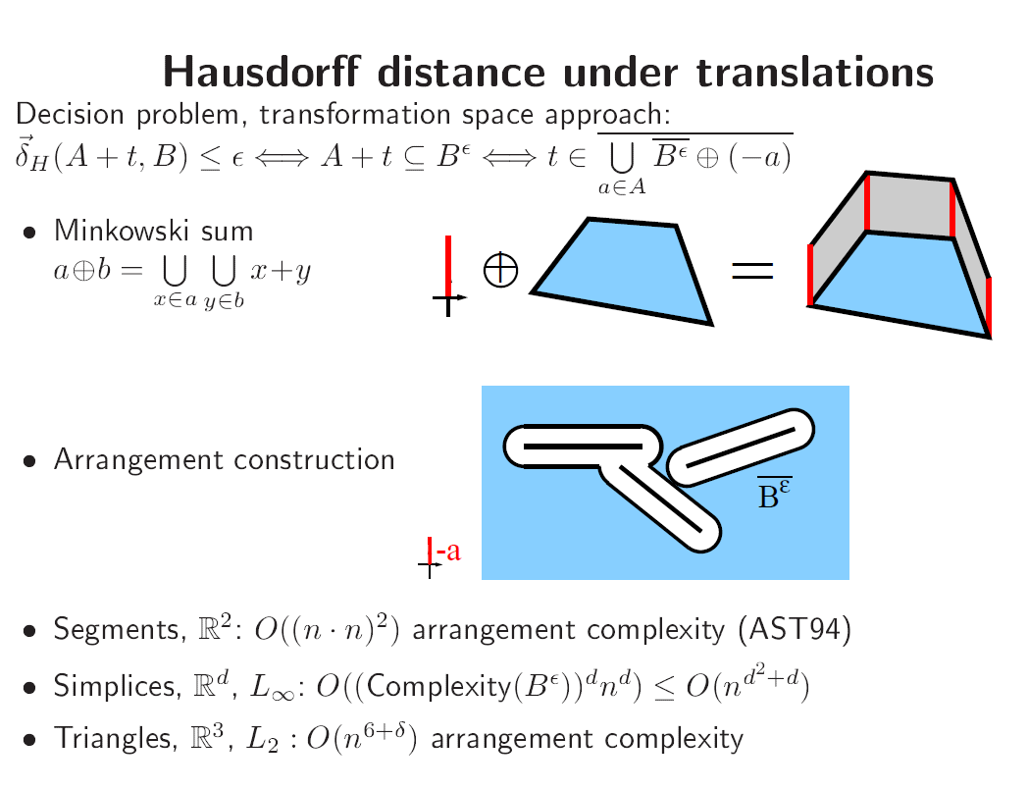
Shape Matching - Applications
Character Recognition
Fingerprint Identification
Molecule Docking, Drug Design
Image Interpretation and Segmentation
Quality Control of Workpieces
Robotics
Pose Determination of Satellites
Puzzling
. . .

Slide 5
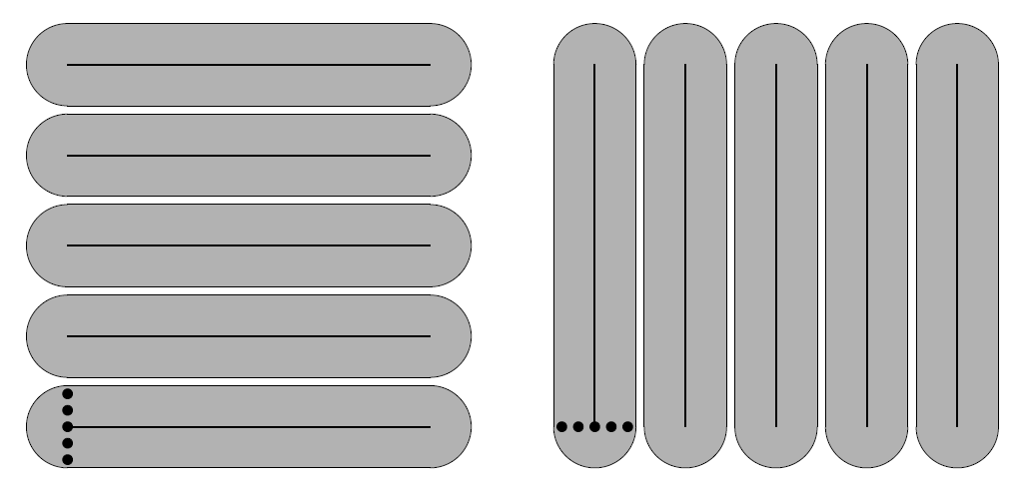
Hausdorff distance
Ω(m²n²) lower bound construction for directed Hausdorff distance of line segments under translations

