Slide 1
CMPS 3120: Computational Geometry Spring 2013
B
A
δ→(B,A)
Shape Matching

Slide 2
Are these shapes similar?
When are two shapes similar?
Translate

Slide 3
Are these shapes similar?
When are two shapes similar?
Translate
Translate & Rotate

Slide 4
Are these shapes similar?
When are two shapes similar?
Translate
Translate & Rotate
Translate & Scale

Slide 5
Are these shapes similar?
When are two shapes similar?
Translate
Translate & Rotate
Translate & Scale
Translate & Reflect

Slide 6
Are these shapes similar?
When are two shapes similar?
Translate
Translate & Rotate
Translate & Scale
Translate & Reflect
Partial Matching

Slide 7
Are these shapes similar?
When are two shapes similar?
Translate
Translate & Rotate
Translate & Scale
Translate & Reflect
Partial Matching

Slide 8
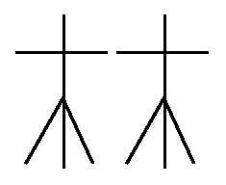
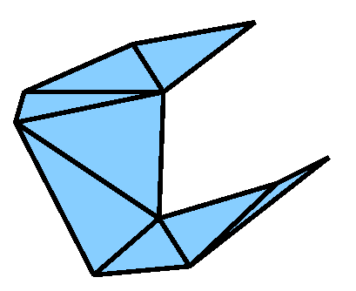
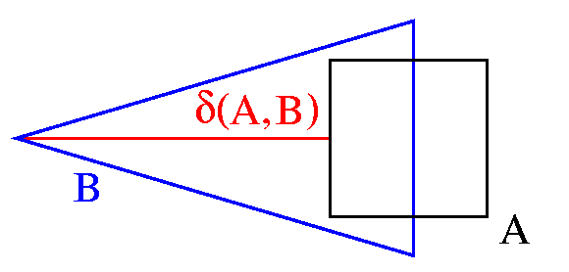
Geometric Shape Matching
Given:
Two geometric shapes, each composed of a number of basic objects such as
points
line segments
triangles
An application dependant distance measure δ, e.g., the Hausdorff distance
A set of transformations T, e.g., translations, rigid motions, or none
Matching Task: Compute
min δ(T(A),B)
Τ∈Τ

