Slide 1
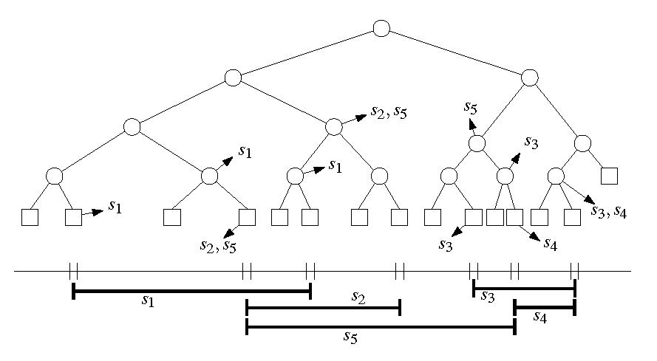

Slide 2
I(v) = {s | Int(v) ⊆ s and Int(parent(v)) ⊄ s}
s₁
s₂
s₃
s₄
s₅

Slide 3
I(v) = {s | Int(v) ⊆ s and Int(parent(v)) ⊄ s}

