Slide 1
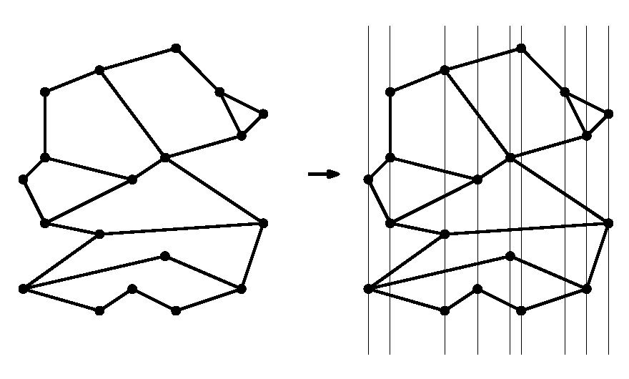

CMPS 3120: Computational Geometry
Spring 2013
p
Planar Subdivisions and Point Location
Carola Wenk
Based on:
Computational Geometry: Algorithms and Applications
and David Mount’s lecture notes

Slide 2
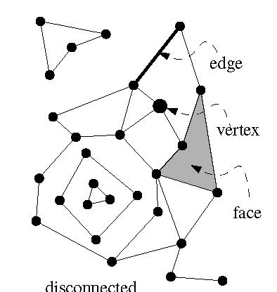
Planar Subdivision
Let G=(V,E) be an undirected graph.
G is planar if it can be embedded in the plane without edge crossings.
planar
K₅, not planar
K_{3,3}, not planar
A planar embedding (=drawing) of a planar graph G induces a planar subdivision consisting of vertices, edges, and faces.

Slide 3
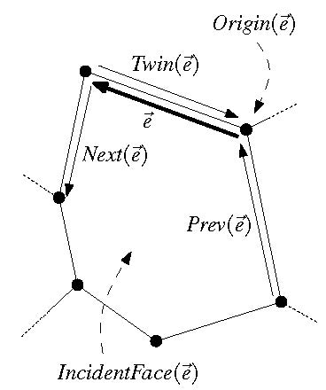
Doubly-Connected Edge List
The doubly-connected edge list (DCEL) is a popular data structure to store the geometric and topological information of a planar subdivision.
  It contains records for each face, edge, vertex
  (Each record might also store additional application-dependent attribute information.)
  It should enable us to perform basic operations needed in algorithms, such as walk around a face, or walk from one face to a neighboring face
The DCEL consists of:
  For each vertex v, its coordinates are stored in Coordinates(v) and a pointer IncidentEdge(v) to a half-edge that has v as it origin.
  Two oriented half-edges per edge, one in each direction. These are called twins. Each of them has an origin and a destination. Each half-edge e stores a pointer Origin(e), a pointer Twin(e), a pointer IncidentFace(e) to the face that it bounds, and pointers Next (e) and Prev(e) to the next and previous half-edge on the boundary of IncidentFace(e).
  For each face f, OuterComponent(f) is a pointer to some half-edge on its outer boundary (null for unbounded faces). It also stores a list InnerComponents(f) which contains for each hole in the face a pointer to some half-edge on the boundary of the hole.

Slide 4
Complexity of a Planar Subdivision
The complexity of a planar subdivision is:
#vertices + #edges + #faces = n_{v} + n_{e} + n_{f}
Euler’s formula for planar graphs:
  n_{v} - n_{e} + n_{f} ≥ 2
  n_{e} ≤ 3n_{v} – 6
  2) follows from 1):
  Count edges. Every face is bounded by ≥ 3 edges.
  Every edge bounds ≤ 2 faces.
  ⇒ 3n_{f} ≤ 2n_{e} ⇒ n_{f} ≤ 2/3n_{e}
  ⇒ 2 ≤ n_{v} - n_{e} + n_{f} ≤ n_{v} - n_{e} + 2/3 n_{e} = n_{v} – 1/3 n_{e}
  ⇒ 2 ≤ n_{v} – 1/3 n_{e}
So, the complexity of a planar subdivision is linear in the number of vertices, so, O(n_{v}).

Slide 5
Point Location
Point location task:
Preprocess a planar subdivision to efficiently answer point-location queries of the type: Given a point p=(p_{x},p_{y}), find the face it lies in.
p
Important metrics:
  Time complexity for preprocessing = time to construct the data structure
  Space needs to store the data structure
  Time complexity for querying the data structure

Slide 6
Slab Method
Slab method:
Draw a vertical line through each vertex. This decomposes the plane into slabs.
p
p
p
In each slab, the vertical order of the line segments remains constant.
If we know in which slab p lies, we can perform binary search, using the sorted order of the segments in the slab.
Find slab that contains p by binary search on x among slab boundaries.
A second binary search in slab determines the face containing p.
Search complexity O(log n), but space complexity Θ(n²) .
lower bound?

Slide 7
Kirkpatrick’s Algorithm
Needs a triangulation as input.
Can convert a planar subdivision with n vertices into a triangulation:
  Triangulate each face, keep same label as original face.
  If the outer face is not a triangle:
    Compute the convex hull of the subdivision.
    Triangulate pockets between the subdivision and the convex hull.
    Add a large triangle (new vertices
    a, b, c) around the convex hull, and triangulate the space in-between.
b
p
a
c
The size of the triangulated planar subdivision is still O(n), by Euler’s formula.
The conversion can be done in O(n log n) time.
Given p, if we find a triangle containing p we also know the (label of) the original subdivision face containing p.

Slide 8
Kirkpatrick’s Hierarchy
Compute a sequence T₀, T₁, …, T_{k} of increasingly coarser triangulations such that the last one has constant complexity.
The sequence T₀, T₁, …, T_{k} should have the following properties:
  T₀ is the input triangulation, T_{k} is the outer triangle
  k ∈ O(log n)
  Each triangle in T_{i+1} overlaps O(1) triangles in T_{i}
How to build such a sequence?
  Need to delete vertices from T_{i} .
  Vertex deletion creates holes, which need
  to be re-triangulated.
How do we go from T₀ of size O(n) to
T_{k} of size O(1) in k=O(log n) steps?
  In each step, delete a constant fraction
  of vertices from T_{i} .
We also need to ensure that each new triangle in T_{i+1} overlaps with only O(1) triangles in T_{i} .

Slide 9
Vertex Deletion and Independent Sets
When creating T_{i+1} from T_{i} , delete vertices from T_{i} that have the following properties:
  Constant degree:
  Each vertex v to be deleted has O(1) degree in the graph T_{i} .
    If v has degree d, the resulting hole can be re-triangulated with d-2 triangles
    Each new triangle in T_{i+1} overlaps at most d original triangles in T_{i}
  Independent sets:
  No two deleted vertices are adjacent.
    Each hole can be re-triangulated independently.

Slide 10
Independent Set Lemma
Lemma: Every planar graph on n vertices contains an independent vertex set of size n/18 in which each vertex has degree at most 8. Such a set can be computed in O(n) time.
Use this lemma to construct Kirkpatrick’s hierarchy:
Start with T₀, and select an independent set S of size n/18 with maximum degree 8. [Never pick the outer triangle vertices a, b, c.]
Remove vertices of S, and re-triangulate holes.
The resulting triangulation, T₁, has at most 17/18n vertices.
Repeat the process to build the hierarchy, until T_{k} equals the outer triangle with vertices a, b, c.
The depth of the hierarchy is k = log 18/17 n
b
a
c

Slide 11
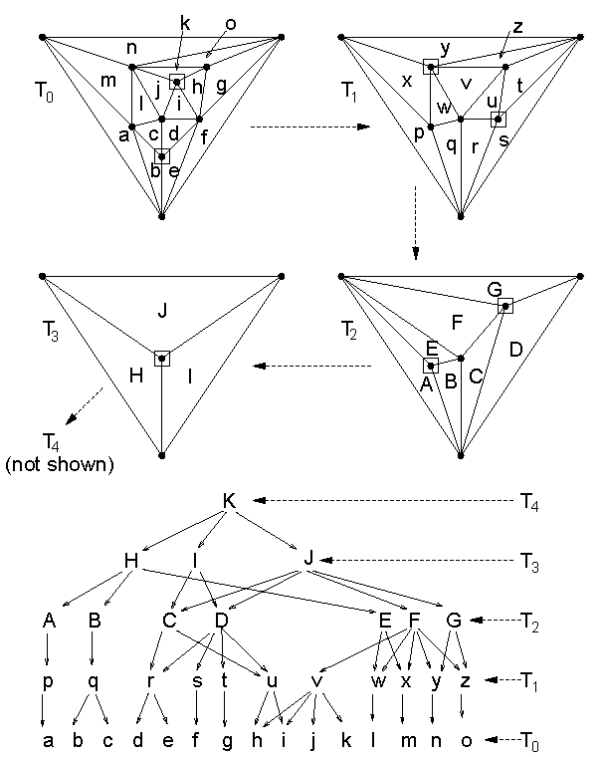
Hierarchy Example
Use this lemma to construct Kirkpatrick’s hierarchy:
Start with T₀, and select an independent set S of size n/18 with maximum degree 8. [Never pick the outer triangle vertices a, b, c.]
Remove vertices of S, and re-triangulate holes.
The resulting triangulation, T₁, has at most 17/18n vertices.
Repeat the process to build the hierarchy, until T_{k} equals the outer triangle with vertices a, b, c.
The depth of the hierarchy is
k = log 18/17 n

Slide 12
Hierarchy Data Structure
Store the hierarchy as a DAG:
The root is T_{k} .
Nodes in each level correspond to triangles T_{i} .
Each node for a triangle in T_{i+1} stores pointers to all triangles of T_{i} that it overlaps.
How to locate point p in the DAG:
Start at the root. If p is outside of T_{k} then p is in exterior face; done.
Else, set Δ to be the triangle at the current level that contains p.
Check each of the at most 6 triangles of T_{k-1} that overlap with Δ, whether they contain p. Update Δ and descend in the hierarchy until reaching T₀ .
Output Δ .
p

Slide 13
Analysis
Query time is O(log n): There are O(log n) levels and it takes constant time to move between levels.
Space complexity is O(n):
  Sum up sizes of all triangulations in hierarchy.
  Because of Euler’s formula, it suffices to sum up the number of vertices.
  Total number of vertices:
  n + 17/18 n + (17/18)² n + (17/18)³ n + …
  ≤ 1/(1-17/18) n = 18 n
Preprocessing time is O(n log n):
  Triangulating the subdivision takes O(n log n) time.
  The time to build the DAG is proportional to its size.
p
13

Slide 14
Independent Set Lemma
Lemma: Every planar graph on n vertices contains an independent vertex set of size n/18 in which each vertex has degree at most 8. Such a set can be computed in O(n) time.
Proof:
Algorithm to construct independent set:
Mark all vertices of degree ≥ 9
While there is an unmarked vertex
  Let v be an unmarked vertex
  Add v to the independent set
  Mark v and all its neighbors
Can be implemented in O(n) time: Keep list of unmarked vertices, and store the triangulation in a data structure that allows finding neighbors in O(1) time.
v

Slide 15
Independent Set Lemma
Still need to prove existence of large independent set.
Euler’s formula for a triangulated planar graph on n vertices:
#edges = 3n – 6
Sum over vertex degrees:
Σ deg(v) = 2 #edges = 6n – 12 < 6n
Claim: At least n/2 vertices have degree ≤ 8.
Proof: By contradiction. So, suppose otherwise.
→ n/2 vertices have degree ≥ 9. The remaining have degree ≥ 3.
→ The sum of the degrees is ≥ 9 n/2 + 3 n/2 = 6n. Contradiction.
In the beginning of the algorithm, at least n/2 nodes are unmarked. Each picked vertex v marks ≤ 8 other vertices, so including itself 9.
Therefore, the while loop can be repeated at least n/18 times.
This shows that there is an independent set of size at least n/18 in which each node has degree ≤ 8.
v

Slide 16
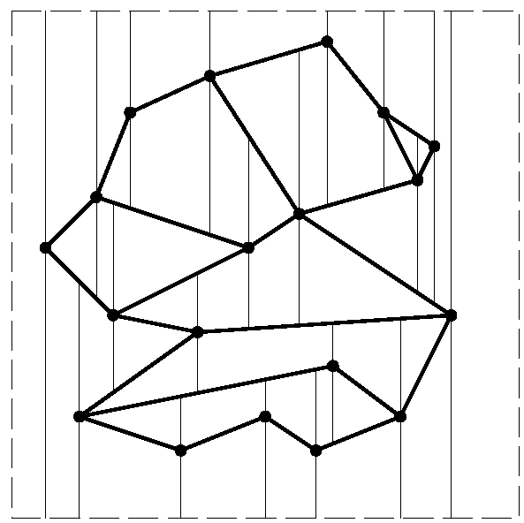
Summing Up
Kirkpatrick’s point location data structure needs O(n log n) preprocessing time, O(n) space, and has O(log n) query time.
It involves high constant factors though.
Next we will discuss a randomized point location scheme (based on trapezoidal maps) which is more efficient in practice.

Slide 17
Trapezoidal map
Input: Set S={s₁,…,s_{n}} of non-intersecting line segments.
Query: Given point p, report the segment directly above p.
Create trapezoidal map by shooting two rays vertically (up and down) from each vertex until a segment is hit. [Assume no segment is vertical.]
Trapezoidal map = rays + segments
Enclose S into bounding box to avoid
infinite rays.
All faces in subdivision are trapezoids,
with vertical sides.
The trapezoidal map has at most
6n+4 vertices and 3n+1 trapezoids:
  Each vertex shoots two rays, so, 2n(1+2)
  vertices, plus 4 for the bounding box.
  Count trapezoids by vertex that creates its
  left boundary segment: Corner of box for
  one trapezoid, right segment endpoint for
  one trapezoid, left segment endpoint for
  at most two trapezoids. → 3n+1

Slide 18
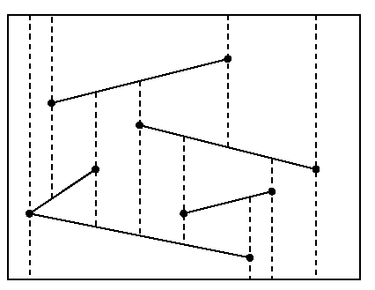
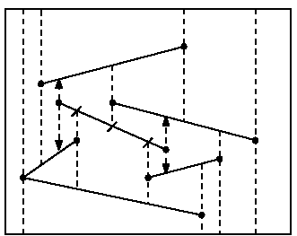
Construction
Randomized incremental construction
Start with outer box which is a single trapezoid. Then add one segment s_{i} at a time, in random order.
s_{i}

Slide 19
Construction
Let S_{i}={s₁,…, s_{i}}, and let T_{i} be the trapezoidal map for S_{i}.
Add s_{i} to T_{i-1}.
Find trapezoid containing left endpoint of s_{i}. [Point location; do later]
Thread s_{i} through T_{i-1}, by walking through it and identifying trapezoids that are cut.
“Fix trapezoids up” by shooting rays from left and right endpoint of s_{i} and trim earlier rays that are cut by s_{i}.
s_{i}

Slide 20
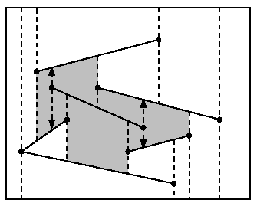
Analysis
Observation: The final trapezoidal map T_{i} does not depend on the order in which the segments were inserted.
Lemma: Ignoring the time spent for point location, the insertion of s_{i} takes O(k_{i}) time, where k_{i} is the number of newly created trapezoids.
Proof:
  Let k be the number of ray shots interrupted by s_{i}.
  Each endpoint of s_{i} shoots two rays
  → k_{i} =k+4 rays need to be processed
  If k=0, we get 4 new trapezoids.
  Create a new trapezoid for each interrupted ray shot; takes O(1) time with DCEL
s_{i}
s_{i}

Slide 21
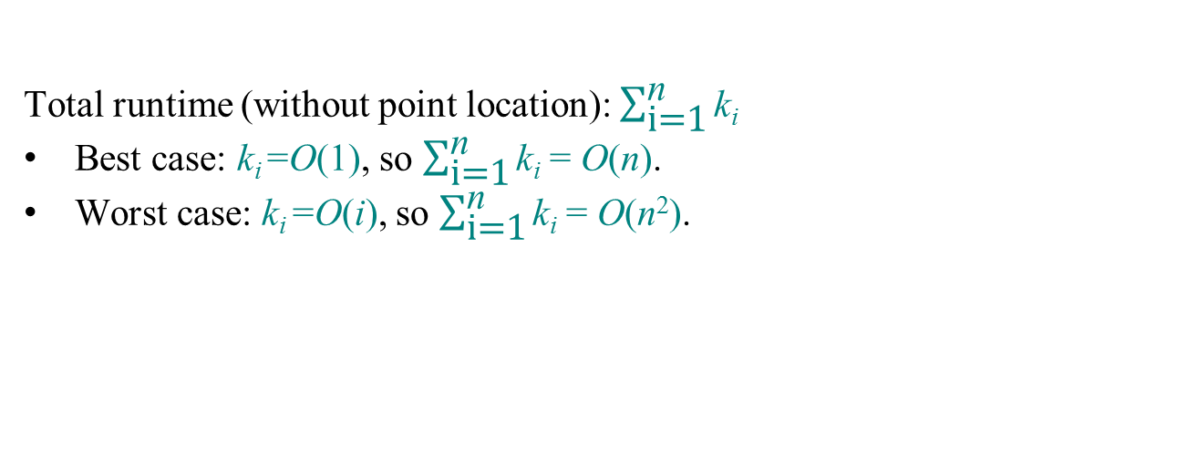
Analysis
n/2+1
n/2+2
n
1
2
3
n/2
Insert segments in random order:
  Π = {all possible permutations/orders of segments}; |Π| = n! for n segments
  k_{i} = k_{i}(π) for some random order π∈Π
  We will show that E(k_{i}) = O(1)
  ⇒ Expected runtime E(T) = E(∑_{i=1}k_{i}) = ∑_{i=1}E(k_{i}) = O(∑_{i=1} 1) = O(n)
n
n
n
linearity of expectation

Slide 22
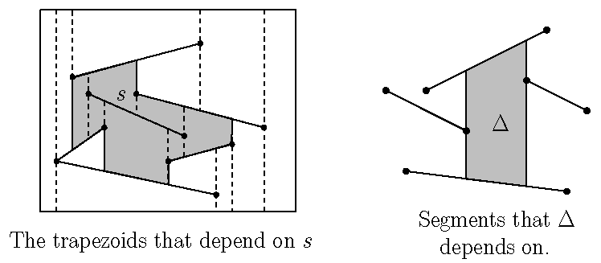
Analysis
  Theorem: E(k_{i}) = O(1), where k_{i} is the number of newly created trapezoids created upon insertion of s_{i}, and the expectation is taken over all segment permutations of S_{i}={s₁,…, s_{i}}.
Proof:
  T_{i} does not depend on the order in which segments s₁,…, s_{i} were added.
  Of s₁,…, s_{i} , what is the probability that a particular segment s was added last?
  1/i
  We want to compute the number of trapezoids that would have been created if s was added last.

Slide 23
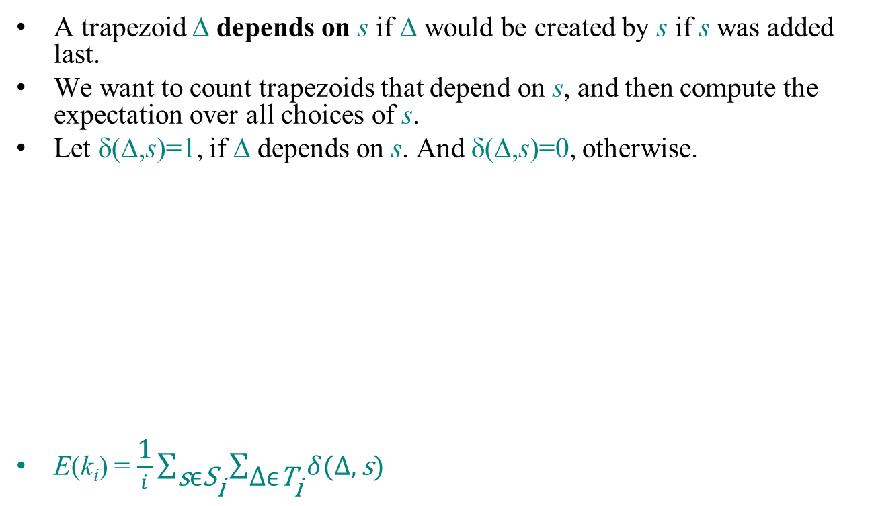
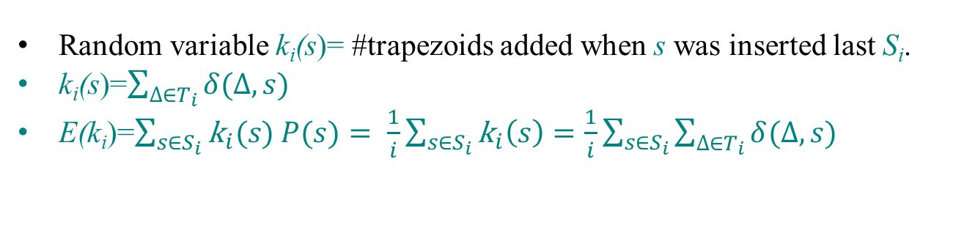
Analysis
Random variable k_{i}(s)= #trapezoids added when s was inserted last S_{i}.
k_{i}(s)=$\sum_{∆∈T_{i}}{δ(∆,s)}$
E(k_{i})=$\sum_{s∈S_{i}}{{\text{k}}_{i}(s) P(s)= \frac{1}{i}\sum_{s∈S_{i}}{{\text{k}}_{i}\left(s\right)=\frac{1}{i}\sum_{s∈S_{i}}{\sum_{∆∈T_{i}}{δ(∆,s)}}}}$

Slide 24
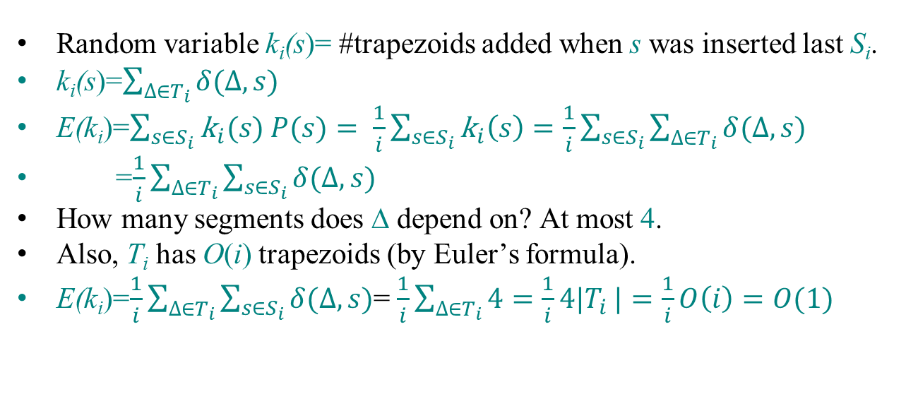
Analysis
Random variable k_{i}(s)= #trapezoids added when s was inserted last S_{i}.
k_{i}(s)=$\sum_{∆∈T_{i}}{δ(∆,s)}$
E(k_{i})=$\sum_{s∈S_{i}}{{\text{k}}_{i}(s) P(s)= \frac{1}{i}\sum_{s∈S_{i}}{{\text{k}}_{i}\left(s\right)=\frac{1}{i}\sum_{s∈S_{i}}{\sum_{∆∈T_{i}}{δ(∆,s)}}}}$
=$\frac{1}{i}\sum_{∆∈T_{i}}{\sum_{s∈S_{i}}{δ(∆,s)}}$
How many segments does Δ depend on? At most 4.
Also, T_{i} has O(i) trapezoids (by Euler’s formula).
E(k_{i})=$\frac{1}{i}\sum_{∆∈T_{i}}{\sum_{s∈S_{i}}{δ(∆,s)}}$= $\frac{1}{i}\sum_{∆∈T_{i}}{4=\frac{1}{i}4|T_{i}}|=\frac{1}{i}O\left(i\right)=O(1)$

Slide 25
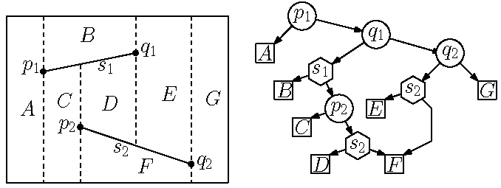
Point Location
Build a point location data structure; a DAG, similar to Kirkpatrick’s
DAG has two types of internal nodes:
  x-node (circle): contains the x-coordinate of a segment endpoint.
  y-node (hexagon): pointer to a segment
The DAG has one leaf for each trapezoid.
Children of x-node: Space to the left and right of x-coordinate
Children of y-node: Space above and below the segment
y-node is only searched when the query’s x-coordinate is within the segment’s span.
⇒ Encodes trapezoidal decomposition and enables point location during construction.

Slide 26
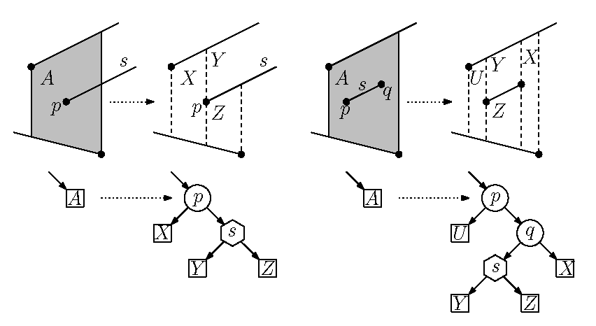
Construction
Incremental construction during trapezoidal map construction.
When a segment s is added, modify the DAG.
  Some leaves will be replaced by new subtrees.
Each old trapezoid will overlap O(1) new trapezoids.
Each trapezoid appears exactly once as a leaf.
Changes are highly local.
If s passes entirely through trapezoid t, then t is replaced with two new trapezoids t’ and t’’ .
  Add new y-node as parent of t’ and t’’ , in order to facilitate search later.
If an endpoint of s lies in trapezoid t, then add an x-node to decide left/right and a y-node for the segment.

Slide 27
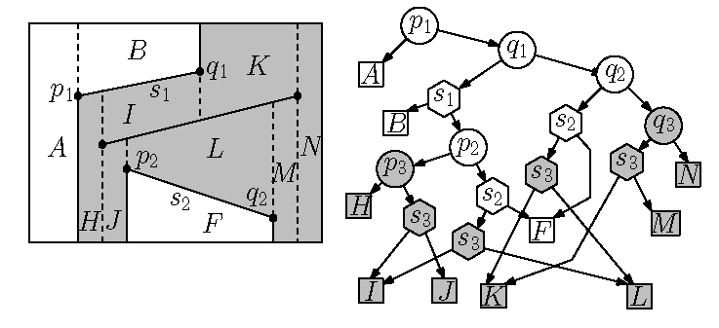
Inserting a Segment
Insert segment s₃.
s₃
q₃
p₃
s₃
q₃
p₃

Slide 28
Analysis
Space: Expected O(n)
  Size of data structure = number of trapezoids = O(n) in expectation, since an expected O(1) trapezoids are created during segment insertion
Query time: Expected O(log n)
Construction time: Expected O(n log n) follows from query time
Proof that the query time is expected O(log n):
  Fix a query point Q.
  Consider how Q moves through the trapezoidal map as it is being constructed as new segments are inserted.
  Search complexity = number of trapezoids encountered by Q
s₃
s₃

Slide 29
Query Time
Let Δ_{i} be the trapezoid containing Q after the insertion of ith segment.
If Δ_{i} = Δ_{i-1} then the insertion does not affect Q’s trapezoid (E.g., Q∈B).
If Δ_{i} ≠ Δ_{i-1} then the insertion deleted Q’s trapezoid, and Q needs to be located among the at most 4 new trapezoids.
Q could fall 3 levels in the DAG.
s₃
s₃

Slide 30
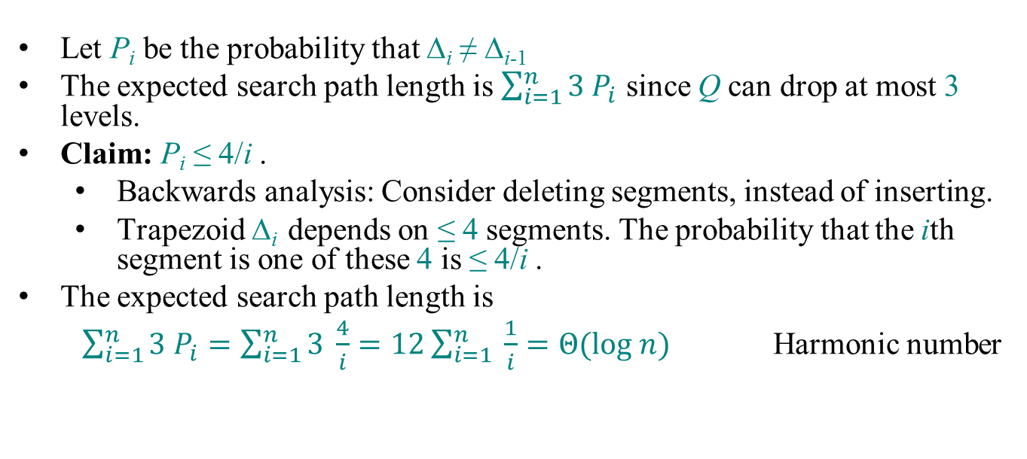
Search Analysis
Let P_{i} be the probability that Δ_{i} ≠ Δ_{i-1}
The expected search path length is $\sum_{i=1}^{n}{3 P_{i}}$ since Q can drop at most 3 levels.
Claim: P_{i} ≤ 4/i .
  Backwards analysis: Consider deleting segments, instead of inserting.
  Trapezoid Δ_{i} depends on ≤ 4 segments. The probability that the ith segment is one of these 4 is ≤ 4/i .
The expected search path length is
  $\sum_{i=1}^{n}{3 P_{i}=\sum_{i=1}^{n}{3 \frac{4}{i}=12\sum_{i=1}^{n}{ \frac{1}{i}=Θ(log n)}}}$ Harmonic number
s₃
s₃

