Slide 1
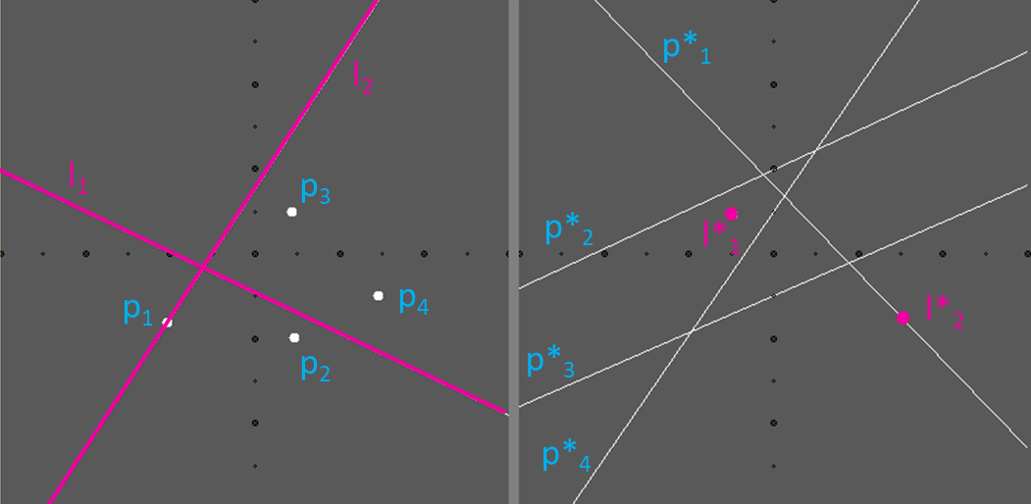
CMPS 3130/6130 Computational Geometry Spring 2020
Point-Line Duality
Carola Wenk

Slide 2
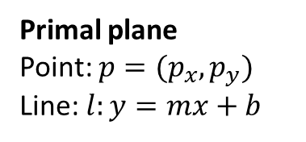
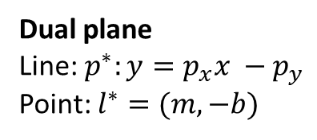
Point-Line Duality
Let $P=\left\{p_{1},…, p_{n}\right\}⊆ℝ^{2}$ be a set of $n$ points. Now define a set $P^{∗}=\left\{p_{1}^{∗},…, p_{n}^{∗}\right\}$ of $n$ lines as follows:
Primal plane
Point: $p=(p_{x},p_{y})$
Line: $l:y=mx+b$
Dual plane
Line: $p^{∗}:y=p_{x}x −p_{y}$
Point: $l^{∗}=(m, −b)$
p*₁
l₂
l₁
p₃
p*₂
l*₁
p₁
p₄
l*₂
p₂
p*₃
p*₄

Slide 3
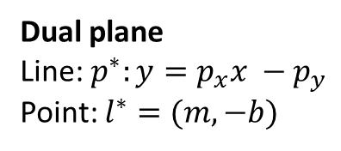
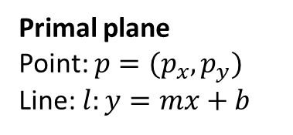
Properties
Primal plane
Point: $p=(p_{x},p_{y})$
Line: $l:y=mx+b$
Dual plane
Line: $p^{∗}:y=p_{x}x −p_{y}$
Point: $l^{∗}=(m, −b)$
Primal
Dual
p*₁
l₂
l₁
p₃
p*₂
l*₁
p₁
p₄
l*₂
p₂
p*₃
p*₄
${\left(p^{∗}\right)}^{∗}=p$
$p∈l ⇔l^{∗}∈p^{∗}$ incidence-preserving
$p$ lies above $l ⇔l^{∗}$ lies above $p^{∗}$
p₁ ∈l₂ ⇔ l*₂ ∈p*₁
p₃ is above l₁ ⇔ l*₁ is above p*₃

Slide 4
Properties
Primal plane
Point: $p=(p_{x},p_{y})$
Line: $l:y=mx+b$
Dual plane
Line: $p^{∗}:y=p_{x}x −p_{y}$
Point: $l^{∗}=(m, −b)$
Primal
Dual
p*₁
l₁
p₁
l*₁
p₂
p*₂
Points$p_{1}$ and $p_{2}$ lie on line $l_{1}$
Lines $p_{1}^{∗}$ and $p_{2}^{∗}$ contain point $l_{1}^{∗}$

Slide 5
Point-Line Duality Puzzle
p₁
l*₂
l₁
l₂
p*₂
l*₁
p*₃
p₄
p*₄
p*₁
p₃
p₂
$$p_{1}$$
lies above
$$l_{1}$$
$$⇔$$
$$l_{1}^{∗}$$
lies above
$$p_{1}^{∗}$$
$$p_{2}$$
lies on
$$l_{1}$$
$$⇔$$
$$l_{1}^{∗}$$
lies on
$$p_{2}^{∗}$$
$$p_{2}$$
lies on
$$l_{2}$$
$$⇔$$
$$l_{2}^{∗}$$
lies on
$$p_{2}^{∗}$$
$$p_{3}$$
lies below
$$l_{1}$$
$$⇔$$
$$l_{1}^{∗}$$
lies below
$$p_{3}^{∗}$$
$$p_{4}$$
lies above
$$l_{2}$$
$$⇔$$
$$l_{2}^{∗}$$
lies above
$$p_{4}^{∗}$$

Slide 6
LCH ≅ UE
Primal plane
Point: $p=(p_{x},p_{y})$
Line: $l:y=mx+b$
Dual plane
Line: $p^{∗}:y=p_{x}x −p_{y}$
Point: $l^{∗}=(m, −b)$
Primal
Dual
p*₂
p*₁
p*₃
p*₄
p₁
p₅
p₂
p₄
p₃
p*₅
LCH lower convex hull
UE upper envelope (= pointwise maximum) = halfplane intersection (of upper halfplanes)
LCH = p₁, p₂, p₃, p₄, p₅
UE = p*₁, p*₂, p*₃, p*₄, p*₅

